Slide 1
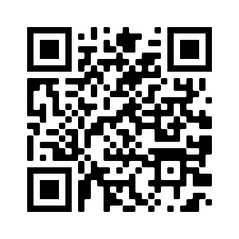



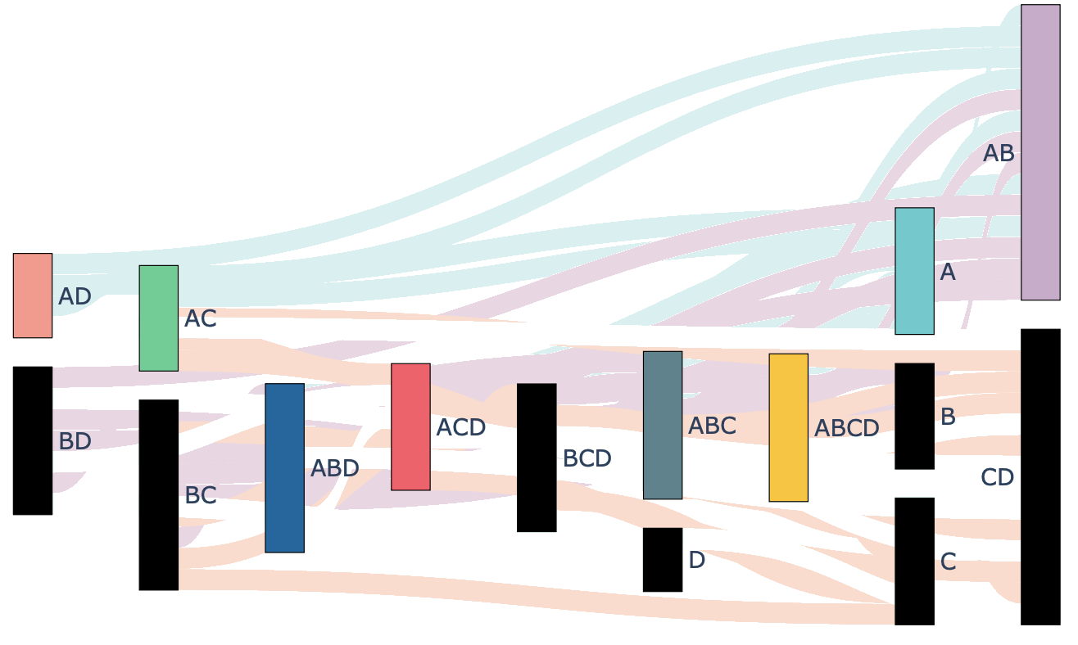
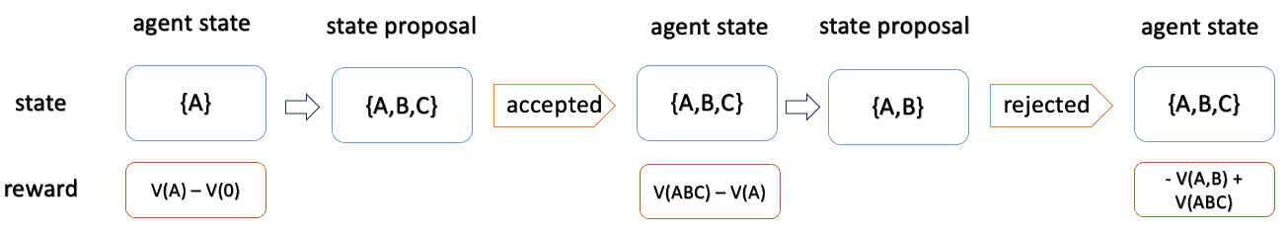
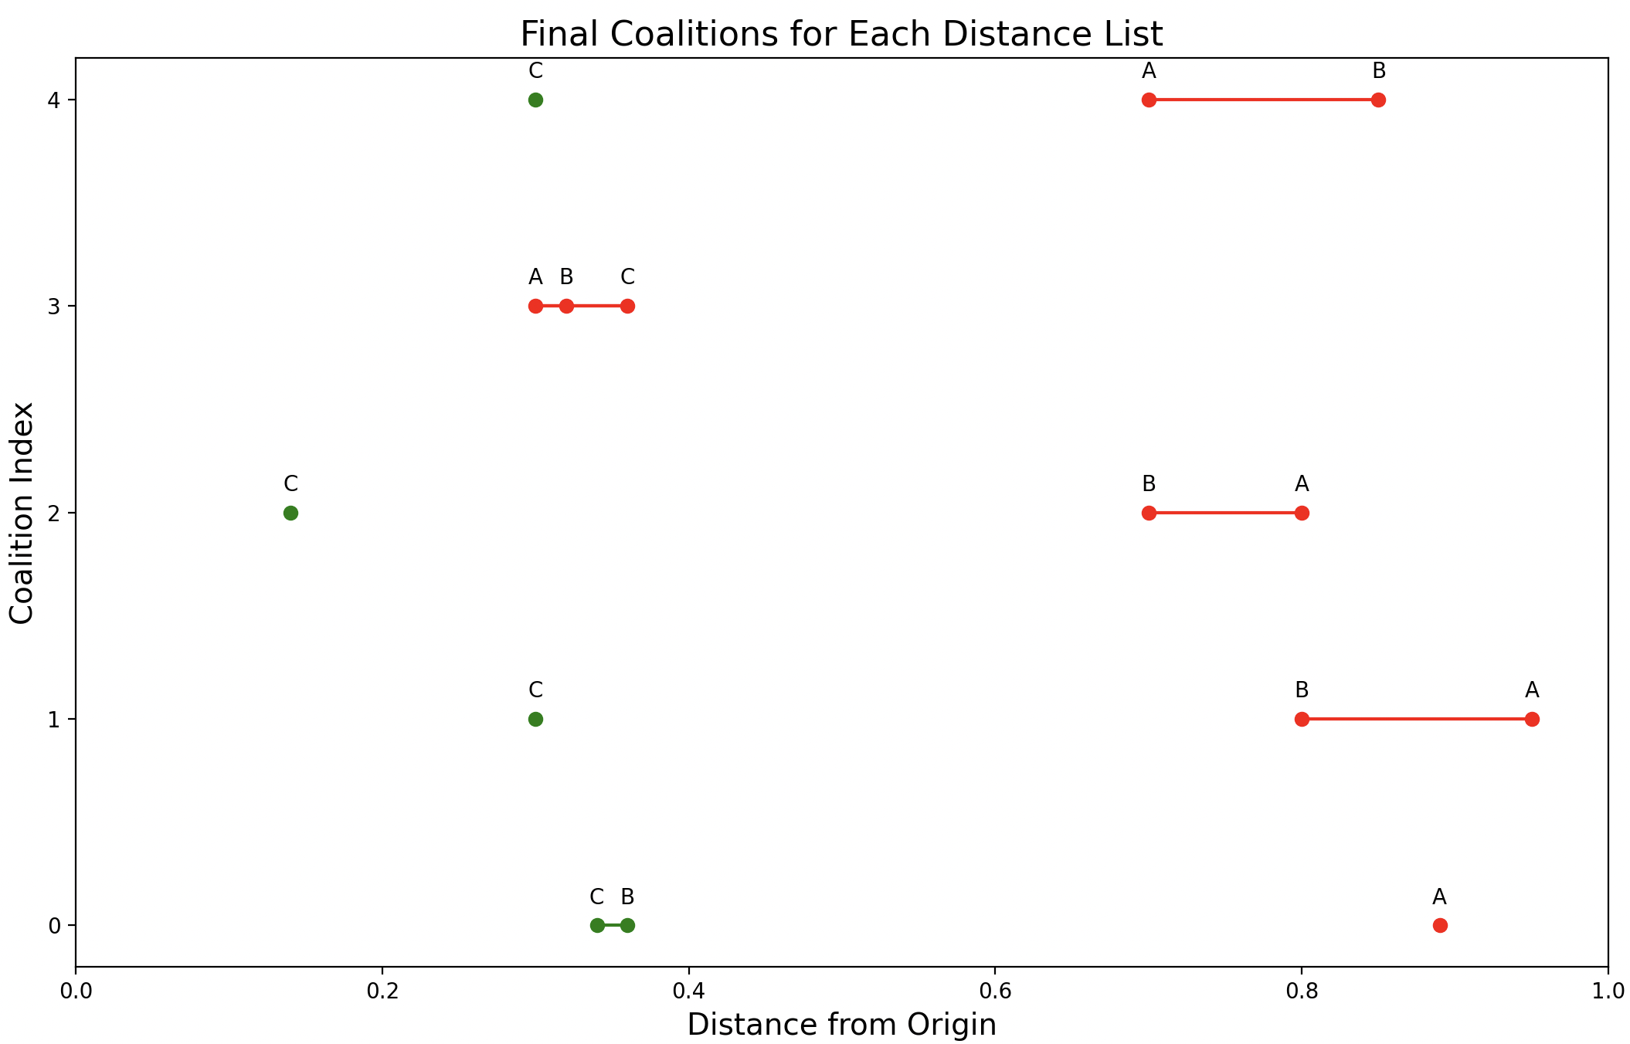
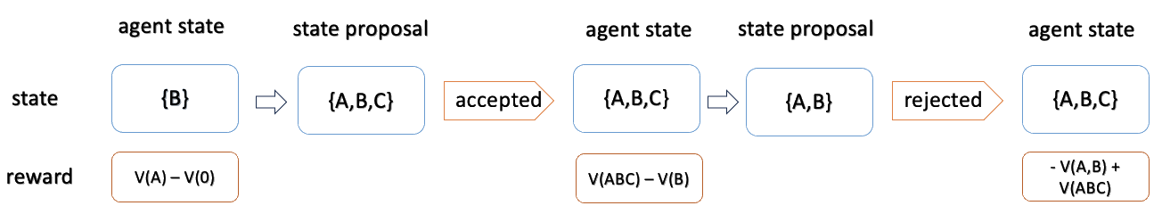
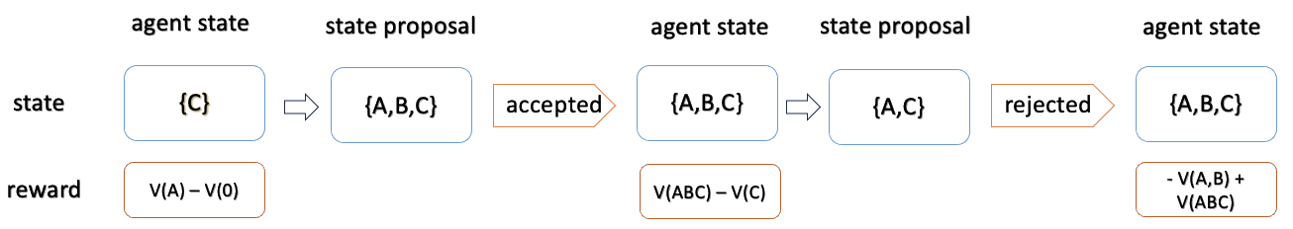
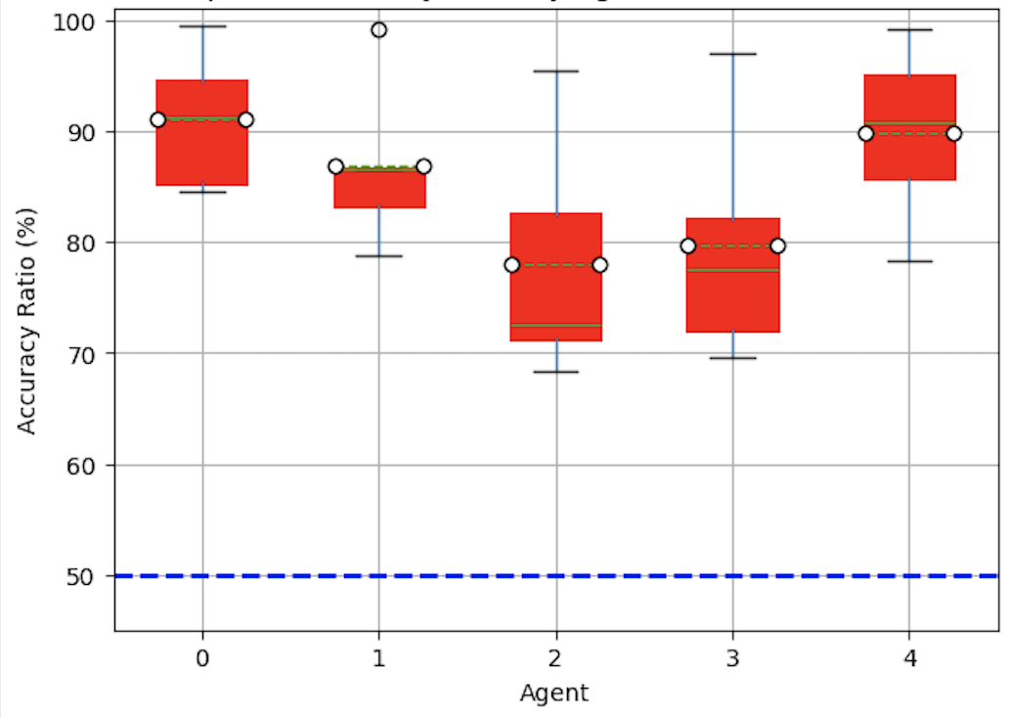
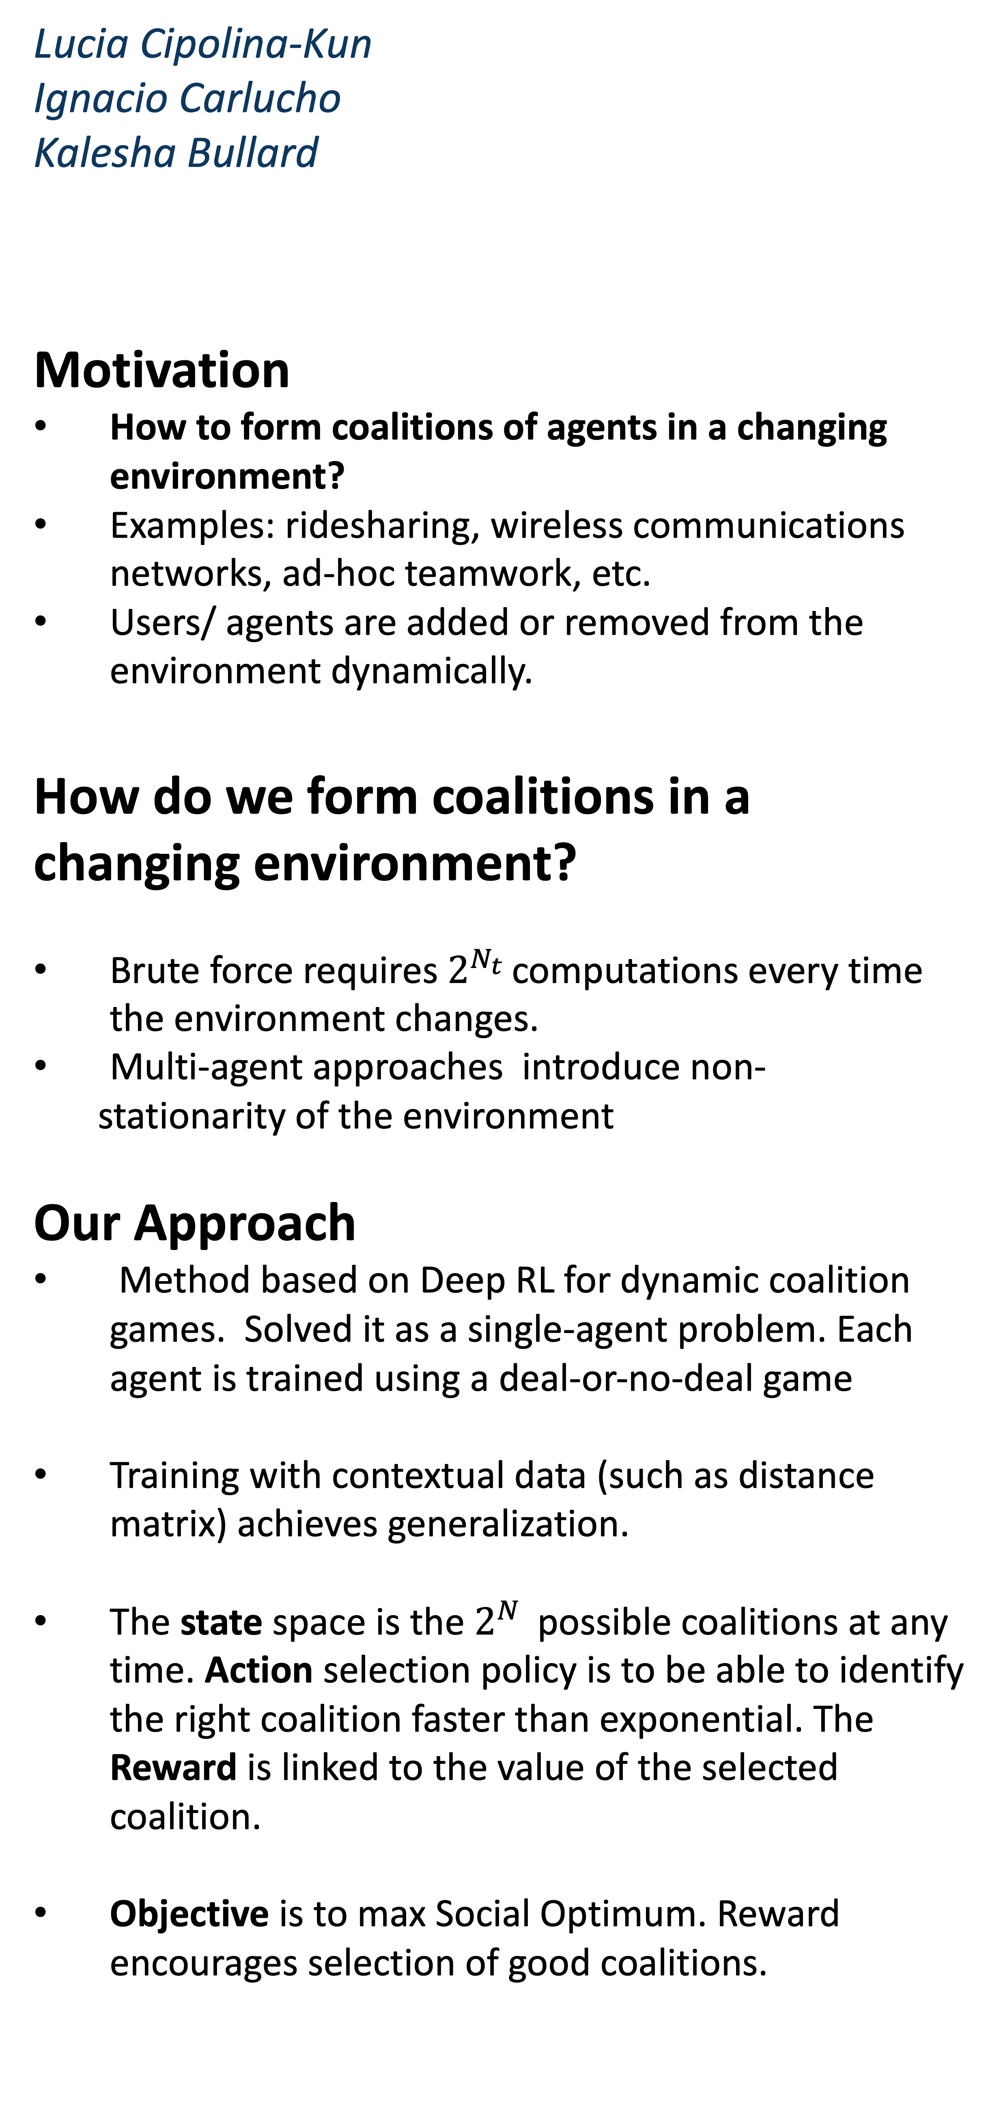
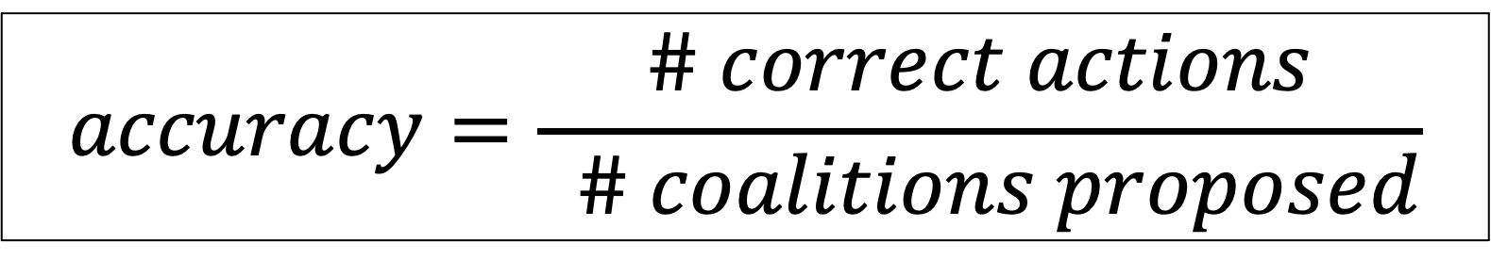
Lucia Cipolina-Kun
Ignacio Carlucho
Kalesha Bullard
Motivation
How to form coalitions of agents in a changing environment?
Examples: ridesharing, wireless communications networks, ad-hoc teamwork, etc.
Users/ agents are added or removed from the environment dynamically.
How do we form coalitions in a changing environment?
Brute force requires $2^{N_{t} }$computations every time the environment changes.
Multi-agent approaches introduce non-
stationarity of the environment
Our Approach
Method based on Deep RL for dynamic coalition games. Solved it as a single-agent problem. Each agent is trained using a deal-or-no-deal game
Training with contextual data (such as distance matrix) achieves generalization.
The state space is the $2^{N }$ possible coalitions at any time. Action selection policy is to be able to identify the right coalition faster than exponential. The Reward is linked to the value of the selected coalition.
Objective is to max Social Optimum. Reward encourages selection of good coalitions.
Adaptive Dynamic Coalition Structure Generation
The Deal-or-No-Deal Game
A Method to Obtain Socially Optimal Coalition Structures in a Dynamic Environment
Results
Coalition dynamics
Generalization – Ridesharing game
$$accuracy=\frac{\# correct actions}{ \# coalitions proposed}$$
Accuracy of each agent’s policy across tasks (1 seed). The dashed line represents the accuracy of a random policy
Time

