Slide 1



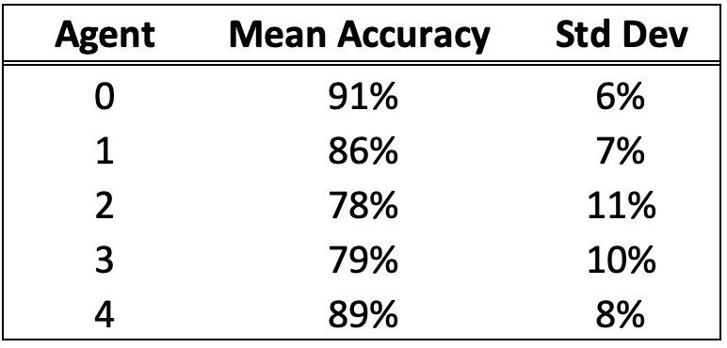

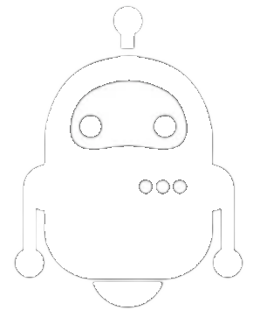


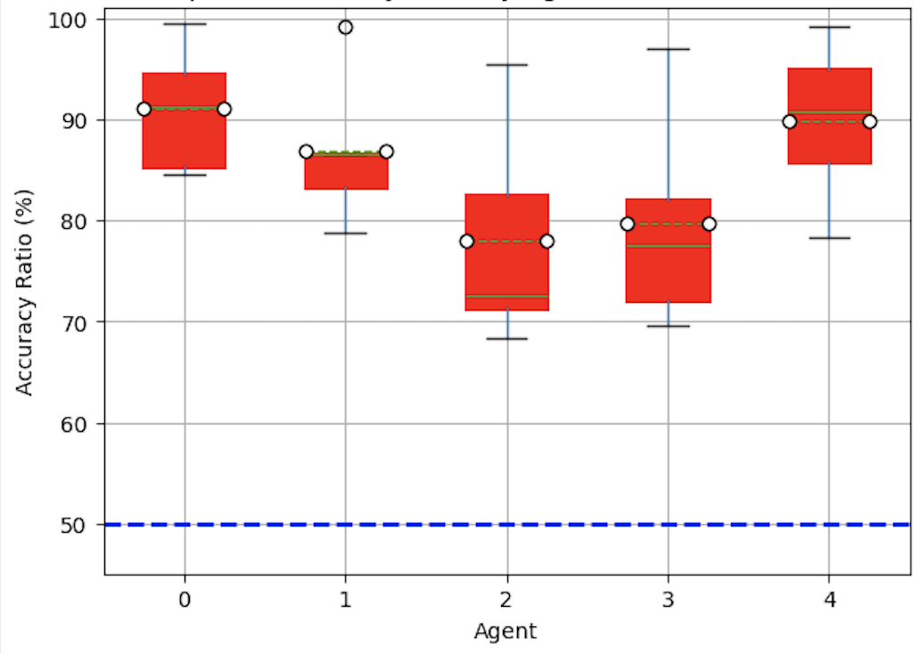
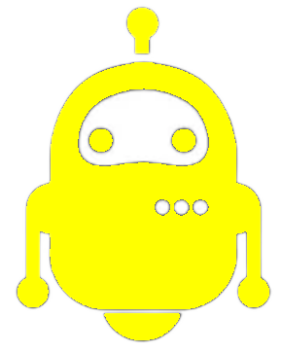
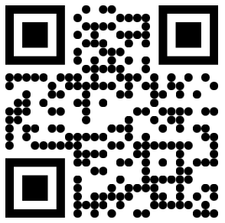
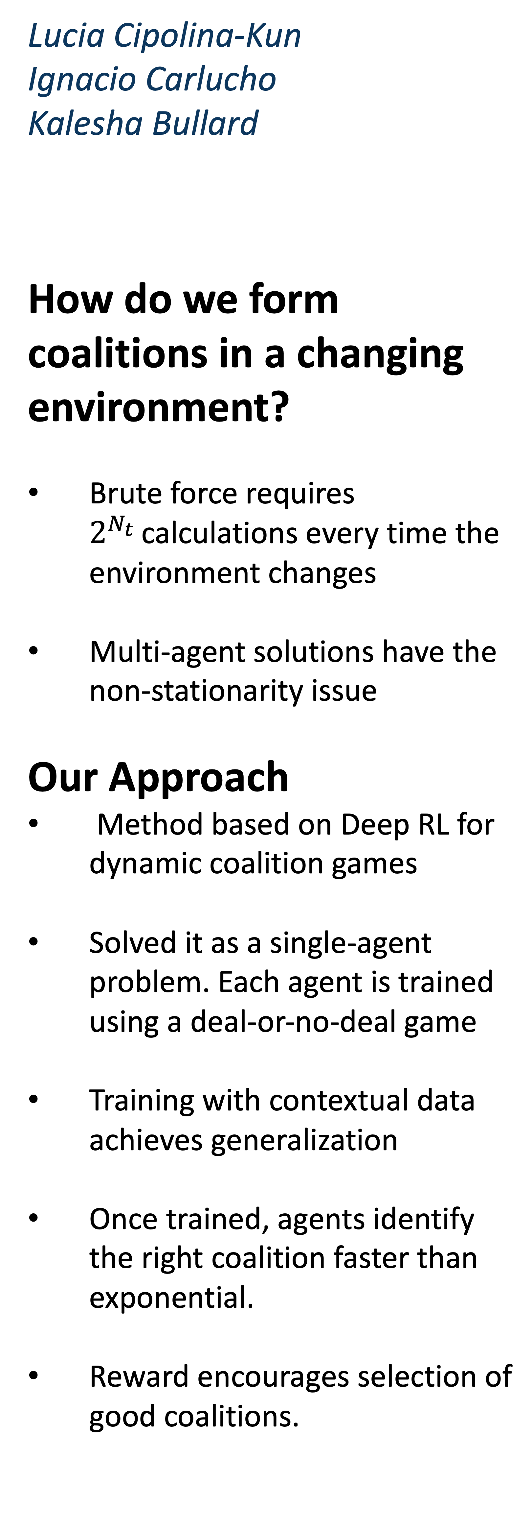
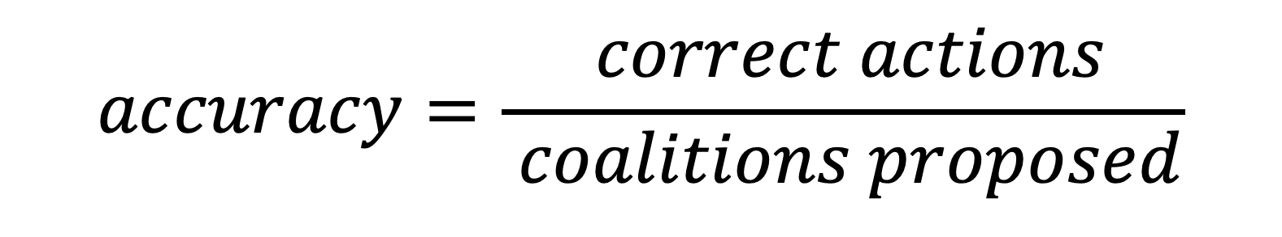
Lucia Cipolina-Kun
Ignacio Carlucho
Kalesha Bullard
How do we form coalitions in a changing environment?
Brute force requires $2^{N_{t} }$calculations every time the environment changes
Multi-agent solutions have the non-stationarity issue
Our Approach
Method based on Deep RL for dynamic coalition games
Solved it as a single-agent problem. Each agent is trained using a deal-or-no-deal game
Training with contextual data achieves generalization
Once trained, agents identify the right coalition faster than exponential.
Reward encourages selection of good coalitions.
Adaptive Dynamic Coalition Structure Generation
Results
The Deal-or-No-Deal Game
A Method to Obtain Socially Optimal Coalition Structures in a Dynamic Environment
$$accuracy=\frac{ correct actions}{ coalitions proposed}$$
Accuracy of each agent’s policy.
Accuracy of each agent’s policy.
The dashed line represents the accuracy of a random policy
Time 0
Time 1
Time 2
Time 3

