Slide 2
The challenge…
Beat the stock market!
Write an algorithm to buy and sell shares for maximum profit.
Increase your starting cash by solving Challenges.
Highest total cash wins!

Slide 3




Instructions
Install from instructions on
https://github.com/tpkelly/Hackathon
Eclipse for Java EE
Apache Tomcat
(optional)

Slide 4
Writing your solution
Work in cli/src/trading/TradingStrategy.java
public void makeDailyTrade(DailyTrades trades) throws … {
// Alternate between “buy all” and “sell all”
for (DailyInput input : trades.getTrades()) {
if (input.getDay() % 2 == 0) {
tradingManager.buyMaxNumberOfShares(input);
} else {
tradingManager.sellAllShares(input);
}
}
}

Slide 5
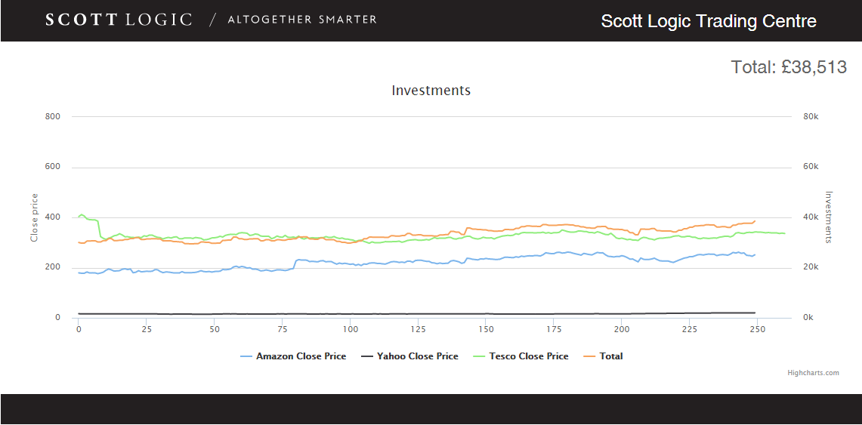
Graphic your solution
(Optional): Use the hackathon-webapp project to check how your algorithm performs over the year.

Slide 6
Schedule
4:00 – Kick off!
4:15 – Start Coding
6:15 – Hand in answers to Challenges
6:45 – Hand in Code
7:00 – Judging and Prizes

Slide 7
Submitting your solution
Email your TradingStrategy.java and any associated classes to tkelly@scottlogic.com
Keep any additional classes within the same package as TradingStrategy.

