Slide 1

EZTr: Getting ETr/Tr from loadcells is easy!

Slide 2
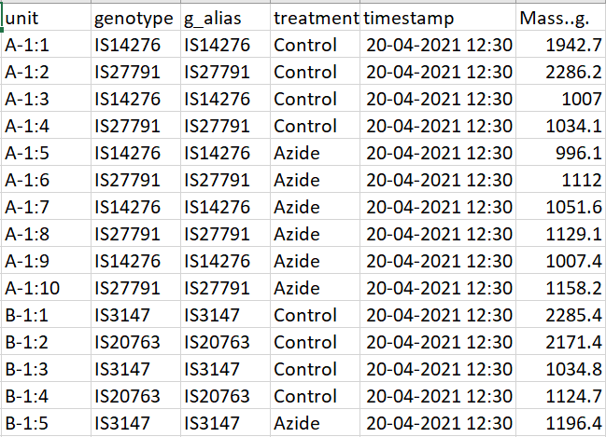
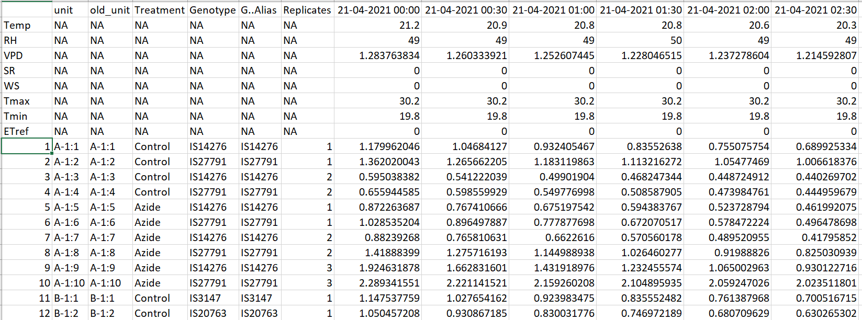
What EZTr does?
Convert raw load cells data into a matrix
Clean and curate raw data
Convert into raw ET_{r}
Reads weather data
Calculates VPD and ET₀
Convert the unit (if needed)
Extract raw ET_{r} features
Get raw features H²
Smooth raw ET_{r}
Extract smooth ET_{r} features
Get smooth features H²

Slide 3
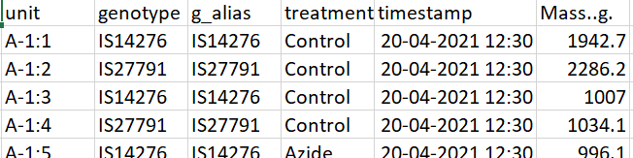
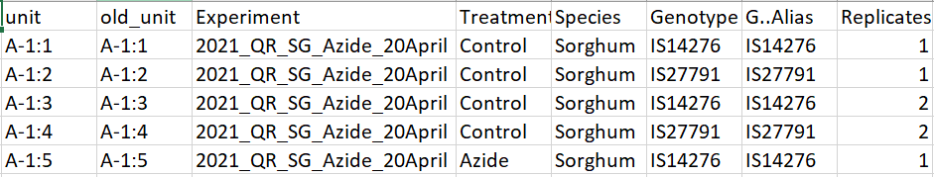
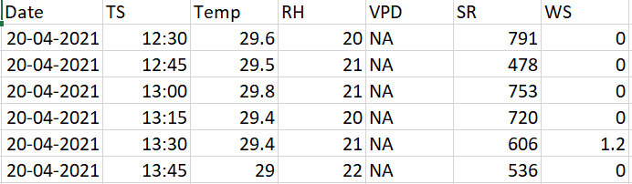
How EZTr works?
Prepare Input and Feed Input (L-138 to L-159, L-252)
Input-1: m.lc.csv (load cells mass values)
Input-2: meta.d.csv (genotypic and experimental metadata)
Input-3: climate.d.csv (climate data)

Slide 4
What features EZTr gives?
Feature No. | Description | Abbreviation
1 | Total area under curve on each day | total.auc
2 | Total area under curve between 07:00 to 19:00 hours | auc.07.19
3 | Proportion of area under curve during day time | auc.prop.07.19
4 | Proportion of area under curve during night time | auc.prop.night
5 | Slope of the curve from 19:00 to 23:45 hours | slope.19.23.45
6 | Maximum TR | maxTR
7 | Slope of the curve between 6 data points before maxTR and maxTR (i.e. 90 minutes) | slope.maxTR.6
8 | Slope of the curve between 00:00 to 07:00 hours | slope.00.07
9 | Slope of the curve from 07:00 hours till it reaches maximum TR | slope.07maxTR
10 | Curvature or angle of the curve at max TR | curvmaxTR
11 | Area under curve between 10:00 to 15:00 hours | auc.10.15
12 | Proportion of area under curve between 10:00 to 15:00 hours | auc.prop.10.15
13 | Standard deviation of the TR values between 10:00 to 15:00 hours | sd.10.15
14 | Standard deviation of the TR values between 07:00 to 19:00 hours | sd.07.19
15 | Similarity between the ET_{r} profile of each sector and Penman Monteith ET | cos.sim.index

Slide 5
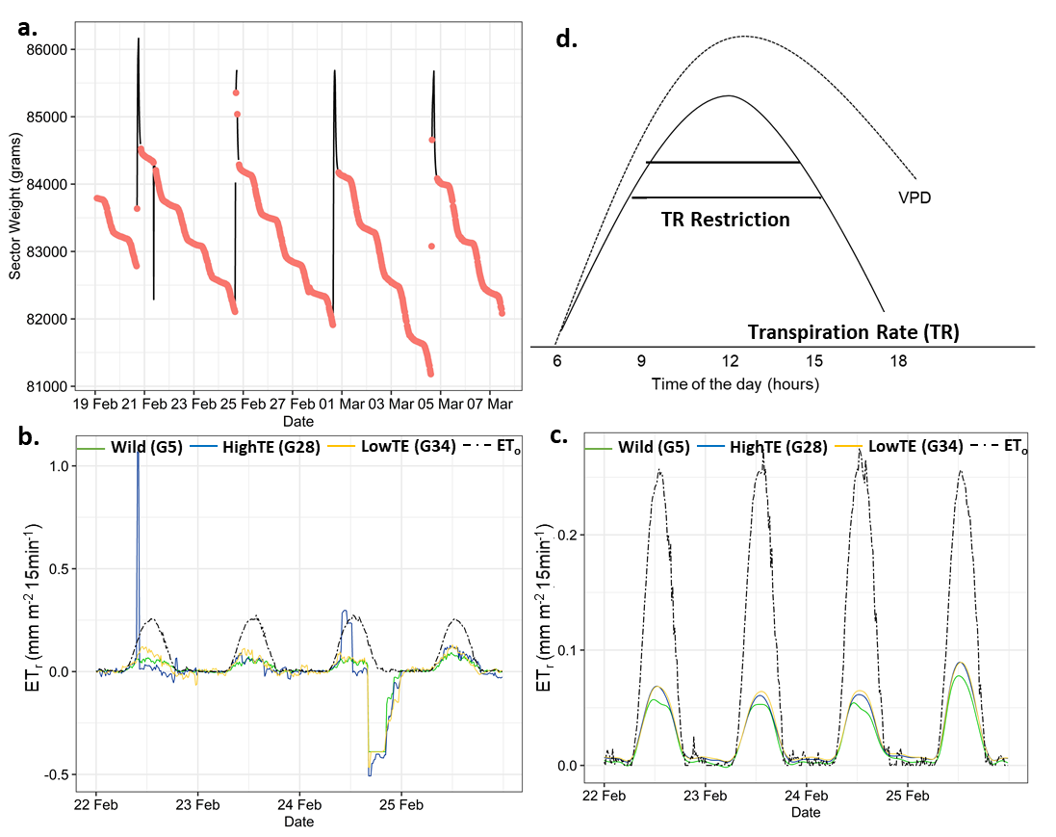
How EZTr results look like?

Slide 6
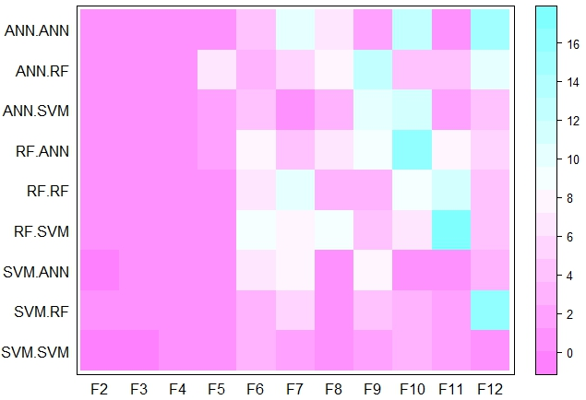
What else EZTr offers?
Change your frequency and still get your results!

Slide 7
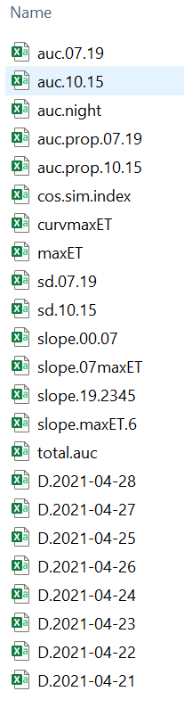
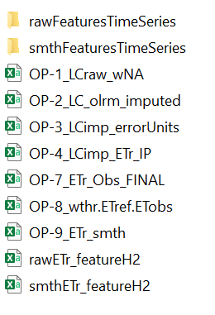
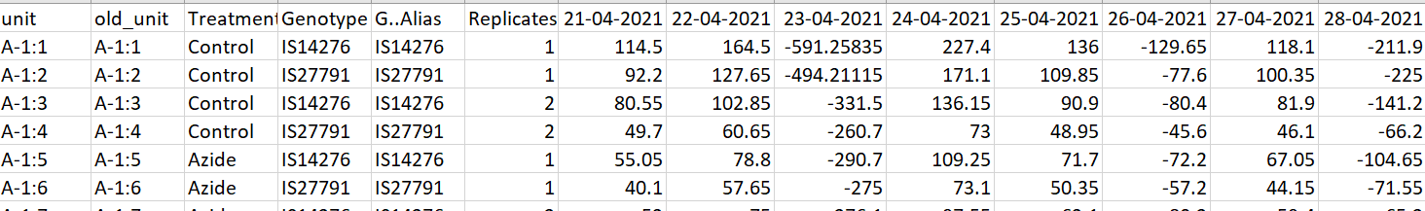
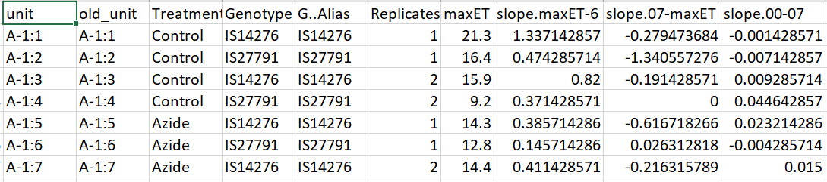
How to store all the results: EZTr automates that!

Slide 8
How to get the EZTr pipeline started?
1. Save the raw data files (meta.d, climate and m.lc) as raw .csv files in the data folder under your project.
2. Go to Project in RStudio and open script S1.EZTr_InputPrep.R.
2.1 Edit Paths to the respective file locations and read the 3 input .csv files
2.2 L.43 - Format date correctly
2.3 L.51 & L.53 - Change file names
3. Go to script EZTr_main.R
3.1 L.111 - Set working directory path
3.2 L.139 & 140 - Change project .RData name
3.3 L.142, 145, 148, 152 - Enter inputs
3.4 L.154, 155 - Read note carefully and edit sequence
3.5 L.157-159 - Edit path information
3.6 L.252 - Enter Y/N for conversion of ETr unit

