Slide 1
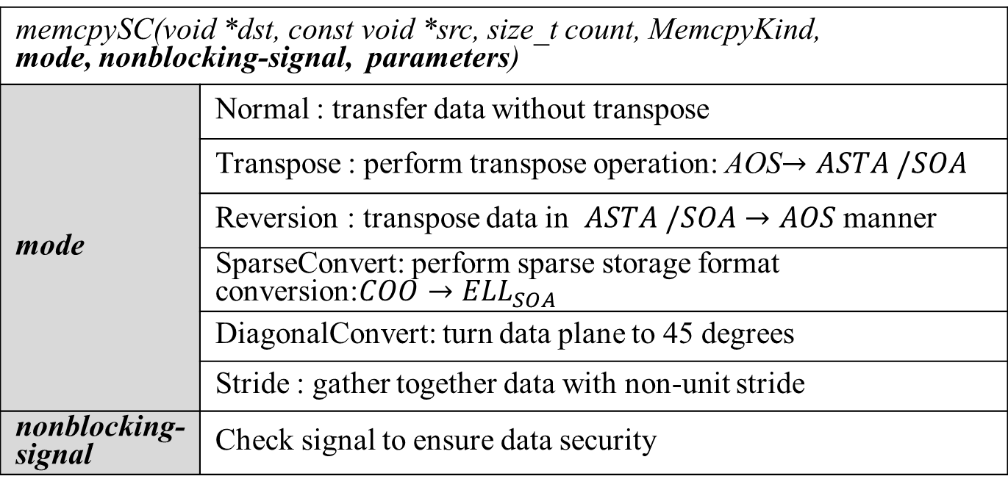
memcpySC(void *dst, const void *src, size_t count, MemcpyKind, mode, nonblocking-signal, parameters)
mode | Normal : transfer data without transpose
 | Transpose : perform transpose operation: AOS$→ASTA /SOA$
 | Reversion : transpose data in $ASTA /SOA→AOS$ manner
 | SparseConvert: perform sparse storage format conversion:$COO→{ELL}_{SOA}$
 | DiagonalConvert: turn data plane to 45 degrees
 | Stride : gather together data with non-unit stride
nonblocking-signal | Check signal to ensure data security

