Slide 1
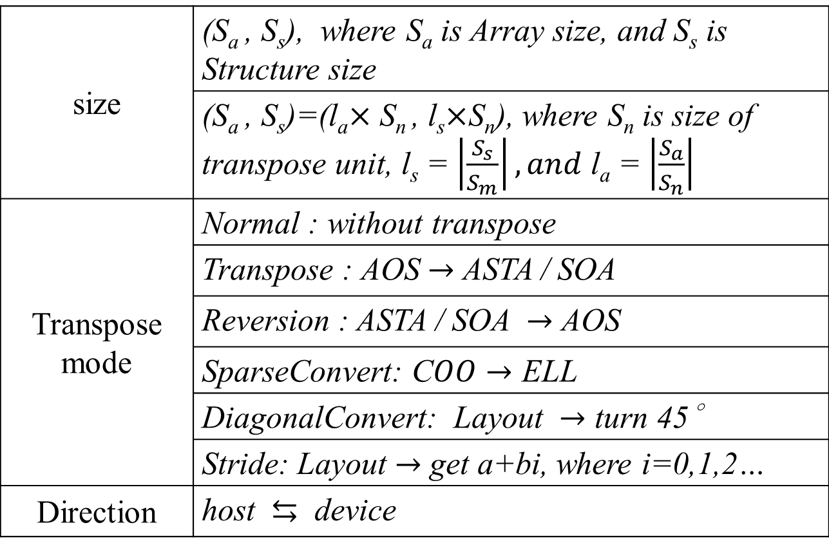
size | (S_{a} , S_{s}), where S_{a} is Array size, and S_{s} is Structure size
 | (S_{a} , S_{s})=(l_{a}$×$ S_{n} , l_{s}$×$S_{n}), where S_{n} is size of transpose unit, l_{s} = $\left|\frac{S_{s}}{S_{m}}\right|, and$ l_{a} = $\left|\frac{S_{a}}{S_{n}}\right|$
Transpose mode | Normal : without transpose
 | Transpose : AOS $→$ ASTA / SOA
 | Reversion : ASTA / SOA $→$ AOS
 | SparseConvert: C$OO→$ ELL
 | DiagonalConvert: Layout $→$ turn 45∘
 | Stride: Layout $→$ get a+bi, where i=0,1,2…
Direction | host $⇆$ device

