Slide 1
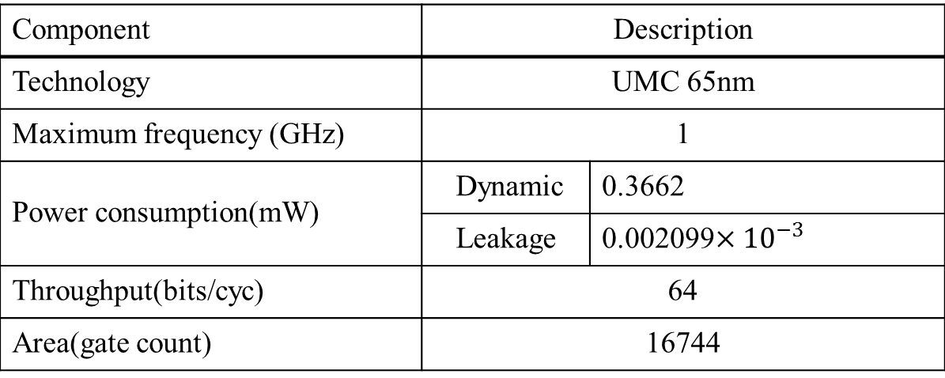
Component | Description
Technology | UMC 65nm
Maximum frequency (GHz) | 1
Power consumption(mW) | Dynamic | 0.3662
 | Leakage | 0.002099$×{10}^{−3}$
Throughput(bits/cyc) | 64
Area(gate count) | 16744
Notes:
SC: 11,254
Sparse transformer: 7906/1.44= 5,490

