Slide 1


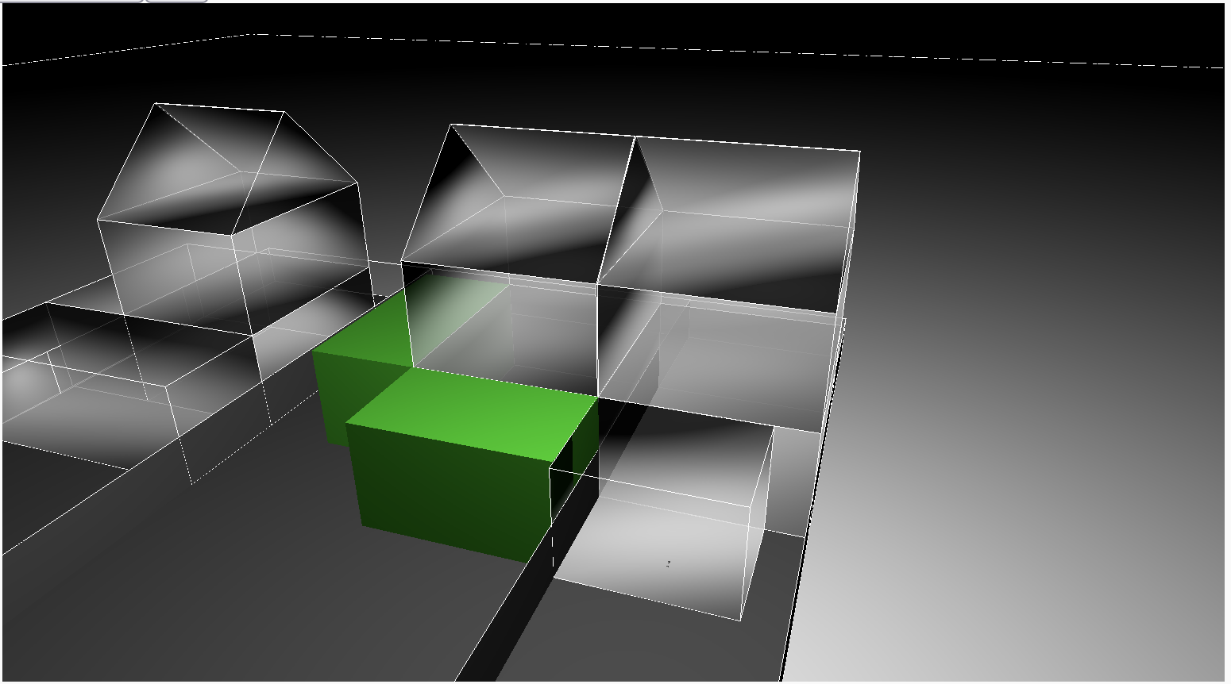
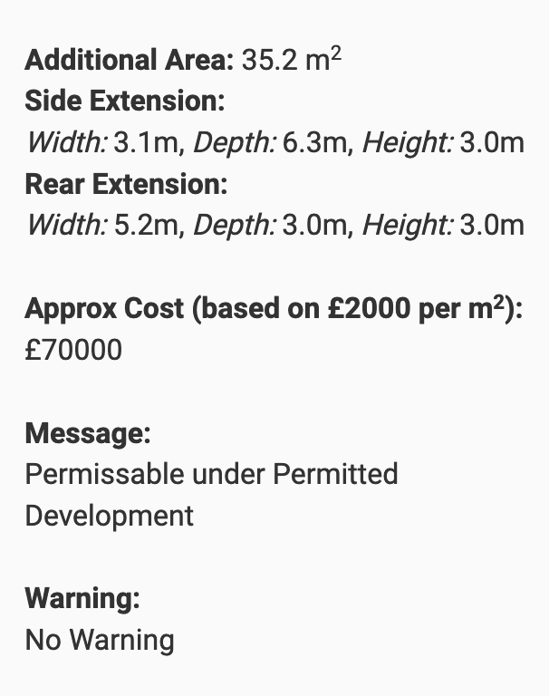
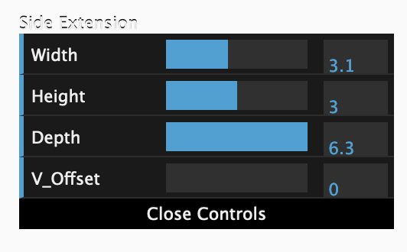
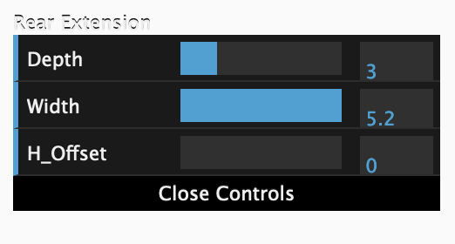

Slide 2
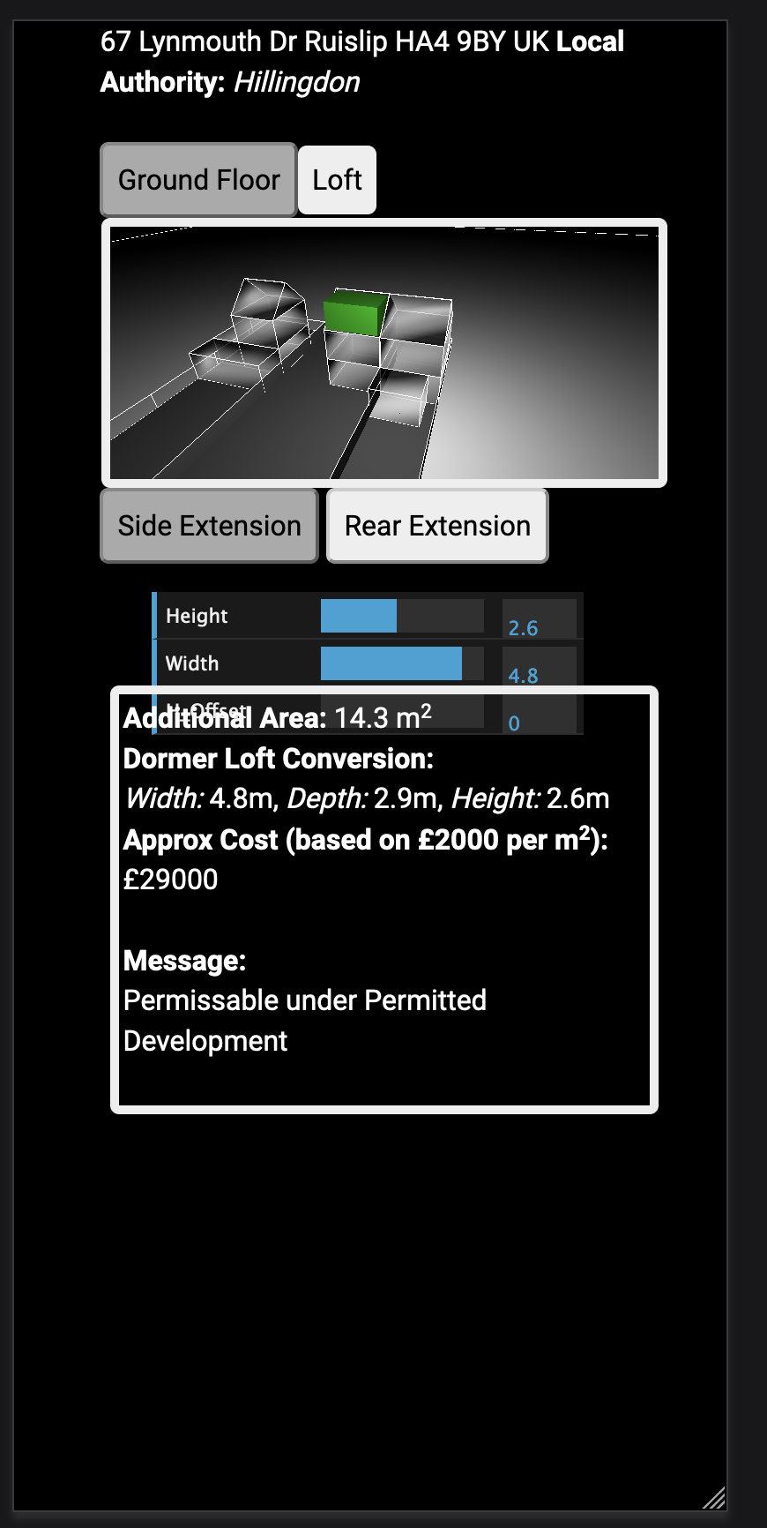
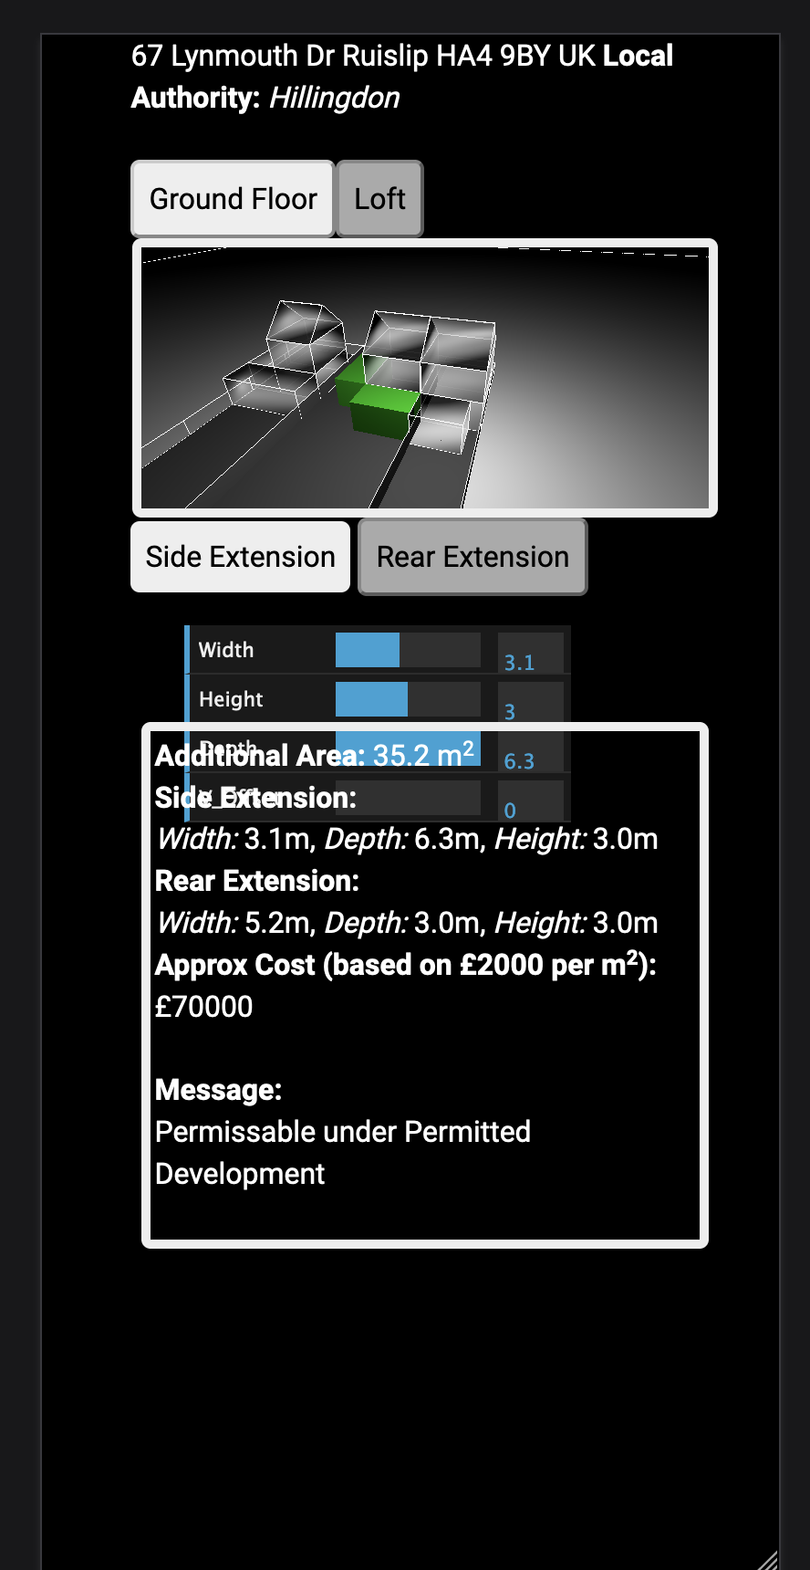
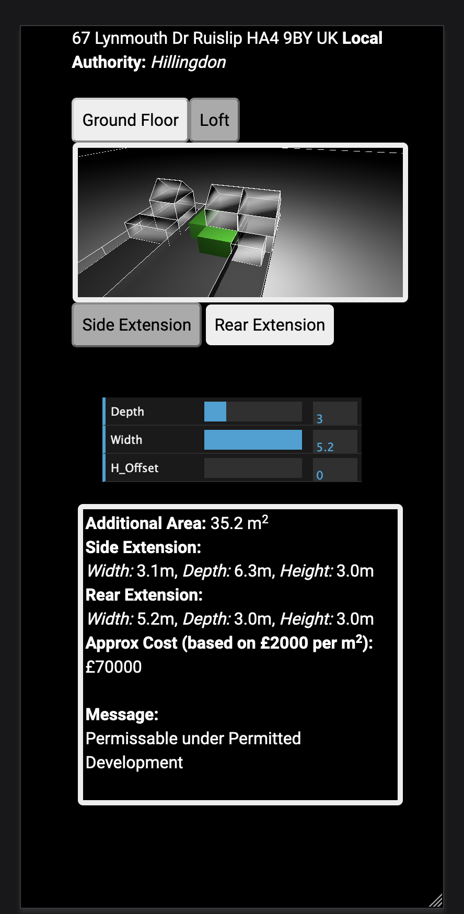
Constant
height

Slide 3
SOME KIND OF DIFFERENT TAB STUFF:
MAYBE WE CAN FIND A NICE EXAMPLE ON CODE PEN
MAYBE LIKE THIS?
SIDE EXTENSION
REAR EXTENSION
SIDE EXTENSION
REAR EXTENSION

