Slide 1
The Wonderful World of RNA-seq
Alyssa Frazee
April 3, 2013

Slide 2
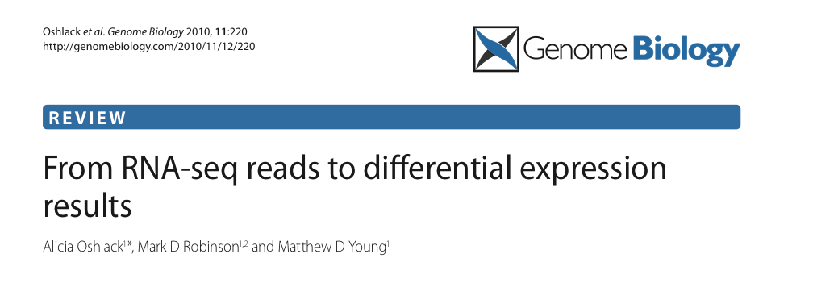
My Favorite RNA-seq paper:
Get it here! http://genomebiology.com/2010/11/12/220

Slide 3
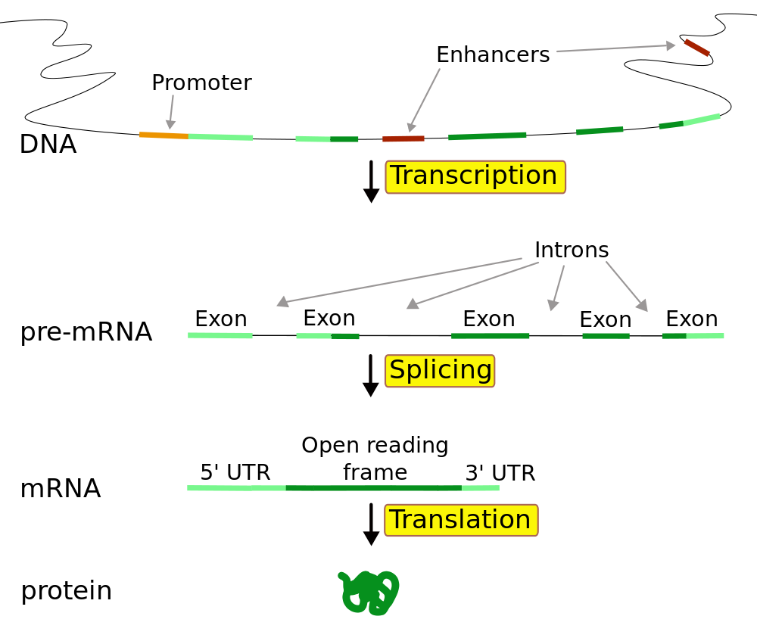

Slide 4
RNA-seq data
Reads
(50-100 bp
long)
Transcripts
(RNA, need to
convert to cDNA
to sequence)
Genome
(DNA)

Slide 5
Questions we want to answer with RNA-seq data:
Where are the genes?
Which genes are most highly expressed?
Which genes have multiple isoforms? What are those isoforms? How common are they?
Which genes/isoforms are expressed at different levels between two (or more) populations?
Which genes are spliced differently between two (or more) populations?
etc

Slide 6
Question I want to answer with RNA-seq data:
Where are the genes?
Which genes are most highly expressed?
Which genes have multiple isoforms? What are those isoforms? How common are they?
Which genes/isoforms are expressed at different levels between two (or more) populations?
Which genes are spliced differently between two (or more) populations?
etc

Slide 7
Big picture: DE analysis
single-end:
shear
sequence fragment end(s)
or paired-end:
purified RNA
cDNA fragments
map reads to reference genome
test each feature for differential expression
summarize mapped reads into feature-level abundances (gene, exon, transcript…)
normalize abundances
Oshlack et al, 2010

Slide 8
Current Approach 1: Annotate-then- Identify
Data
(50-100 bp
reads)
Genome/
Transcriptome
(assume
we know it)

Slide 9
Current Approach 1: Annotate-then-Identify
Align
put reads back
where they came from
Genome
slide credit: Jeff Leek (this and all other pretty-colored-genome-pictures

Slide 10
Current Approach 1: Annotate-then-Identify
Option 1:
Count by Exon
Genome

Slide 11
Current Approach 1: Annotate-then-Identify
Option 2:
Count by taking
union of all exons
Genome

Slide 12
Current Approach 1: Annotate-then-Identify
Option 3:
Count by taking
intersection of
all transcripts’ exons
Genome

Slide 13

Current Approach 1: Annotate-then-Identify
The data: gene x sample count matrix
Counts at each gene have a distribution, e.g.:
[sample i, gene j, mean/variance relationship allowing overdispersion]
The statistical test: exact p-value calculation
DESeq: Anders & Huber, 2010, http://genomebiology.com/2010/11/10/R106

Slide 14
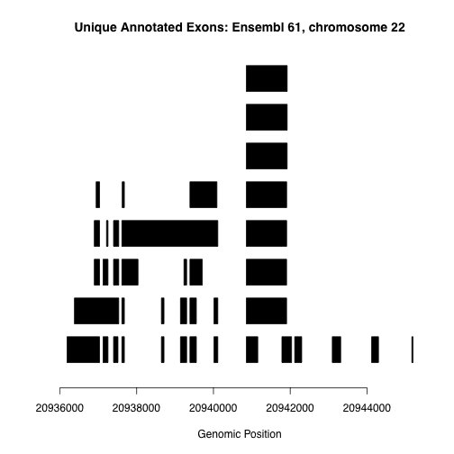

Slide 15
Current Approach 2: Assemble-then-Identify
Data
(50-100 bp
reads)
Genome
(guide for
alignment)

Slide 16
Current Approach 2: Assemble-then-Identify
Align
put reads back
where they came from
Genome

Slide 17
Current Approach 2: Assemble-then-Identify
Assemble
Reconstruct the
gene’s transcripts
based on read
alignments
Genome
Fragments
Transcripts
Cufflinks: Trapnell et al. 2010 Nat. Biotech, http://bit.ly/12cCzqR

Slide 18
Current Approach 2: Assemble-then-Identify
Estimate Abundances
Determine which reads
originated from
which transcripts
Genome
Transcripts
Cufflinks: Trapnell et al. 2010 Nat. Biotech, http://bit.ly/12cCzqR

Slide 19
Current Approach 2: Assemble-then-Identify
Warning!!!
Ambiguity is
inherent in the
assembly problem
Genome
Alternative
Assemblies

Slide 20
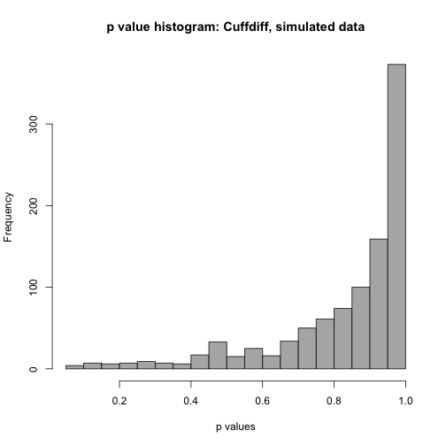
The assemble-identify problem is really really hard to do well:

Slide 21
A new approach: Identify-then-annotate
Aligned
Reads
calculate coverage at base-pair resolution
statistical tests: identify contiguous regions showing signal
annotate any regions of interest

Slide 22
Shall we talk DER Finder?
(it’s up to you)

Slide 23
Normalization
Some samples are sequenced at higher depth than others
Longer genes/transcripts will generate more reads
One proposed solution: use RPKM = reads per kilobase per million mapped reads
GC content
Know your research question: comparing whether two genes are expressed differently from each other in same group? or comparing expression of the same gene between different groups?

