Slide 1
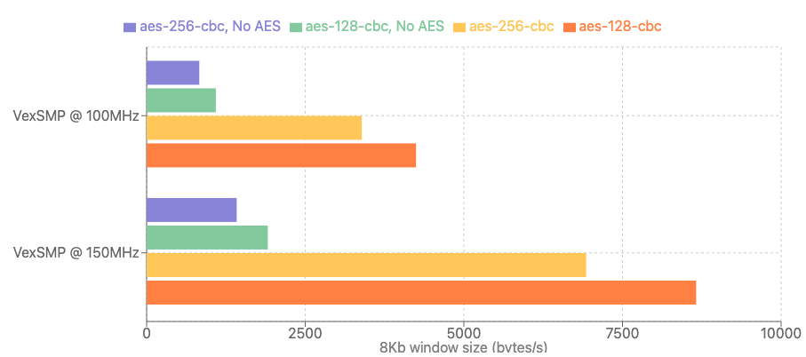
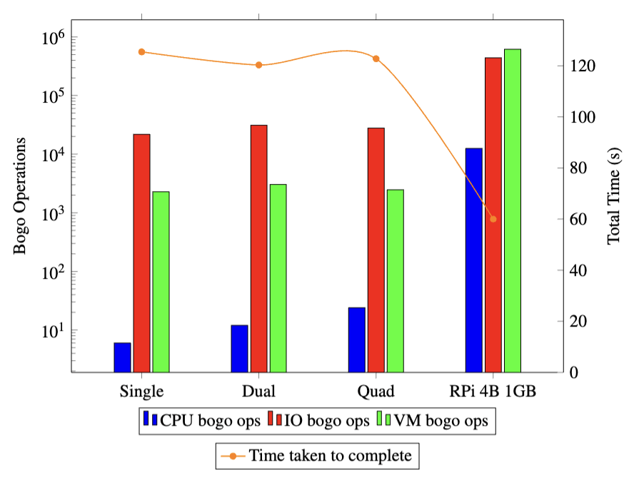
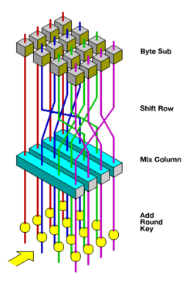
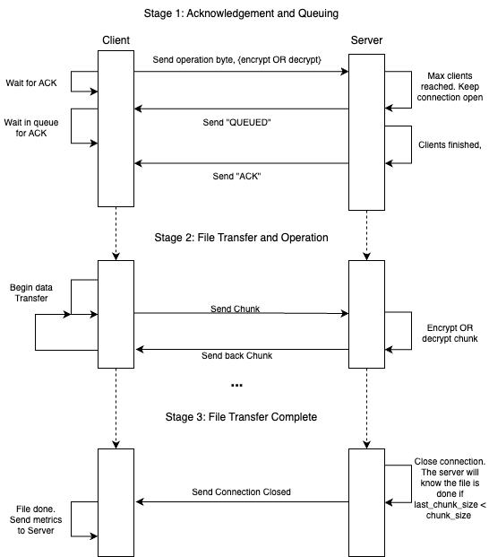
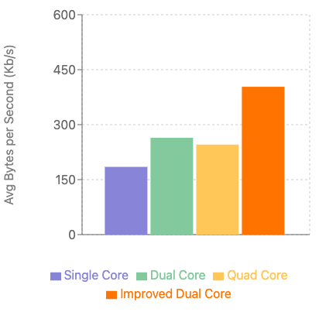
FPGA RISC-V Softcore Processor for Network Security
Lachlan Comino, s4532119; Supervised by Matthew D’Souza
Performance Benchmarks
REIT4814
Project Aims, Goals and Scope
Encryption Rate
Stress-ng Tests
2016 saw the most damaging DDOS attack in history…
Constructed from a botnet of unsecured IoT devices, it achieved a throughput of 1.2Tbps and targeted Dyn servers, taking down a majority of the internet.
∴ Security in IoT devices is critical.
However, additional security protocols can strain IoT devices.
Speed-up is required for critical processes.
Figure 3: OpenSSL Speed Tests for VexRiscv Configurations (Single-core)
Figure 4: Stress-ng Performance Comparison Across Configurations
Aim: Speed-up AES-128-CBC
Algorithm Steps
ExpandKey
AddRoundKey
Loop for n rounds:
ByteSub
ShiftRow
MixColumn
AddRoundKey
Ethernet Throughput
With the dual-core 100MHz VexRiscv, an average TCP throughput of 9.9Mbits/s was achieved in iPerf3.
With 150Mhz dual-core, the TCP stream average increased to 22.4Mbits/s.
Q: Does Overall Throughput Increase with CPU Core Amount?
Three ways we can speed up AES:
Precompute SBoxes in BRAM
Implement operations at the ISA-level
Combine operations into a single operation
Parallelisation is not possible (CBC relies on previous block ciphers).
A: No. Because of Resource Contention
Server Application, Python3
Figure 2 (Right): Diagram showing Server-Client Relationship
Server Application Performance
Implemented in full Python3 running on Buildroot Linux.
Client streams input chunks to the server.
Server then encrypts or decrypts depending on what the client specified.
Server sends back the processed chunk and the transaction is closed.
This process supports the threading of multiple clients on the same port.
For analysing performance, “metrics” are collected both server-side and client-side.
These results are then posted to a HTTP server that uses a SQLite DB.
Average throughput from each configuration, serving 100 total clients, in 10 client chunks.
Figure 4: Server Throughputs per core amount
Figure 1: Diagram showing ciphering process of one AES round, Wikipedia
Goal: Implement an Encryption SoC Server on FPGA Hardware
Using Open-Source Tools:
Tool | Xilinx | Open-Source
SC CPU | ARM Cortex M series | VexRiscv (RISC-V)
HDL | Verilog, VHDL | SpinalHDL
Synthesis | Vivado | F4PGA (Yosys)
SoC Building | Add IP Core in Vivado | LiteX SoC Builder
Linux Variant | PetaLinux | Buildroot Linux
CRICOS 00025B • TEQSA PRV12080
School of Electrical Engineering and Computer Science

