Slide 1
REIT4841
Embedded Systems Super Thesis Project: FPGA RISC-V Softcore Processor for Network Security
Lachlan Comino, s4532119
Supervisor: Matthew D’Souza

Slide 2
Contents
Topic Definition
Aim’s and KPI
Hardware Overview
Network Testbed Overview
Project Plan
Progress so Far

Slide 3
Topic Definition
Goal: Design a mutable, FPGA-based, edge device that emphasises network security.
FPGA-Based RISC-V softcore processor running zephyr
Soft Core Processor for Network Security – S.C.P.N.S
Mutable – Can run an application in parallel with networking (within reason)
A chosen network security method
Networking testbed, via Kubernetes

Slide 4
Aims and KPI
Aims | Performance Indicator
Network Securable | Packet sniffing, interception testing
Processing Latency | Measure processing speed (speed per packet)
Power Efficient | Heat emission (power per packet)
Resource-minimising | Amount of: LUTs, FFs, RAM usage
Scalability | Performance impacts once peripherals are added as well as applications running on the FPGA

Slide 5
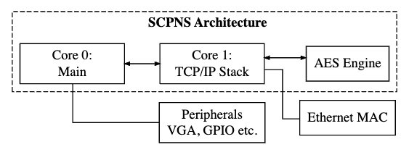
SCPNS Architecture Overview
Multi-core design
Hardware-accelerated encryption
Notes:
Mention:
Multicore design
Explain the purpose of each core
Mention core 1’s closeness to ethernet MAC and the AES engine

Slide 6
FPGA Development Overview
The chosen CPU architecture is VexRiscv 32-bit
Highly-documented
Open-source
Compatible with Zephyr
Developer Environment: SpinalHDL, Scala Build Tool, LiteX
Board: Diligent Arty S7
Xilinx Spartan-7 FPGA (XC7S50)
8,150 logic slices, 337.5 KB Kb DRAM, 32,600 LUTs, 65,200 FFs
Universal clock rate of 100MHz
Notes:
Mention:
SpinalHDL for programming, built on top of scala built tools, Vexriscv-32 is built with it
LiteX for building SOCs
100MHz in literature

Slide 7
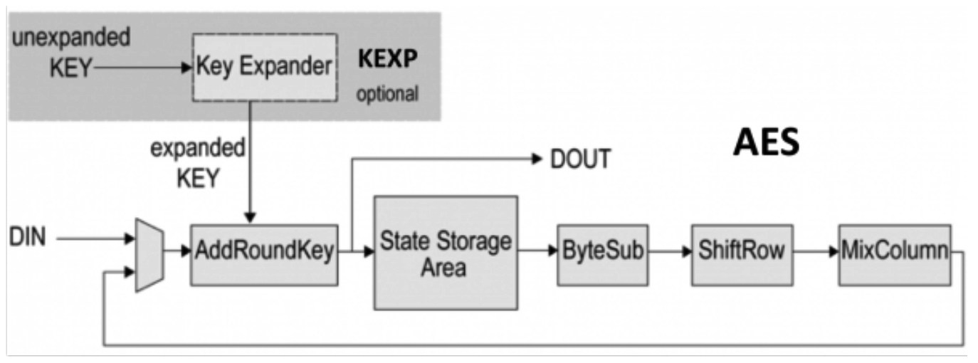
AES Engine
Chosen encryption method: 128-aes-cbc
Advanced Encryption Standard, 128-bit block and key length, Cipher Block Chaining
From https://www.cast-inc.com/security/encryption-primitives/aes
Unfortunately, only does encryption in serial blocks

Slide 8
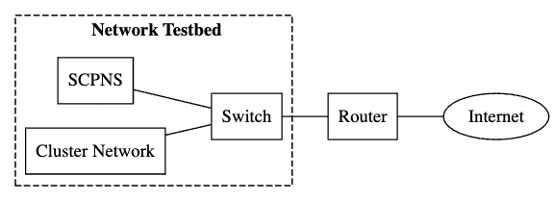
Testbed Overview
RPI3s will be used for Cluster Devices
Kubernetes will orchestrate deployment

Slide 9
What is Kubernetes??
Docker is a program that builds and runs containers
Containers are pre-packaged software applications (images)
Kubernetes orchestrates the running of containers
Handles deployment, scaling etc.
A ‘Node’ in Kubernetes is like an edge in a network
It can be a collection of containers or a control panel node

Slide 10
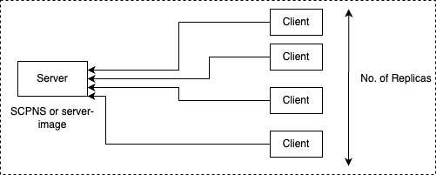
Cluster Network
Server-side:
SCPNS
Client-side:
Containers ”spamming” messages
Scalable
…
And the RPI3 should be able to run many clients

Slide 11
Project Plan – Semester 1
Task | Due
Proposal | Week 8
Interface Rpi/s to Router | Week 9
Set up Cluster Network | Week 10
Seminar | Week 11

Slide 12
Break
Task | Due
Create the SCPNS | Week 1
Run Zephyr | Week 2
Interface Network Core | Week 3
AES Encryption Engine | Week 3-4

Slide 13
Semester 2
Task | Due
Experimentation | Week 1
Measure and Compare | Week 2
Poster & Demonstration | Week 11
Thesis | Nov 4th

Slide 14
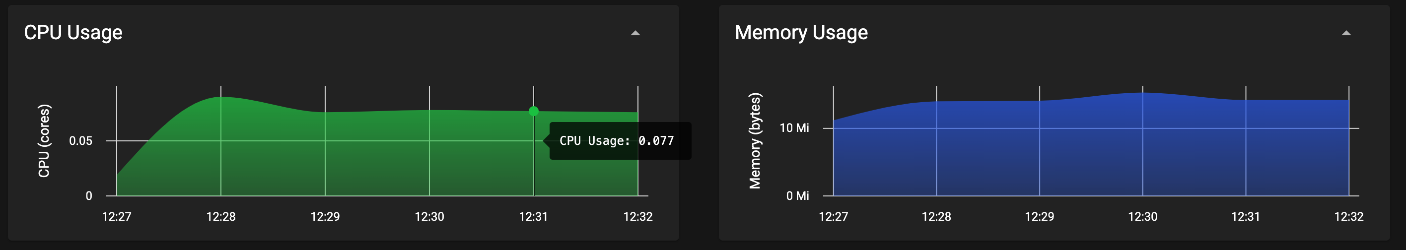
Progress So Far…
The test bed is done (only virtually)
Image and container deployment for clients and mimic SCPNS
Image: “debian:stable-slim” (~150Mb)
Both run a simple networking/encryption bash script
Microk8s dashboard add-on
From running 5 clients, 1 server
Notes:
The test bed is done (but only virtually)
Containers and deployment services defined
Container that mimics the SCPNS
Container for clients
However, …
It still needs to run on the cluster network hardware

Slide 15
Challenges
How will the networking core on the SCPNS handle multiple connections?

