Slide 1
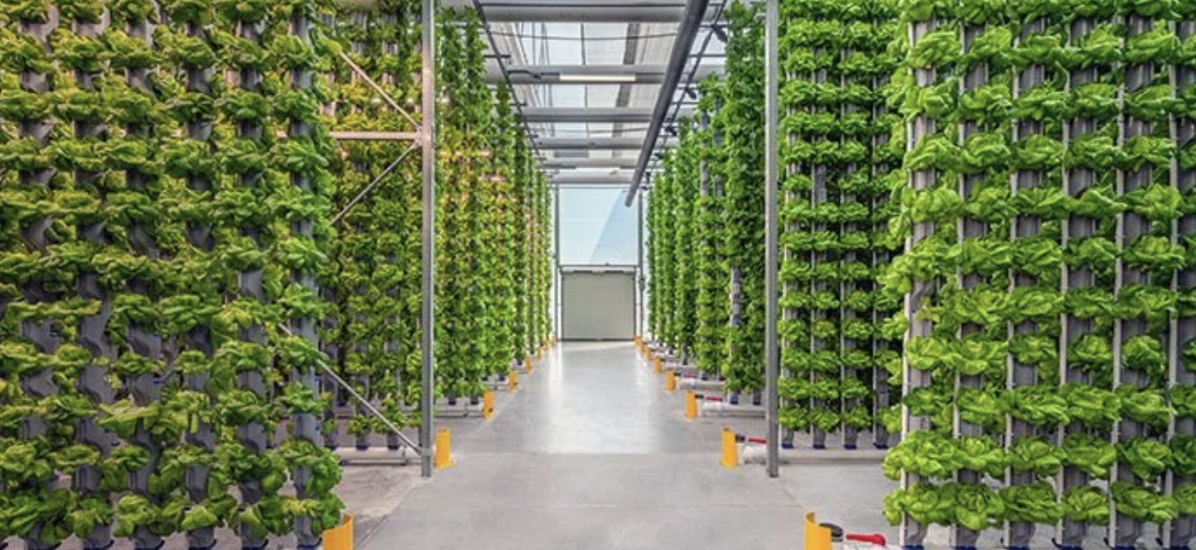
AI Systems – Individual Study
Optimizing Hydroponic Farming with AI & IoT
Student: Lindsay Cooper
Minor Program: AI Systems

Slide 2
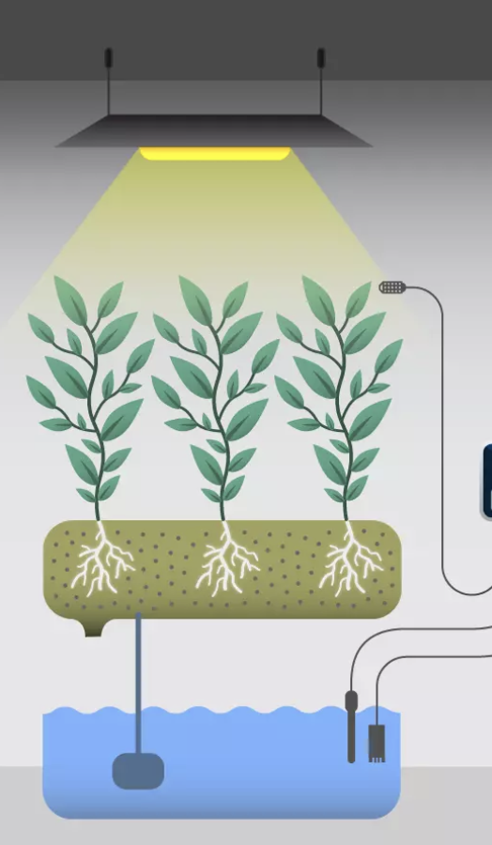
Objective & Focus
Objective:
To design and develop an intelligent IoT-based system that uses AI and sensors to monitor and optimize water quality in hydroponic farming for sustainable agriculture.
Focus:
Monitor water parameters (EC, pH, temperature, dissolved oxygen).
Use predictive analytics for optimization.
Evaluate financial, ecological, and technical impact.
Main Question:
How can AI be applied to optimize hydroponic farming by combining IoT-based monitoring of water parameters with predictive analytics for sustainable resource management?

Slide 3
Background & Problem Statement
Agriculture consumes vast water and nutrient resources.
Hydroponics offers a sustainable alternative but requires precise water management.
Current monitoring methods are often manual and costly.

Slide 4
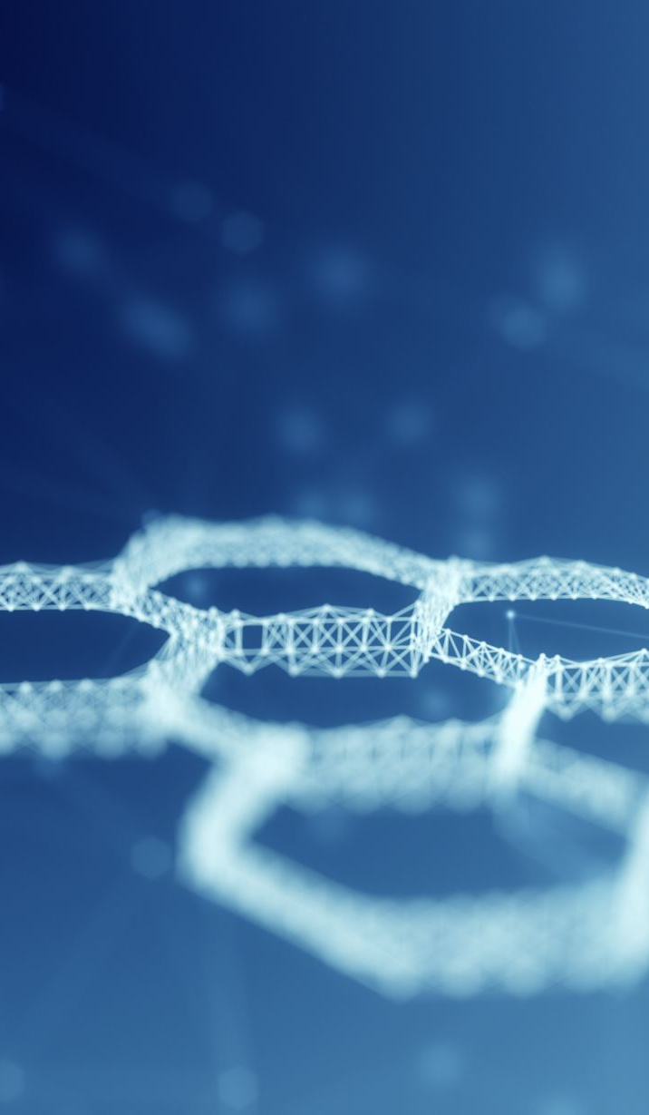
Learning Goals
Technical Goals:
Integrate AI with IoT for real-time monitoring.
Build predictive analytics for water-quality forecasting.
Design a scalable system architecture.
Personal Goals:
Strengthen skills in Python, AI frameworks, and architecture design.
Improve project management and communication.
Bridge software engineering and sustainability applications.

Slide 5
Current Working On
Conducting literature review on AI in hydroponics and IoT applications.
Identified critical water parameters: EC, pH, temperature, oxygen.
Identify potential sensors for the implementation from the supplier list.
Explored open-source frameworks: TensorFlow Lite, scikit-learn, Edge Impulse.

