Slide 1
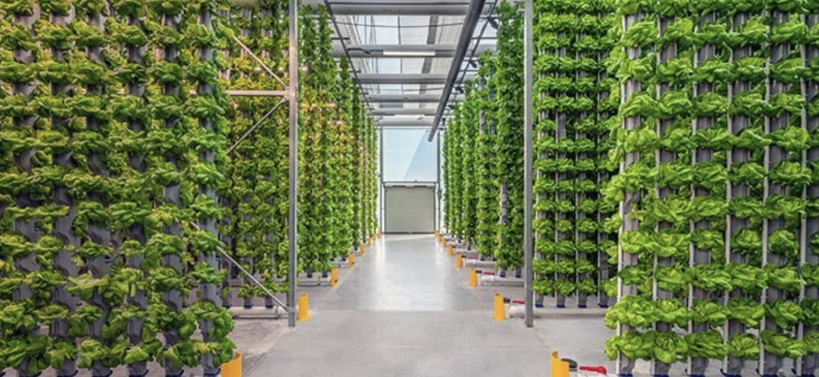
AI Systems – Individual Study
Optimizing Hydroponic Farming with AI & IoT
Student: Lindsay Cooper
Minor Program: AI Systems

Slide 2
Project Summary
Objective:
- Design and build an AI-enabled IoT system for hydroponic farming.
Focus:
- Monitor water parameters (EC, pH, temperature, oxygen).
- Use predictive analytics for optimization.
- Evaluate financial, ecological, and technical impact.
Main Question:
- How can AI be applied to optimize hydroponic farming by combining IoT-based monitoring of water parameters with predictive analytics for sustainable resource management?

