Slide 1
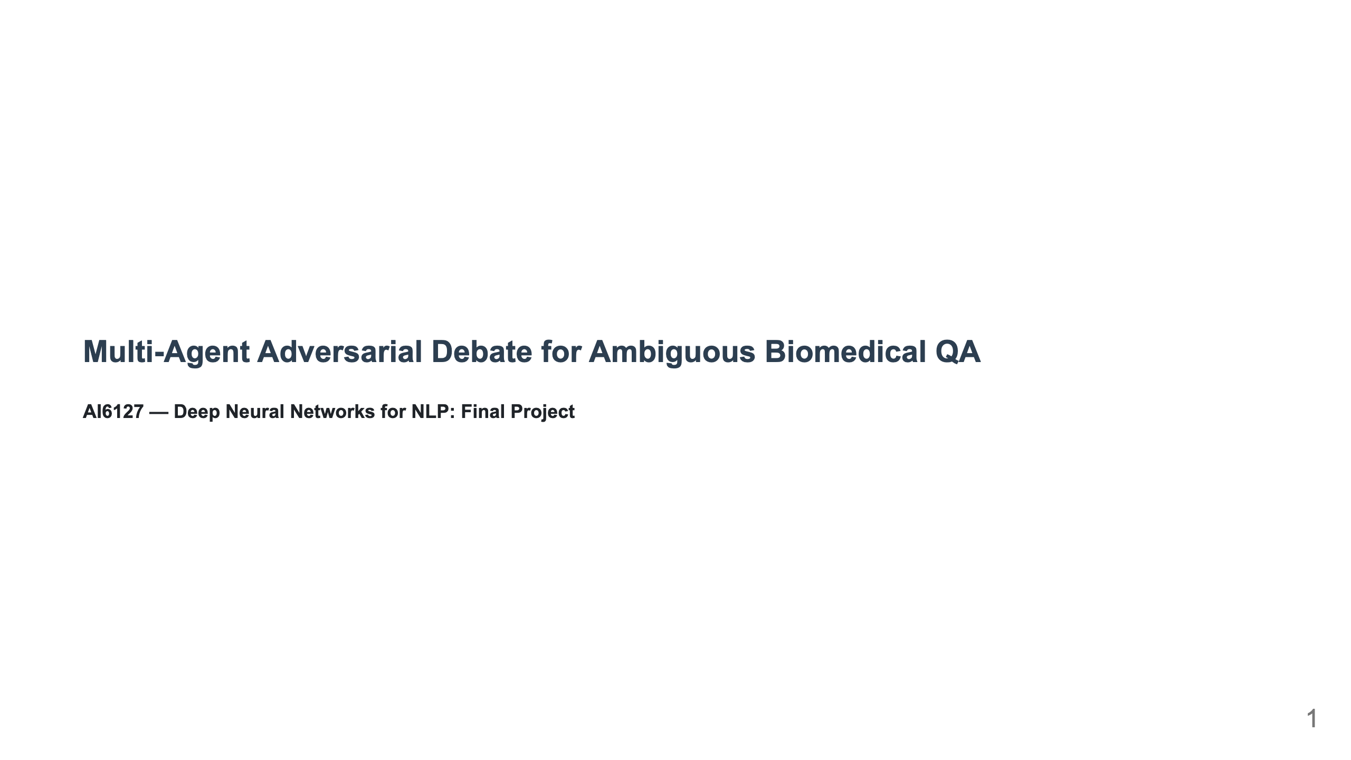
Notes:
Slide 1: Title

Slide 2
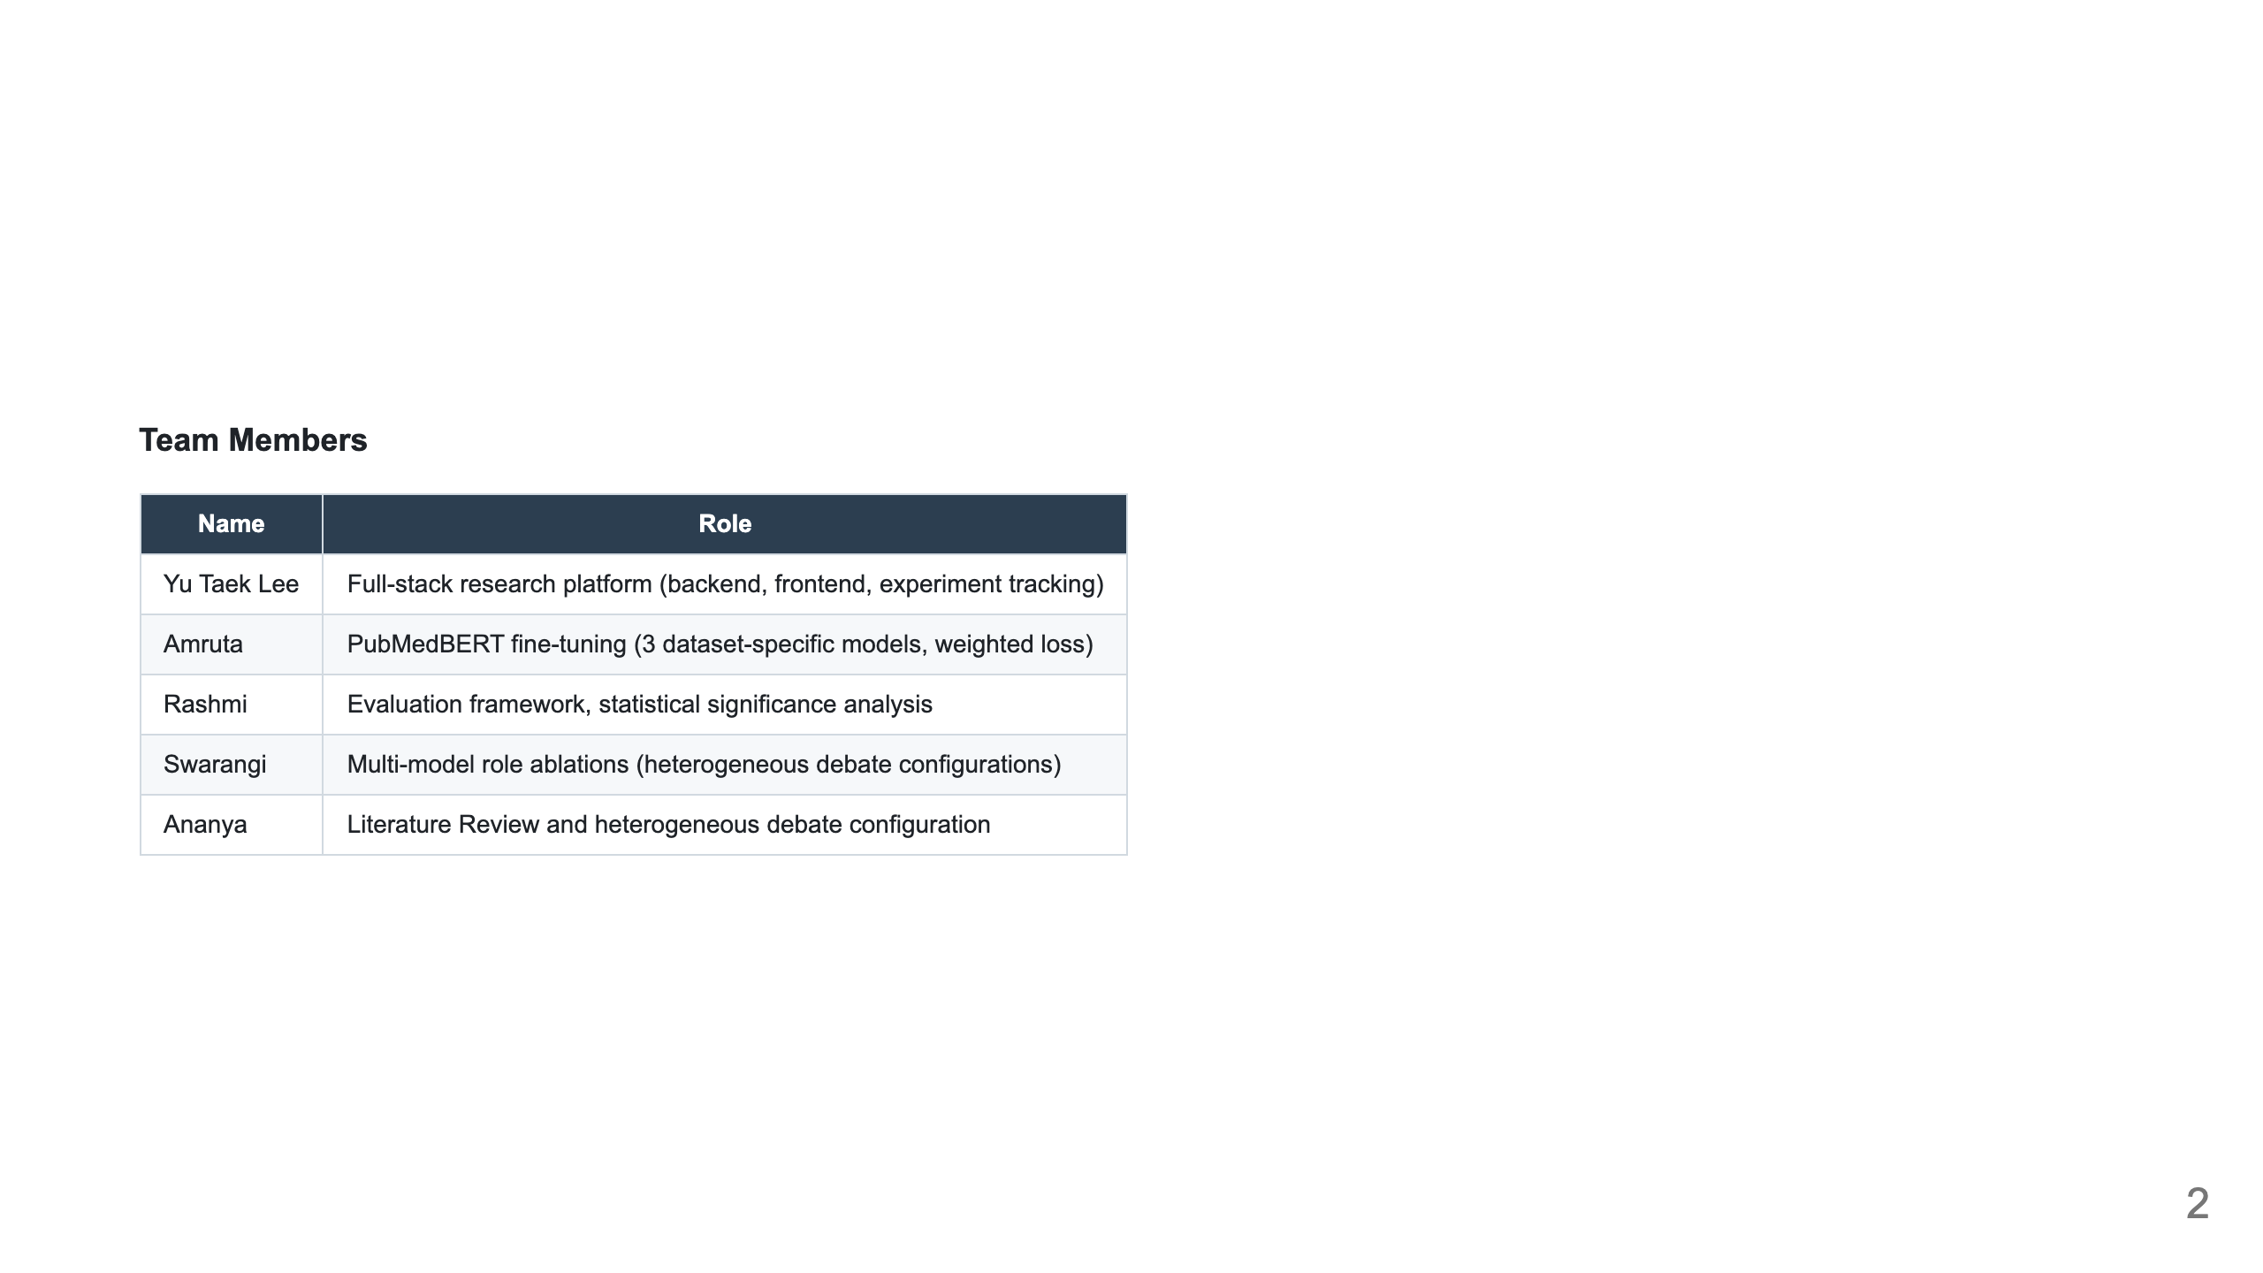

Slide 3
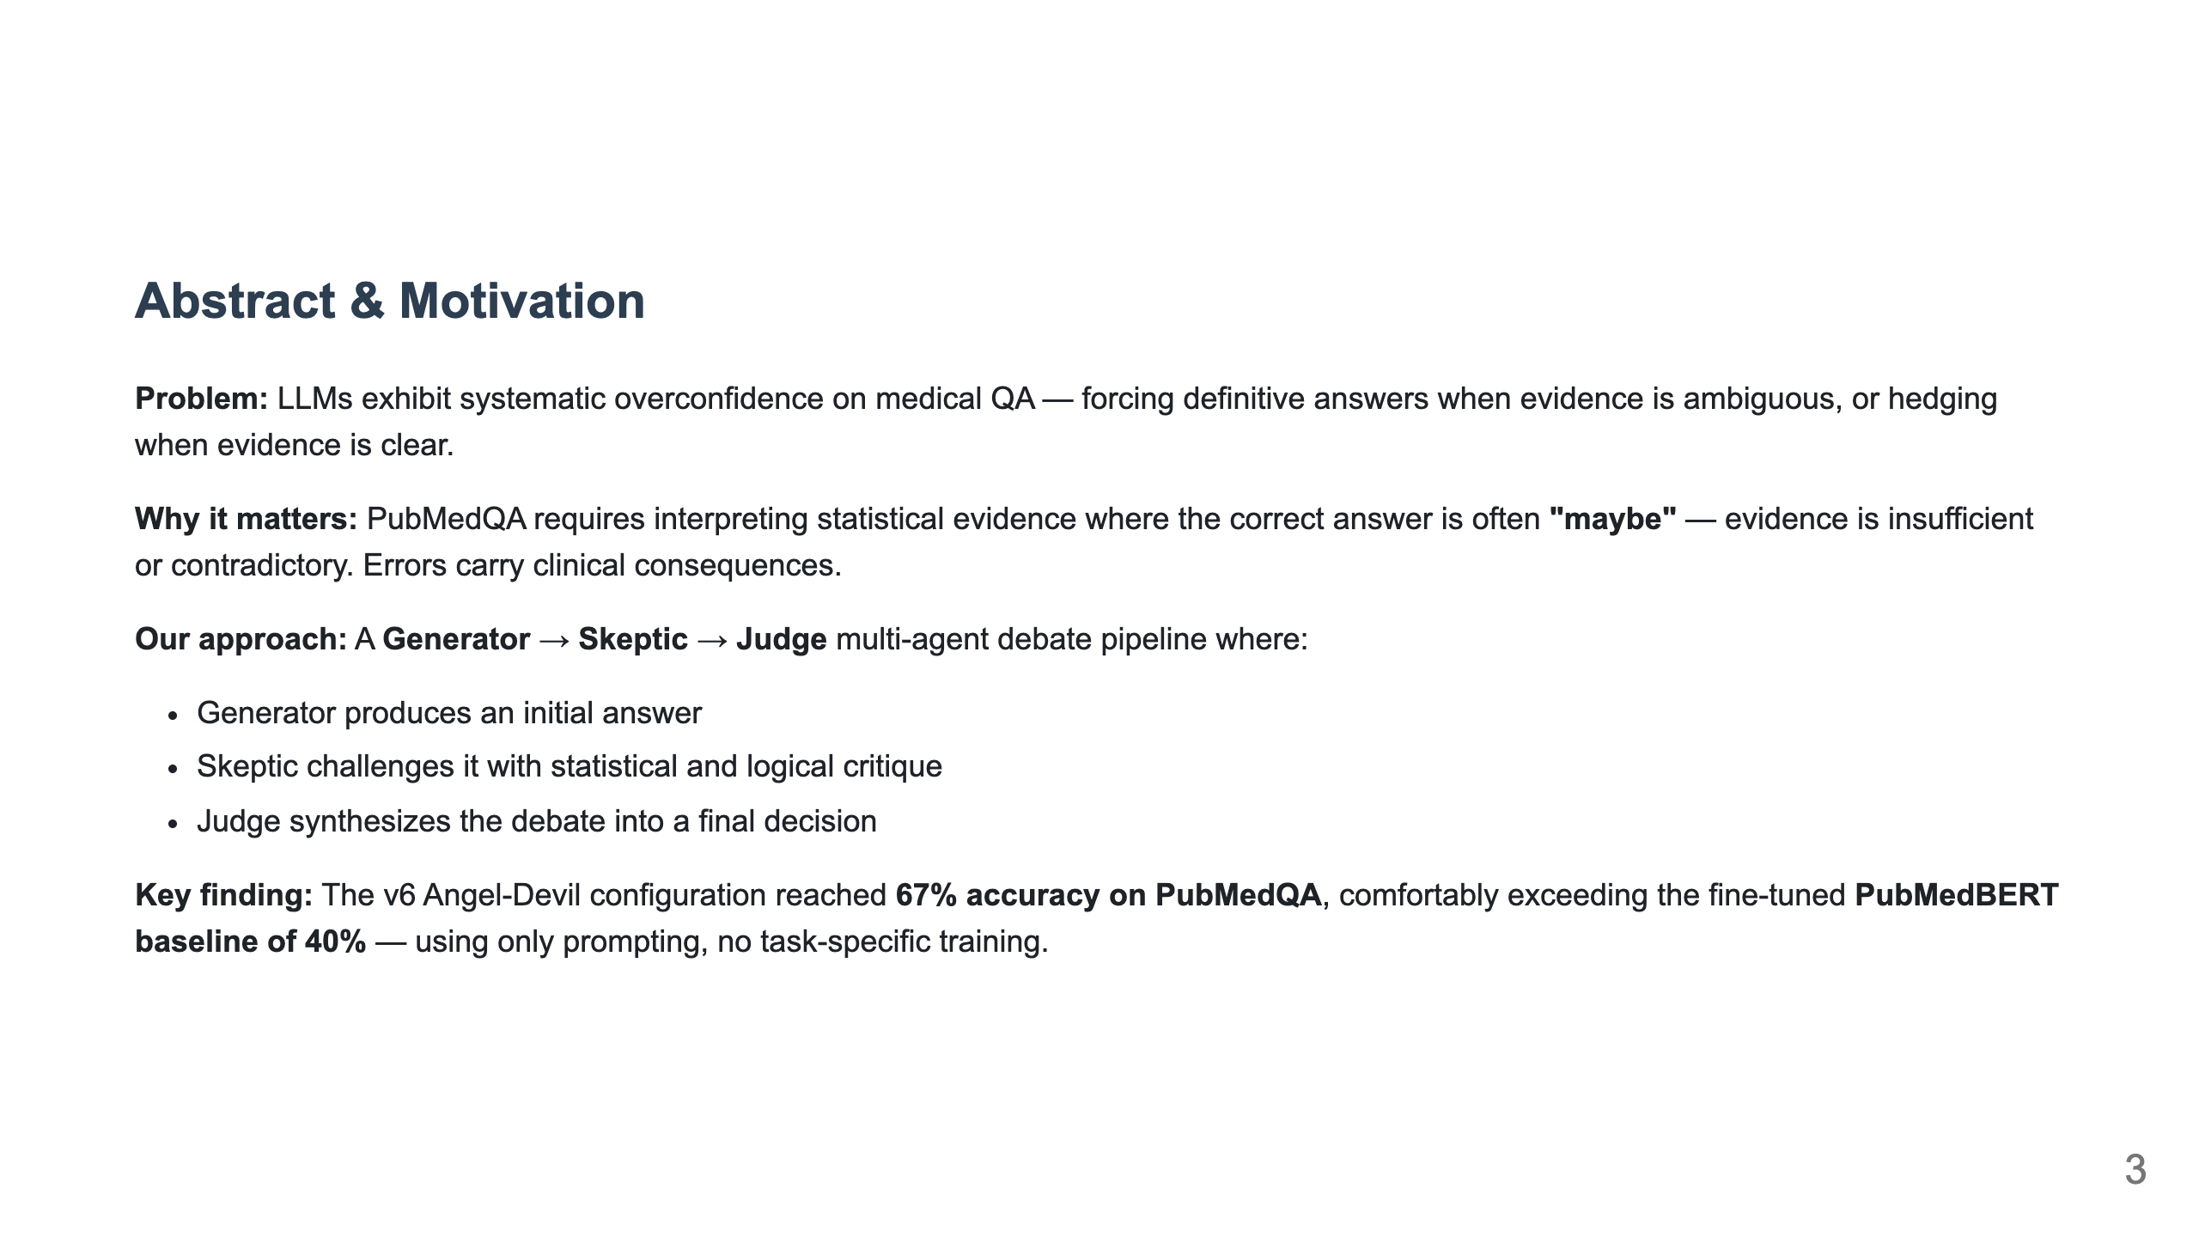
Notes:
Slide 2: Abstract / Motivation

Slide 4
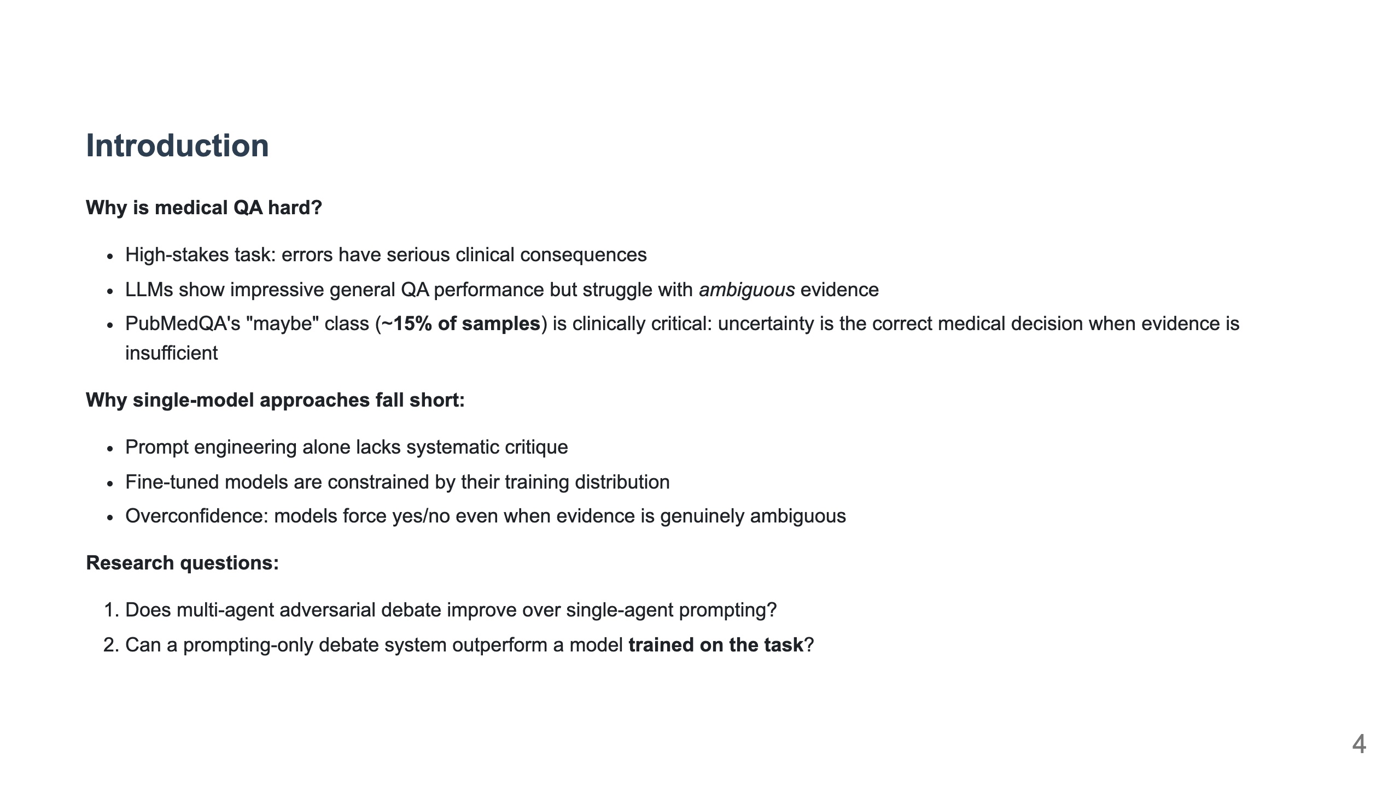
Notes:
Slide 3: Introduction

Slide 5
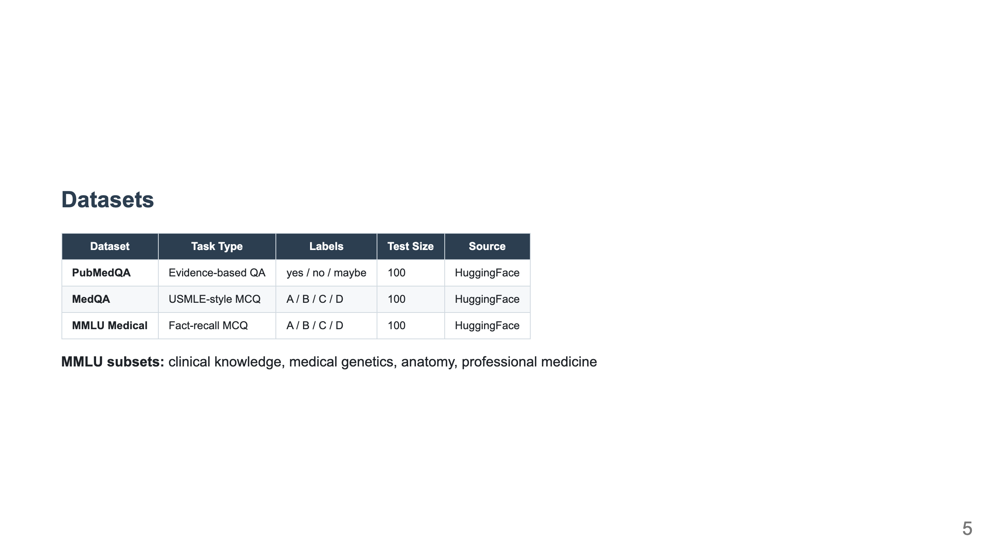
Notes:
Slide 4: Datasets

Slide 6
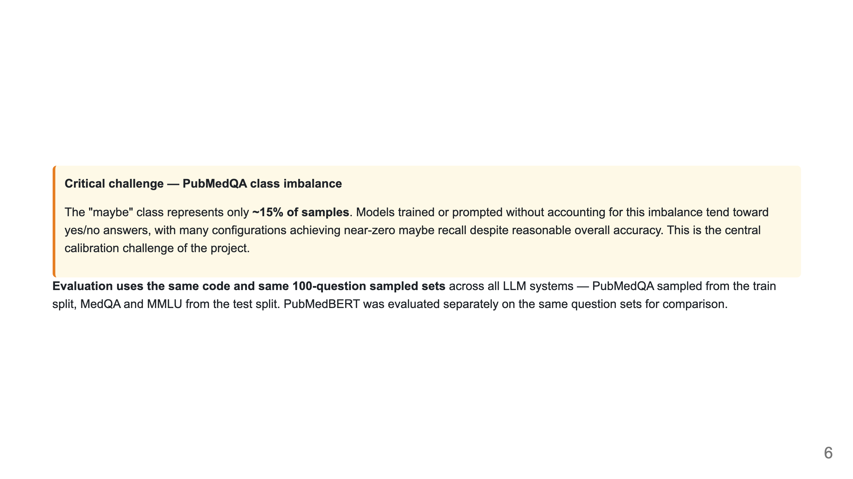

Slide 7
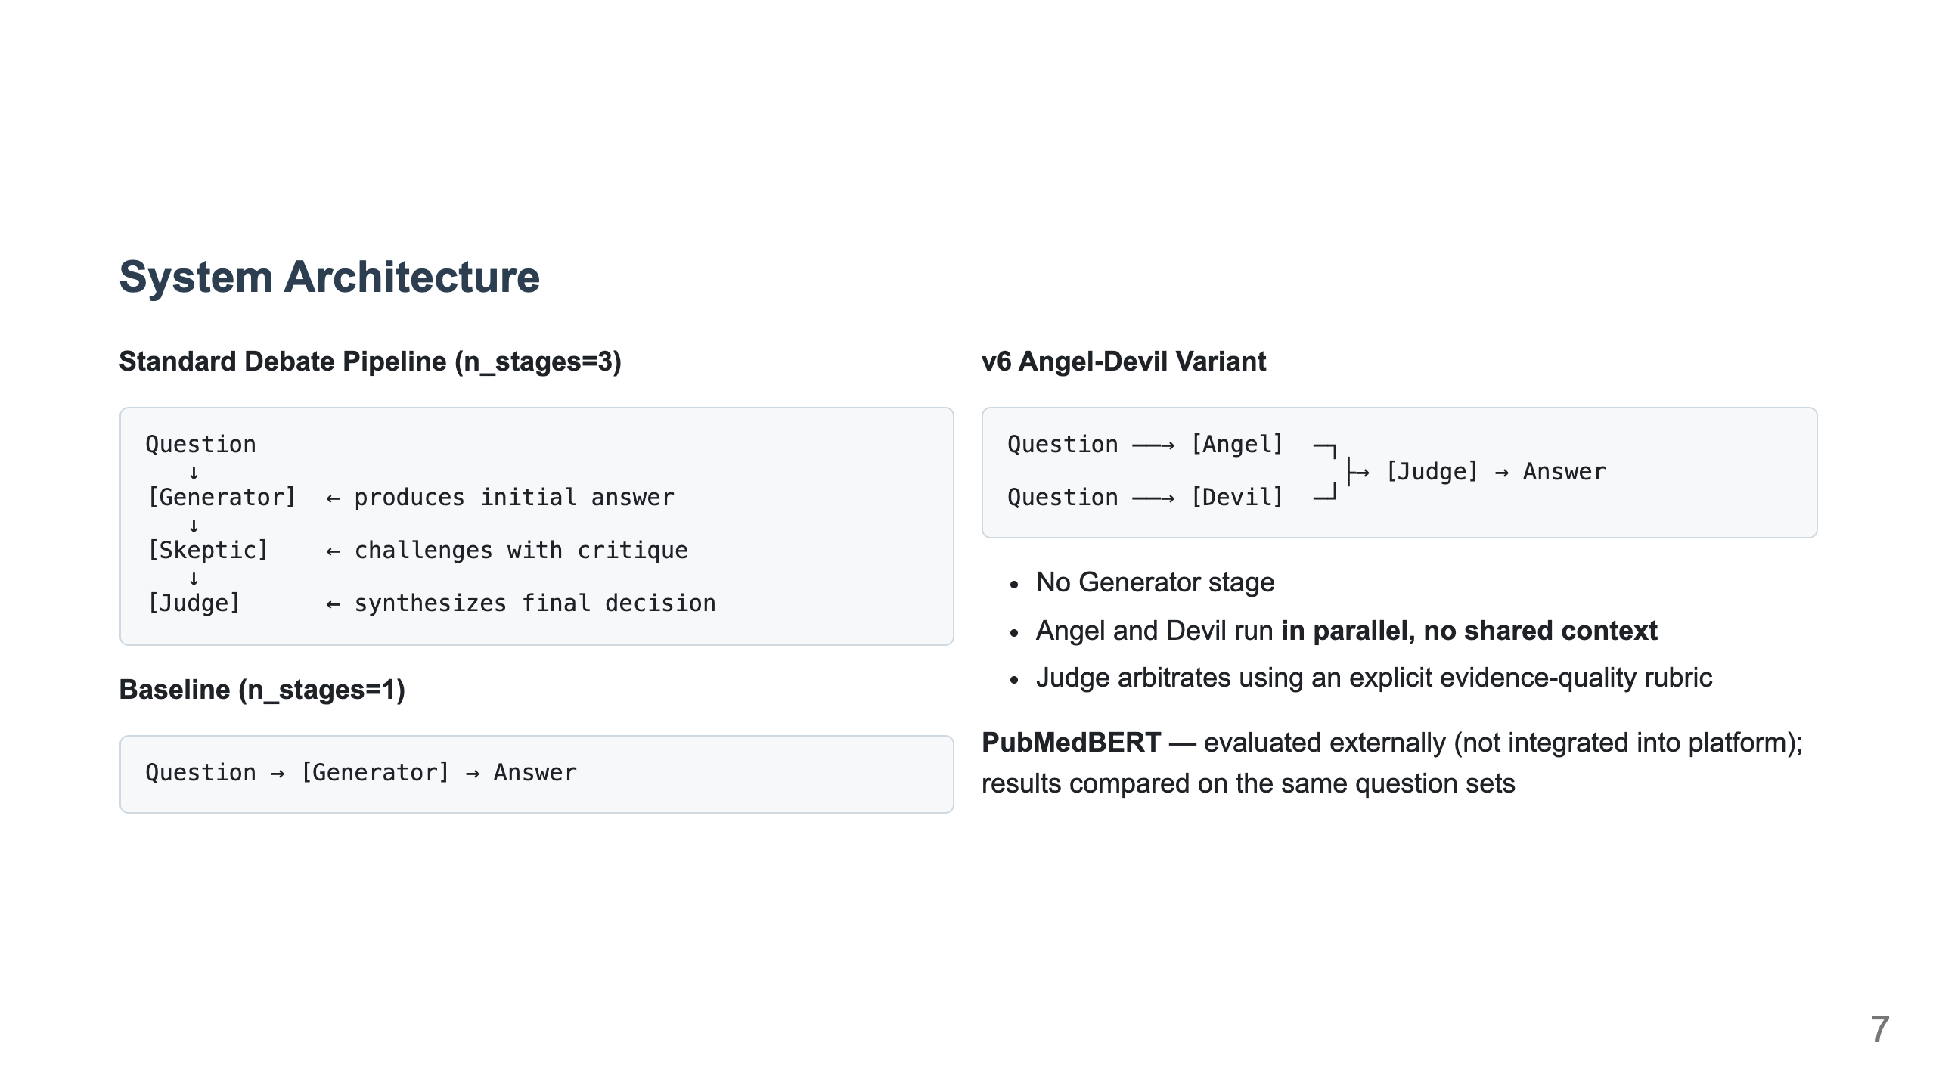
Notes:
Slide 5: System Architecture

Slide 8
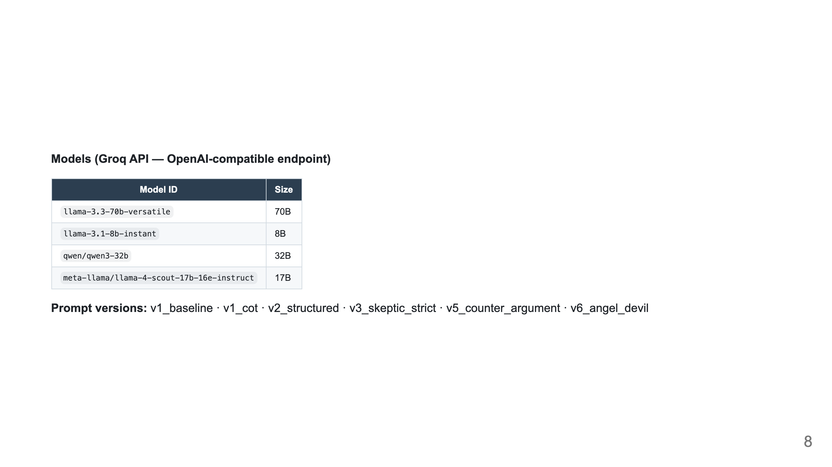

Slide 9
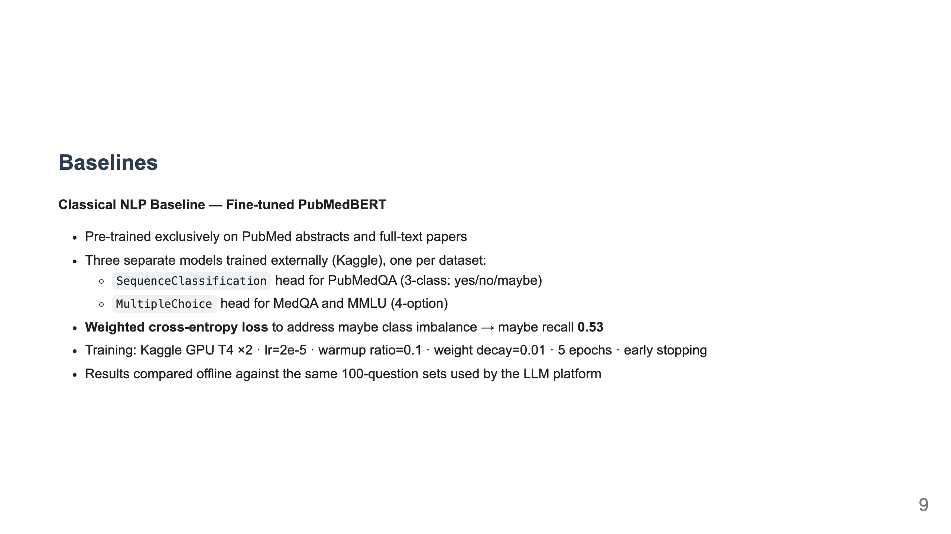
Notes:
Slide 6: Baselines

Slide 10
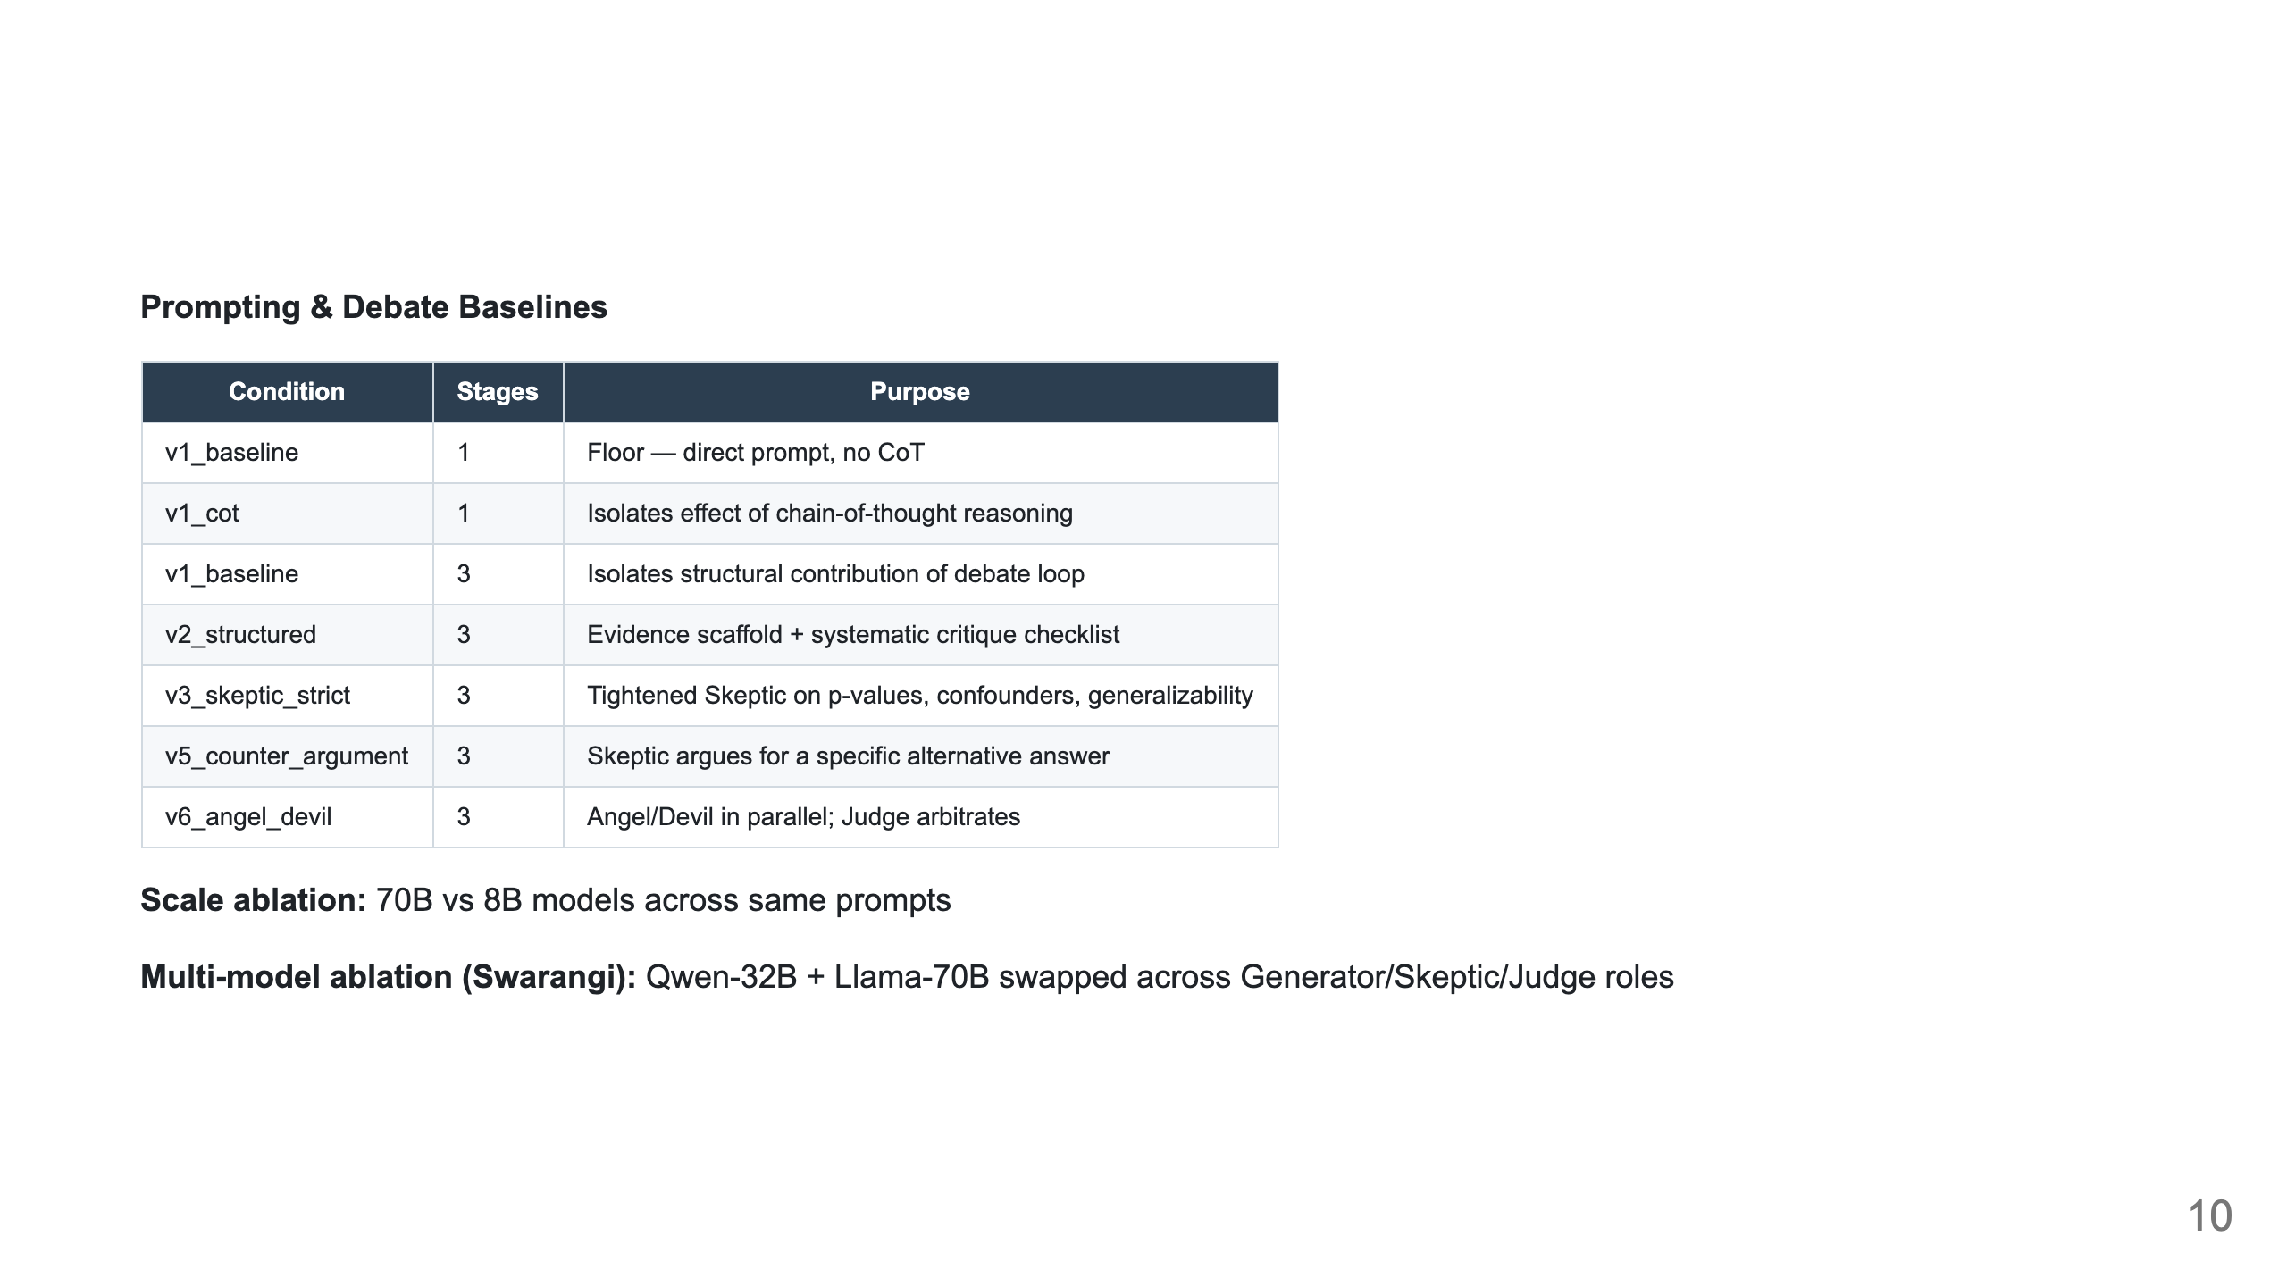

Slide 11
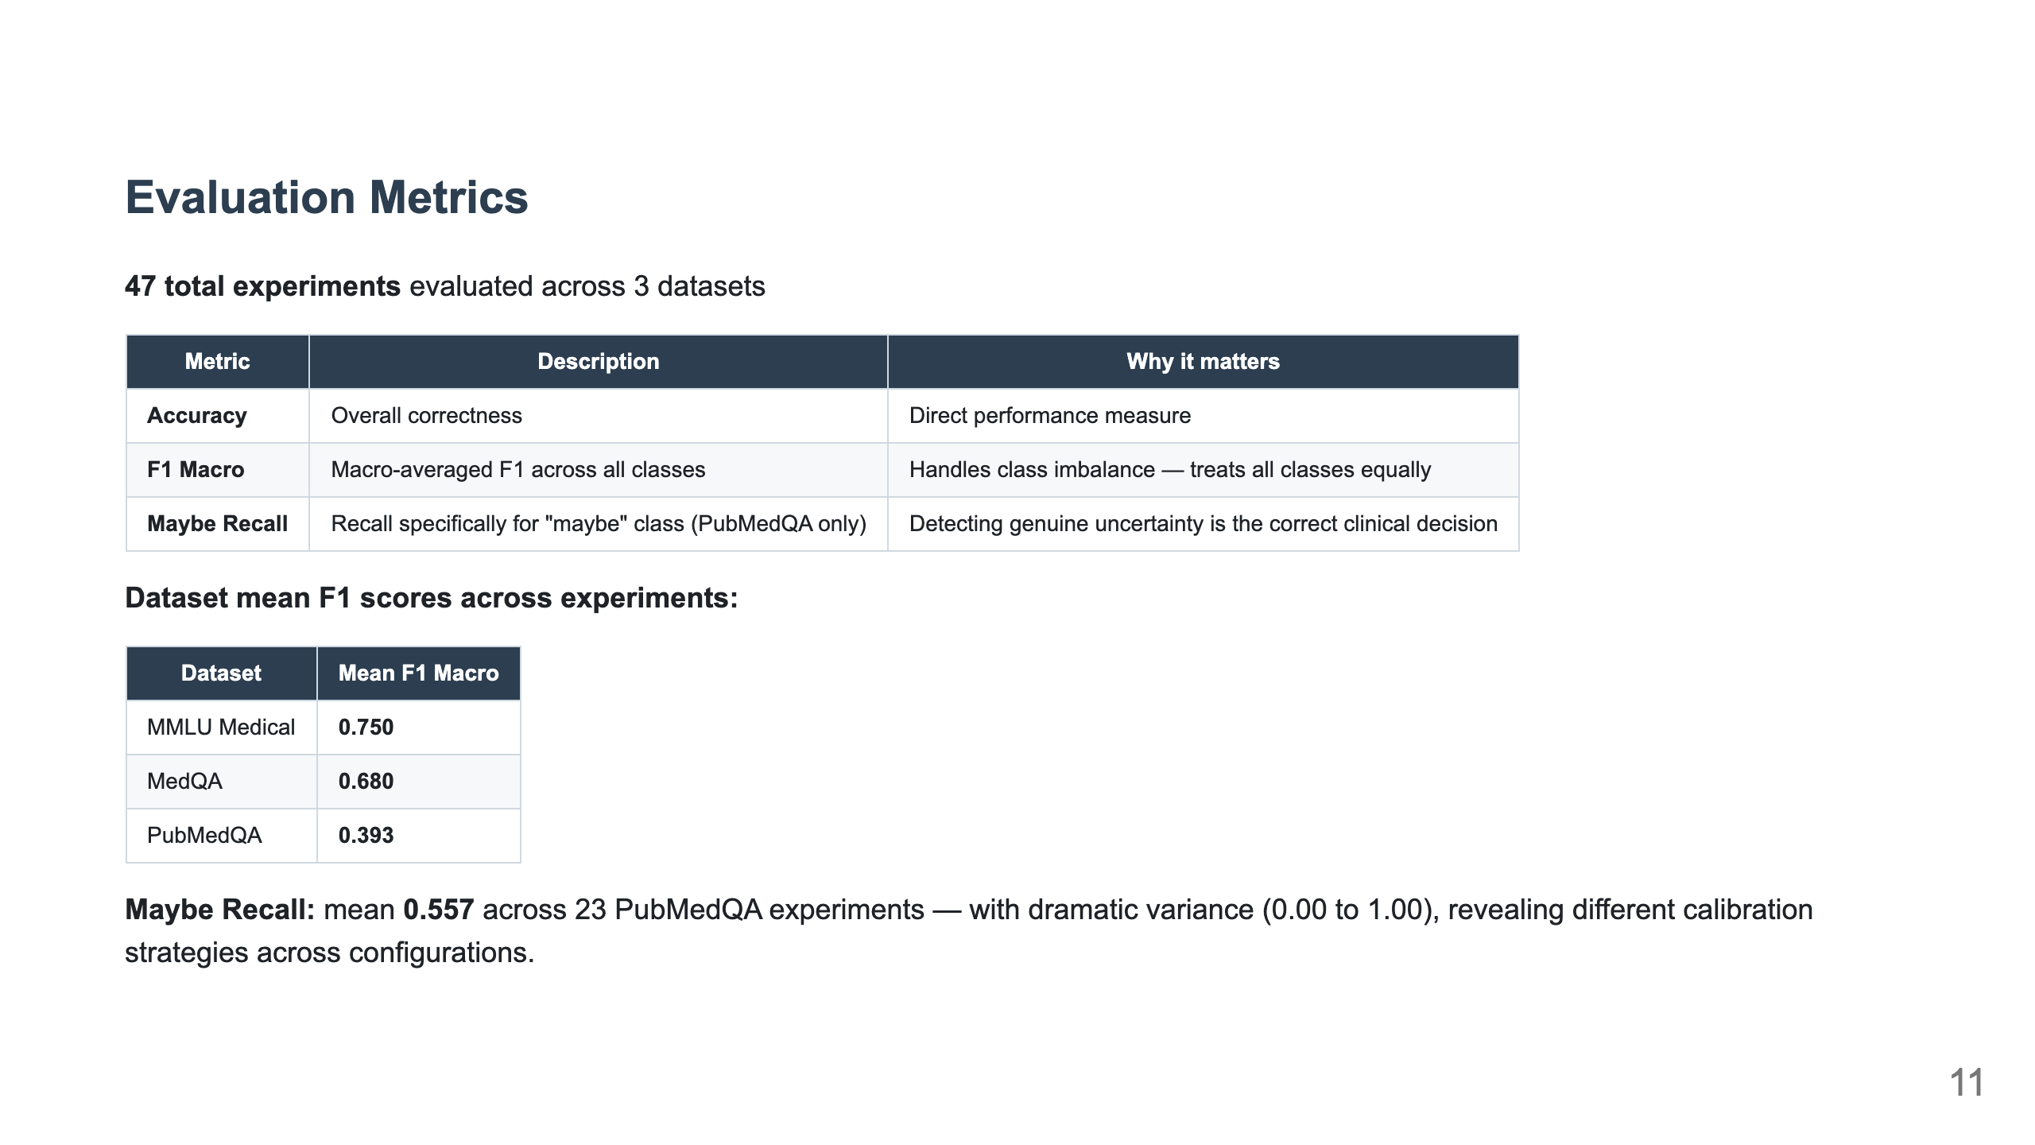
Notes:
Slide 7: Evaluation Metrics

Slide 12
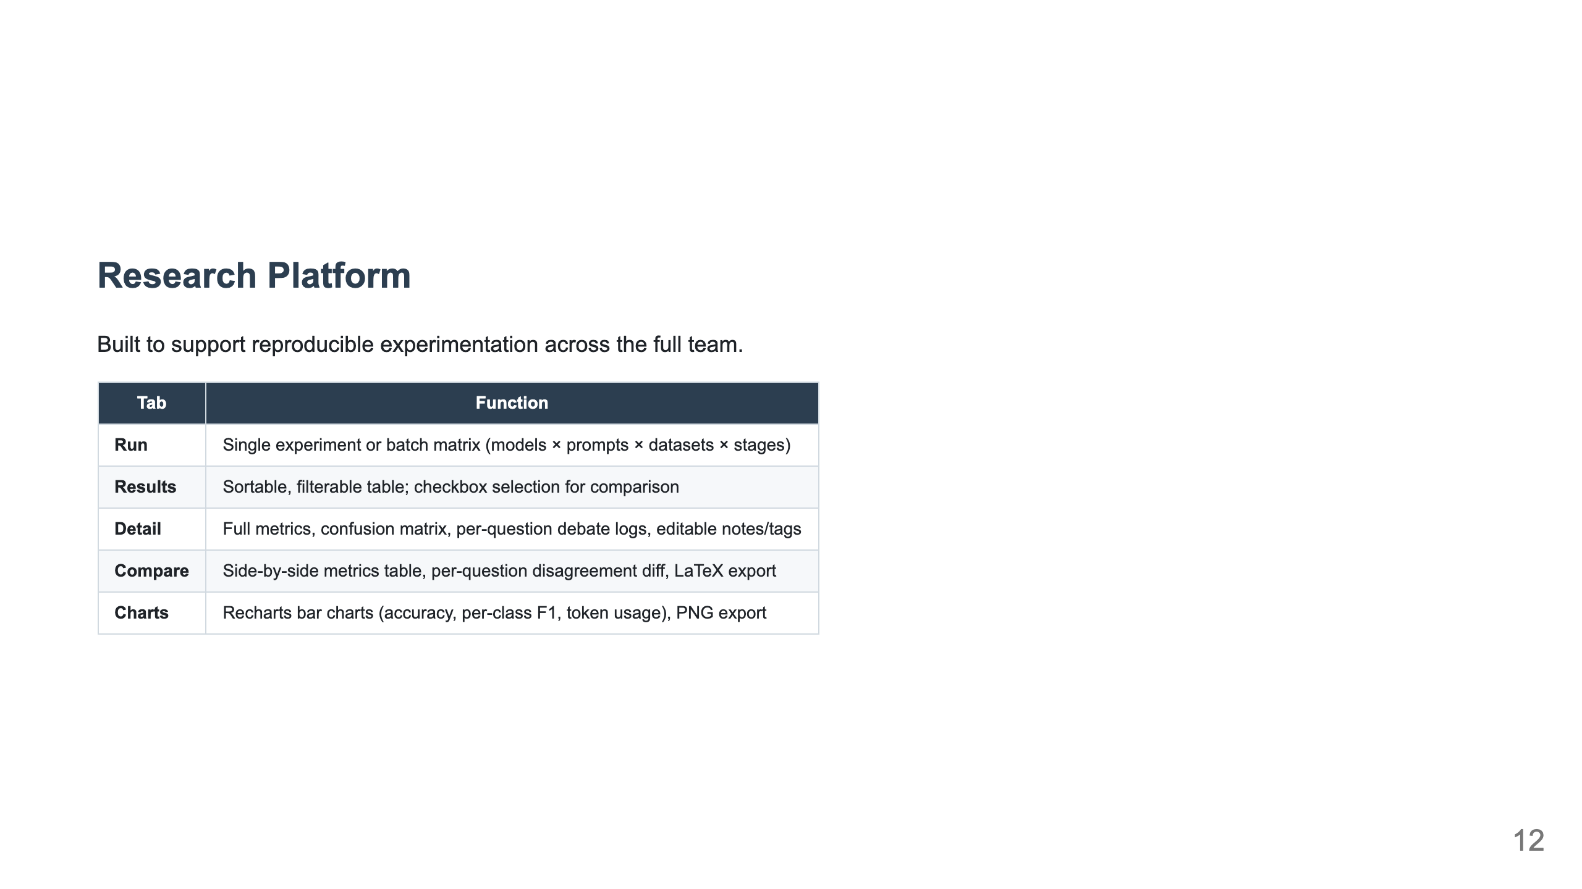
Notes:
Slide 8: Platform Demo

Slide 13
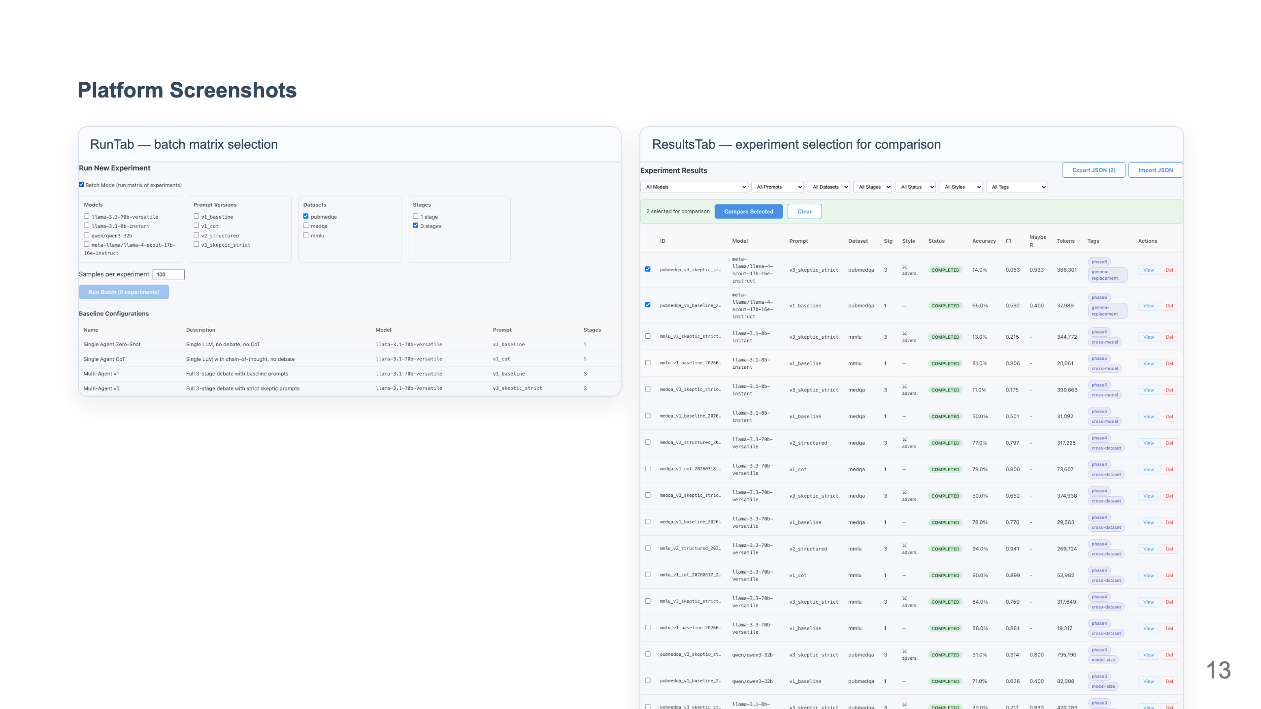

Slide 14
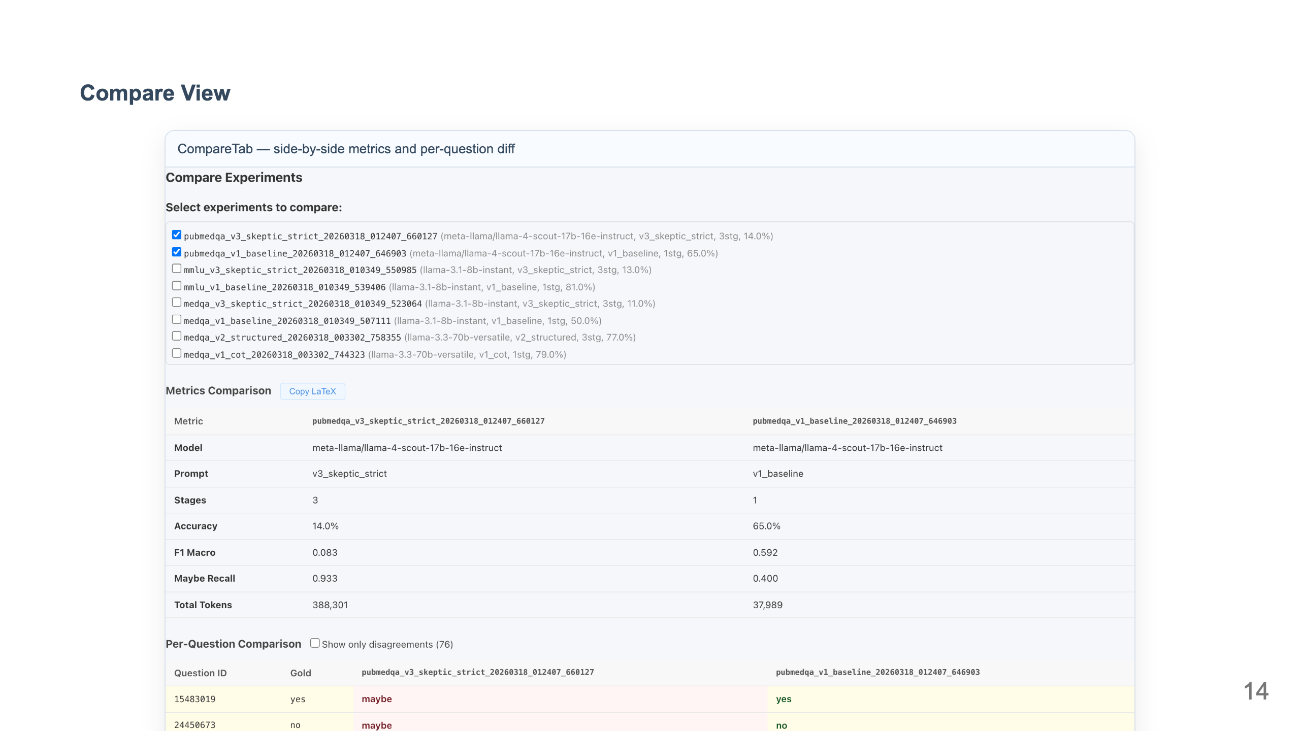

Slide 15
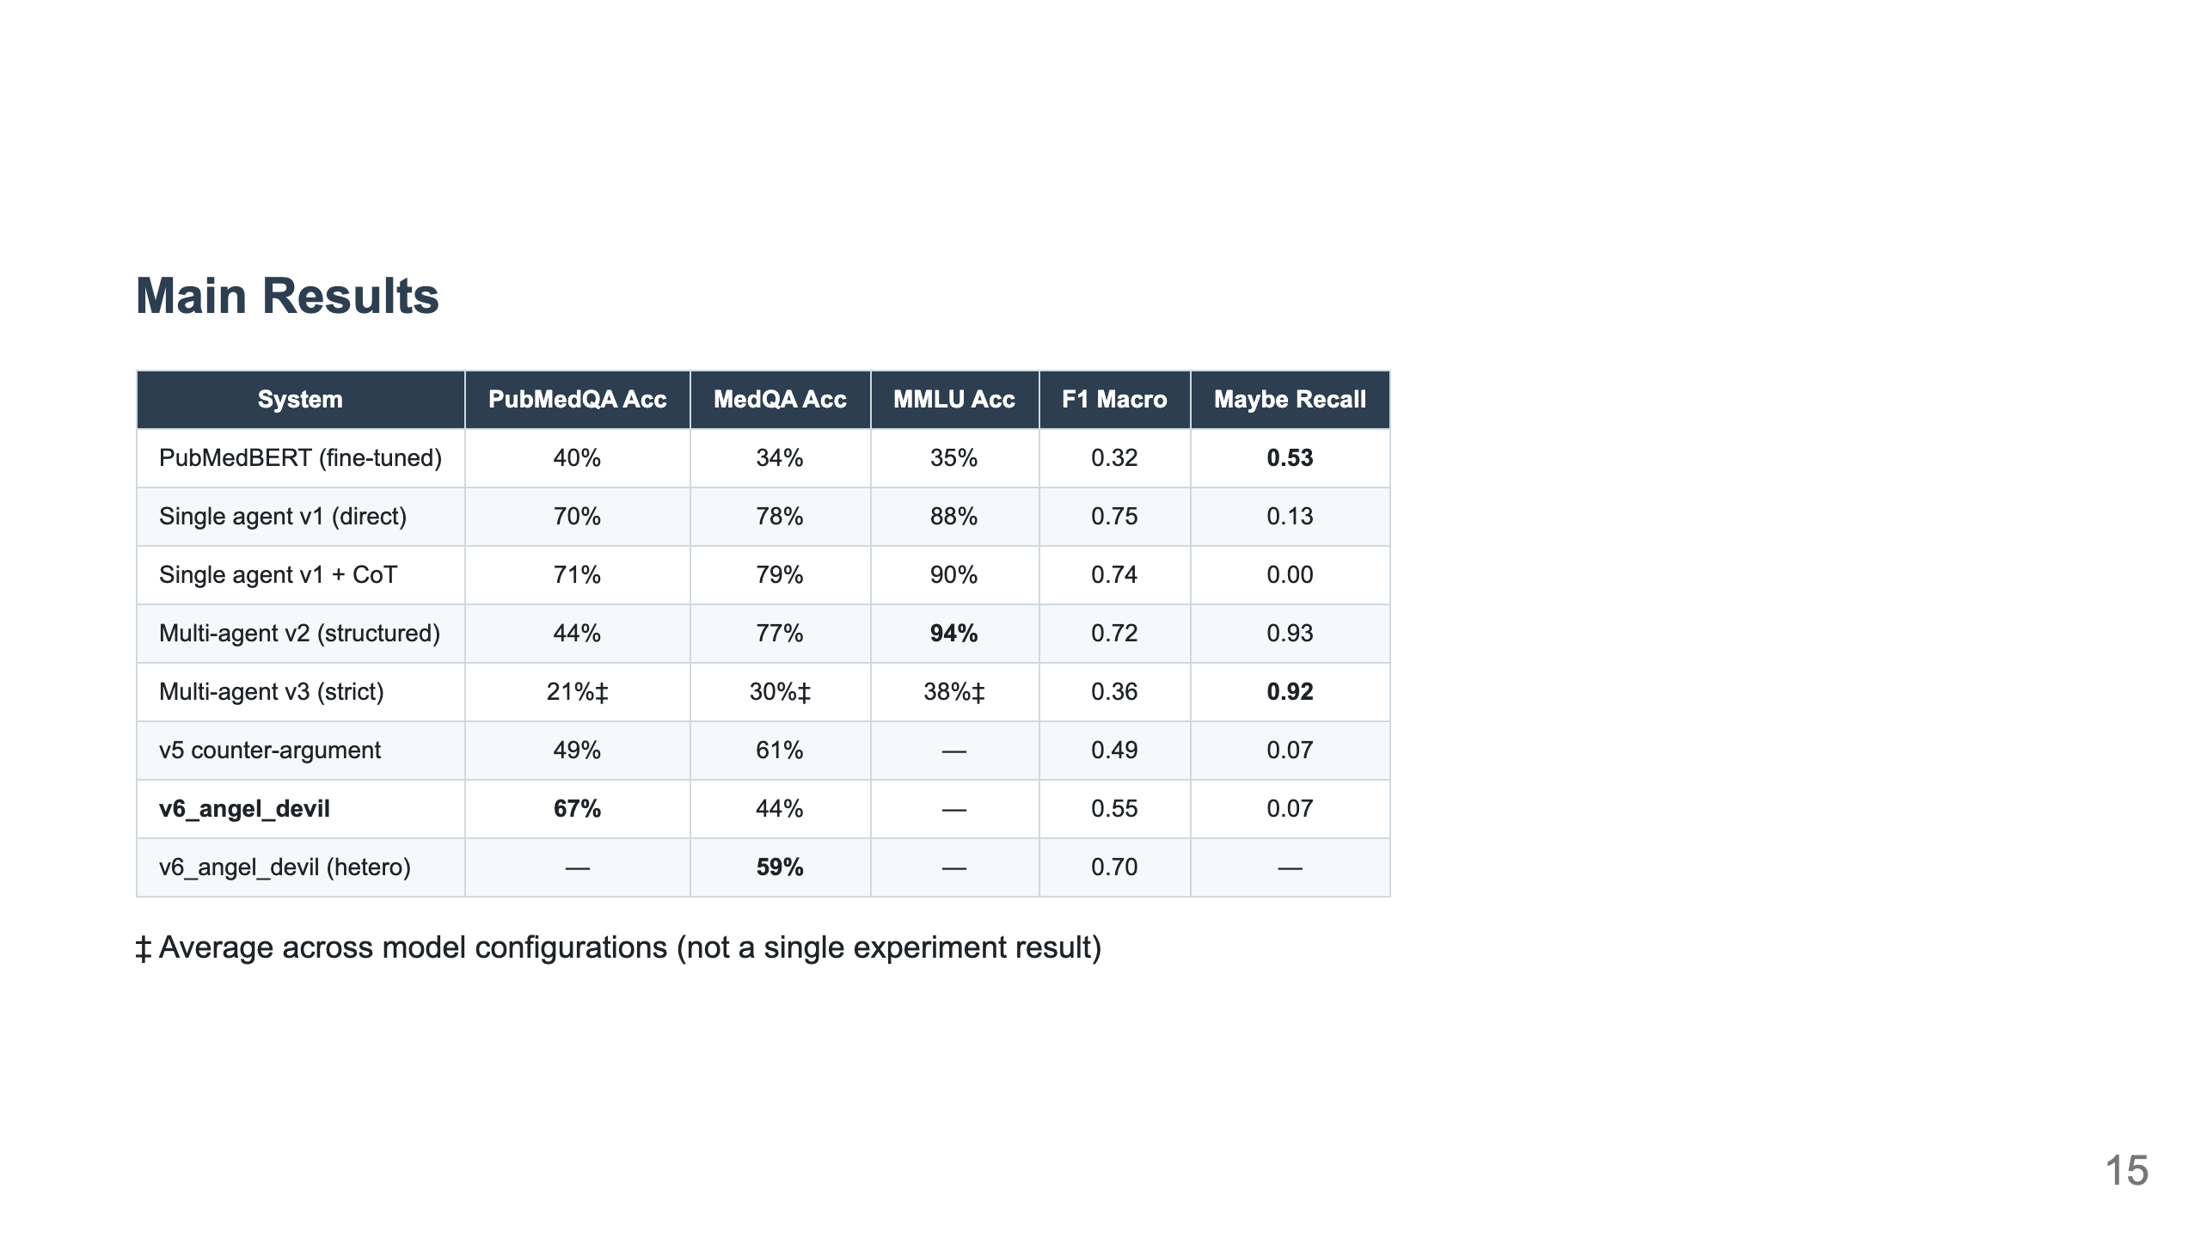
Notes:
Slide 9: Main Results Table

Slide 16
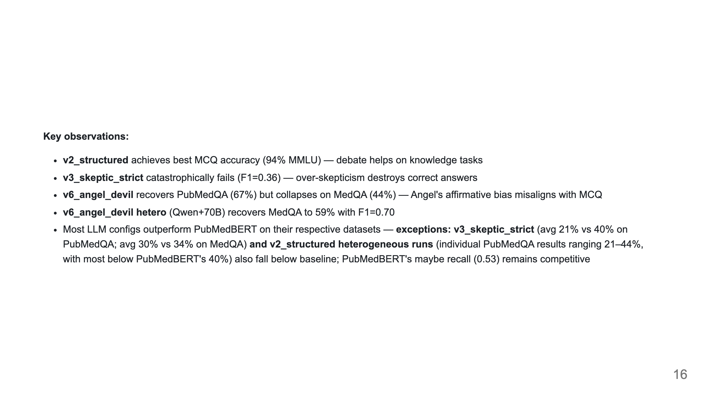

Slide 17
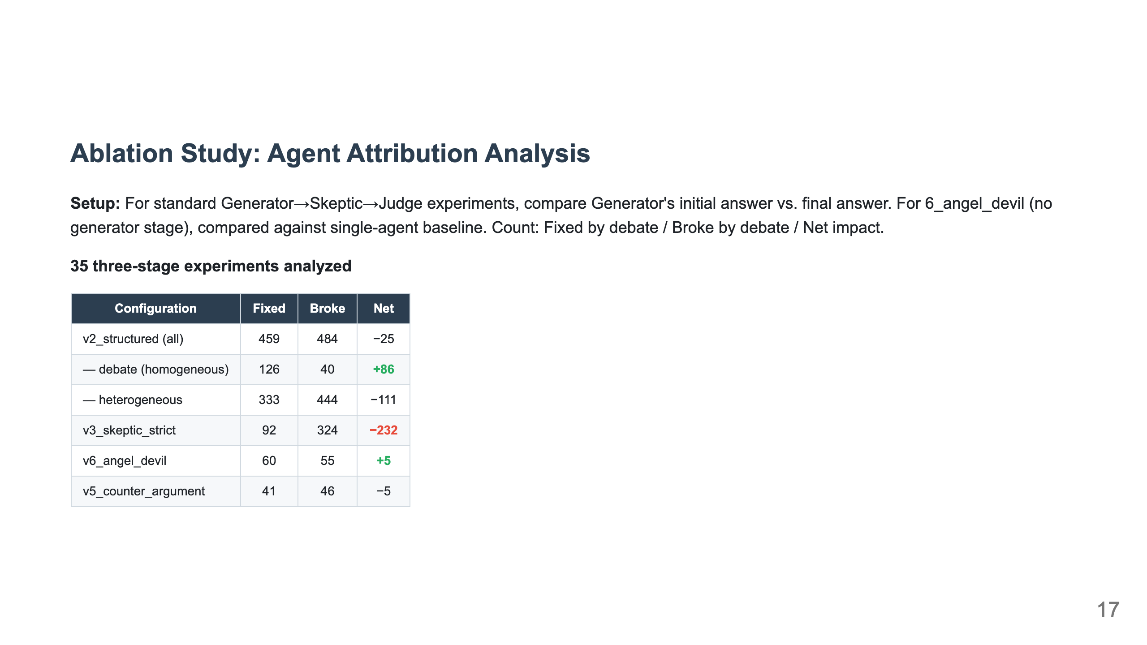
Notes:
Slide 10: Ablation Study & Agent Attribution

Slide 18
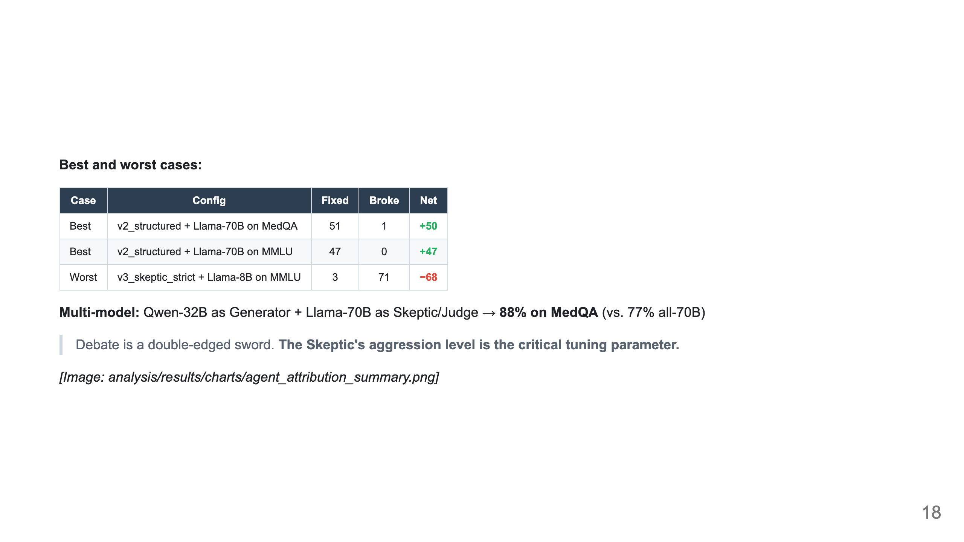

Slide 19
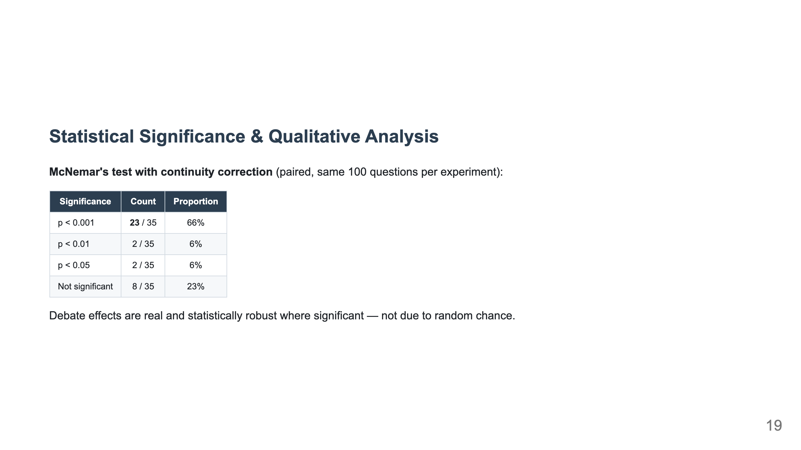
Notes:
Slide 11: Statistical Significance & Qualitative Analysis

Slide 20
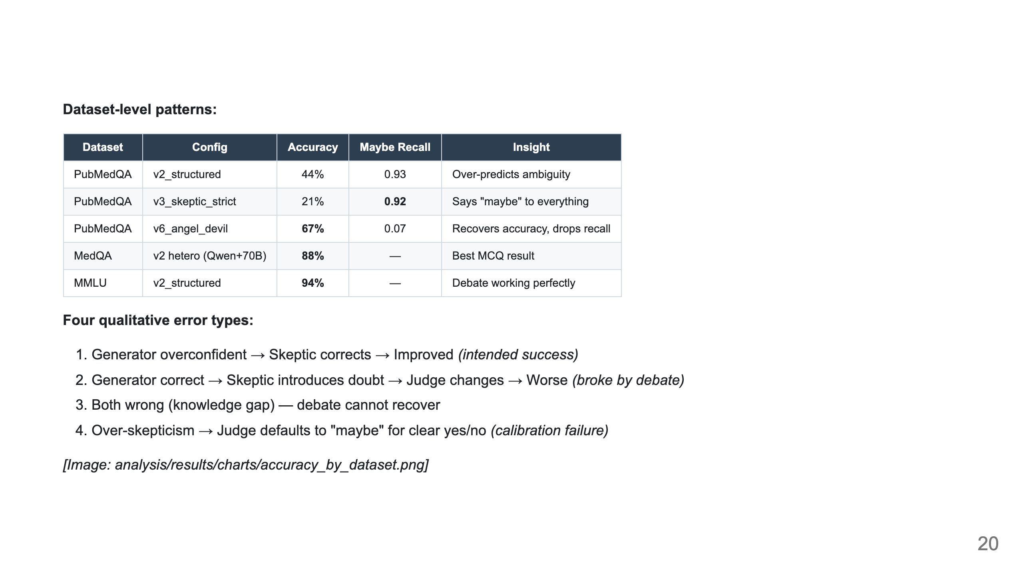

Slide 21
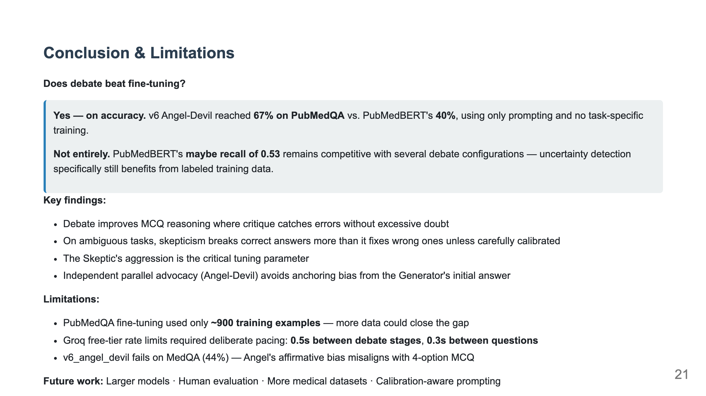
Notes:
Slide 12: Conclusion & Limitations

