Slide 1

Securing Transactions: A Mobile-Centric Approach to Credit Card Fraud Prevention
DEPARTMENT OF COMPUTER SCIENCE AND ENGINEERING
Team Members
Project Mentor
xxxxxxxxxxxxxxxxxx
Asst. Professor / CSE
SRM TRP Engineering College.
Nithishna S (814720104031)
Yogesh M S (814720104059)
Rachel Freeda A (814720104036)
Megas C (814720104701)

Slide 2
OBJECTIVE
Creating a robust real-time credit card fraud detection system with mobile-centric alerts, we establish secure communication channels, enabling timely user alerts and empowering quick responses to potential fraudulent transactions, fostering heightened awareness and engagement in financial security.

Slide 3
ABSTRACT
As digital transactions become increasingly prevalent, the risk of credit card fraud looms larger than ever. This project is to avoid the such fraudelent transaction of the victim’s credit card and push the notification to the victim instantly after any suspecious transactions occurs.

Slide 4
DOMAIN & SUBDOMAIN
Deep Learning
Deep learning is a subset of machine learning that involves neural networks with multiple layers (deep neural networks).
Machine Learning (ML)
Machine learning is the study of computer algorithms that can improve automatically through experience and by use of data.

Slide 5
SPECIALIZATION
Realtime suspicious Transaction alert.
Implementation of secure communication channels between credit card systems and mobile devices.
Utilizing advanced algorithms and previous Transactions datasets for immediate monitoring and prevention of suspicious credit card transactions.

Slide 6
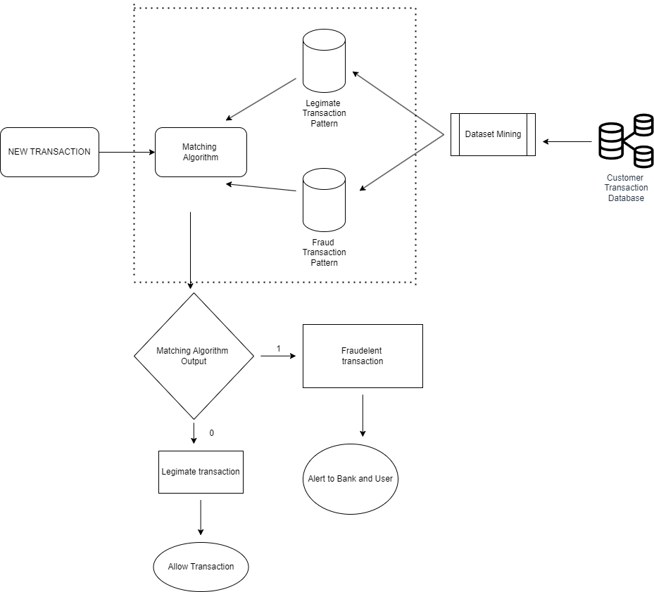
ER-Diagram

Slide 7
Thank You

