Slide 1

Leveraging credit card fictitious detection
DEPARTMENT OF COMPUTER SCIENCE AND ENGINEERING
Team Members
Project Mentor
Nithishna S (814720104031)
Rachel Freeda A (814720104036)
Yogesh M S (814720104059)
Megas C (814720104701)

Slide 2
OBJECTIVE
Creating a robust real-time credit card fraud detection system with mobile-centric alerts, we establish secure communication channels, enabling timely user alerts and empowering quick responses to potential fraudulent transactions, fostering heightened awareness and engagement in financial security.

Slide 3
DOMAIN & SUBDOMAIN
Deep Learning
Deep learning is a subset of machine learning that involves Regression to classify the data sets .
Data Analytics
Real-time analysis of transaction data to identify anomalies and suspicious patterns.
Historical data analysis to understand user behavior and transaction patterns.

Slide 4
ABSTRACT
As digital transactions become increasingly prevalent, the risk of credit card fraud looms larger than ever. The project is to avoid the such fraudelent transaction of the victim’s credit card and push the notification to the victim instantly after any suspecious transactions occurs.

Slide 5
SPECIALIZATION
Fraudulent transaction detection
Fraudulent transaction detection to Detect Suspecious Credit card transaction with the help of previous transactions data sets. (Matching Algorithm)
Multi-factor authentication
A multi-step account login process that requires users to enter more information than just a password.
Prometheus Alert Manager
The Alertmanager handles alerts sent by client applications such as the Prometheus server. It takes care of deduplicating, grouping, and routing them to the correct receiver integration such as email, PagerDuty, or OpsGenie.

Slide 6
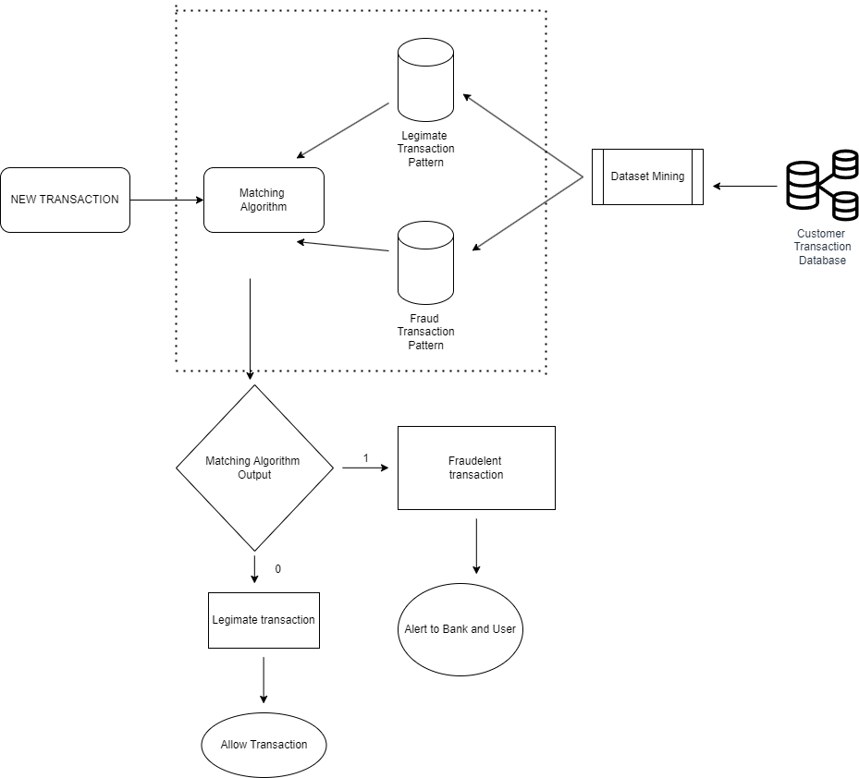
ER-Diagram

Slide 7
Thank You

