Slide 1
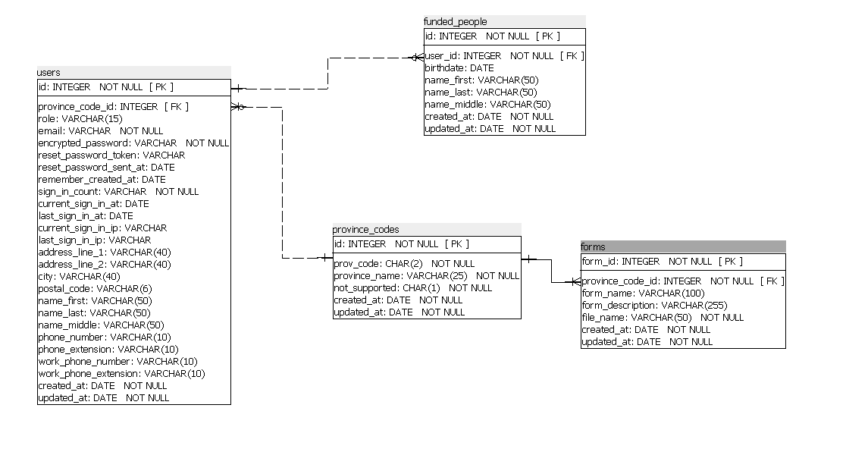
FundedPerson belongs_to :province_codes
ProvinceCode has_many :users has_many :forms
Form belongs_to :province_codes
User belongs_to :province_codes, optional: true

