Slide 1
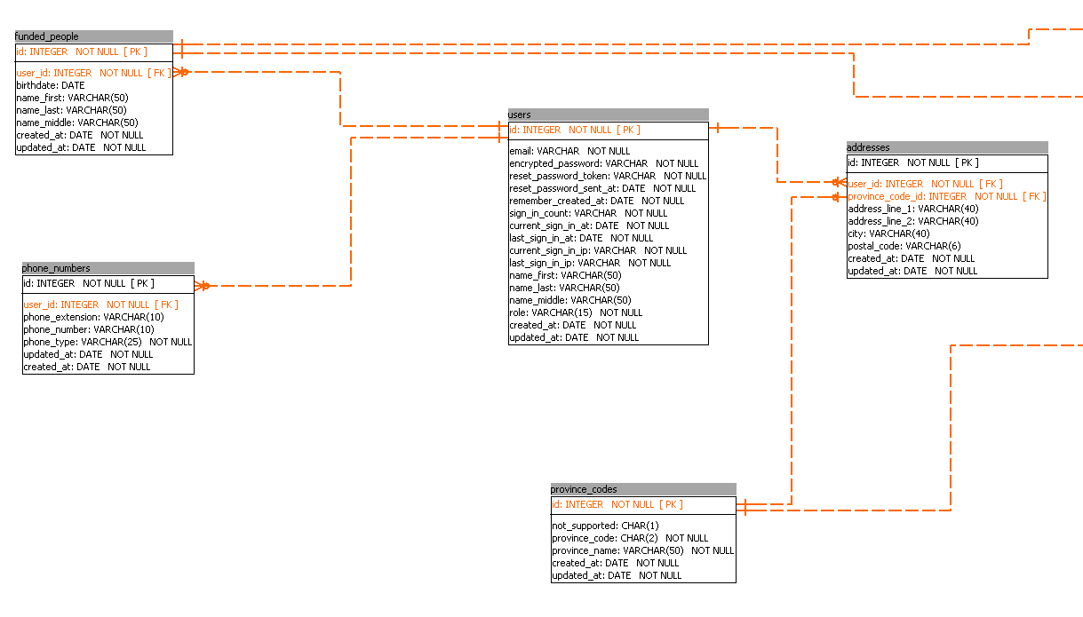
(invoices)
(cf0925s)
FundedPerson belongs_to :user
has_many :cf0925
has_many :inovices
Address belongs_to :province_code belongs_to :user
User has_many :addresses has_many :phone_numers has_many :funded_people
(forms)
PhoneNumber belongs_to :user
ProvinceCode has_many :addresses has_many :forms

Slide 2
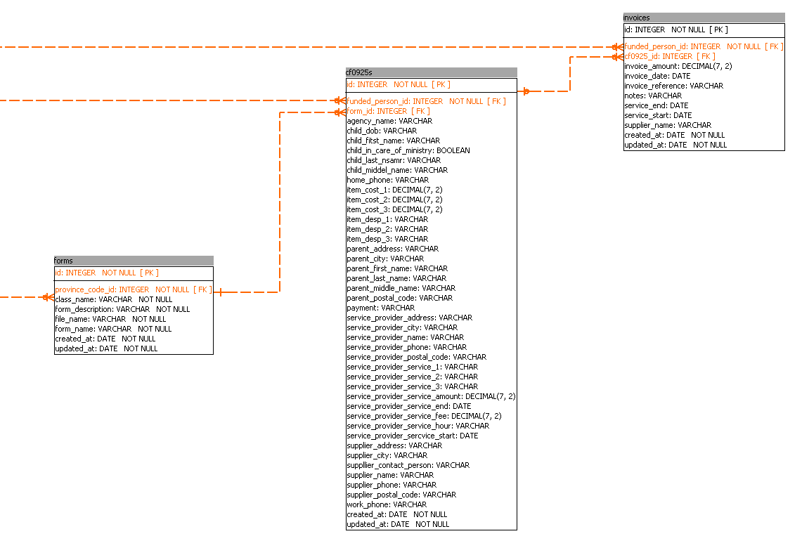
(funded_people)
(funded_people)
Invoice_from varchar
Invoice
belongs_to :funded_person
belongs_to :cf0925, optional: true
Cf0925s_invoices
(province_codes)
Cf0925s_id
Invoices_id
Amount
Form
has_many :cf0925s belongs_to :province_code
Cf0925
has_many :invoices belongs_to :funded_person
belongs_to :form

