Slide 1
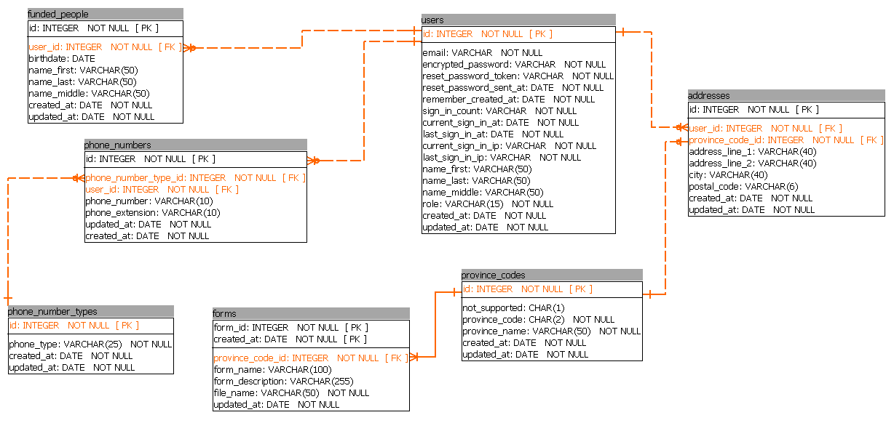
User has_many :addresses has_many :phone_numers has_many :funded_people
FundedPerson belongs_to user
Address belongs_to :province_code belongs_to :user
PhoneNumber belongs_to :phone_number_type belongs_to :user
ProvinceCode has_many :addresses has_many :forms
PhoneNumberType has_many :phone_numbers
Form belongs_to :province_code

