Slide 1
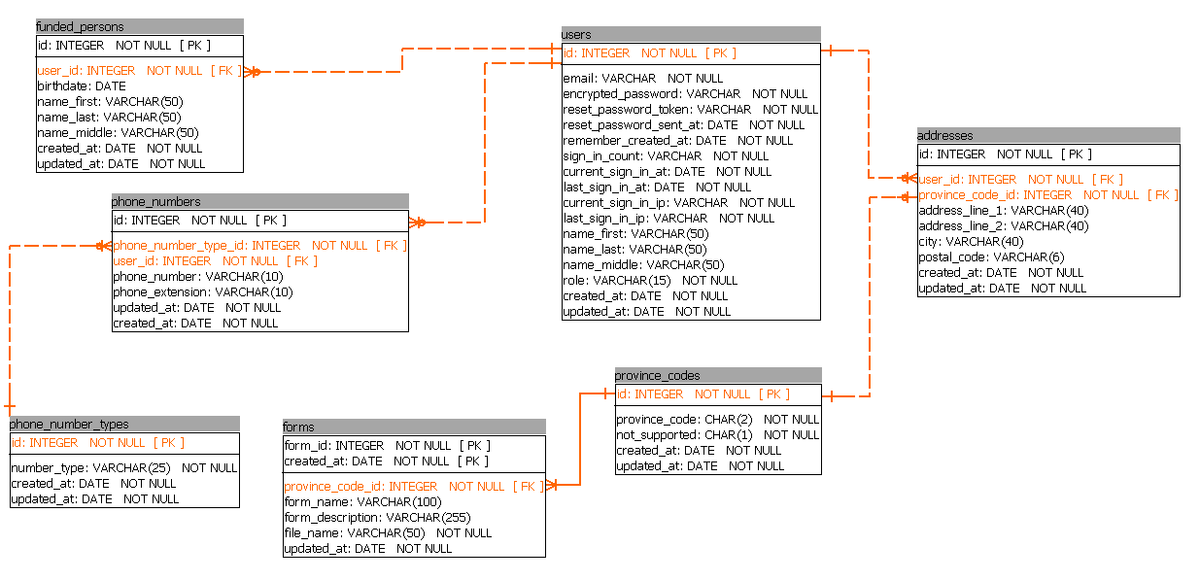
User has_many :addresses has_many :phone_numers has_many :fnded_peaople
FundedPerson belongs_to :province_codes
Address belongs_to :province_codes belongs_to :users
PhoneNumber belongs_to :phone_number_types belongs_to :users
ProvinceCode has_many :addresses has_many :forms
PhoneNumberType has_many :phone_numbers
Form belongs_to :province_codes

