Slide 1
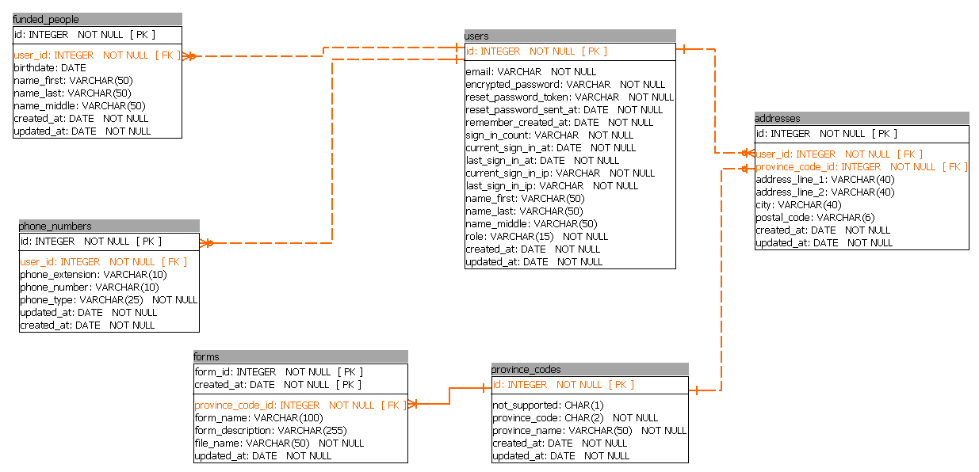
FundedPerson belongs_to user
User has_many :addresses has_many :phone_numers has_many :funded_people
Address belongs_to :province_code belongs_to :user
PhoneNumber belongs_to :user
Form belongs_to :province_code
ProvinceCode has_many :addresses has_many :forms

