Slide 1

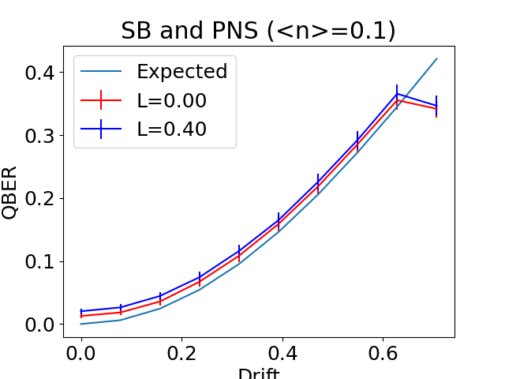
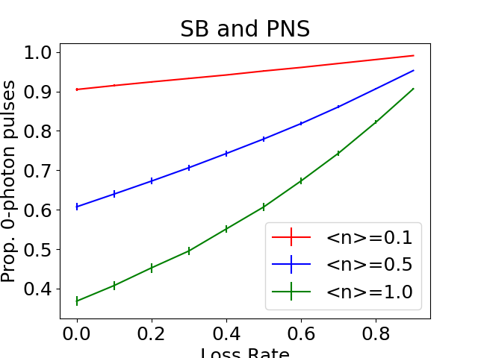

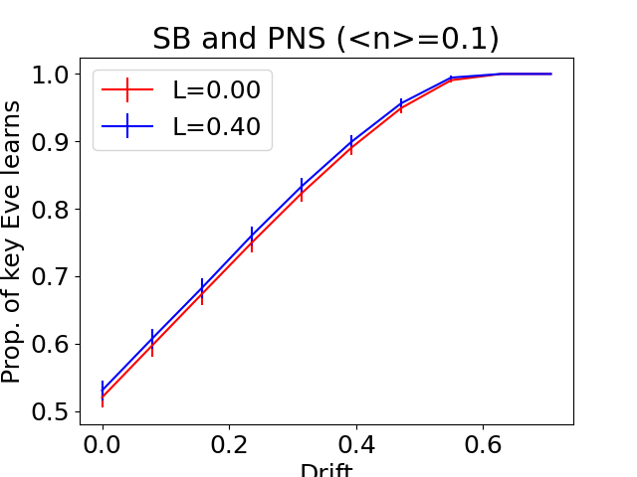
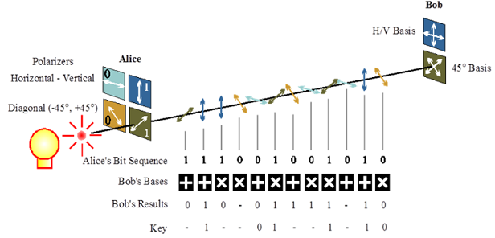
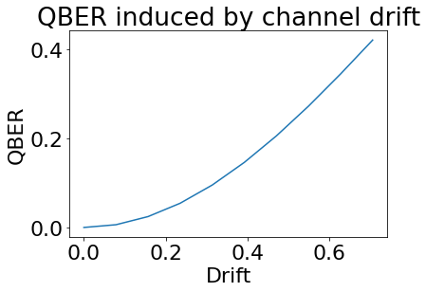
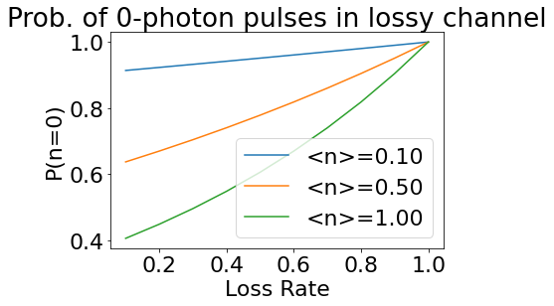
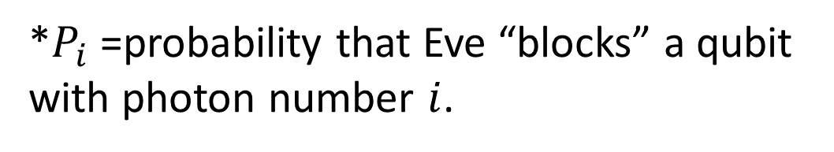
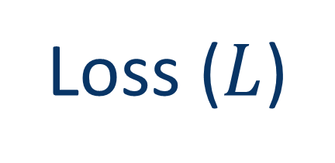
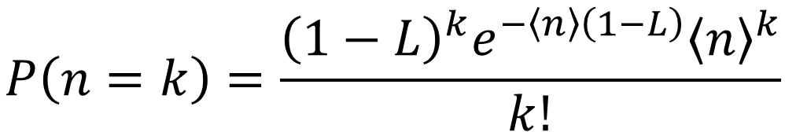
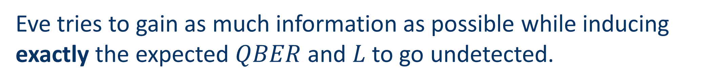
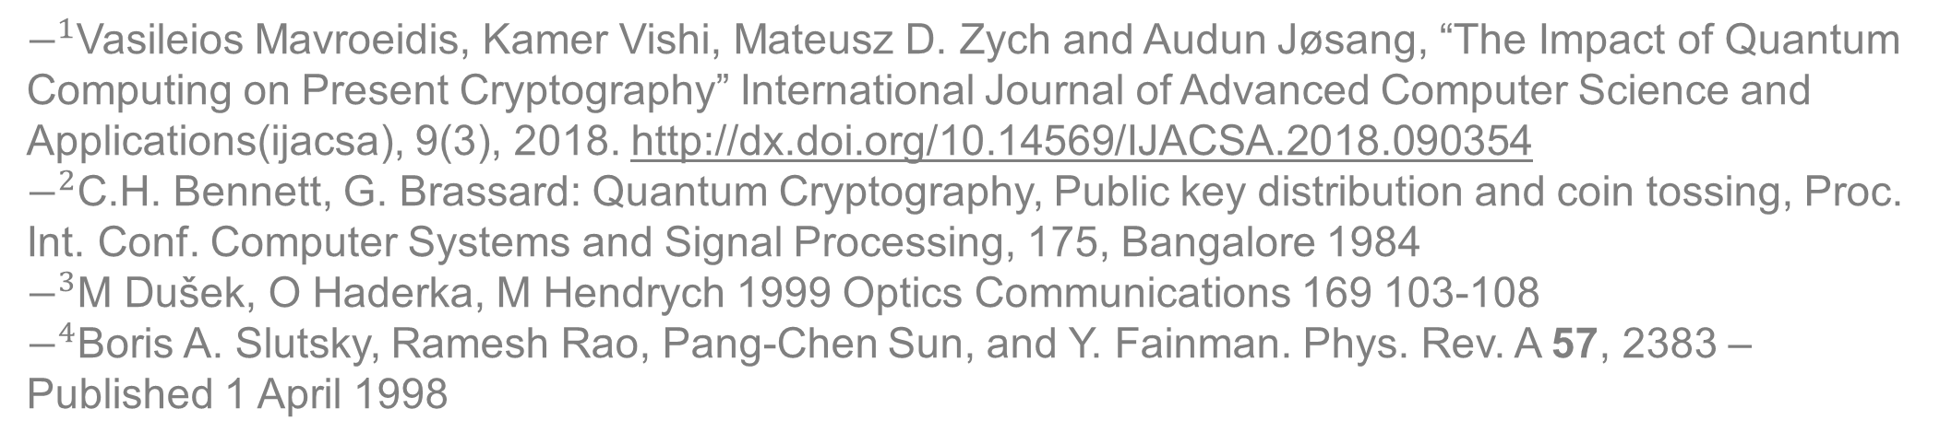
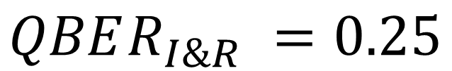
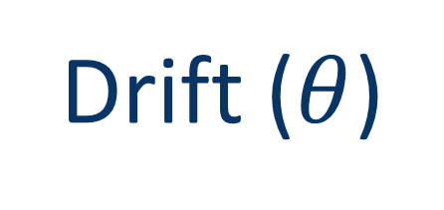
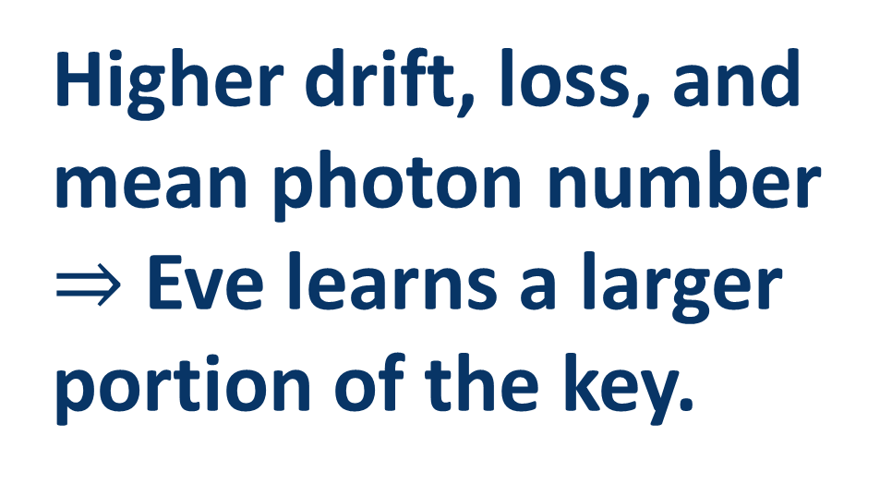
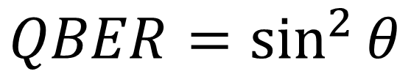
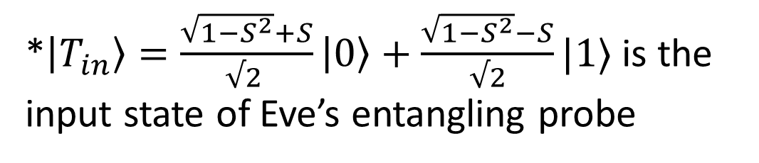
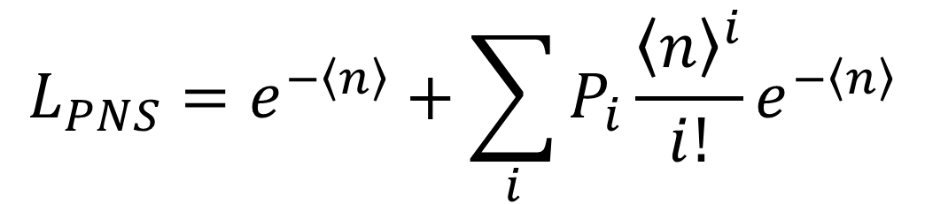




Quantum Hacking:
Computer-Simulated Attacks against the BB84 Protocol
Leo Crowder, Inès Montaño
Applied Physics and Materials Science, Northern Arizona University
Introduction
Methods
Results
The Importance of Quantum Key Distribution
Attacks
Common encryption protocols are vulnerable to quantum computers! (Shor’s Algorithm)
Intercept and Resend (I&R)
A
B
D:<
Classical Computer
$$|ψ⟩$$
Quantum Computer
E
>:)
Photon-Number Splitting (PNS)
]:
D:
A
PNR
B
:]
:D
Attack-induced errors closely match expected channel errors
Curves match expected loss
Error-free BB84 and other QKD protocols are secure against attacks made possible by quantum computers.
E
E
Attack-induced errors begin to deviate from expected channel errors
What is BB84?
Slutsky-Brandt (SB)
Generate a cryptographic key using polarized quantum particles of light (photons).
Eavesdropper’s (Eve) attempts to learn the key will induce detectable errors
A
RY
RY
B
Higher drift, loss, and mean photon number $⇒$ Eve learns a larger portion of the key.
E
E
50%
Strategy
50%
Eve tries to gain as much information as possible while inducing exactly the expected $QBER$ and $L$ to go undetected.
Conclusion
Channel-induced Errors
$$=$$
Attack-induced Errors
Greater errors generally allow Eve to acquire more information.
Eve’s strategy needs refinement:
Her induced error closely (but not exactly) matches expected error.
Quickly diverges beyond $θ≈0.6$
The security of BB84 is highly dependent on the technology used to implement the protocol.
Imperfect implementation of BB84 must be supplemented with procedures to prevent or detect potential eavesdropping.
$$QBER=\sin^{2}{θ}$$
$$QBER_{I\&R} =0.25$$
$$QBER_{SB} =\frac{S^{2}}{2}$$
*$\left|T_{in}\right\rangle =\frac{\sqrt{1−S^{2}}+S}{√2 }\left|0\right\rangle +\frac{\sqrt{1−S^{2}}−S}{√2}|1⟩$ is the input state of Eve’s entangling probe
Figure 1: BB84 implementation using polarized photons
References
The Problem
$$P\left(n=k\right)=\frac{{\left(1−L\right)}^{k}e^{−\left\langle n\right\rangle \left(1−L\right)}{\left\langle n\right\rangle }^{k}}{k!}$$
$−^{1}$Vasileios Mavroeidis, Kamer Vishi, Mateusz D. Zych and Audun Jøsang, “The Impact of Quantum Computing on Present Cryptography” International Journal of Advanced Computer Science and Applications(ijacsa), 9(3), 2018. http://dx.doi.org/10.14569/IJACSA.2018.090354
$−^{2}$C.H. Bennett, G. Brassard: Quantum Cryptography, Public key distribution and coin tossing, Proc. Int. Conf. Computer Systems and Signal Processing, 175, Bangalore 1984
$−^{3}$M Dušek, O Haderka, M Hendrych 1999 Optics Communications 169 103-108
$−^{4}$Boris A. Slutsky, Ramesh Rao, Pang-Chen Sun, and Y. Fainman. Phys. Rev. A 57, 2383 – Published 1 April 1998
Practical implementation is prone to natural errors which can be exploited by Eve to gain information about the key.
$$L_{PNS}=e^{−\left\langle n\right\rangle }+\sum_{i}{P_{i}\frac{{\left\langle n\right\rangle }^{i}}{i!}e^{−\left\langle n\right\rangle }}$$
Drift ($θ$)
Acknowledgements
?
Loss ($L$)
*$P_{i}$ =probability that Eve “blocks” a qubit with photon number $i$.
This project would not be possible without funding and support through the Hooper Undergraduate Research Award.

