Slide 1
TLS

Slide 2
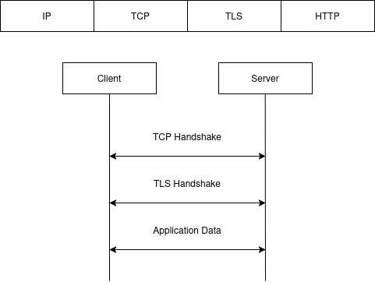
TLS - What it is
TLS - Transport Layer Security is a transport layer protocol used to secure communications
It usually comes as an additional layer between TCP and HTTP/application layer protocol
It doesn’t handle packet loss and packet ordering so it can’t be used directly over UDP. It has a different flavor named DTLS(Datagram TLS) for this.
Its key functions are: Encryption, Authentication and Integrity
It puts the S in HTTPS, FTPS etc

Slide 3
TLS - Cryptography concepts
Symmetric cryptography
Uses the same key for encryption and decryption
In a communication context, both peers should know the key used for encryption
The key is a secret so it should be shared in a secure fashion using a key exchange mechanism like Diffie Hellman
The key is shorter than the ones used for asymmetric encryption, usually 256 bits and the encryption/decryption operations are faster
Common usage: data encryption
Popular algorithms: AES, ChaCha20, TwoFish, BlowFish, DES, 3DES, RC4/5/6
Asymmetric cryptography
Has two keys, usually referred as public and private keys
What is encrypted using public key can be decrypted using the private key and vice versa
As the name suggests the private key should be kept private and never shared. Just the public key should be shared
The keys are longer than the ones used for symmetric encryption and the encryption/decryption operations are slower
Common usage: digital signatures
Popular algorithms: RSA, ECDSA, EDDSA

Slide 4
TLS - Cryptography concepts
Hashes
One way process that converts any data of any length into a fixed length hash
Common usage: data integrity, digital signatures, password security, hashtables
Popular algorithms: SHA, BLAKE, MD5
MAC - Message authentication code
Similar to hashes but combined with a secret key
They take in data and a key and returns a fixed length MAC tag
Key functions: data integrity - detects if data has been changed, authentication - confirms that the data are coming from a known source
Popular algorithms: HMAC-SHA256, Poly1305
HKDF - HMAC key derivation functions
Is a standard cryptographic function that securely derives one or more stronger keys from the a initial one
Uses HMAC algorithm in an "extract-then-expand" process, creating keys for encryption or authentication
AEAD - Authenticated encryption with associated data
Combines an encryption algorithm with a MAC algorithm to provide both encryption and integrity check

Slide 5
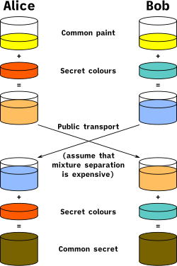
TLS - Cryptography concepts
Diffie Hellman key exchange algorithm
Allows two parties to secretly establish a shared secret key over an insecure channel
It is used in the TLS protocol to establish the shared secret key between the peers
The original algorithm used the discrete logarithm problem and modular exponentiation, but it evolved into using elliptic curves
You will see it as DH (Diffie-Hellman), DHE(Diffie-Hellman ephemeral) and ECDHD(Elliptic curve Diffie-Hellman ephemeral)
It provides forward secrecy. Perfect Forward Secrecy is the property in the cryptography that prevents the exposure of long-term secret keys from compromising the past or future communication
By its own it’s vulnerable to man in the middle attacks

Slide 6
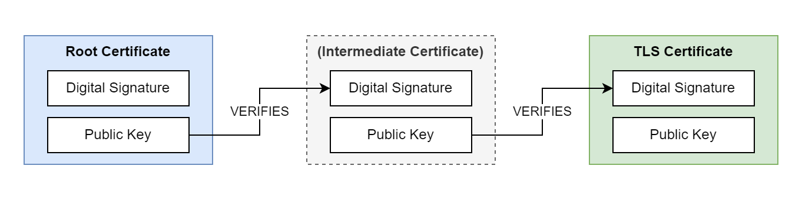
TLS - Cryptography concepts
PKI - Private key infrastructure and The Chain of Trust
It‘s a hierarchical sequence of certificates where each one is signed by the authority above it. Starting from the leaf certificate up to the root certificate (Trust anchor)
The root certificate is self-signed and guarded by a Certificate Authority
This system provides authentication to the TLS protocol and ensures that the data has not been tampered by a man-in-the-middle

Slide 7
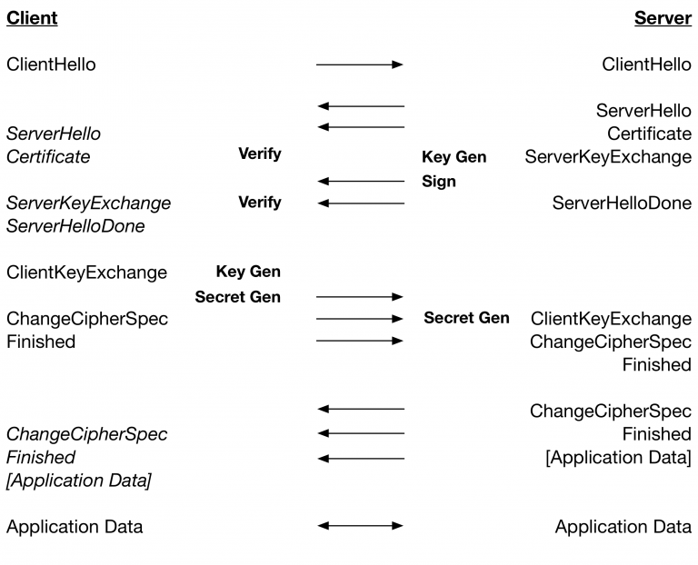
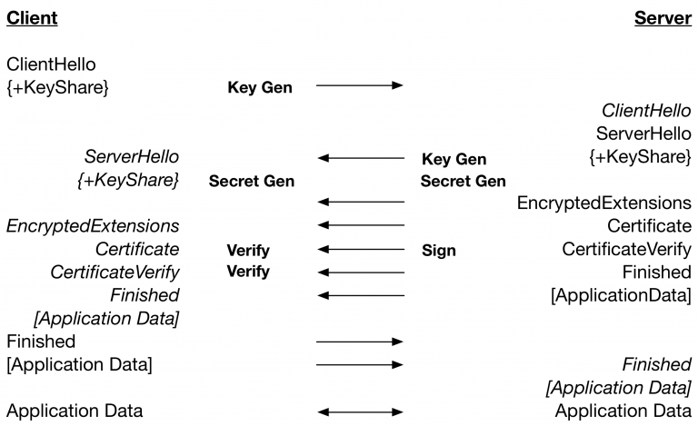
TLS - Handshake 1.2 and 1.3

Slide 8
TLS - Handshake messages 1.3
Client Hello
Supported TLS versions - Ex: TLS1.3
Cipher suites - Ex: TLS_AES_256_GCM_SHA256
Key share - an ECDHE public key
Supported groups - Ex: X25519
Signature algorithms
SNI - server name indication
ALPN - application layer protocol - Ex: h2, http/1.1
PSK / 0-RTT info
Server Hello
Chosen TLS version
Chosen cipher suite
Server’s key share
Encrypted Extensions
ALPN selection
Other extensions not needed for the key share process
Certificate
The server’s certificate chain
Certificate Verify
The proof of possession of the private key
It’s a signature over the handshake transcript
Finished
Prove handshake integrity
Contains a MAC over the entire handshake transcript

Slide 9
References
Diffie-Hellman
https://datatracker.ietf.org/doc/html/rfc8446
https://www.geeksforgeeks.org/computer-networks/diffie-hellman-key-exchange-and-perfect-forward-secrecy/
https://www.youtube.com/@Computerphile
https://tls13.xargs.org/
https://x25519.xargs.org/
https://curves.xargs.org/

