Slide 1
Convolutional Neural Networks

Slide 2

Predict the sentiment (positive, negative, or neutral) of sentences
• Part of the charm of Mickey Mouse is that it avoids the obvious with humor and lightness.
• Still, this flick is fun and host to some truly excellent sequences.

Slide 3
Order matters!
CBOW/SkipGram ignores the ordering information completely and will give same sentiment to both the following sentences:
it was not good, it was actually quite bad
It was not bad, it was actually quite good
The local ordering of the words (that the word “not” appears right before the word “bad”) is very important

Slide 4
Solution 1: n-gram embedding
Embed word-pairs (bi-grams) or word-triplets (trigrams) rather than words, and building a CBOW over the embedded n-grams
Problems:
It will result huge embedding matrices
It will not scale for longer n-grams
It will suffer from data sparsity problems as it does not share statistical strength between different n-grams (“quite good” vs. “very good”)

Slide 5
Solution 2: CNN
BASIC CONVOLUTION + POOLING
Apply a nonlinear (learned) function over each instantiation of a k-word sliding window over the sentence
Nonlinear function/filter/kernel transforms a window of k words into a scalar value
Several such filters can be applied, resulting in l dimensional vector
Focus on the most important “features” in the sentence, regardless of their location
each filter extracts a different indicator from the window, and the pooling operation zooms in on the important indicators

Slide 6
1D Convolutions over Text
Lets discuss on whiteboard

Slide 7
Narrow vs. Wide Convolutions
How many vectors p_{i} do we have?
For a sentence of length n with a window of size k, there are n-k+1 positions in which to start the sequence, and we get n-k+1 vectors p_{1:n-k+1}. This is called a narrow convolution.
An alternative is to pad the sentence with k-1 padding-words to each side, resulting in n+k-1 vectors p_{1:n+k-1}. This is called a wide convolution

Slide 8
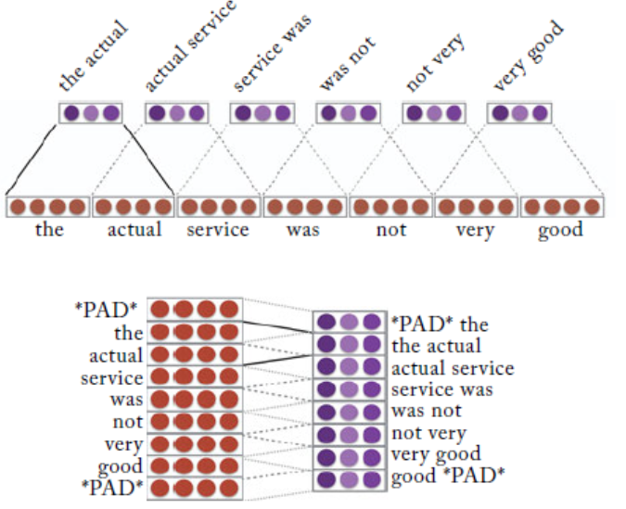
An Alternative Formulation of Convolutions

Slide 9
Vector Pooling
Applying the convolution over the text results in m vectors p_{1:m}. These vectors are then combined (pooled) into a single vector c, representing the entire sequence.
During training, the vector c is fed into downstream network layers (i.e., an MLP), culminating in an output layer which is used for prediction.

Slide 10
Vector Pooling
The most common pooling operation is max pooling, taking the maximum value across each dimension.

Slide 11
Vector Pooling
Average pooling:
K-max pooling: the top k values in each dimension are retained instead of only the best one, while preserving the order in which they appeared in the text
2-max pooling
Concatenate
Dynamic Pooling: Split the vectors into r distinct groups and apply pooling on each group separately

Slide 12
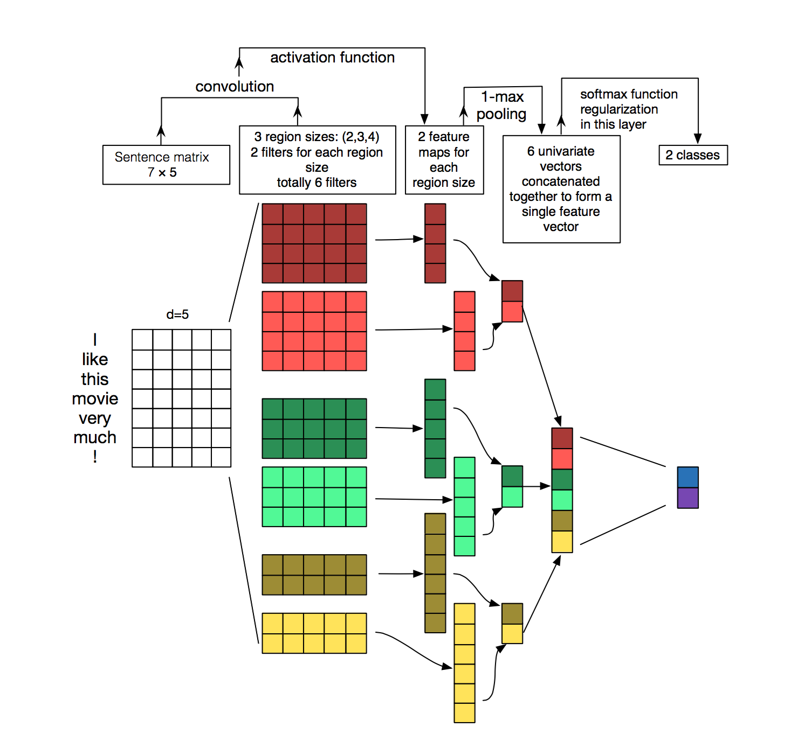
Variations
We may have four different convolutional layers, each with a different window size in the range 2–5, capturing k-gram sequences of varying lengths
Image Reference : http://www.wildml.com/2015/11/understanding-convolutional-neural-networks-for-nlp/

Slide 13
Hierarchical Convolutions

Slide 14
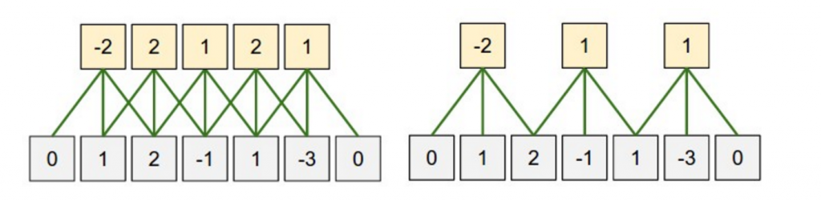
Strides
how much you want to shift your filter at each step.
A larger stride size leads to fewer applications of the filter and a smaller output size.
Strides. (a–c) Convolution layer with k=3 and stride sizes 1, 2, 3.
Convolution Stride Size. Left: Stride size 1. Right: Stride size 2. Source: http://cs231n.github.io/convolutional-networks/

Slide 15
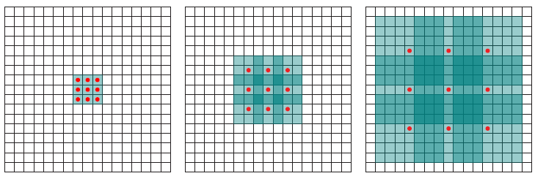
Dilation
Standard Convolution (l=1)
Dilated Convolution (l=2)
In a dilated convolution architecture, the hierarchy of convolution layers each has a stride of k-1.
This allows an exponential growth in the effective window size as a function of the number of layers.
l=1 (left), l=2 (Middle), l=4 (Right)
https://towardsdatascience.com/review-dilated-convolution-semantic-segmentation-9d5a5bd768f5

Slide 16
Channel
Channels are different “views” of your input data.
For example, in image recognition you typically have RGB (red, green, blue) channels. You can apply convolutions across channels, either with different or equal weights.
In NLP you could imagine having various channels as well: You could have a separate channels for different word embeddings (e.g., word2vec and GloVe), or you could have a channel for the same sentence represented in different languages, or phrased in different ways.
http://www.wildml.com/2015/11/understanding-convolutional-neural-networks-for-nlp/

Slide 17
https://stackoverflow.com/questions/54098364/understanding-channel-in-convolution-neural-network-cnn-input-shape-and-output

Slide 18
CNN for sentence classification (Kim, 2014)
Goal: Sentence classification:
Mainly positive or negative sentiment of a sentence
• Other tasks like:
Subjective or objective language sentence
Question classification: about person, location, number
EMNLP 2014. https://arxiv.org/pdf/1408.5882.pdf
Code: https://arxiv.org/pdf/1408.5882.pdf
Slide: http://web.stanford.edu/class/cs224n/

Slide 19
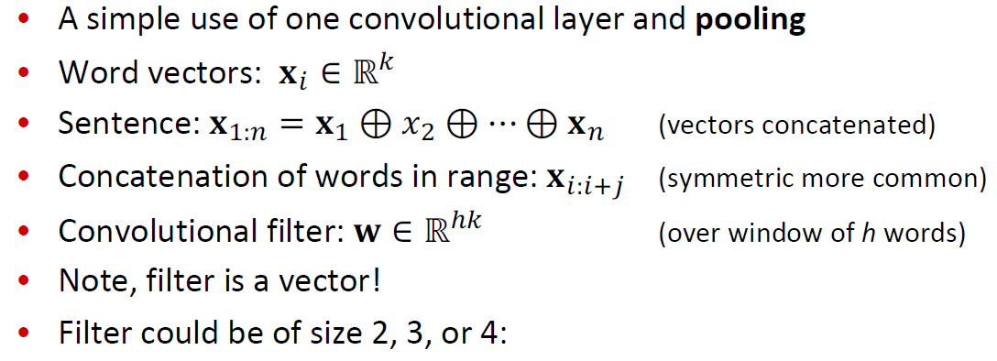
Single Layer CNN for Sentence Classification

Slide 20
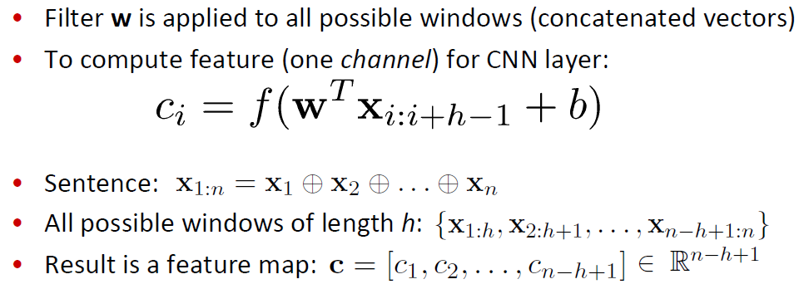
Single-Layer CNN

Slide 21
Pooling and Channels

Slide 22
Multi-channel Input

Slide 23
Classification after one CNN layer

