Slide 1

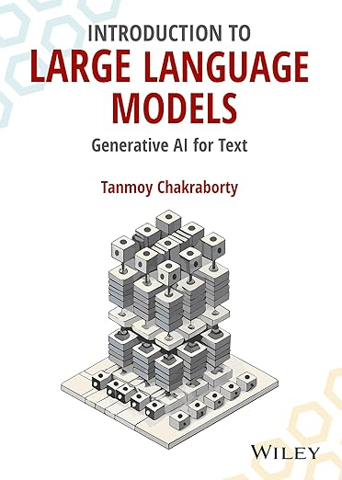
Language Models
& Neural Networks
Tanmoy Chakraborty
Associate Professor, IIT Delhi
https://tanmoychak.com/

Slide 2
Language Modeling
Language Modeling is the task of predicting what word comes next
cheese
P(cheese | I like pizza with loads of)
I like pizza with loads of ______.
corn
P(corn | I like pizza with loads of)
Previous words in the sentence
Word to be predicted
tree
P(tree | I like pizza with loads of)

Slide 3
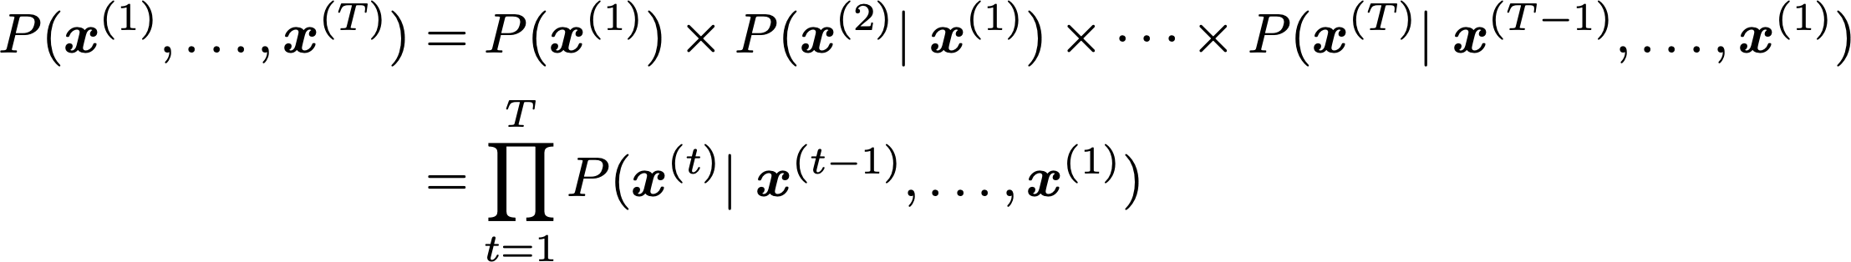
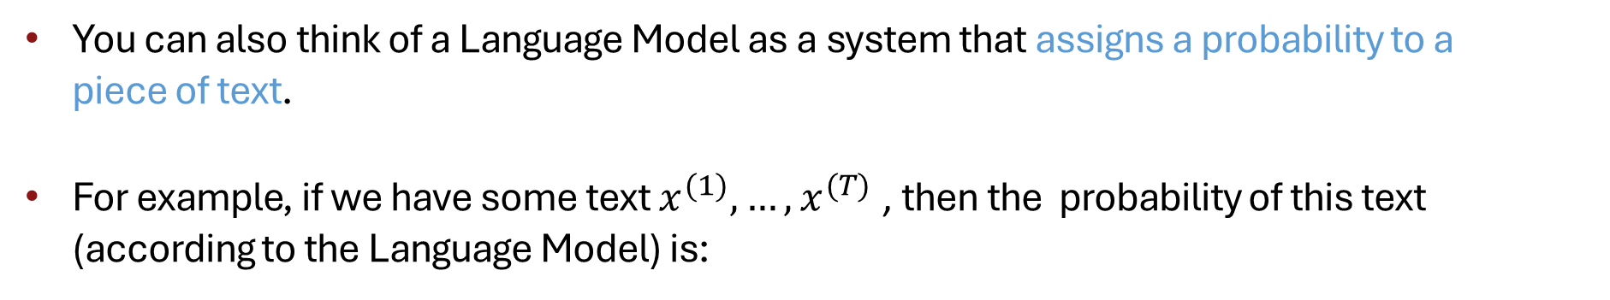
Language Modeling
You can also think of a Language Model as a system that assigns a probability to a piece of text.
For example, if we have some text $x^{(1)}, …,x^{(T)}$, then the probability of this text (according to the Language Model) is:
This is what our LM provides

Slide 4

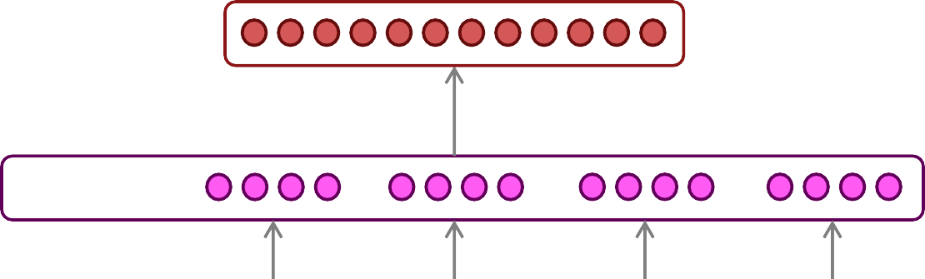
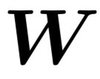




How to Build a Neural Language Model?
Recall the Language Modeling task:
Input: sequence of words $x^{(1)},x^{(2)},…,x^{(t)}$
Output: probability distribution of the next word $P\left(x^{\left(t+1\right)} | x^{\left(t\right)}, …, x^{\left(1\right)}\right)$
How about a window-based neural model?
Example: NER Task
LOCATION
museums
in
Paris
are amazing

Slide 5
A Fixed-window Neural Language Model
as
the
proctor started the
clock
the students opened
fixed window
their
discard

Slide 6

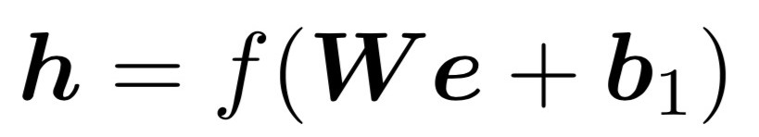






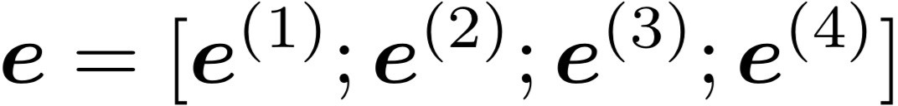
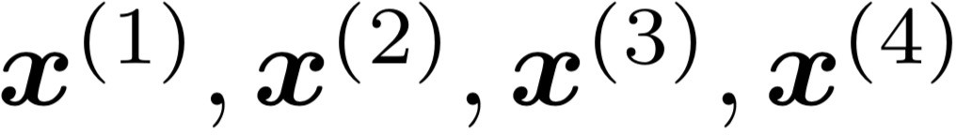
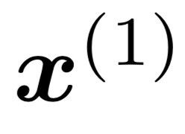
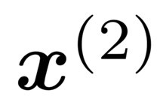
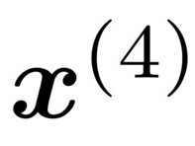
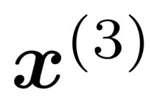
A Fixed-window Neural Language Model
books
laptops
output distribution
a
zoo
hidden layer
concatenated word embeddings
words / one-hot vectors
as
the
proctor started the
clock
the students opened
fixed window
their
discard

Slide 7
A Fixed-window Neural Language Model
books
Approximately: Y. Bengio, et al. (2000/2003): A Neural Probabilistic Language Model
Improvements over n-gram LM:
No sparsity problem
Don’t need to store all observed n-grams
laptops
We need a neural architecture that can process any length input
a
zoo
Remaining problems:
Fixed window is too small
Enlarging window enlarges 𝑊
𝑥⁽¹⁾ and 𝑥⁽²⁾ are multiplied by completely different weights in 𝑊. No symmetry in how the inputs are processed.
opened
the students
their

Slide 8
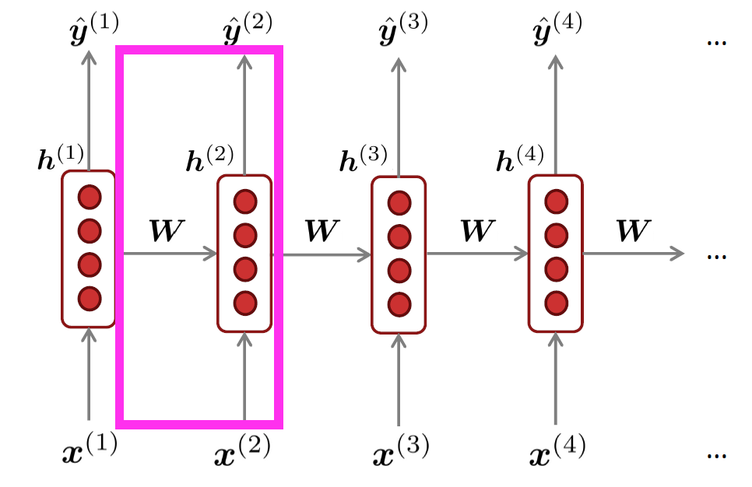
Recurrent Neural Networks (RNN)
outputs (optional)
Core idea: Apply the same weights 𝑊 repeatedly
hidden states
input sequence (any length)

Slide 9
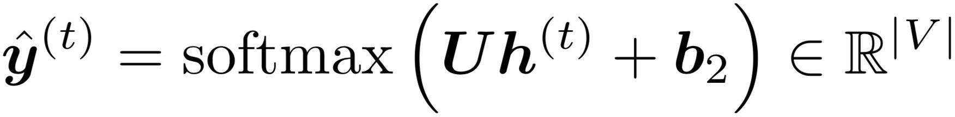



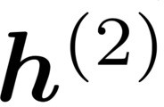
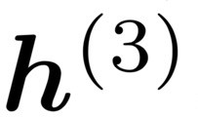
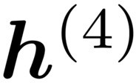




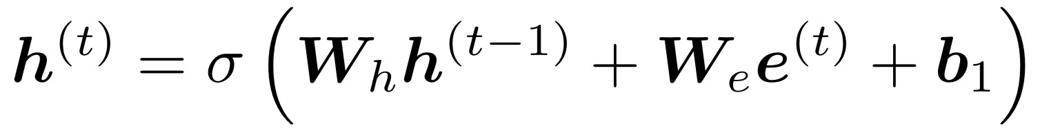






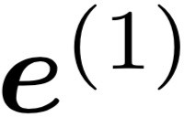
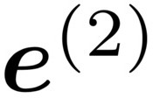
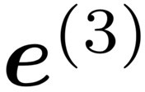
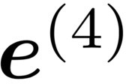


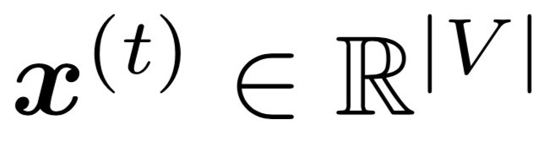
A Simple RNN Language Model
books
laptops
output distribution
a
zoo
hidden states
is the initial hidden state
word embeddings
words / one-hot vectors
the students
opened
their
Note: this input sequence could be much longer now!

Slide 10
RNN Language Models
books
laptops
RNN Advantages:
Can process any length input
Computation for step t can (in
theory) use information from many steps back
Model size doesn’t increase for longer input context
Same weights applied on every
timestep, so there is symmetry in how inputs are processed.
a
zoo
RNN Disadvantages:
Recurrent computation is slow
In practice, difficult to access information from many steps back
the students
opened
their

Slide 11
Training an RNN Language Model

Slide 12
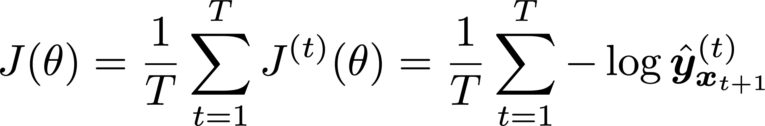
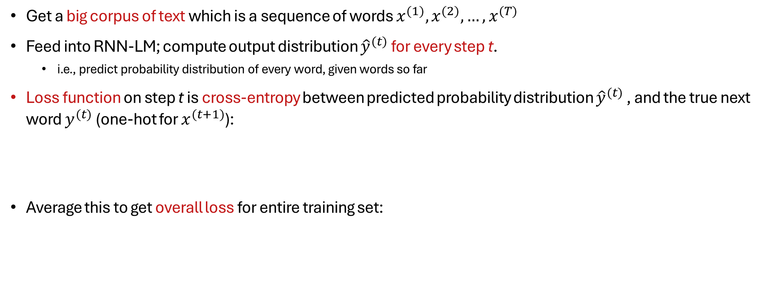
Training an RNN Language Model
Get a big corpus of text which is a sequence of words $x^{(1)},x^{(2)},…,x^{(T)}$
Feed into RNN-LM; compute output distribution ${\hat{y}}^{(t)}$ for every step t.
i.e., predict probability distribution of every word, given words so far
Loss function on step t is cross-entropy between predicted probability distribution ${\hat{y}}^{(t)}$ , and the true next word $y^{(t)}$ (one-hot for $x^{(t+1)}$):
Average this to get overall loss for entire training set:

Slide 13
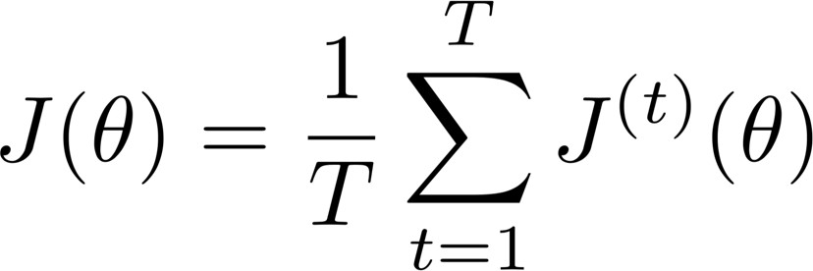
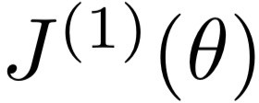
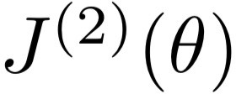
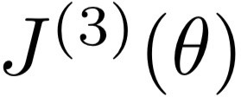
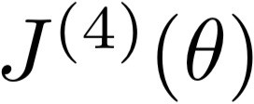
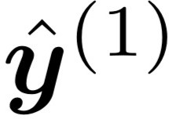
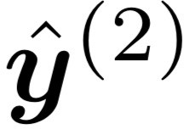
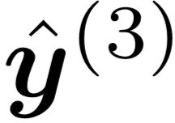
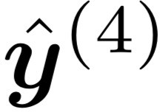



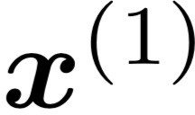
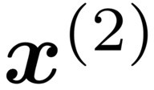
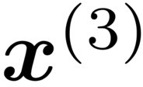
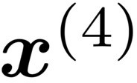
“Teacher forcing”
Loss
+
+
+
+ … =
Predicted probability distributions
…
Corpus
the
students
opened
their
exams
…

Slide 14
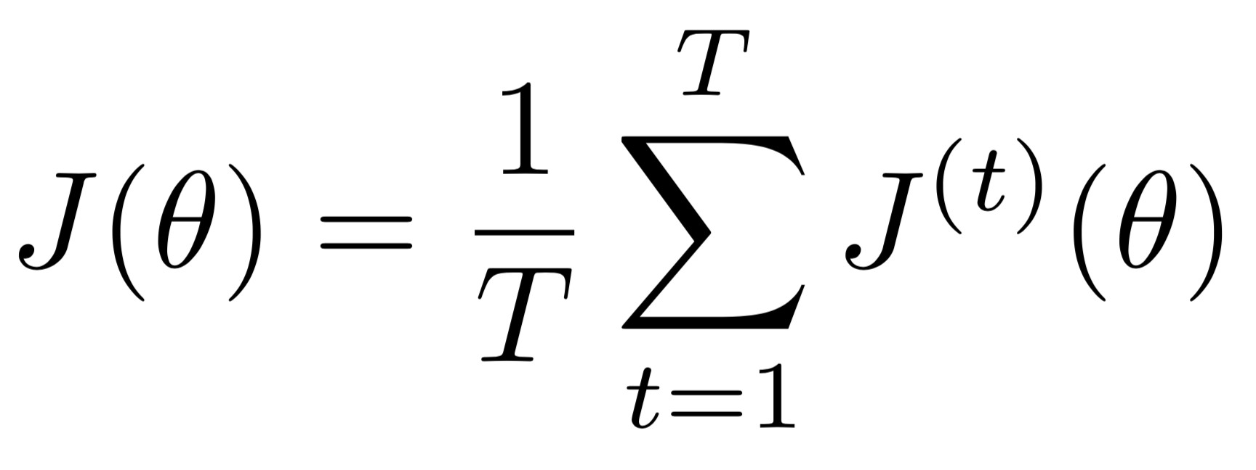
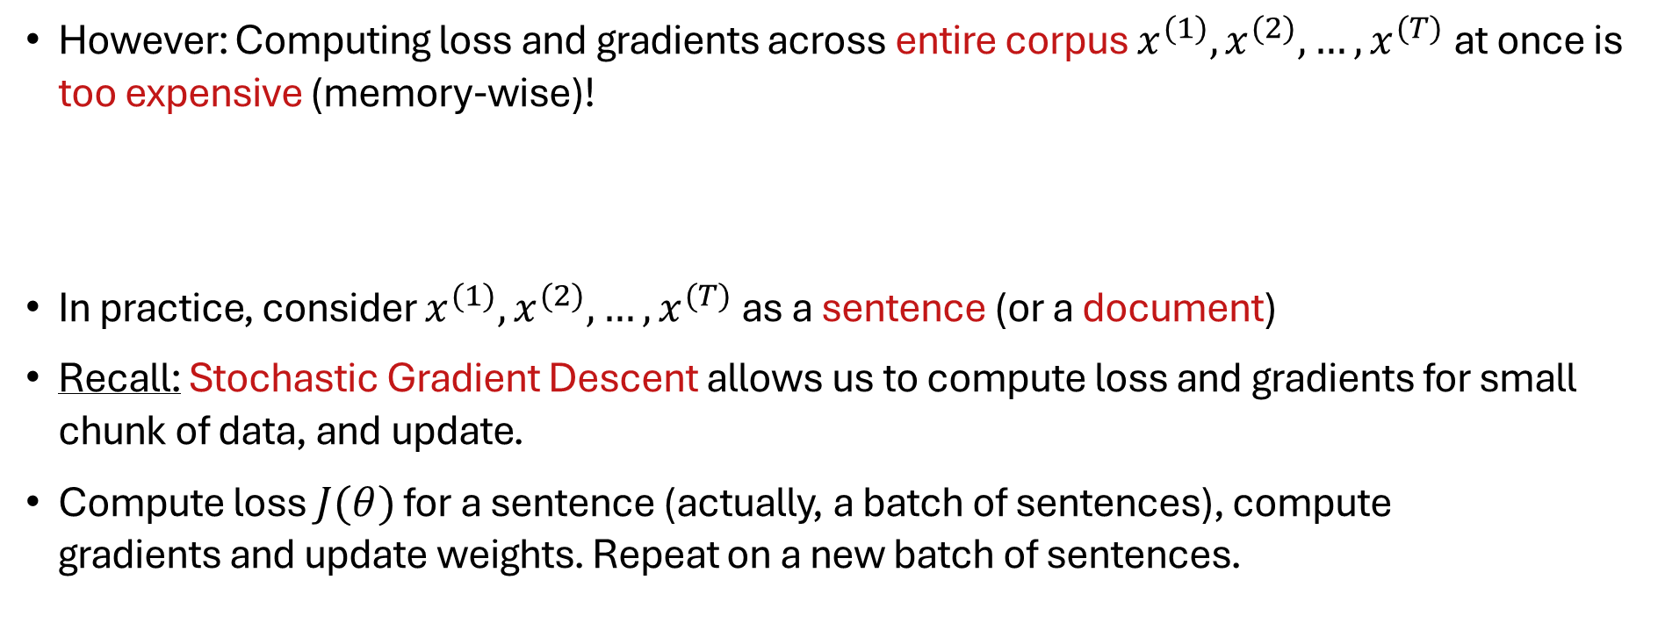
Training a RNN Language Model
However: Computing loss and gradients across entire corpus $x^{(1)},x^{(2)},…,x^{(T)}$at once is too expensive (memory-wise)!
In practice, consider $x^{(1)},x^{(2)},…,x^{(T)}$as a sentence (or a document)
Recall: Stochastic Gradient Descent allows us to compute loss and gradients for small chunk of data, and update.
Compute loss $J(θ)$ for a sentence (actually, a batch of sentences), compute gradients and update weights. Repeat on a new batch of sentences.

Slide 15
Problems with RNNs

Slide 16
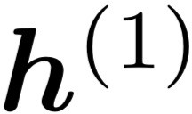

Vanishing and Exploding Gradients

Slide 17
Effect of Vanishing Gradient on RNN-LM
LM task: When she tried to print her tickets, she found that the printer was out of toner. She went to the stationery store to buy more toner. It was very overpriced. After installing the toner into the printer, she finally printed her
To learn from this training example, the RNN-LM needs to model the dependency between “tickets” on the 7th step and the target word “tickets” at the end.
But if the gradient is small, the model can’t learn this dependency
So, the model is unable to predict similar long-distance dependencies at test time

Slide 18
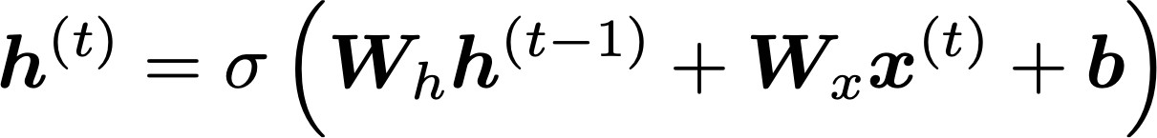
How to Fix the Vanishing Gradient Problem?
The main problem is that it’s too difficult for the RNN to learn to preserve information over many timesteps.
In a vanilla RNN, the hidden state is constantly being rewritten
How about an RNN with separate memory which is added to?
LSTMs
And then: Creating more direct and linear pass-through connections in model
Attention, residual connections, etc.

Slide 19
LSTMs & GRUs

Slide 20
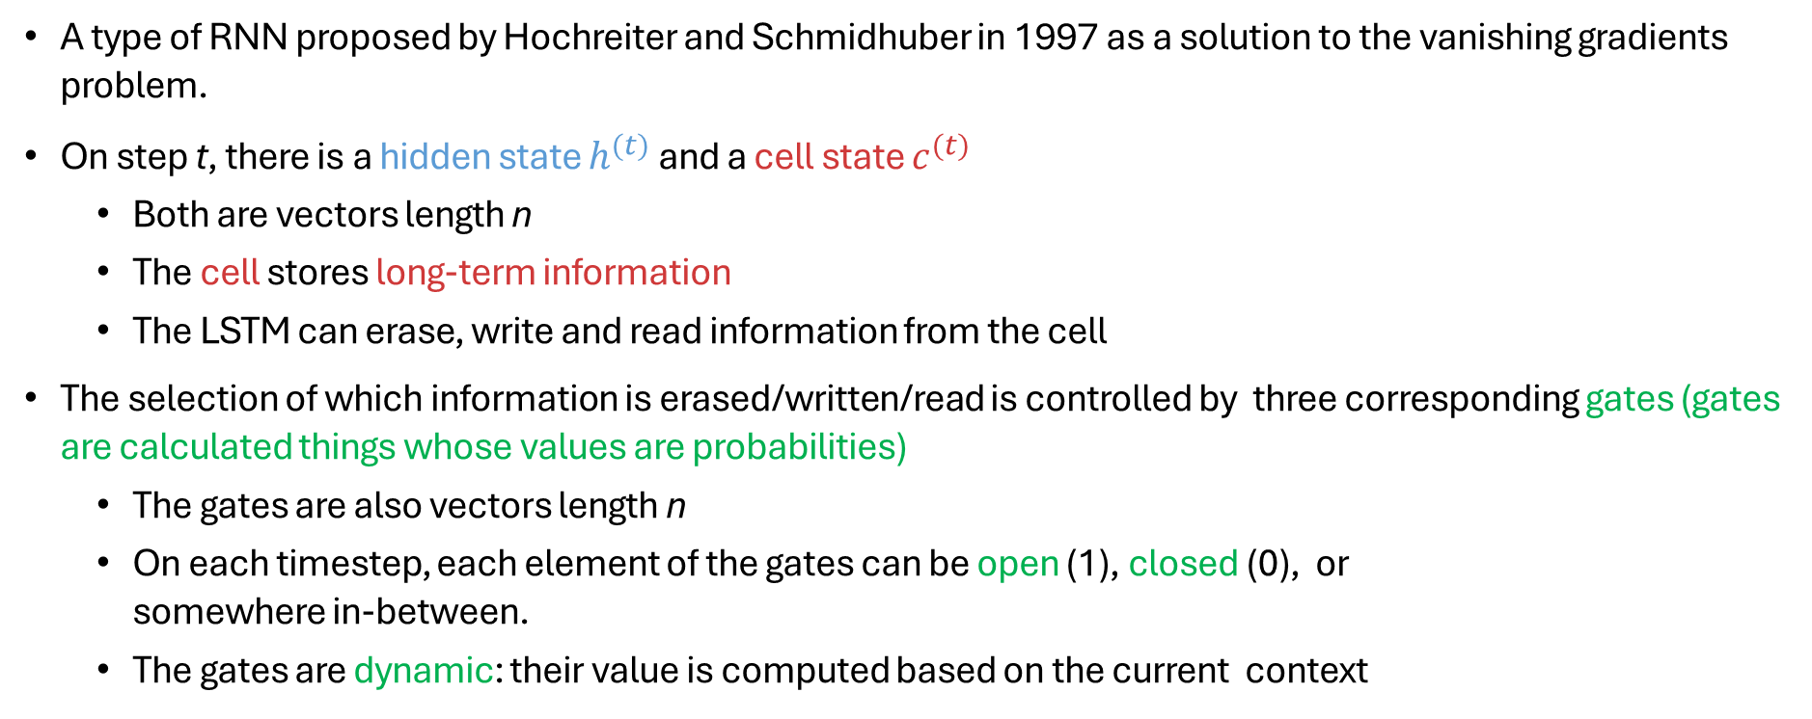
Long Short-Term Memory (LSTM)
A type of RNN proposed by Hochreiter and Schmidhuber in 1997 as a solution to the vanishing gradients problem.
On step t, there is a hidden state $h^{(t)}$ and a cell state $c^{(t)}$
Both are vectors length n
The cell stores long-term information
The LSTM can erase, write and read information from the cell
The selection of which information is erased/written/read is controlled by three corresponding gates (gates are calculated things whose values are probabilities)
The gates are also vectors length n
On each timestep, each element of the gates can be open (1), closed (0), or somewhere in-between.
The gates are dynamic: their value is computed based on the current context

Slide 21
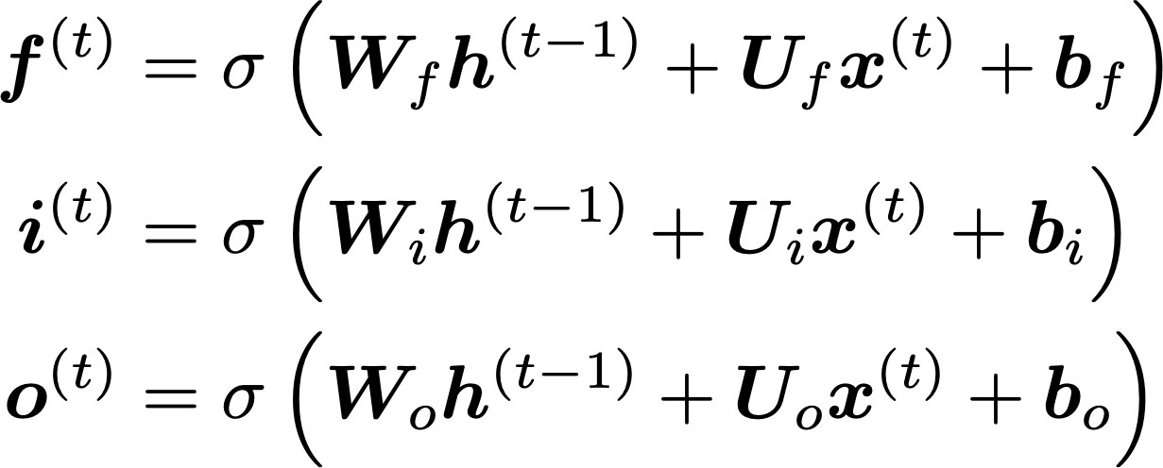
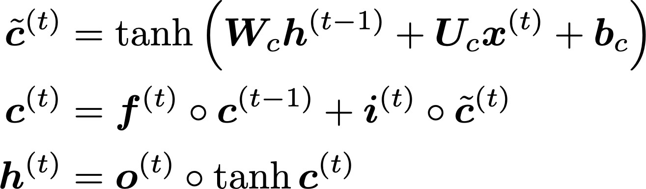
LSTM
We have a sequence of inputs 𝑥^{(𝑡)}, and we will compute a sequence of hidden states ℎ^{(𝑡)} and cell states 𝑐^{(𝑡)}. On timestep t:
Sigmoid function: all gate values are between 0 and 1
Forget gate: controls what is kept vs forgotten, from previous cell state
Input gate: controls what parts of the new cell content are written to cell
All these are vectors of same length n
Output gate: controls what parts of cell are output to hidden state
New cell content: this is the new content to be written to the cell
Cell state: erase (“forget”) some content from last cell state, and write (“input”) some new cell content
⊙
⊙
Hidden state: read (“output”) some content from the cell
⊙
Gates are applied using element-wise (or Hadamard) product: ⊙

Slide 22
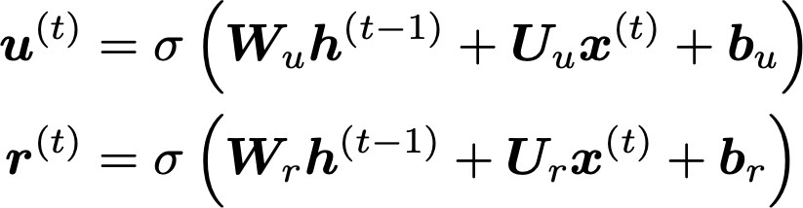
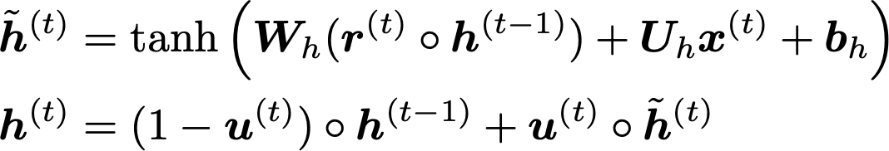

Gated Recurrent Units (GRUs)
How does this solve vanishing gradient? Like LSTM, GRU makes it easier to retain info long-term (e.g. by setting update gate to 0)
Proposed by Cho et al. in 2014 as a simpler alternative to the LSTM.
On each timestep t, we have input $x^{(t)}$and hidden state $h^{(t)}$ (no cell state).
Update gate: controls what parts of hidden state are updated vs preserved
Reset gate: controls what parts of previous hidden state are used to compute new content
New hidden state content: reset gate selects useful parts of prev hidden state. Use this and current input to compute new hidden content.
Hidden state: update gate simultaneously controls what is kept from previous hidden state, and what is updated to new hidden state content
"Learning Phrase Representations using RNN Encoder–Decoder for Statistical Machine Translation", Cho et al. 2014, https://arxiv.org/pdf/1406.1078v3.pdf

Slide 23
LSTM vs GRU
Researchers have proposed many gated RNN variants, but LSTM and GRU are the most widely-used.
The biggest difference is that GRU is quicker to compute and has fewer parameters.
There is no conclusive evidence that one consistently performs better than the other.
LSTM is a good default choice (especially if your data has particularly long dependencies, or you have lots of training data).
Rule of thumb: start with LSTM, but switch to GRU if you want something more efficient.

Slide 24
Sequence-to-Sequence
Modeling & Attention

Slide 25
Neural Machine Translation?
Neural Machine Translation (NMT) is a way to do Machine Translation with a single neural network.
The neural network architecture is called sequence-to-sequence (aka seq2seq) and it involves two RNNs.

Slide 26
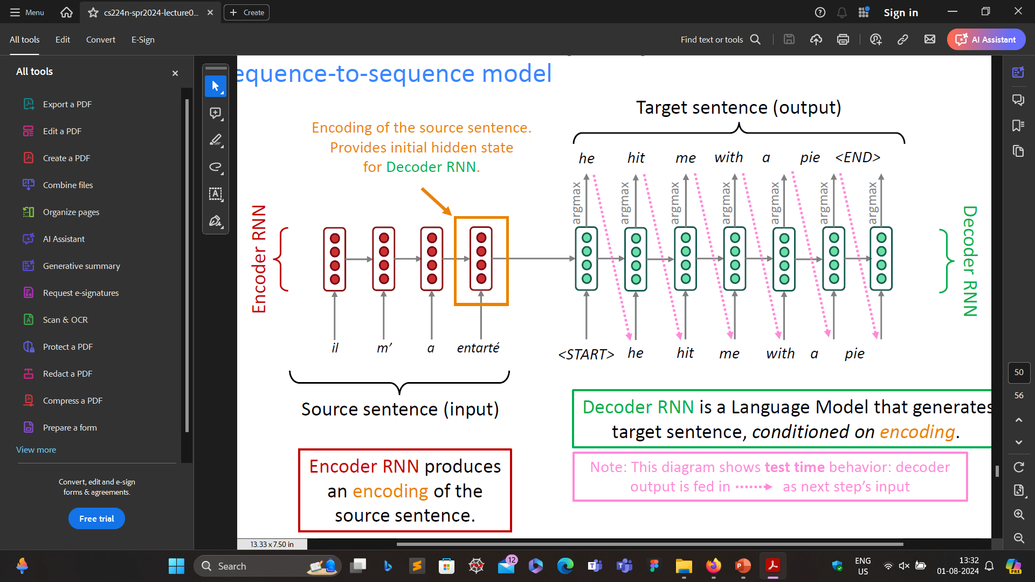
Neural Machine Translation (NMT)
The Sequence-to-Sequence Model
Source sentence (input)
Encoder RNN produces an encoding of the source sentence.

Slide 27
Neural Machine Translation (NMT)
The Sequence-to-Sequence Model
Decoder RNN is a Language Model that generates target sentence, conditioned on encoding.
Source sentence (input)
Note: This diagram shows test time behavior: decoder output is fed in as next step’s input
Encoder RNN produces an encoding of the source sentence.

Slide 28



Neural Machine Translation (NMT)
The sequence-to-sequence model is an example of a Conditional Language Model
Language Model because the decoder is predicting the next word of the target sentence y
Conditional because its predictions are also conditioned on the source sentence x
NMT directly calculates $P(y|x)$
How to train an NMT system?
Probability of next target word, given
target words so far and source sentence $x$

Slide 29

Training an NMT System
Seq2seq is optimized as a single system. Backpropagation operates “end-to-end”.

Slide 30

Greedy decoding
We saw how to generate (or “decode”) the target sentence by taking argmax on each step of the decoder.
This is greedy decoding (take most probable word on each step)
Problems with this method?
he hit me with a pie <END>
argmax
argmax
argmax
argmax
argmax
argmax
argmax
<START> he hit me with a pie

Slide 31
Problems With Greedy Decoding
Greedy decoding has no way to undo decisions!
Input: il a m’entarté
→ he
→ he hit
→ he hit a
(he hit me with a pie)
(whoops! no going back now…)
How to fix this?

Slide 32

Exhaustive Search Decoding
Ideally we want to find a (length T) translation y that maximizes
We could try computing all possible sequences y
This means that on each step t of the decoder, we’re tracking V^{t} possible partial translations, where V is vocab size
This O(V^{T}) complexity is far too expensive!

Slide 33

Beam Search Decoding
Core idea: On each step of decoder, keep track of the k most probable partial translations (which we call hypotheses)
k is the beam size (in practice around 5 to 10)
A hypothesis $y_{1}, …,y_{t}$ has a score which is its log probability:
Scores are all negative, and higher score is better
We search for high-scoring hypotheses, tracking top k on each step
Beam search is not guaranteed to find optimal solution
But much more efficient than exhaustive search!

Slide 34
Beam Search Decoding: Example

Slide 35
Beam size = k = 2.
<START>
Calculate prob
distribution of next word

Slide 36

Beam size = k = 2. Blue numbers =
-0.7 = log P_{LM}(he|<START>)
he
<START>
I
-0.9 = log P_{LM}(I|<START>)
Take top k words and compute scores

Slide 37
Beam size = k = 2. Blue numbers =
-1.7 = log P_{LM}(hit|<START> he) + -0.7
-0.7
hit
he
struck
-2.9 = log P_{LM}(struck|<START> he) + -0.7
<START>
-1.6 = log P_{LM}(was|<START> I) + -0.9
was
I
got
-0.9
-1.8 = log P_{LM}(got|<START> I) + -0.9
For each of the k hypotheses, find
top k next words and calculate scores

Slide 38
Beam size = k = 2. Blue numbers =
-1.7
-0.7
hit
he
struck
-2.9
<START>
-1.6
was
I
got
-0.9
-1.8
Of these k² hypotheses,
just keep k with highest scores

Slide 39
Beam size = k = 2. Blue numbers =
-2.8 = log P_{LM}(a|<START> he hit) + -1.7
-1.7
a
-0.7
hit
he
me
struck
-2.5 = log P_{LM}(me|<START> he hit) + -1.7
-2.9
<START>
-2.9 = log P_{LM}(hit|<START> I was) + -1.6
-1.6
hit
was
I
struck
got
-0.9
-3.8 = log P_{LM}(struck|<START> I was) + -1.6
-1.8
For each of the k hypotheses, find
top k next words and calculate scores

Slide 40
Beam size = k = 2. Blue numbers =
-2.8
-1.7
a
-0.7
hit
he
me
struck
-2.5
-2.9
<START>
-2.9
-1.6
hit
was
I
struck
got
-0.9
-3.8
-1.8
Of these k² hypotheses,
just keep k with highest scores

Slide 41
Beam size = k = 2. Blue numbers =
tart
-2.8
pie
-1.7
a
-0.7
hit
-3.4
he
me
-3.3
struck
-2.5
with
-2.9
<START>
-2.9
on
-1.6
hit
-3.5
was
I
struck
got
-0.9
-3.8
-1.8
For each of the k hypotheses, find
top k next words and calculate scores

Slide 42
Beam size = k = 2. Blue numbers =
tart
-2.8
pie
-1.7
a
-0.7
hit
-3.4
he
me
-3.3
struck
-2.5
with
-2.9
<START>
-2.9
on
-1.6
hit
-3.5
was
I
struck
got
-0.9
-3.8
-1.8
Of these k² hypotheses,
just keep k with highest scores

Slide 43
Beam size = k = 2. Blue numbers =
-4.0
-4.8
tart
in
-2.8
pie
with
-1.7
a
-0.7
hit
-3.4
-4.5
he
me
-3.3
-3.7
struck
-2.5
with
a
-2.9
<START>
-2.9
on
one
-1.6
hit
-3.5
-4.3
was
I
struck
got
-0.9
-3.8
-1.8
For each of the k hypotheses, find
top k next words and calculate scores

Slide 44
Beam size = k = 2. Blue numbers =
-4.0
-4.8
tart
in
-2.8
pie
with
-1.7
a
-0.7
hit
-3.4
-4.5
he
me
-3.3
-3.7
struck
-2.5
with
a
-2.9
<START>
-2.9
on
one
-1.6
hit
-3.5
-4.3
was
I
struck
got
-0.9
-3.8
-1.8
Of these k² hypotheses,
just keep k with highest scores

Slide 45
Beam size = k = 2. Blue numbers =
-4.0
-4.8
tart
in
-2.8
-4.3
pie
with
-1.7
a
pie
-0.7
hit
-3.4
-4.5
he
me
-3.3
-3.7
tart
struck
-2.5
with
a
-4.6
-2.9
<START>
-2.9
on
one
-5.0
-1.6
hit
pie
-3.5
-4.3
was
I
struck
tart
got
-0.9
-3.8
-5.3
-1.8
For each of the k hypotheses, find
top k next words and calculate scores

Slide 46
Beam size = k = 2. Blue numbers =
-4.0
-4.8
tart
in
-2.8
-4.3
pie
with
-1.7
a
pie
-0.7
hit
-3.4
-4.5
he
me
-3.3
-3.7
tart
struck
-2.5
with
a
-4.6
-2.9
<START>
-2.9
on
one
-5.0
-1.6
hit
pie
-3.5
-4.3
was
I
struck
tart
got
-0.9
-3.8
-5.3
-1.8
This is the top-scoring hypothesis!

Slide 47
Beam size = k = 2. Blue numbers =
-4.0
-4.8
tart
in
-2.8
-4.3
pie
with
-1.7
a
pie
-0.7
hit
-3.4
-4.5
he
me
-3.3
-3.7
tart
struck
-2.5
with
a
-4.6
-2.9
<START>
-2.9
on
one
-5.0
-1.6
hit
pie
-3.5
-4.3
was
I
struck
tart
got
-0.9
-3.8
-5.3
-1.8
Backtrack to obtain the full hypothesis

Slide 48
Beam Search Decoding: Stopping Criterion
In greedy decoding, usually we decode until the model produces a <END> token
For example: <START> he hit me with a pie <END>
In beam search decoding, different hypotheses may produce <END> tokens on different timesteps
When a hypothesis produces <END>, that hypothesis is complete.
Place it aside and continue exploring other hypotheses via beam search.
Usually we continue beam search until:
We reach timestep T (where T is some pre-defined cutoff), or
We have at least n completed hypotheses (where n is pre-defined cutoff)

Slide 49


Beam Search Decoding: Finishing Up
We have our list of completed hypotheses.
How to select top one with highest score?
Each hypothesis $y_{1},…,y_{t}$ on our list has a score
Problem: longer hypotheses have lower scores
Fix: Normalize by length. Use this to select the top one instead:

Slide 50
Issues With RNN
Linear interaction distance
Bottleneck problem
Lack of parallelizability
ATTENTION

Slide 51
Attention

Slide 52

Sequence-to-Sequence: The Bottleneck Problem
Encoding of the source sentence
Target sentence (output)
we
had
gone to
the
market <END>
Encoder RNN
Decoder RNN
हम
बाजार
गये
थे
<START> we
had
gone to
the
market
ham baajaar gaye the
Source sentence (input)
Any problems with this architecture?

Slide 53
Sequence-to-Sequence: The Bottleneck Problem
Encoding of the source sentence
Target sentence (output)
This needs to capture all information about the source sentence.
Information bottleneck!
we
had
gone to
the
market <END>
Encoder RNN
Decoder RNN
हम
बाजार
गये
थे
<START> we
had
gone to
the
market
ham baajaar gaye the
Source sentence (input)

Slide 54
Attention
Attention provides a solution to the bottleneck problem.
Core idea: on each step of the decoder, use direct connection to the encoder to focus on a particular part of the source sequence
Let’s start with the visualization of the attention mechanism.

Slide 55

Sequence-to-Sequence With Attention
dot product
Attention
scores
Decoder RNN
Encoder
RNN
हम
बाजार
गये
थे
<START>
ham baajaar gaye the
Source sentence (input)

Slide 56

Sequence-to-Sequence With Attention
dot product
Attention
scores
Decoder RNN
Encoder
RNN
हम
बाजार
गये
थे
<START>
ham baajaar gaye the
Source sentence (input)

Slide 57

Sequence-to-Sequence With Attention
dot product
Attention
scores
Decoder RNN
Encoder
RNN
हम
बाजार
गये
थे
<START>
ham baajaar gaye the
Source sentence (input)

Slide 58

Sequence-to-Sequence With Attention
dot product
Attention
scores
Decoder RNN
Encoder
RNN
हम
बाजार
गये
थे
<START>
ham baajaar gaye the
Source sentence (input)

Slide 59
Sequence-to-Sequence With Attention
On this decoder timestep, we are mostly focusing on the first encoder hidden state
Attention
distribution
Take softmax to turn the scores into a probability distribution
Attention
scores
Decoder RNN
Encoder
RNN
हम
बाजार
गये
थे
<START>
ham baajaar gaye the
Source sentence (input)

Slide 60

Sequence-to-Sequence With Attention
Attention output
Use the attention distribution to take a weighted sum of the encoder hidden states.
The attention output mostly contains information from the hidden states that received high attention.
Attention
distribution
Attention
scores
Decoder RNN
Encoder
RNN
हम
बाजार
गये
थे
<START>
ham baajaar gaye the
Source sentence (input)

Slide 61
Sequence-to-Sequence With Attention
Attention output
we
Concatenate attention output with decoder hidden state, then use to compute ŷ₁ as before
Attention
distribution
Attention
scores
Decoder RNN
Encoder
RNN
हम
बाजार
गये
थे
<START>
ham baajaar gaye the
Source sentence (input)

Slide 62



Sequence-to-Sequence With Attention
Attention output
had
Attention
distribution
Attention
scores
Decoder RNN
Encoder
RNN
Sometimes we take the attention output from the previous step, and also feed it into the decoder (along with the usual decoder input).
हम
बाजार
गये
थे
<START> we
ham baajaar gaye the
Source sentence (input)

Slide 63


Sequence-to-Sequence With Attention
Attention output
gone
Attention
distribution
Attention
scores
Decoder RNN
Encoder
RNN
हम
बाजार
गये
थे
<START> we
had
ham baajaar gaye the
Source sentence (input)

Slide 64


Sequence-to-Sequence With Attention
Attention output
to
Attention
distribution
Attention
scores
Decoder RNN
Encoder
RNN
हम
बाजार
गये
थे
<START> we
had
gone
ham baajaar gaye the
Source sentence (input)

Slide 65

Sequence-to-Sequence With Attention
Attention output
the
Attention
distribution
Attention
scores
Decoder RNN
Encoder
RNN
हम
बाजार
गये
थे
<START> we
had
gone to
ham baajaar gaye the
Source sentence (input)

Slide 66


Sequence-to-Sequence With Attention
Attention output
market
Attention
distribution
Attention
scores
Decoder RNN
Encoder
RNN
हम
बाजार
गये
थे
<START> we
had
gone to
the
ham baajaar gaye the
Source sentence (input)

Slide 67



Attention: In Equations
We have encoder hidden states h₁ , . . . , h_{N} ∈ ℝ^{h}
On timestep t, we have decoder hidden state s_{t} ∈ ℝ^{h}
We get the attention scores e^{t} for this step:
We take softmax to get the attention distribution α^{t} for this step (this is a probability distribution, sums to 1)
We use α^{t} to take a weighted sum of the encoder hidden states to get the attention output a_{t}
Finally we concatenate the attention output a_{t} with the decoder hidden state s_{t} and proceed as in the non-attention seq2seq model

Slide 68
Attention is Great
Attention significantly improves NMT performance
It’s very useful to allow decoder to focus on certain parts of the source
Attention solves the bottleneck problem
Attention allows decoder to look directly at source; bypass bottleneck
Attention helps with vanishing gradient problem
Provides shortcut to faraway states
Attention provides some interpretability
By inspecting attention distribution, we can see what the decoder was focusing on
We get (soft) alignment for free!
This is cool because we never explicitly trained an alignment system
The network just learned alignment by itself
 | he | hit | me | with | a | pie
il
a
m’
entarté

Slide 69

Seq2Seq+Attention for LM

Slide 70
Attention is a General Deep Learning Technique
We’ve seen that attention is a great way to improve the sequence-to-sequence model for Machine Translation.
However: You can use attention in many architectures (not just seq2seq) and many tasks (not just MT)
More general definition of attention:
Given a set of vector values, and a vector query, attention is a technique to compute a weighted sum of the values, dependent on the query.
We sometimes say that the query attends to the values.
For example, in the seq2seq + attention model, each decoder hidden state (query) attends to all the encoder hidden states (values).
Intuition:
The weighted sum is a selective summary of the information contained in the values, where the query determines which values to focus on.
Attention is a way to obtain a fixed-size representation of an arbitrary set of representations (the values), dependent on some other representation (the query).
75

Slide 71
Attention
Encoding
h₁
h₂
h₃
x₁
x₂
x₃
Input Sequence

Slide 72
Attention
Key vectors represent what information is encoded at each encoder time step.
k₁
k₂
k₃
Encoding
h₁
h₂
h₃
x₁
x₂
x₃
Input Sequence

Slide 73
Attention
Query vectors represent what information we are looking for at each decoder time step.
k₁
k₂
k₃
q₁
h₁
h₂
h₃
s₀
Decoding
x₁
x₂
x₃
y₁
Input Sequence

Slide 74
Attention
α₁
α₂
α₃
softmax
Softmax converts the similarity scores into a probability distribution.
e₁
e₂
e₃
Dot product between query vector and every key vector gives similarity score.
k₁
k₂
k₃
q₁
h₁
h₂
h₃
s₀
Decoding
x₁
x₂
x₃
y₁
Input Sequence

Slide 75
Attention
α₁
α₂
α₃
softmax
The output of attention mechanism is the weighted sum of hidden vectors.
e₁
e₂
e₃
Σ_{t} α_{t}h_{t}
Instead of simply summing up the hidden vectors, we can transform them using a learned function to generate value vectors and then compute a weighted sum.
k₁
k₂
k₃
q₁
h₁
h₂
h₃
s₀
Decoding
x₁
x₂
x₃
y₁
Input Sequence

Slide 76

Variants of Attention
More information:
“Deep Learning for NLP Best Practices”, Ruder, 2017. http://ruder.io/deep-learning-nlp-best-practices/index.html#attention
“Massive Exploration of Neural Machine Translation Architectures”, Britz et al, 2017, https://arxiv.org/pdf/1703.03906.pdf

