Slide 1


Privacy Defenses in LLMs
ELL8299 · COL8383
Tanmoy Chakraborty
Professor, IIT Delhi
https://tanmoychak.com/

Slide 2
From attacks to defenses
Attack | What We Learned
Memorization & Extraction | LLMs verbatim regurgitate training sequences when prompted
Membership Inference | An adversary can determine with high confidence if you were in the training set
Prompt & ICL Leakage | System prompts and demonstrations are recoverable from model outputs
Prompt Injection | Malicious inputs can override intended model behavior
Heuristic defenses are unprovable.
Today we study defenses that offer formal, quantifiable guarantees.

Slide 3
Why heuristics are not enough?
What heuristic defenses give us:
Redaction removes named entities, but context still leaks identity
Output filtering blocks some extractions, but not all, and it can be bypassed.
Deduplicating the training data reduces memorization, but we still can’t say how exposed each record is.
None of these gives us number we can report, audit, or prove.

Slide 4
Why heuristics are not enough?
What a formal guarantee gives us:
A quantified bound on information leakage: the privacy budget ε.
Adversary-agnostic guarantee: the proof holds against all adversaries.
Composability: we can reason about what happens when defences are combined.
Accountability: regulators, auditors, and users can verify the claim.
Differential Privacy is the framework that makes this possible.

Slide 5
Differential Privacy as a Defence
Formal guarantees against memorization, extraction and inference attacks

Slide 6
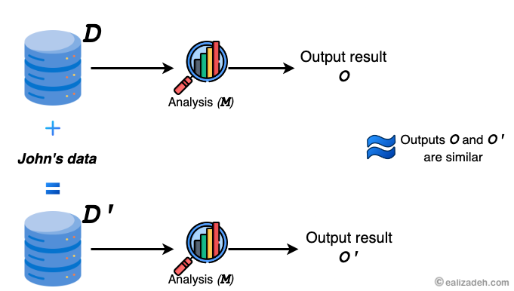

Differential privacy: Intuition
Two datasets D and D' are neighbors if they differ in exactly one person’s record
Differential Privacy (DP) says that a randomized algorithm’s output looks almost the same whether it ran on D or D'
https://ealizadeh.com/blog/abc-of-differential-privacy/
Notes:
Add example of DP

Slide 7
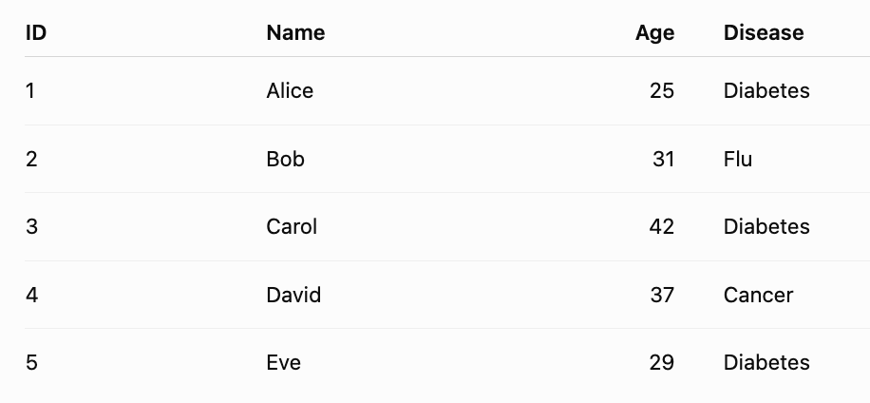

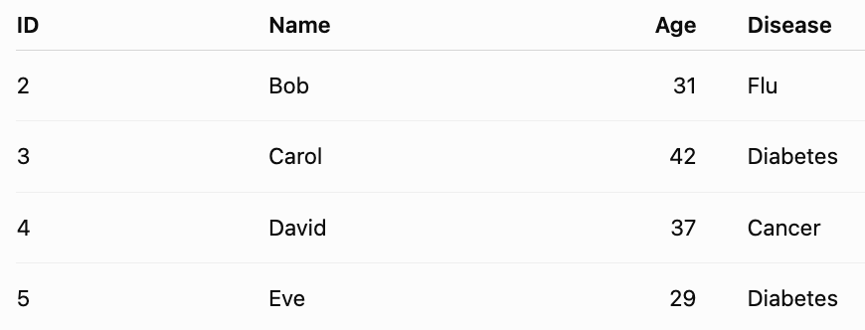

Differential privacy: Example
F(D)= How many patients have diabetes?
Suppose an attacker already knows Bob, Carol, David, and Eve's records. They also know Alice may or may not be in the database.
If the system says 3, the attacker immediately learns something about Alice: Alice has diabetes

Slide 8
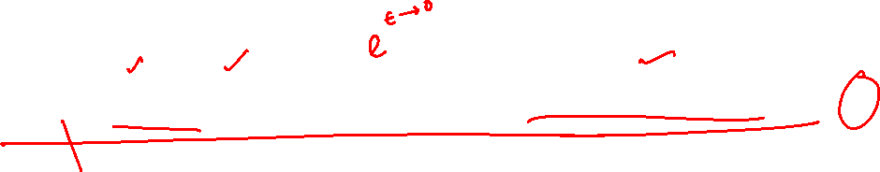
Differential privacy: Definition
A randomized mechanism M is (ε,δ)-DP, for all neighbours D and D' and every set of outcomes O, if
ε is the privacy budget. Lower value => more privacy, lesser utility. Privacy utility trade off
δ is the failure probability. Typically set to < 1/N
At δ = 0, the mechanism is ε-DP
Think of ϵ and δ as two ways of providing slack in this inequality. If you insist that ϵ be extremely small, the required δ can be larger.

Slide 9
Differential privacy for LLMs
DP can theoretically be applied to any of the surfaces where private data enters
Training data: Train with DP-SGD
User’s shared text: Apply DP-based text sanitization
Notes:
A

Slide 10
DP-SGD
Training with privacy guarantees

Slide 11
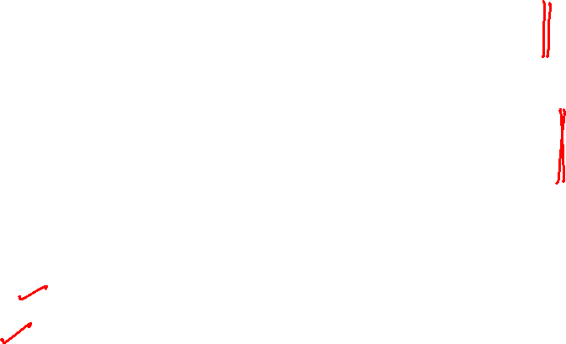
Privacy problems with SGD
Unbounded influence: Since the gradient of a single outlier can be arbitrarily large, an individual datapoint can exert unlimited influence on the model during training.
Deterministic leakage: Without noise, gradients are a deterministic function of the batch, allowing for potential reconstruction of private training data via inversion attacks (search for an input whose gradient matches the observed gradient).
DP-SGD attempts to fix these problems by:
Clipping gradients to bound influence
Adding Gaussian noise to gradients

Slide 12
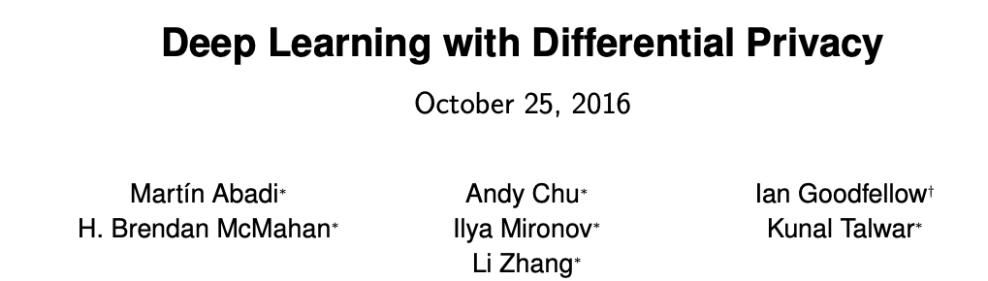

Incorporating differential privacy in deep learning
https://arxiv.org/pdf/1607.00133

Slide 13


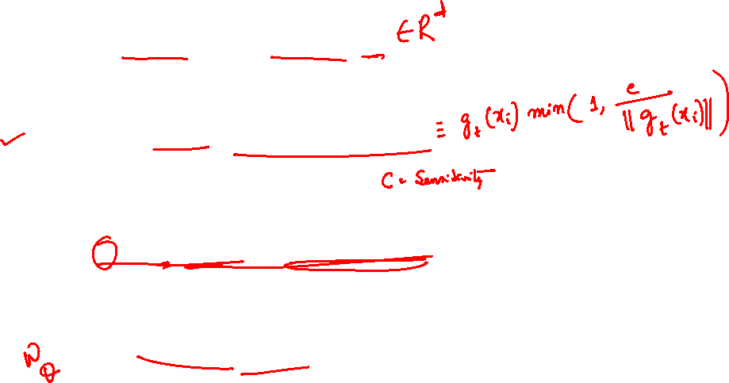
Training with DP-SGD
Compute per-example gradients for every sample x_{i}
Clip gradients
Add noise and average
Update parameters
Clipping limits how much information one individual can contribute.
Noise makes it difficult to determine whether that individual's contribution was present at all.

Slide 14
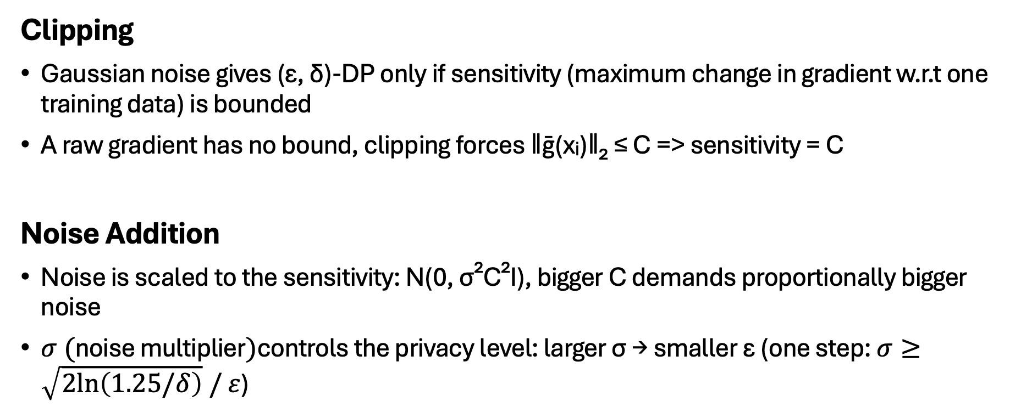
How clipping and noise give privacy
Clipping
Gaussian noise gives (ε, δ)-DP only if sensitivity (maximum change in gradient w.r.t one training data) is bounded
A raw gradient has no bound, clipping forces ‖ḡ(xᵢ)‖₂ ≤ C => sensitivity = C
Noise Addition
Noise is scaled to the sensitivity: N(0, σ²C²I), bigger C demands proportionally bigger noise
$σ (\text{noise multiplier})$controls the privacy level: larger σ → smaller ε (one step: $σ≥\sqrt{2ln⁡\left(1.25/δ\right)} / ε$)

Slide 15
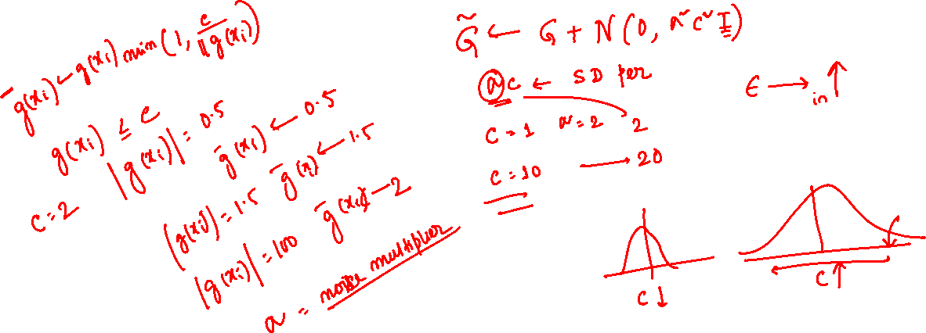

Slide 17

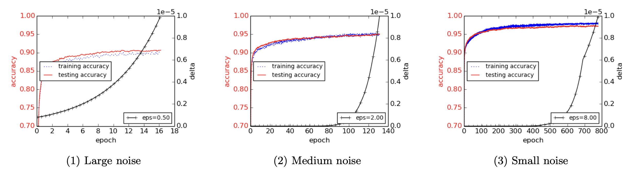
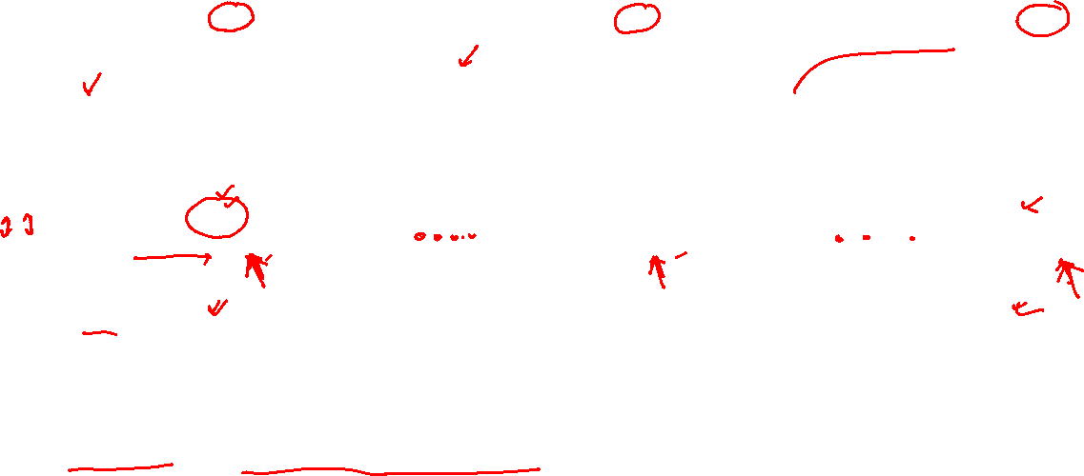
DP-SGD: Results on MNIST
Training stops after only around 16 epochs before the specified privacy budget is exhausted.
Roughly 130 epochs under the plotted privacy accounting.
As we train for more epochs, we spend more of our privacy budget. For a fixed ϵ, this is reflected here by an increasing δ. Once δ reaches the chosen threshold, around 10⁻⁵, we stop training.
Notes:
Black line shows delta value

Slide 18
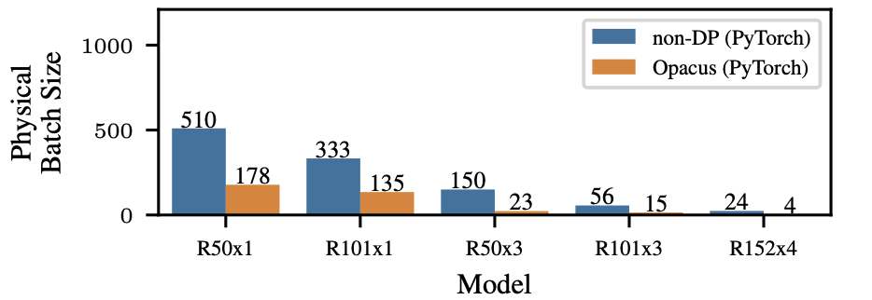
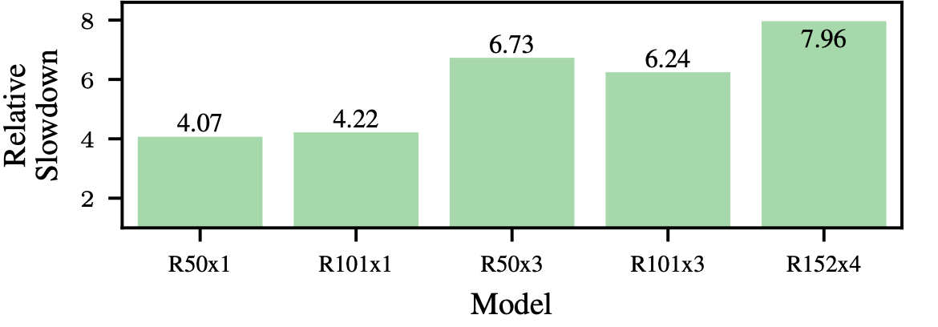
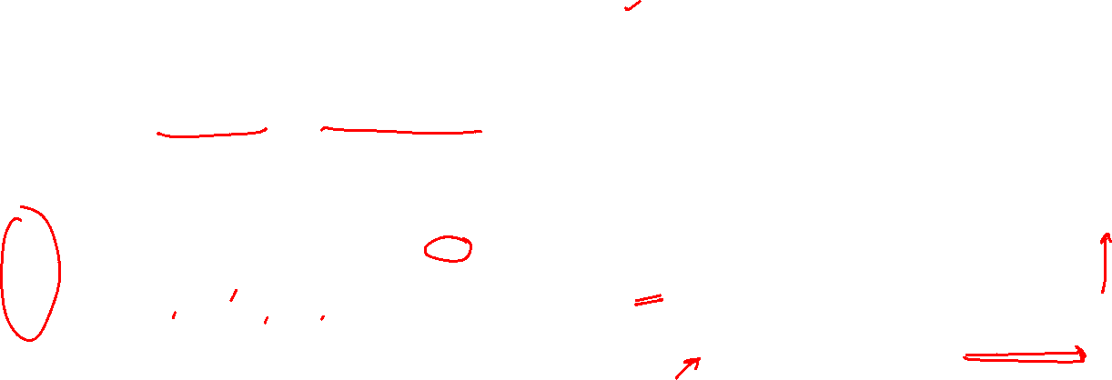
Computational cost of privacy in DP-SGD
Gaussian Noise addition: Convergence slows down
Per-sample gradient clipping: Must store per-sample gradient in memory, memory required increases, throughput (#training samples processed per sec) reduces
Ratio of mean throughputs between
non-private and private baseline
Maximum achievable batch size of ResNet on A100
E.g., R50x3 is a ResNet-50 architecture whose layers are approximately 3× wider than the standard ResNet-50
https://arxiv.org/pdf/2406.17298v3
Notes:
Opacus: Open source library to implement DP based Pytorch Models

Slide 19
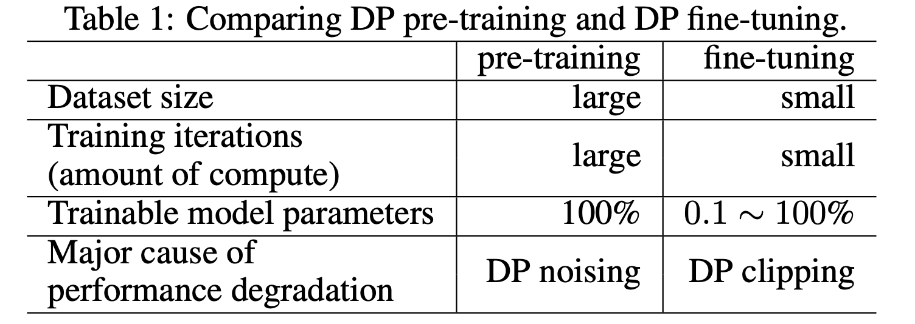
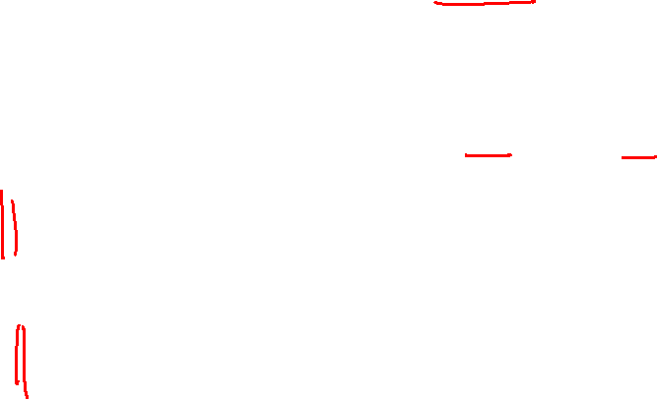
DP-SGD for LLMs
The feasibility of applying DP-SGD to an LLM depends on the training stage
Pre-training from scratch: very large performance drop, often impractical
Fine-tuning a pretrained model: small accuracy loss, works well at ε = 3 -- 8
WHY?
Pretraining: Huge numbers of optimization steps -> Privacy loss accumulates-> Gaussian noise can become a major obstacle to learning
Finetuning: Some examples may produce large and informative gradients as the pretrained model needs to adapt to a new task/domain. Aggressive clipping can suppress these useful updates.
https://proceedings.neurips.cc/paper_files/paper/2024/file/ac04e54e0a2d1927d60709019e4e7870-Paper-Conference.pdf

Slide 20
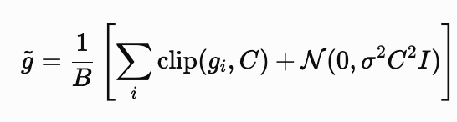
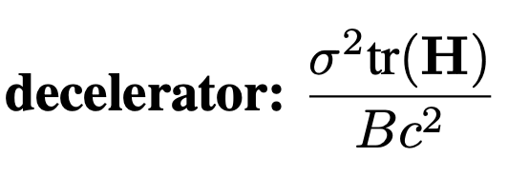
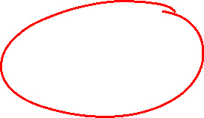
Why pre-training with DP is hard
DP-SGD changes each parameter update in two ways [Bu et al., 2024]:
Clips each sample’s gradient (clipping factor c)
Adds Gaussian noise (noise scale σ)
These modifications introduce an additionally penalty in the expected improvement of training loss
This penalty is called the decelerator
https://arxiv.org/pdf/2402.18752
Notes:
Decelerator term is 0 when sigma = 0 in normal SGD, in DP-SGD it remains present thus slowding down per iteration loss improvement

Slide 25
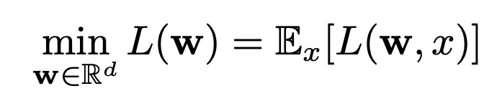
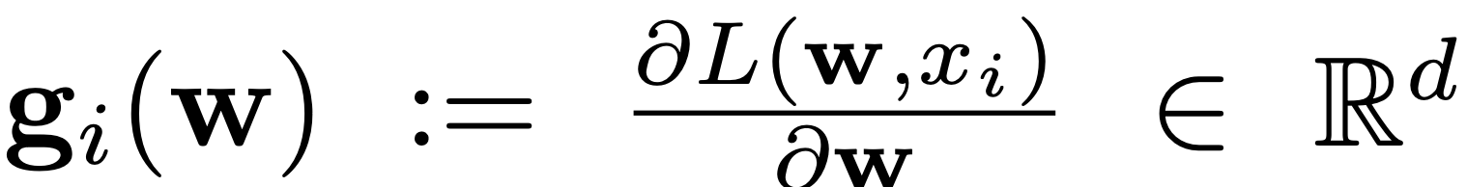
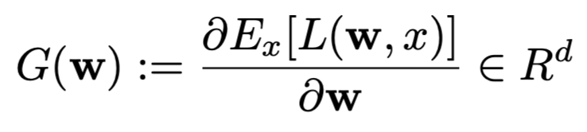

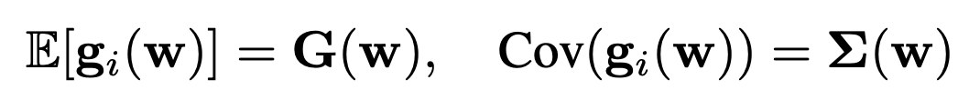
Why pre-training with DP is hard?
Overall goal during training is to minimize expected loss over data
Per sample gradient
Oracle gradient
Assumption: Per-sample gradients are IID with no
restriction on the covariance structure
Oracle hessian
https://arxiv.org/pdf/2402.18752

Slide 26
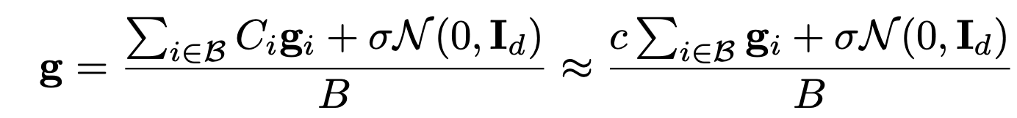

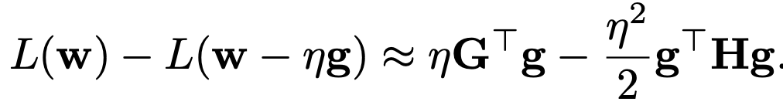
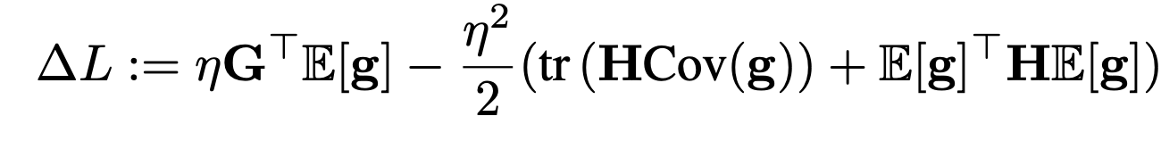
Why pre-training with DP is hard?
For DP optimizers
Eq (1)
Update rule
By using second-order Taylor approximation, we get
By taking expectation on RHS, expected per iteration loss improvement
Eq (2)
https://arxiv.org/pdf/2402.18752

Slide 27
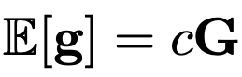
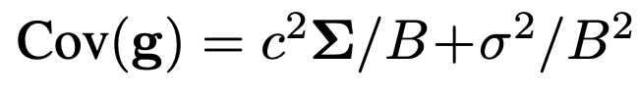
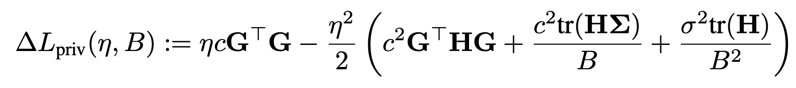
Why pre-training with DP is hard?
Taking expectation and covariance of Eq 1 with IID assumption
Substituting into Eq 2
The final term is called the decelerator, which isn’t present in standard training (σ = 0, c = 1)

Slide 28
Why pre-training with DP is hard?
tr(H) measures the curvature of the loss surface at the current weights
Pre-training starts with random-initialization, sharply curved surface, tr(H) is large, noise compounds the effect
An already pre-trained model, has a comparatively flat region, so tr(H) is smaller

Slide 29
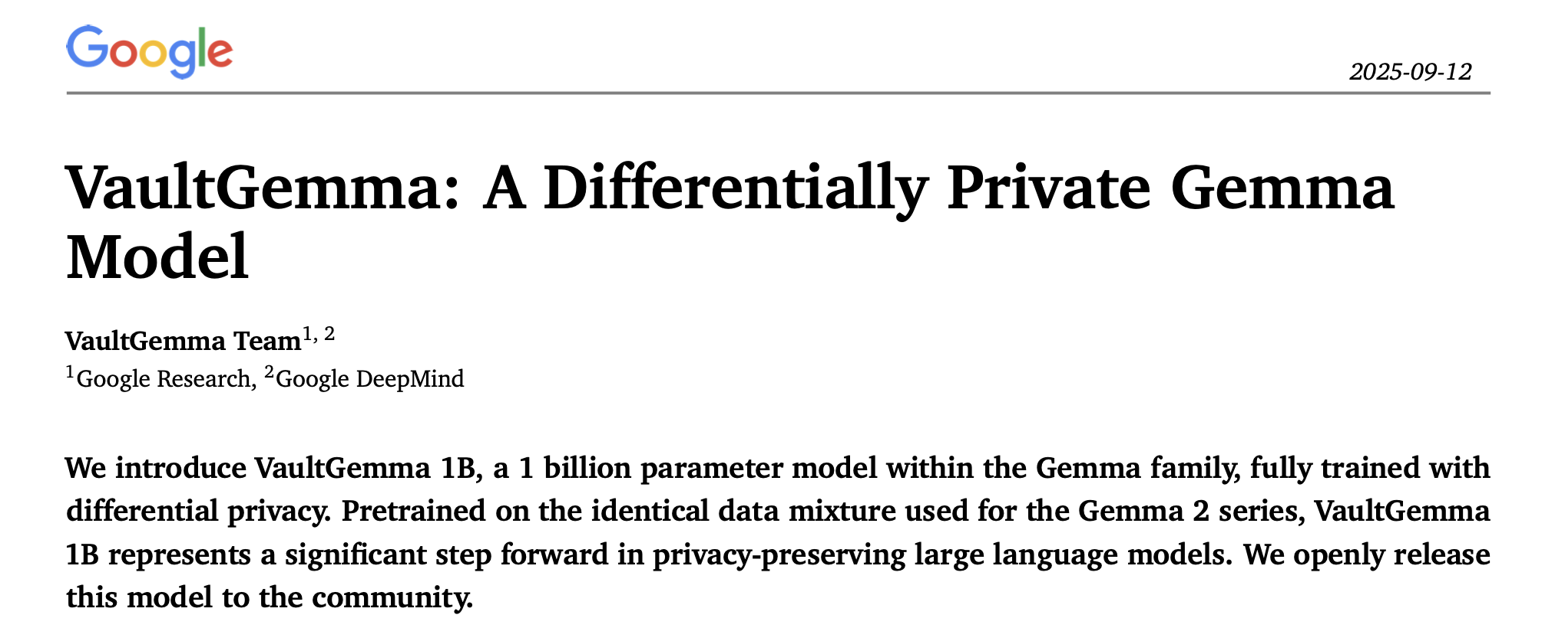
https://arxiv.org/pdf/2510.15001

Slide 30
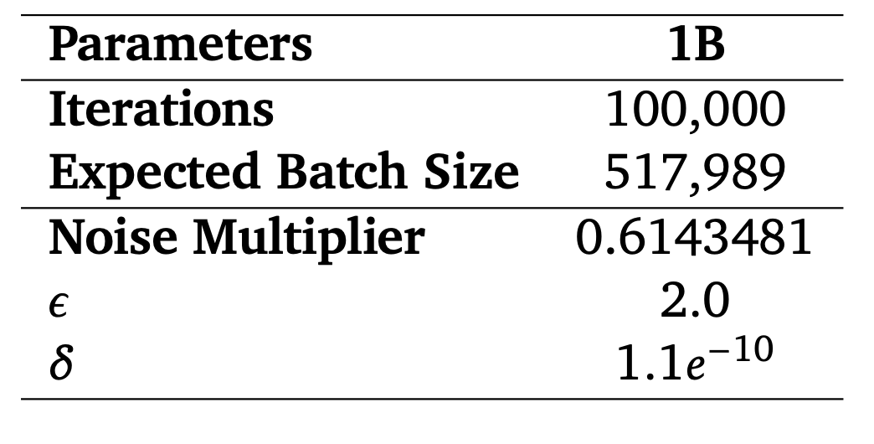
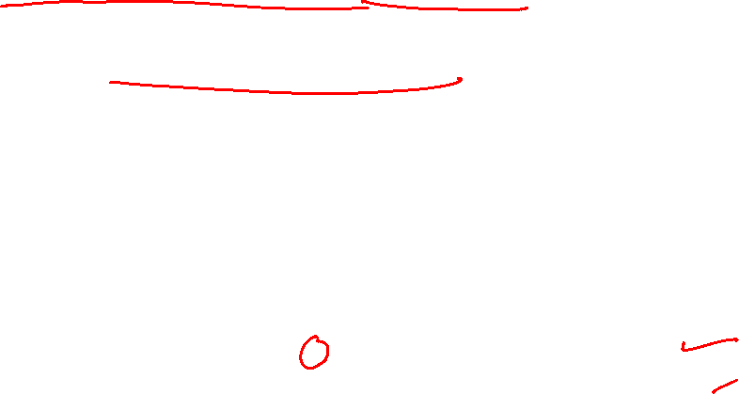
VaultGemma: How it was pretrained
A very large batch size to reduce decelerator
Short sequence length (~1024 tokens) to free up compute for large batch size
Huge compute infrastructure with 2048 TPUv6e chips
Notes:
Expected batch size is due to Poisson subsampling, where we include each sample independently in a batch with probability B/N, so batch size isn’t fixed

Slide 31
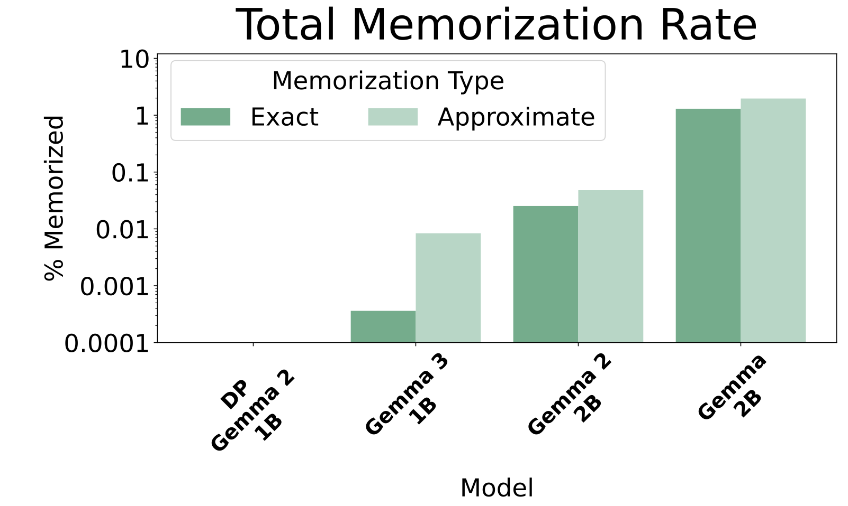
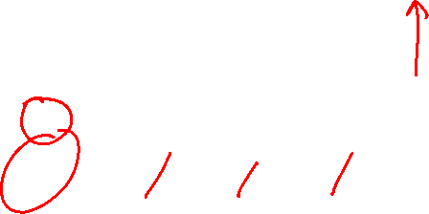
VaultGemma: No detectable memorization
Test: feed the model a 50-token prefix of a training example, check if it reproduces the next 50 tokens.
Every non-private Gemma model reproduces some training data, VaultGemma produces none
Notes:
Expected batch size is due to Poisson subsampling, where we include each sample independently in a batch with probability B/N, so batch size isn’t fixed

Slide 32
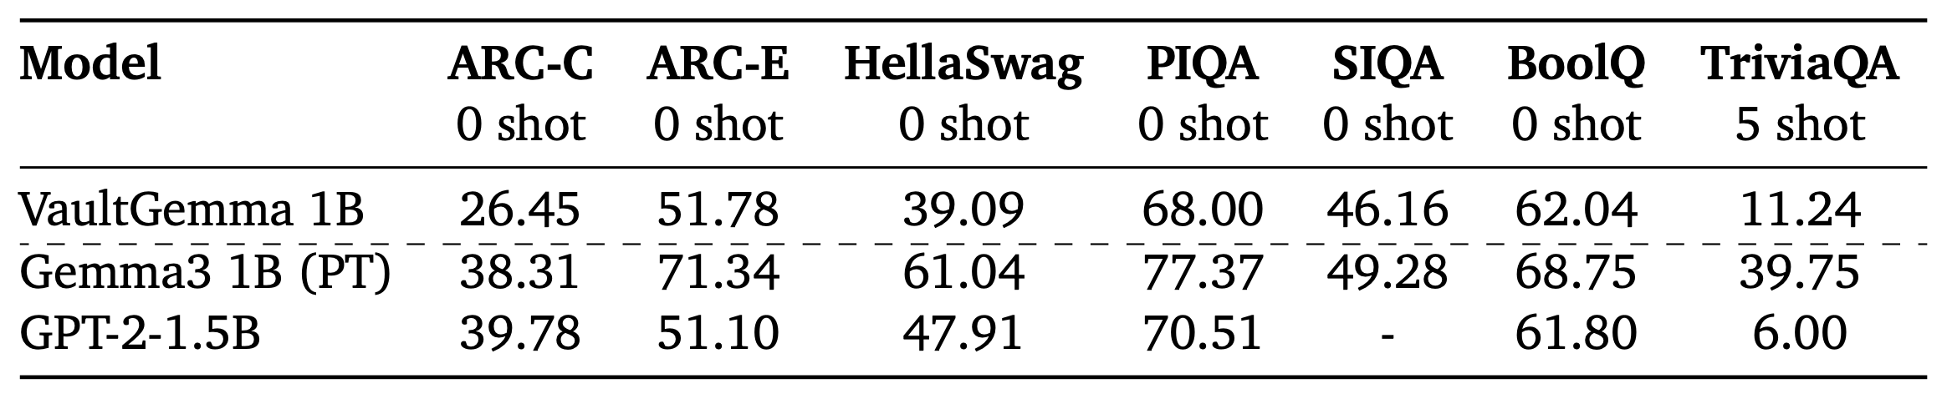
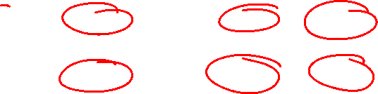
VaultGemma: The utility cost
On standard benchmarks, VaultGemma performs close to GPT-2 1.5B an almost 6-year older model
A modern non-private Gemma model of same size performs much better.
Notes:
Expected batch size is due to Poisson subsampling, where we include each sample independently in a batch with probability B/N, so batch size isn’t fixed

Slide 33
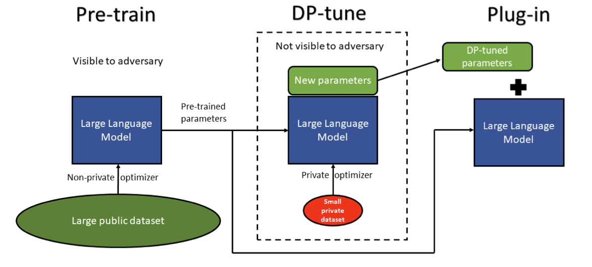
Where is DP usually applied?
Standard practice applies DP optimizers during fine-tuning, on top of a public pretrained model
Loss landscape is already flat after pre-training, decelerator term is small
https://openreview.net/pdf?id=Q42f0dfjECO

Slide 34
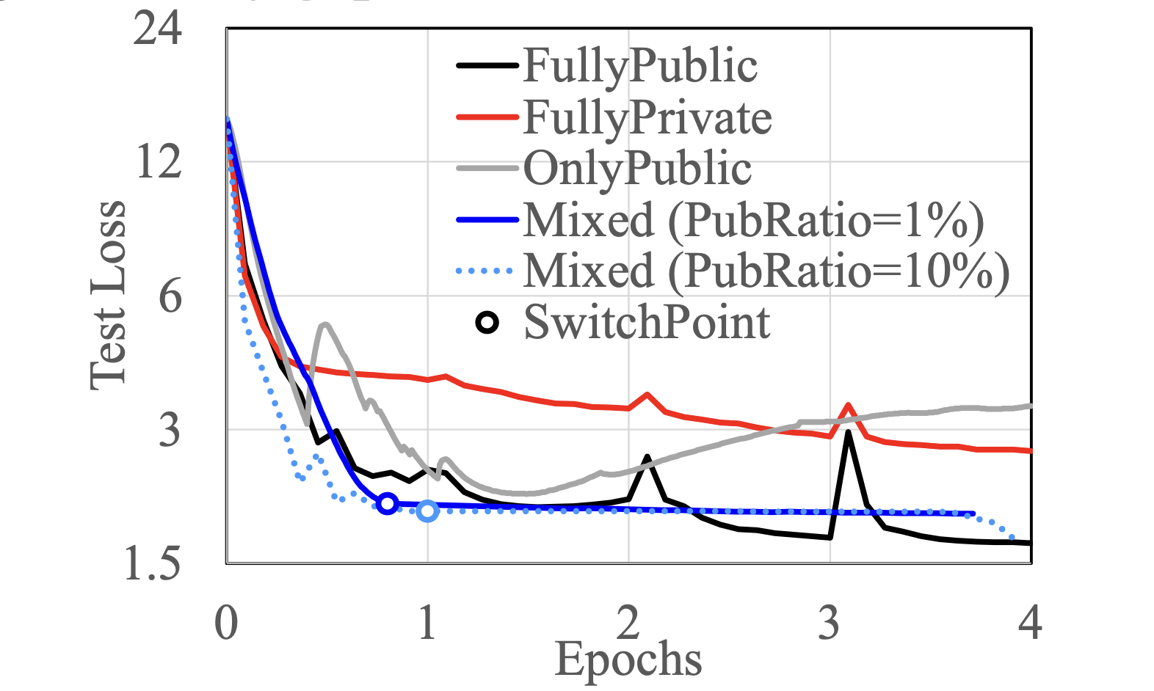
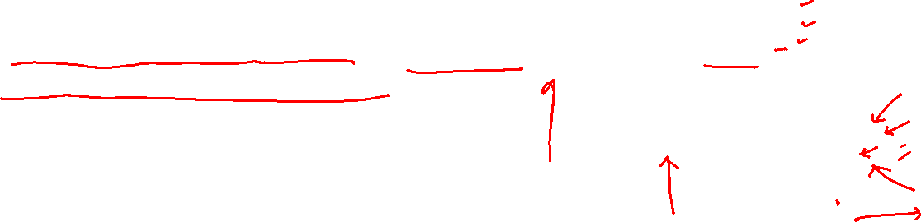
A middle ground: DP continual pre-training
Bu et al. [NeurIPS’24] suggested a middle ground between entirely pre-training with DP and non-private pre-training.
Start pre-training on public data with no DP, then switch on DP-SGD to continue pre-training on private data.
The public phase moves the model into a flat region in the loss landscape, so decelerator is already small when noise is applied.
With ~10% public data this method reaches near non-private accuracy while still protecting private pre-training data.
GPT2-small pre-training on CodeParrot dataset
(ε = 8 for mixed and private)
CodeParrot: Github dataset with ~20M .py files
https://arxiv.org/pdf/2402.18752

Slide 35
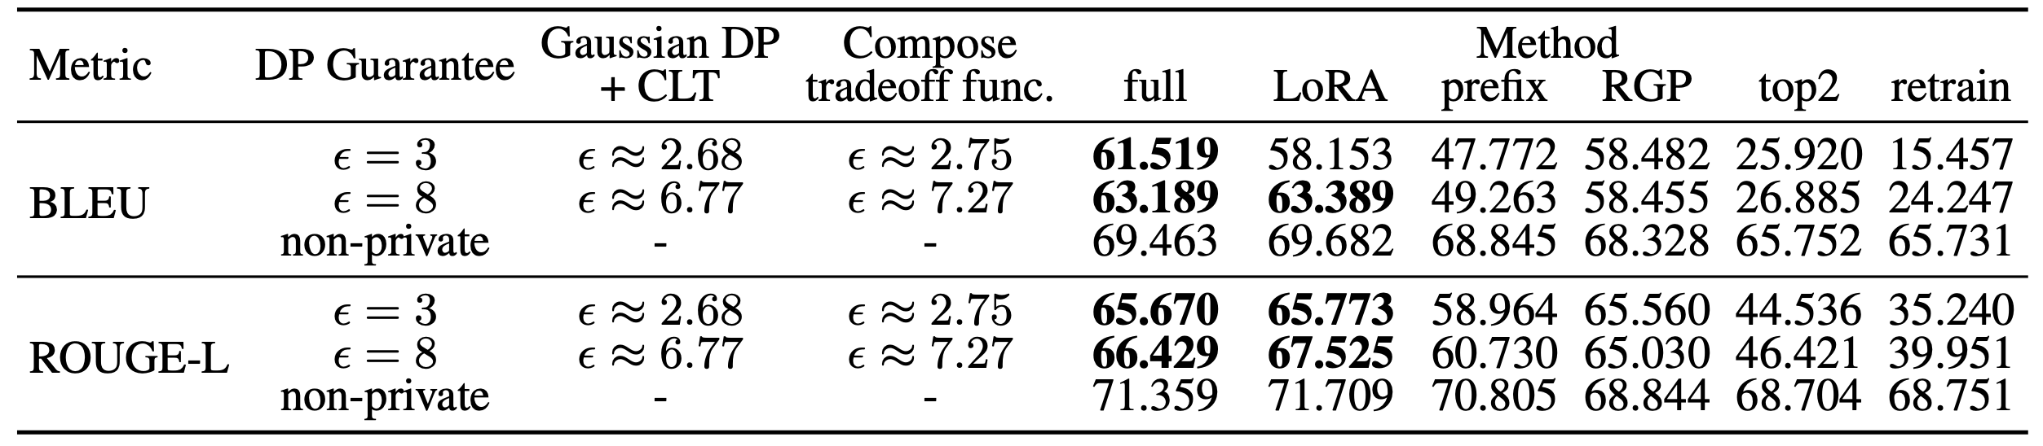
DP fine-tuning: Protect only the downstream data
Most cost-effective strategy: skip private pre-training, apply DP only when fine-tuning
Pre-training corpus is no longer protected, but the computational overhead is almost eliminated
GPT-2 on the E2E dataset (table-to-text generation)
https://arxiv.org/pdf/2110.05679
Notes:
Gaussian DP + CLT and Compose trade off function are privacy/moment accountant which calculated the actual privacy budget spent during training
Prefix- prefix tuning
RGP – Reparameterized Gradient Perturbation: a method which applies DP on BERT fine-tuning
Top-2 – Finetuning top 2 transformer blocks

Slide 36
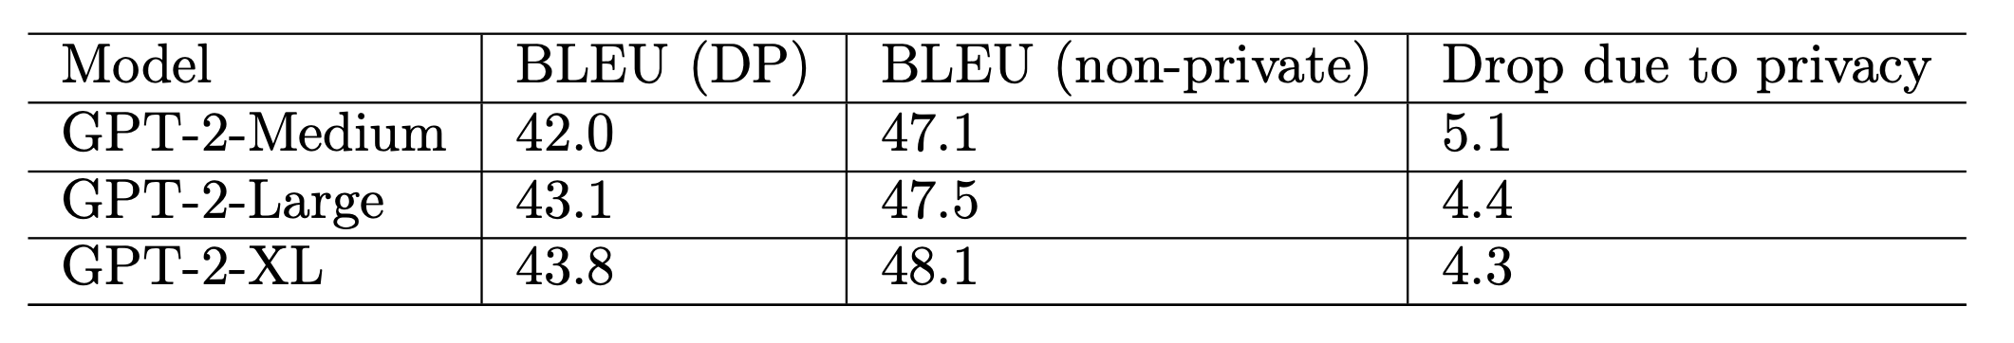
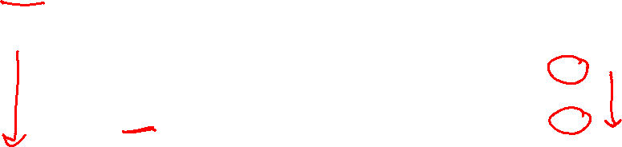
Private fine-tuning favours larger models
For prior DP work in areas like image classification with CNNs, the traditional belief was smaller models are better for private learning.
Accuracy of privately trained models typically degraded with increase in number of parameters due to DP noise being injected across every parameter, causing cumulative noise to drown out actual signal.
Yu et al. [ICLR’22] found the reverse for fine-tuning, scaling GPT-2 up narrows the gap to non-private.
Fine-tuning results on DART dataset (table-to-text generation)
DP params: ε = 6.8, δ=1e-5
https://openreview.net/pdf?id=Q42f0dfjECO

Slide 37
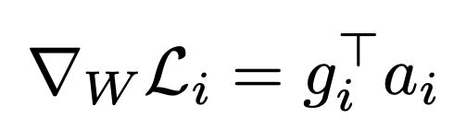
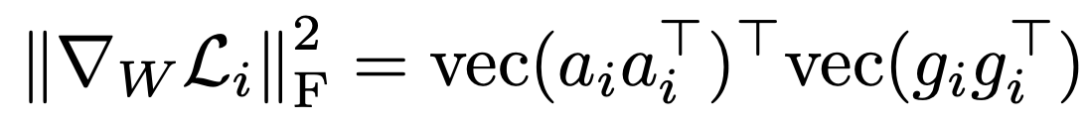
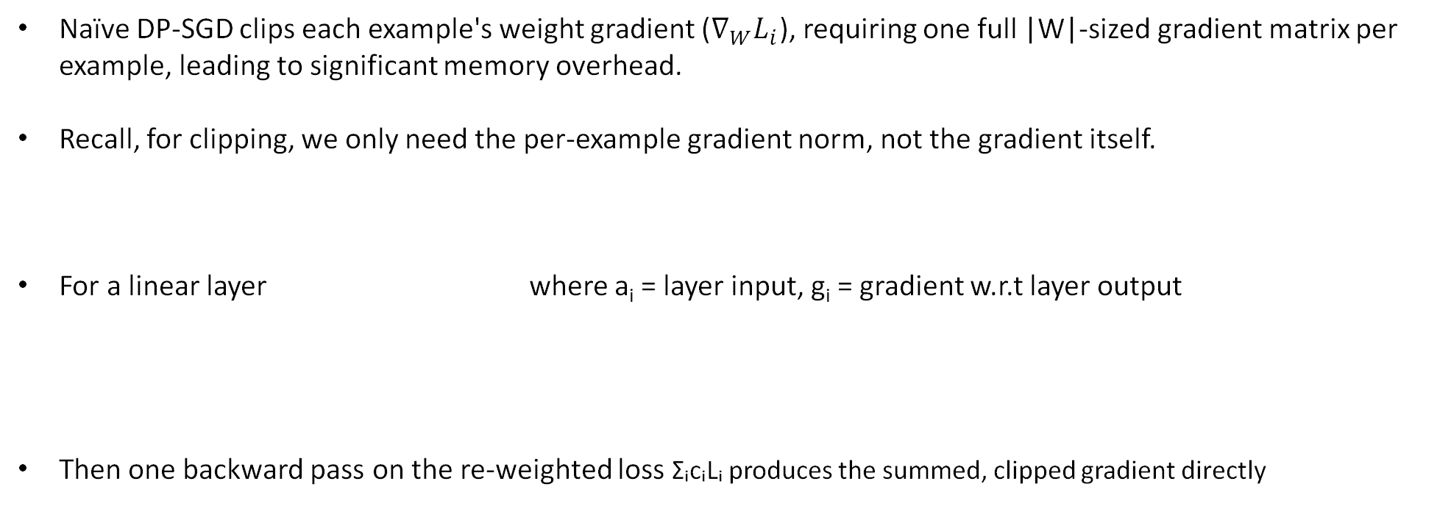
Making it practical: Ghost clipping
Naïve DP-SGD clips each example's weight gradient ($∇_{W}L_{i}$), requiring one full |W|-sized gradient matrix per example, leading to significant memory overhead.
Recall, for clipping, we only need the per-example gradient norm, not the gradient itself.
For a linear layer where a_{i} = layer input, g_{i} = gradient w.r.t layer output
Then one backward pass on the re-weighted loss ΣᵢcᵢLᵢ produces the summed, clipped gradient directly
https://arxiv.org/pdf/2110.05679
Notes:
s -> output, w - > weight matrix, a-> input, g→ gradient wrt s
s = w · a
∂s/∂w = a
∂L/∂w = (∂L/∂s) · (∂s/∂w)
∂L/∂w = g.a

Slide 38
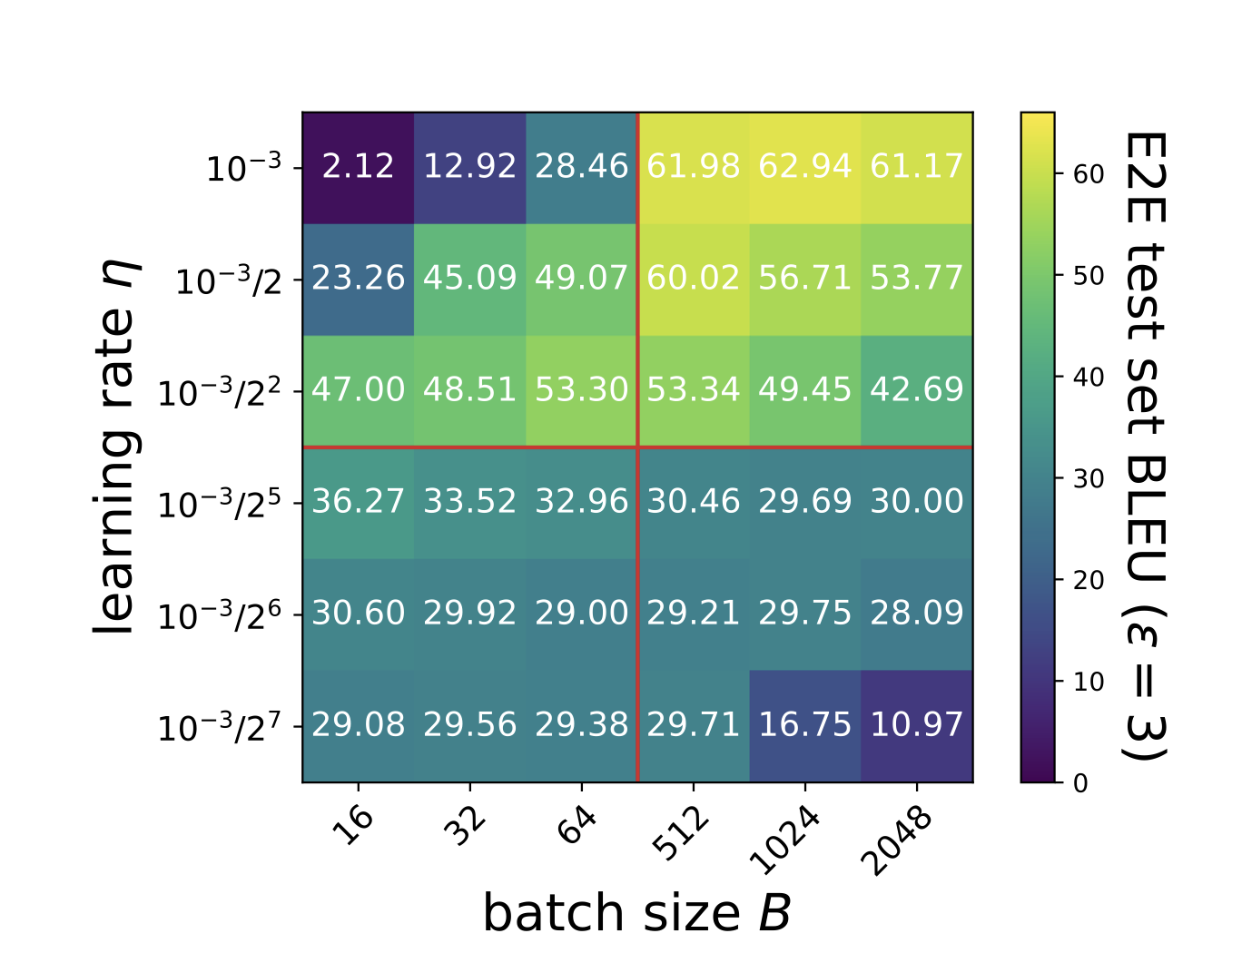
Hyperparameters for DP fine-tuning
DP fine-tuning is very sensitive to hyperparameters.
Usually, a large batch size and large learning rate are preferred, opposite of non-private tuning.
Aligning the downstream task with pre-training objective (e.g. framing a sentiment classification task as text-infilling) further improves performance.

Slide 39
DP-based Text Sanitization
Text Sanitization with Differential Privacy

Slide 40
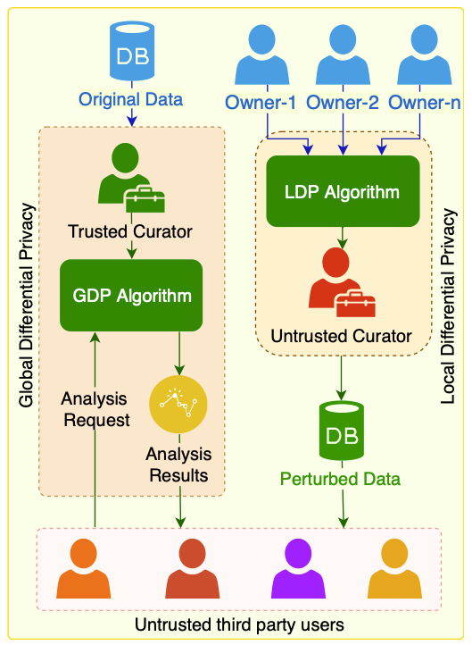
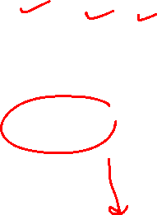
What and why?
What is it?
A local-DP method that re-writes text by replacing sensitive words with non-sensitive ones.
Runs on the user side, the model sees only the sanitized text
Motivation
Training-time DP (DP-SGD) protects the model, not the text the user shares
We want a formal guarantee on the shared text itself

Slide 41
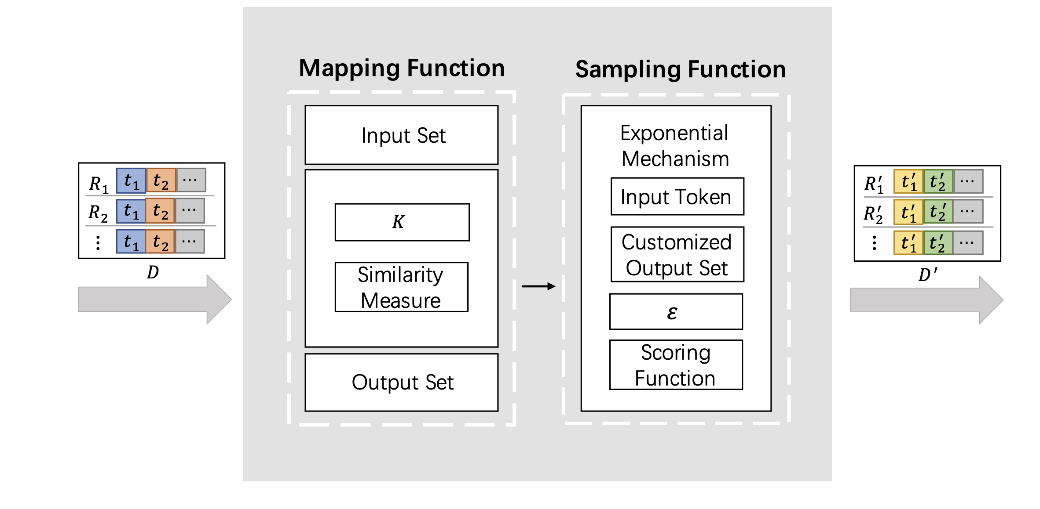
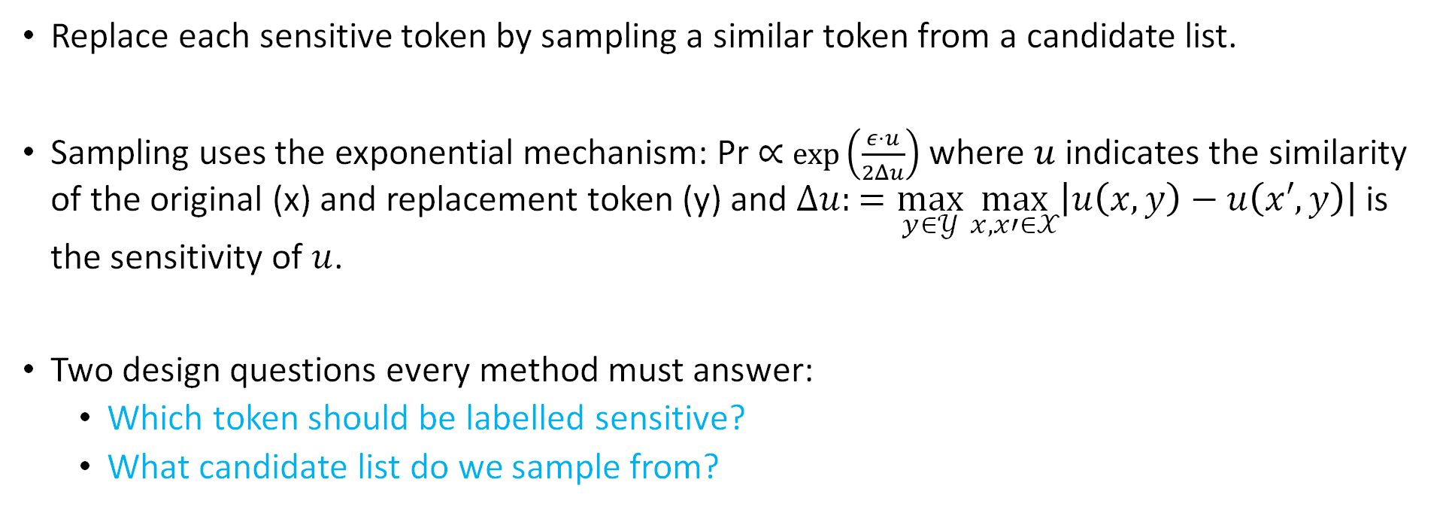

The standard mechanism for token substitution
Replace each sensitive token by sampling a similar token from a candidate list.
Sampling uses the exponential mechanism: Pr ∝ $\exp\left(\frac{ε⋅u}{2Δu}\right)$ where $u$ indicates the similarity of the original (x) and replacement token (y) and $Δu:=\max_{y∈𝒴}{\max_{x,x′∈𝒳}\left|u\left(x,y\right)−u\left(x′,y\right)\right|}$ is the sensitivity of $u$.
Two design questions every method must answer:
Which token should be labelled sensitive?
What candidate list do we sample from?
Figure Source: CusText

Slide 42


CusText: Candidate list
Idea
For each sensitive word, fix a list of its K nearest words using semantic distance (K ≈ 20)
Sample the replacement only from that list
Why
Keeps the replacement semantically close, so utility stays high
Works with any similarity measure, not only metric distances.

Slide 43

CusText+: Which words are sensitive?
CusText (base method) treats every token as sensitive and perturbs all of them
CusText+ uses a simple rule: skip a fixed stopword list (e.g. from NLTK), every other word is considered sensitive.
Consequence: a highly revealing word (e.g. cancer) gets no more protection than an ordinary one.
Notes:
Because

Slide 44


CusText+: Results
Privacy is measured using query attack: Repeatedly querying sanitized document until original token is recovered
Privacy: Number of queries needed to recover mentioned token
Utility: Accuracy on SST-2 (sentiment analysis task)
Notes:
SanText is a prior work which has candidate list of vocabulary size
SanText has ε’ as it uses metric-LDP

Slide 45
CusText: Drawbacks and towards adaptive protection
Drawbacks
Simplistic sensitivity rule: Treats every non-stopword as sensitive, without actually considering privacy risk
Static candidate list: Uses the same replacement candidates for a sensitive token in every run, making the mechanism more predictable and easier to attack.
Uniform candidate list size: Assigns the same number of replacement candidates to every word, regardless of sensitivity.
Can the candidate list be adapted to each word's actual sensitivity
instead of using a fixed, uniform size?

Slide 46
DynText: Intution
Decide each word’s sensitivity from its semantic density in the embedding space.
Rare words (few close neighbors) are more sensitive
Frequent words (many neighbors) are less sensitive

Slide 47


DynText: Method
Estimate each word’s density under DP using Gaussian mechanism
Let $f\left(t\right)=\left|\left\{\overset{ˆ}{t}∈V_{t}∣d\left(t,\overset{ˆ}{t}\right)≤γ\right\}\right|$ be the true density of token t in embedding space
$F\left(t\right)=f\left(t\right)+𝒩\left(0,σ_{d}^{2}\right)$ noisy density after adding Gaussian noise
$\overset{ˆ}{F}\left(t\right)=\frac{F\left(t\right)−F_{min}}{F_{max}−F_{min}}$ is the normalized density
Candidate list size $k_{t}=\max\left(1,\left\lfloor \left(1−\overset{ˆ}{F}\left(t\right)\right)K\right\rfloor \right)$, where K is the maximum list size
Low density -> larger replacement list (more noise, more privacy)
High density -> smaller replacement list
Sample replacement from the list using exponential mechanism (discussed in CusText)
Notes:
Overview of DYNTEXT. Given a sensitive text, DYNTEXT sanitizes it through three modules, executed sequentially:
Semantic-based Density Information Modeling under DP extracts each token’s semantic-based] density information in the embedding space and applies noise;
Dynamic Construction of Adjacency List builds an adjacency list for each token based on this density information;
Finally, Private Token Replacement via Similarity samples non-sensitive tokens from the adjacency list to replace sensitive tokens.

Slide 48

DynText: Results
Privacy
Input inference attack: the adversary uses a pre-trained BERT model to recover the original private text from the sanitized text by masking and predicting each token
Input inference attack success rate near 0, stable as ε grows
Attack success rate on input inference attack

Slide 49


DynText: Results
MAUVE: similarity between LM generated text and human authored target continuation
Coherence: cosine similarity between text and continuation
Close to non-private GPT-4 upper bound with respect to utility
Replacement stays closer to original word (less semantic loss)

Slide 50
Summary
Surface | DP mechanism | Guarantee | Gap
Pre-training corpus | DP-SGD from scratch | No detectable memorization | GPT-2 level utility; massive compute cost
Private pre-training data | DP continual pre-training | Near non-private accuracy ε = 8 | Requires ~10% public data
Downstream task data | DP fine-tuning | Small drop at ε = 3-8 | Pre-training corpus unprotected
User’s prompt | Local-DP sanitization | ε-LDP per token | Semantic drift, token level privacy not person-level

