Slide 1
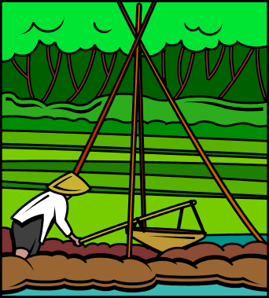


AEN 459 Design of Wells and Pumps
Where are our Water Resources?
Surface Water
Groundwater
Precipitation

Slide 2
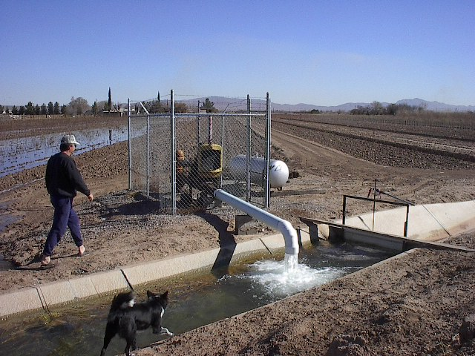
Water Is Precious in New Mexico

Slide 3
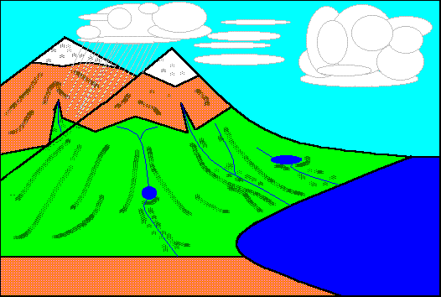
Where does water come from?
Hydrologic Cycle

Slide 4
What percent of the world water is freshwater?
<0.2 %?
Glacier: 2. percent
Streams, River,groundwater

Slide 5
What percent of the world freshwater is
In the form of groundwater?
>98%?

Slide 6
What percent of drinking water in NM
Is coming from groundwater?
~100 percent

Slide 7
Which GW are we using?
In Southern NM?
Mesilla Bolson
Jornada Basin

Slide 8


What are our other sources of water?
Rio Grande River?
Precipitation?

Slide 9
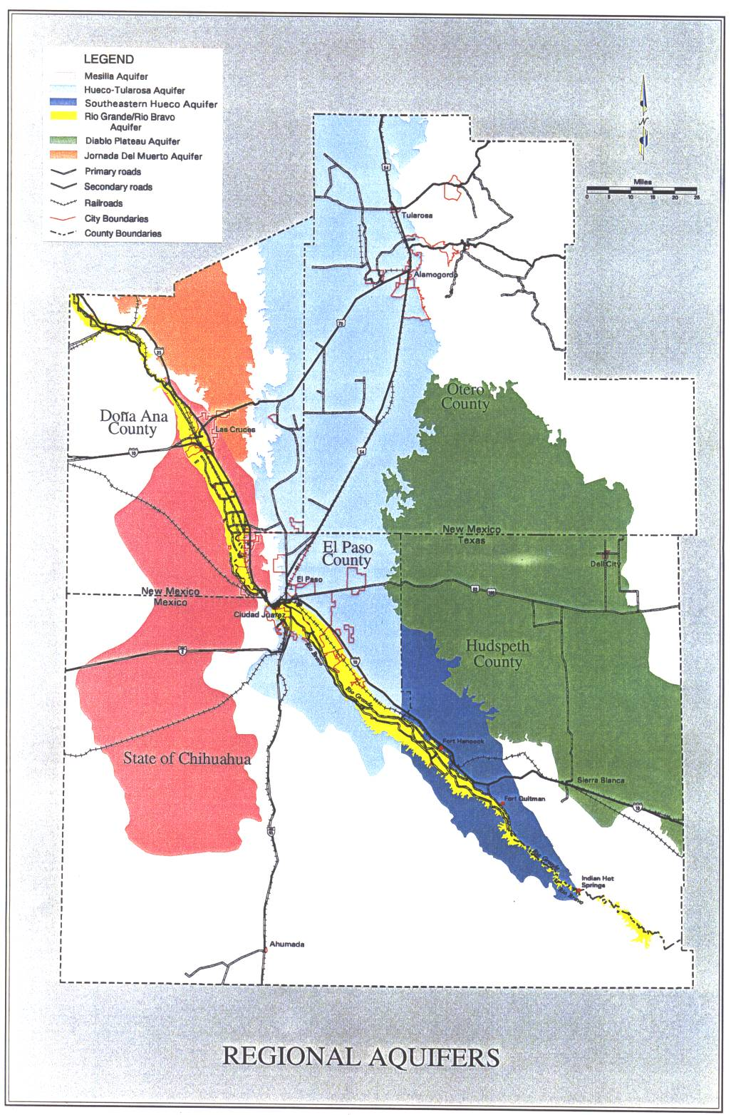

Slide 10
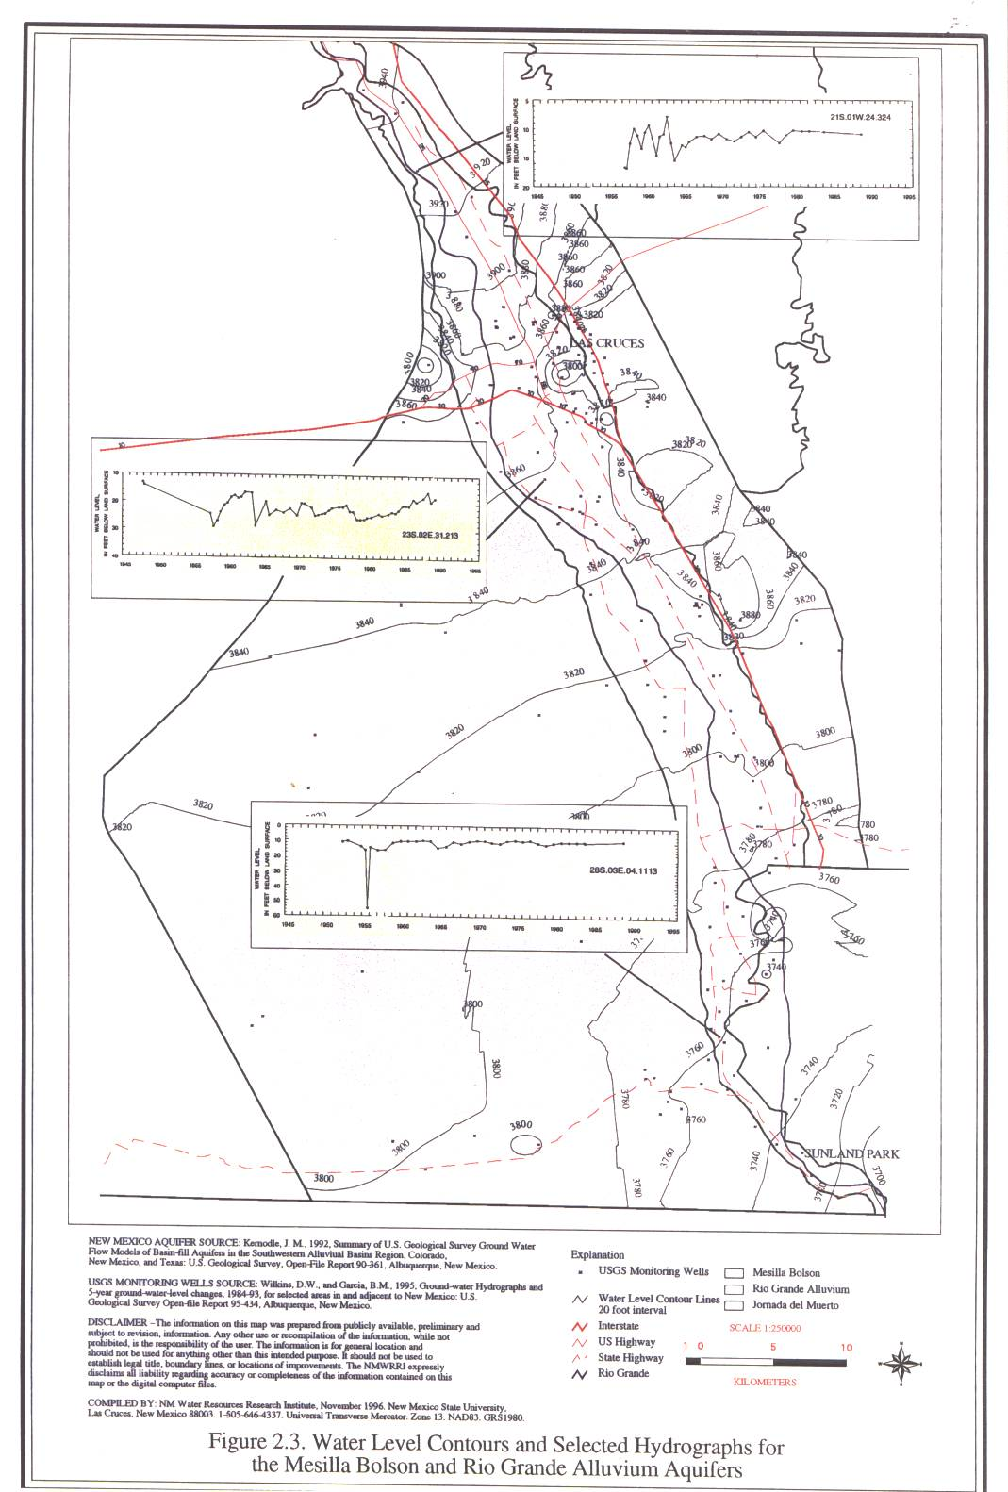

Slide 11
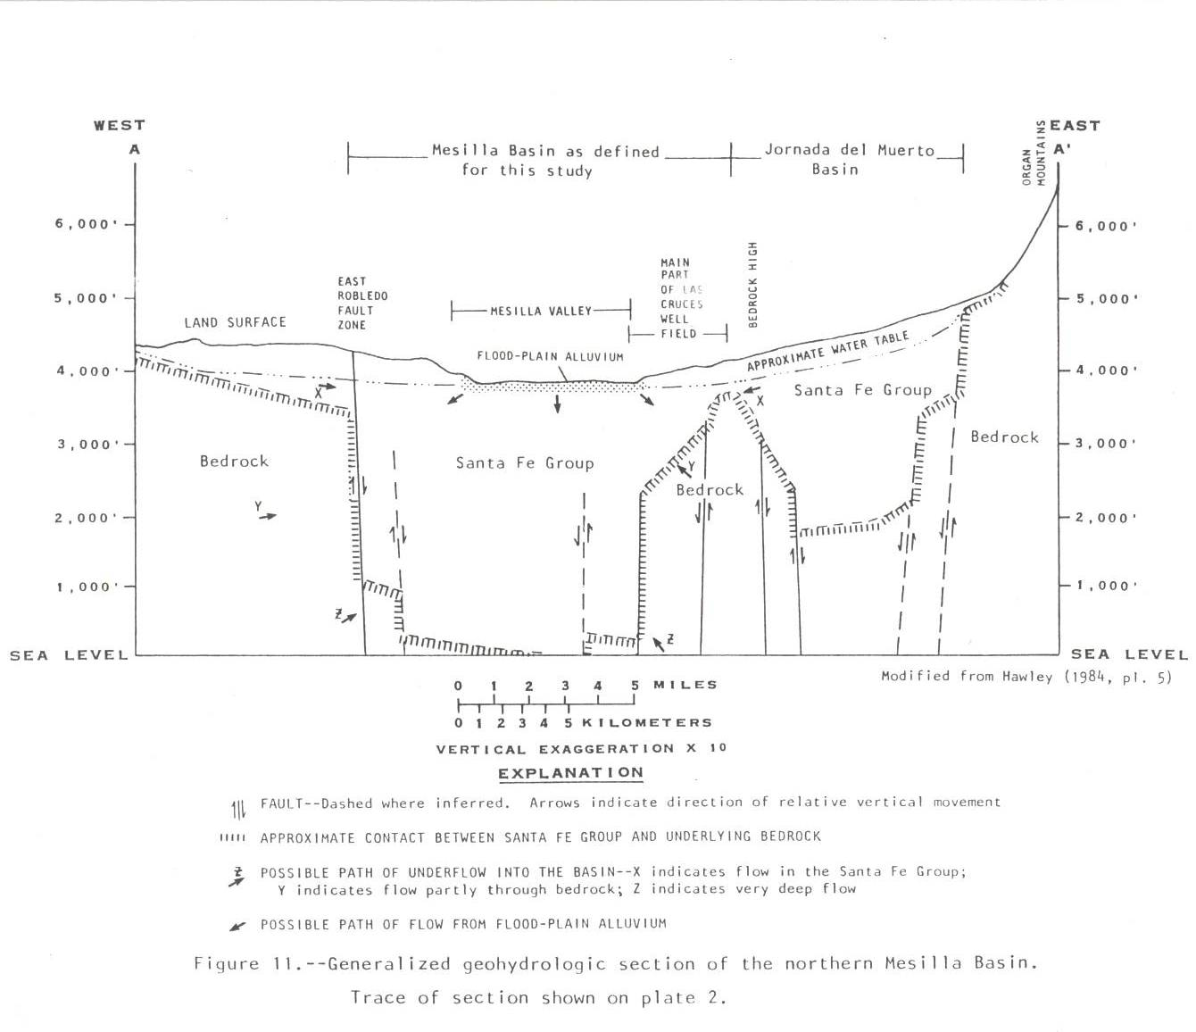

Slide 12
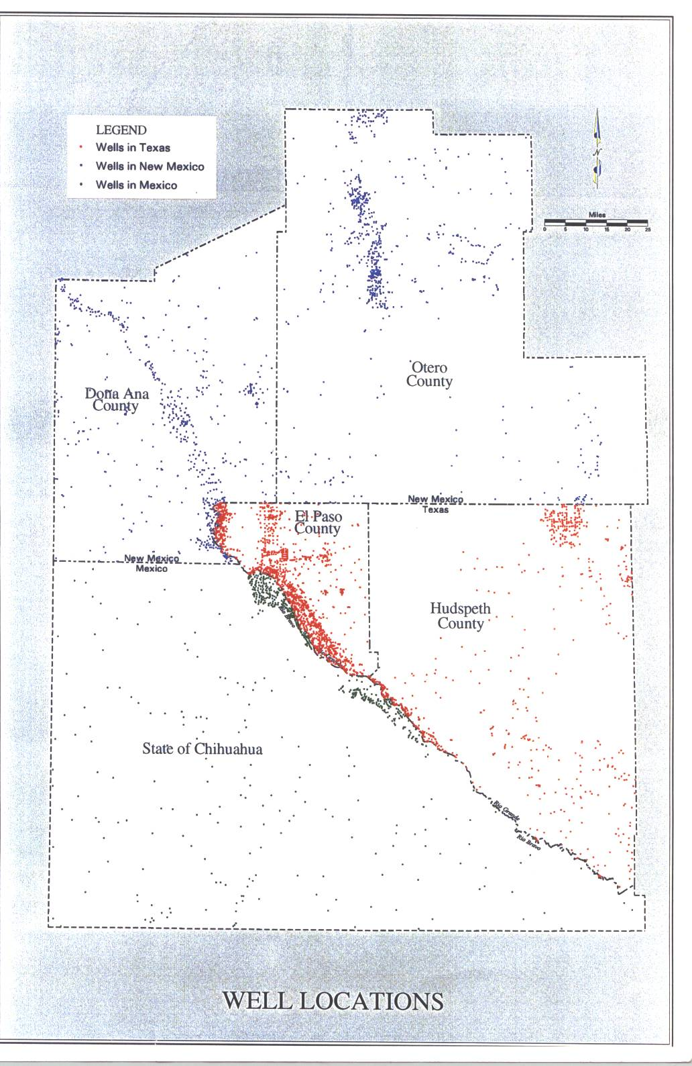


Slide 13
What is GW?
Groundwater is water bearing formation which can store
And transmit water in sufficient quantity.

Slide 14
What are advantages and
Disadvantages of GW compared
to Surface Water?
Dependability?
Quality?
Economics (Cost)?

Slide 15
Potential Threats to GW resources?
Over exploitation?
Contamination?

Slide 16
Definition of Terms
Aquifer:
Groundwater is a water bearing formation that can store and
Transmit water in sufficient quantity.
2. Water Table:
Water table is part of the saturated formation where pressure
Is atmospheric.
3. Piezometric surface:
The level to which water will rise in a well penetrating a confined aquifer

Slide 17
4. Confining bed:
A formation of less permeable material above or below a more permeable
Aquifer. Its hydraulic conductivity may be greater than zero, but it is
Distinctly lower than the aquifer it confines.
What is hydraulic conductivity?
5. Confined aquifer:
An aquifer sandwiched between confining beds. Water in confined aquifer
Is under a pressure greater that atmospheric and rises in a well to the
Piezometric surface. It is also know as artesian aquifer.

Slide 18
6. Static Water Level:
The level of water in the well when the well is not being pumped
7. Dynamic water level/pumping water level:
The level of water in a well when the water is being pumped
8. Drawdown:
The difference between static water level and dynamic water level

Slide 19
9. Porosity:
The ratio of total void space in a media divided by bulk volume
10: Well yield
The pumping rate from a well

Slide 20

Suppose that we want to drill a well
In Las Cruces in our property,
What should we do?

