Slide 1

AEN 459
Suppose that we want to drill a well
In Las Cruces in our property,
What should we do?

Slide 2
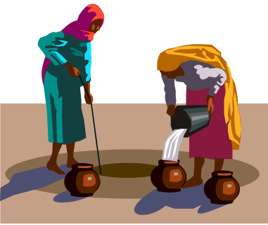

Questions to be asked
Before drilling a well
Is GW available?
What type of GW?
How deep is the GW?
What is the water quality?
How much can be pumped ?
How much needed?
Cost?
Legal/permit issues

Slide 3
We need to identify the aquifer characteristics, which are:
Porosity
Permeability, K
3. Thickness
4. Specific yield and/or storage coefficient

Slide 4
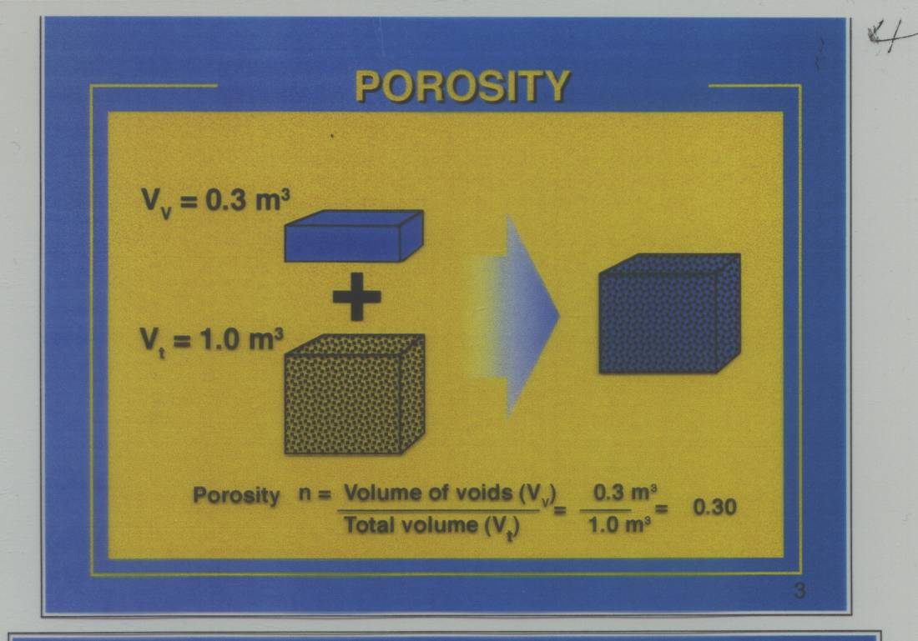

Slide 5
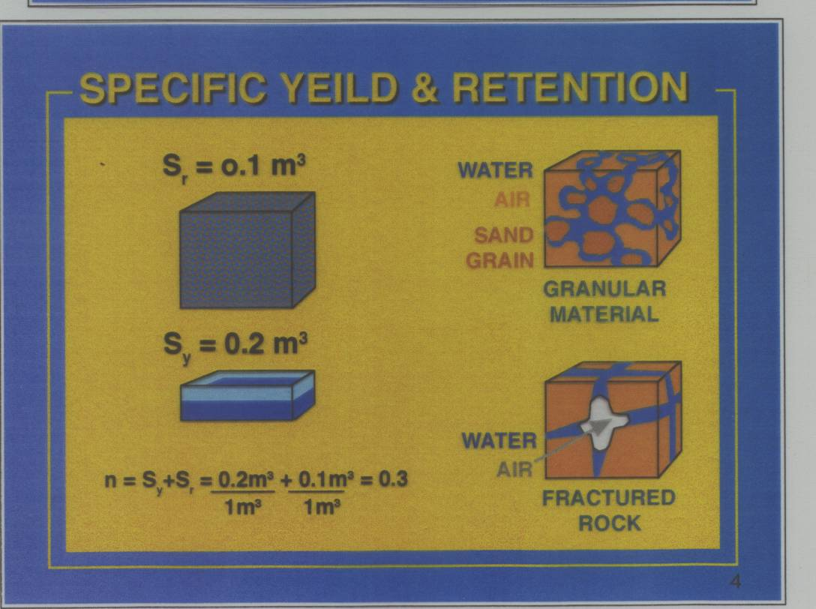

Slide 6
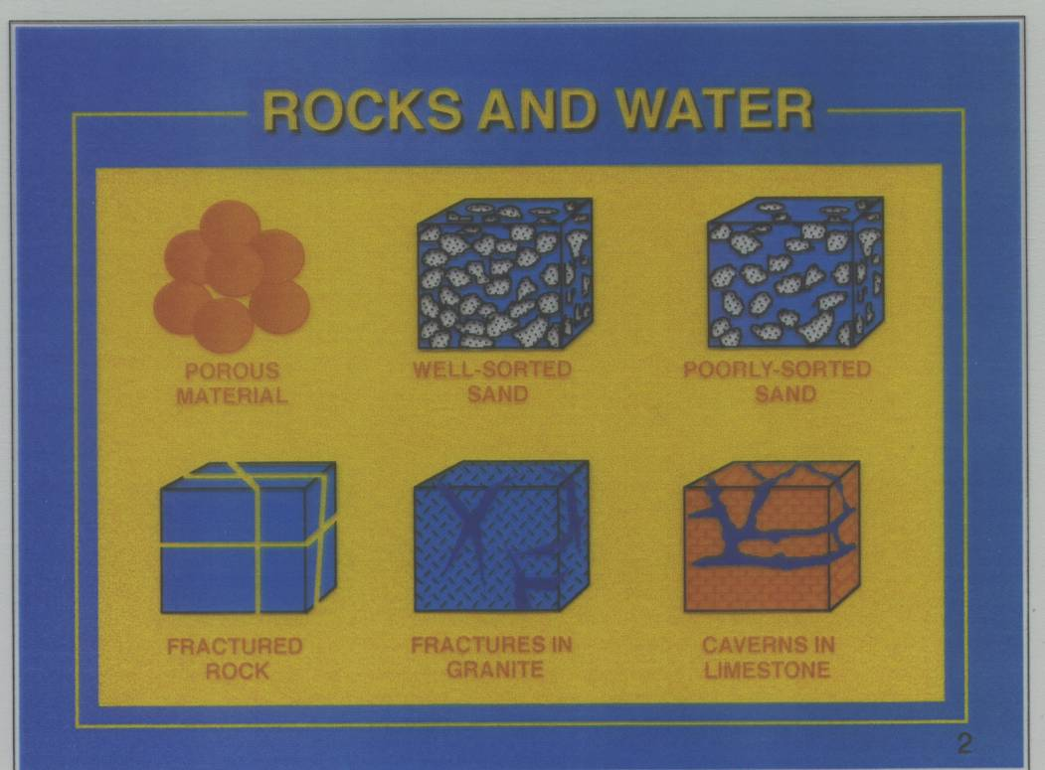

Slide 7
Porosity:
Porosity = volume of void/ total bulk volume
Max theoretical porosity in porous media is 48%

Slide 8
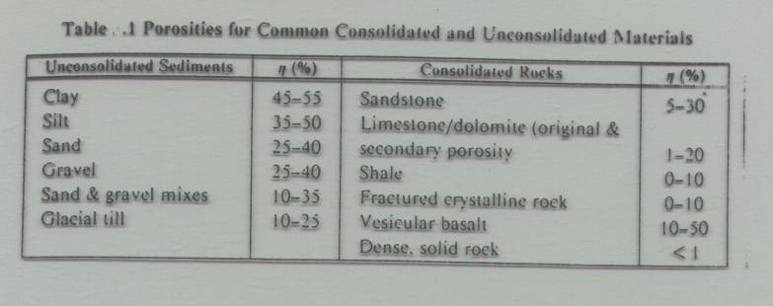

Slide 9
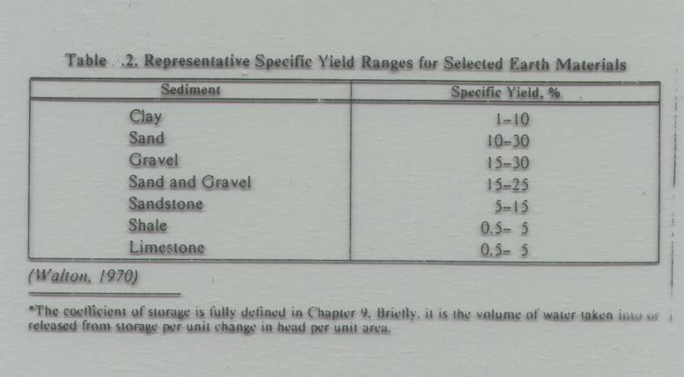

Slide 10
How do we measure porosity?
Laboratory measurement
Field measurement
How do we measure specific yield?
Laboratory measurement
Field measurement

Slide 11
Aquifer properties:
Porosity, specific yield, Transmissivity
Total volume stored:
Volume of aquifer x n
Total volume available:
Volume of aquifer x S_{y}

Slide 12
Specific yield:
is volume of water drainable
From a unit area of aquifer under a unit drop
In piezometric head.

Slide 13
Piezometric head:
The level to which water will rise in a well
Drilled in a confined aquifer
Static water level:
The level of water in a well drilled in
Unconfined aquifer

Slide 14
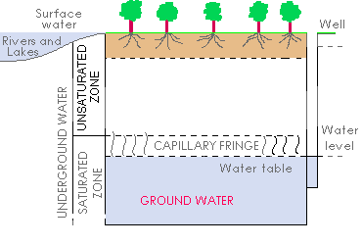
How does water store underground?

Slide 15
Aquifer: Water bearing formation
That can store and transmit water
In sufficient quantity
Types of aquifer:
Perched
Confined
unconfined

Slide 16
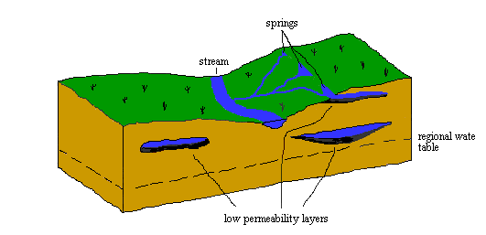
Perched water (aquifer)

Slide 17
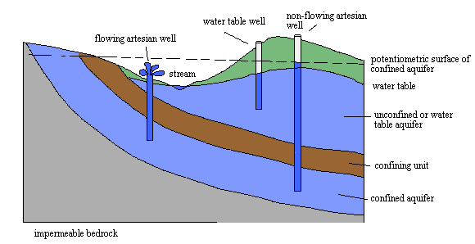
Confined aquifer
Unconfined aquifer

Slide 18
Unconfined aquifer:
A saturated formation where the top of the
Formation is at atmospheric pressure
Confined aquifer:
A saturated formation where the top of
the aquifer is at positive pressure.
The water level in confined aquifer will
Rise in the well to piezometric head

Slide 19
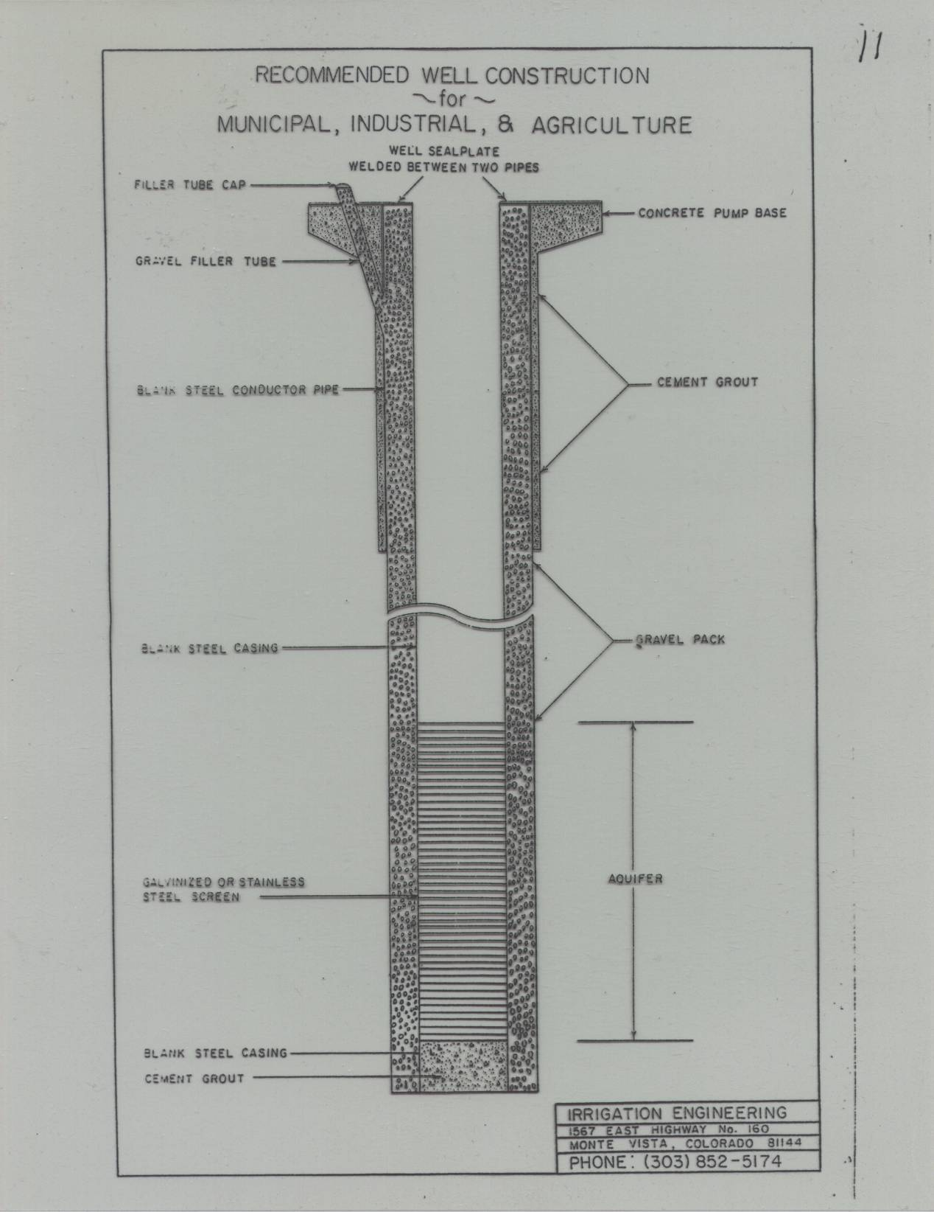
How do we explore GW?

Slide 20
