Slide 1
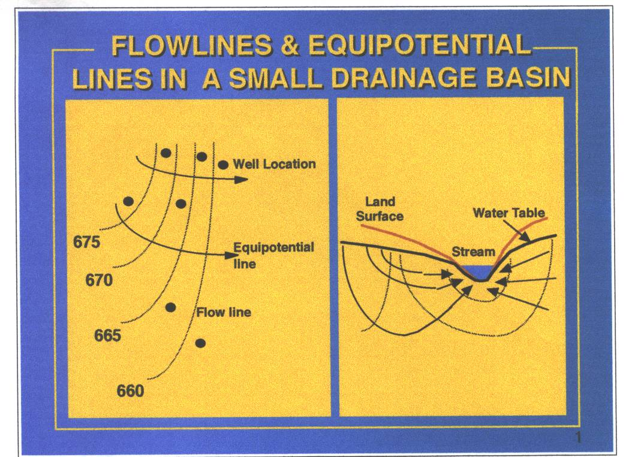

Slide 2
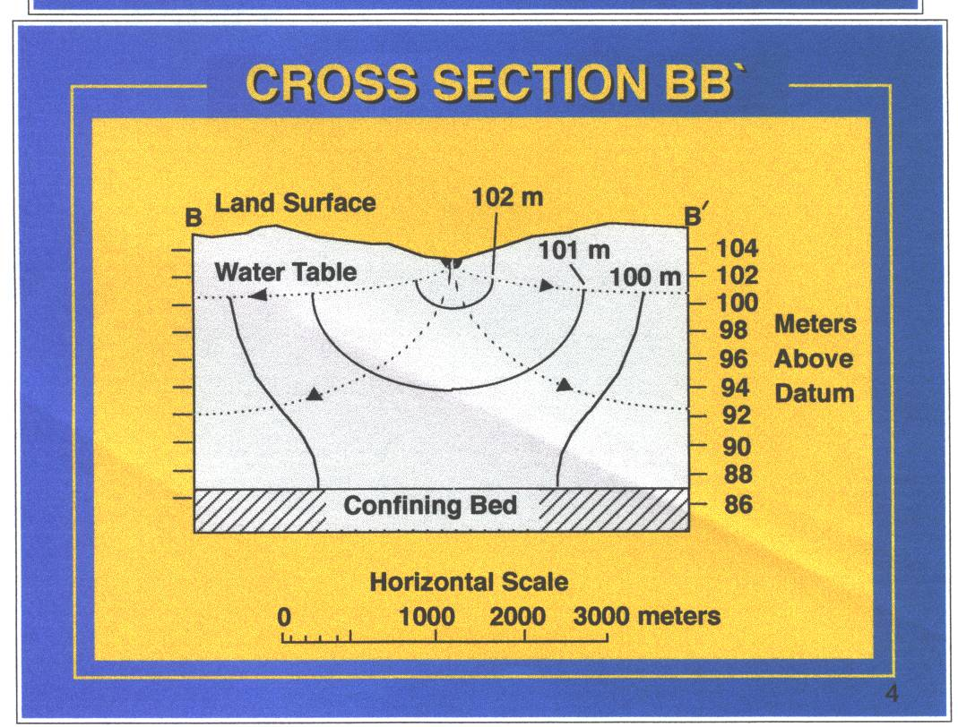

Slide 3
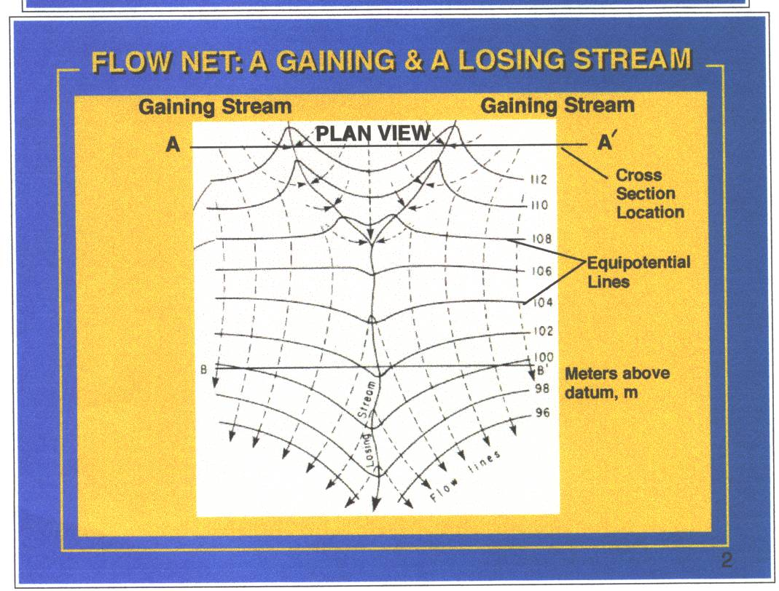

Slide 4
Darcy’s Law
Assumption: Steady state flow condition
Vol. = K.I.A.T
Q= K.I.A
V=K.I
Q = T.I.W

Slide 5
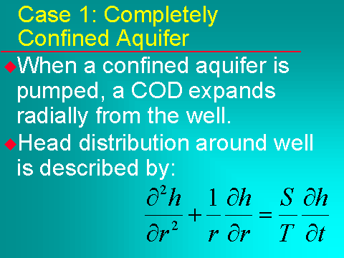

Slide 6
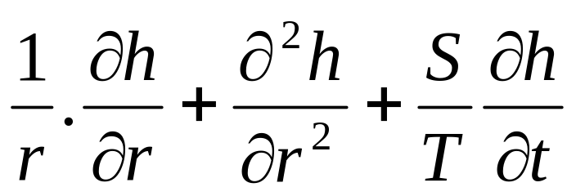
Theis, 1935, New Mexico
Developed the transient GW flow equation
GW Flow Equation in radial form
r = distance from a well
h= hydraulic head at distance r
S = storage coefficient of aquifer
T = Transmissivity
t = elapsed time

Slide 7
Groundwater Flow
Steady State
Non-Steady (Transient flow)

Slide 8
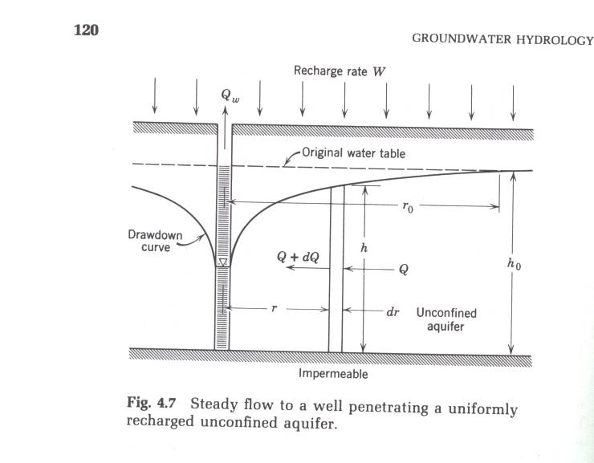
GW Flow Toward a Well
In Radial Coordinates

Slide 9
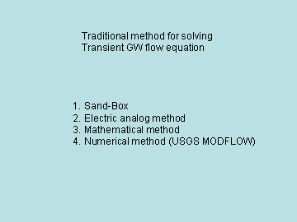
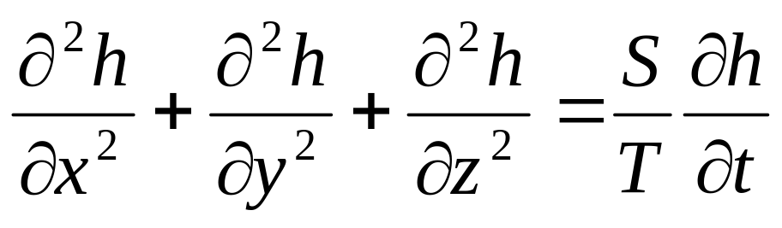
GW flow equation in Cartesian Coordinated
X, y and z are distance from origin

Slide 10
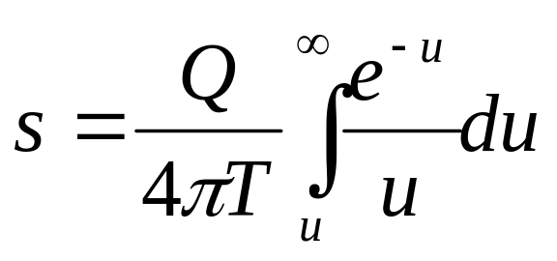
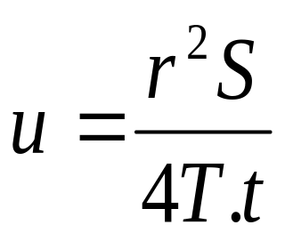
Theis (1935) used the concept of
Heat sink/source to solve the
Radial form of GW flow equation
s = drawdown
Q =pumping rate
T = transmissivity

Slide 11
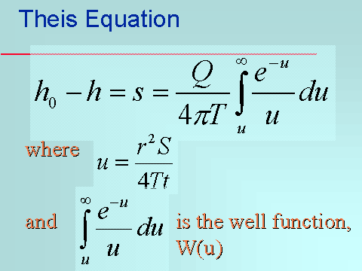

Slide 12
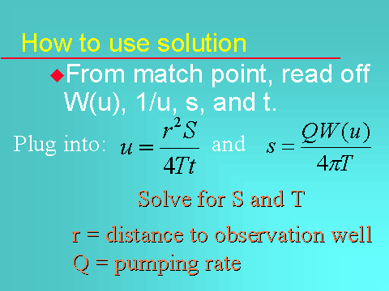

Slide 13
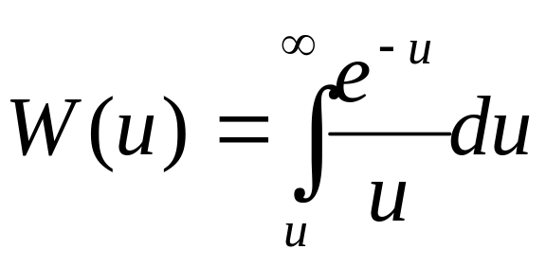
W(u) =[-0.5772-lnu+u-u²/(2.2!)+u³/(3.3!)-u⁴/(4.4!)+u⁵/(5.5!)-…]
Normally five elements within the bracket
Is sufficient.
You can also use table 4.1, p29

Slide 14
Theis assumptions:
No external recharge or discharge
The aquifer is homogeneous, Isotropic and
Has uniform thickness
3. Aquifer is confined
4.The well penetrates the entire aquifer and
Is screened all the way through aquifer
5. The flow lines are horizontal
6.The well diameter is infinitely small
7.The head in the aquifer responds instantly
8. The aquifer is infinite

Slide 15
Why do we need Theis eq.
What is the first thing we need to do
If we want to drill a well?
1.Preliminary investigation using existing data
2. Get a permit for a test hole
Need to advertise the intent.
You get sued for infringement

Slide 16
If infringement is proven,
What are possible remedies?
Rejection of permit
Financial compensation for the impact
Night versus day pumping
Gun?

Slide 17
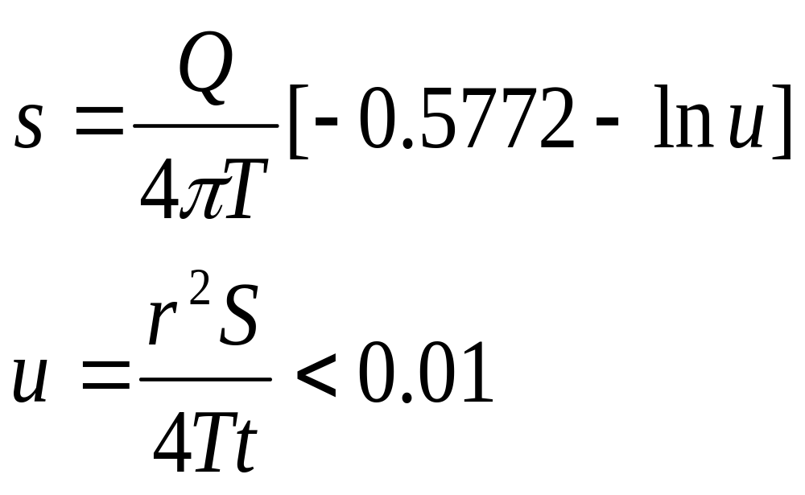
Cooper-Jacob eq.

Slide 18
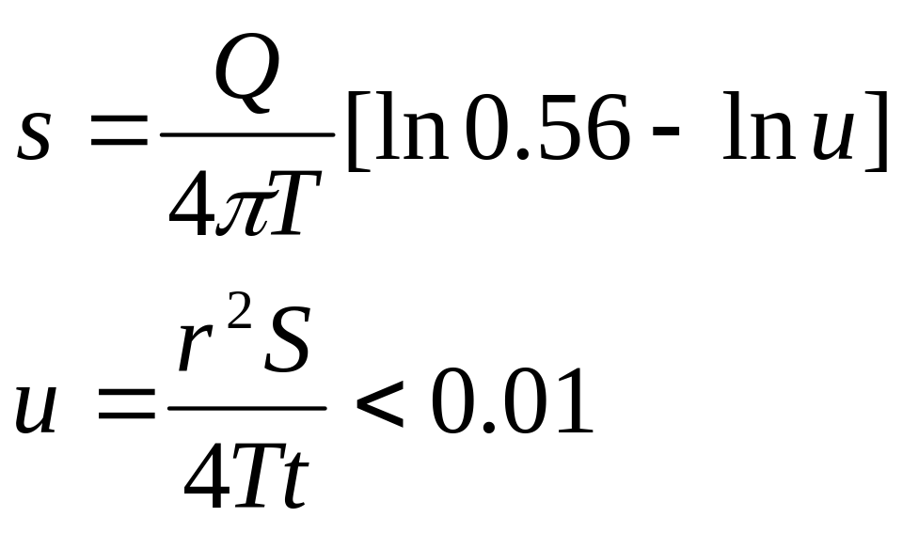

Slide 19
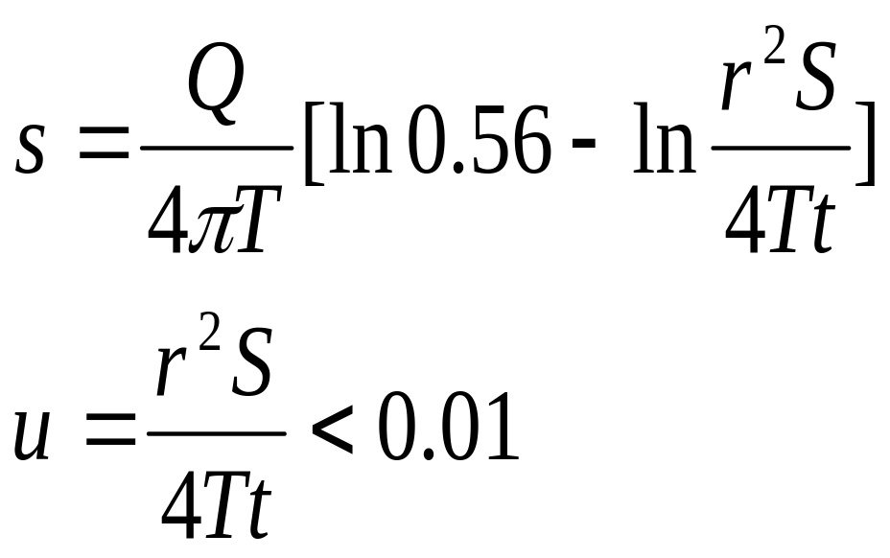

Slide 20
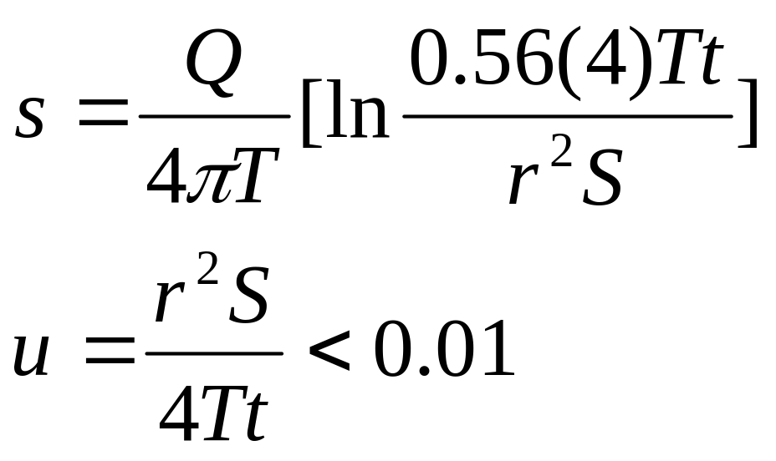

Slide 21
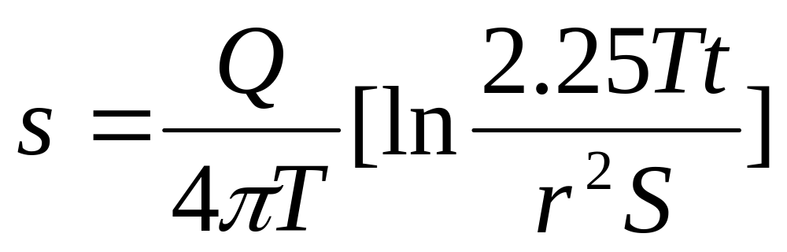

Slide 22
If s, drawdown = 0
2.25Tt/r²S =1

Slide 23
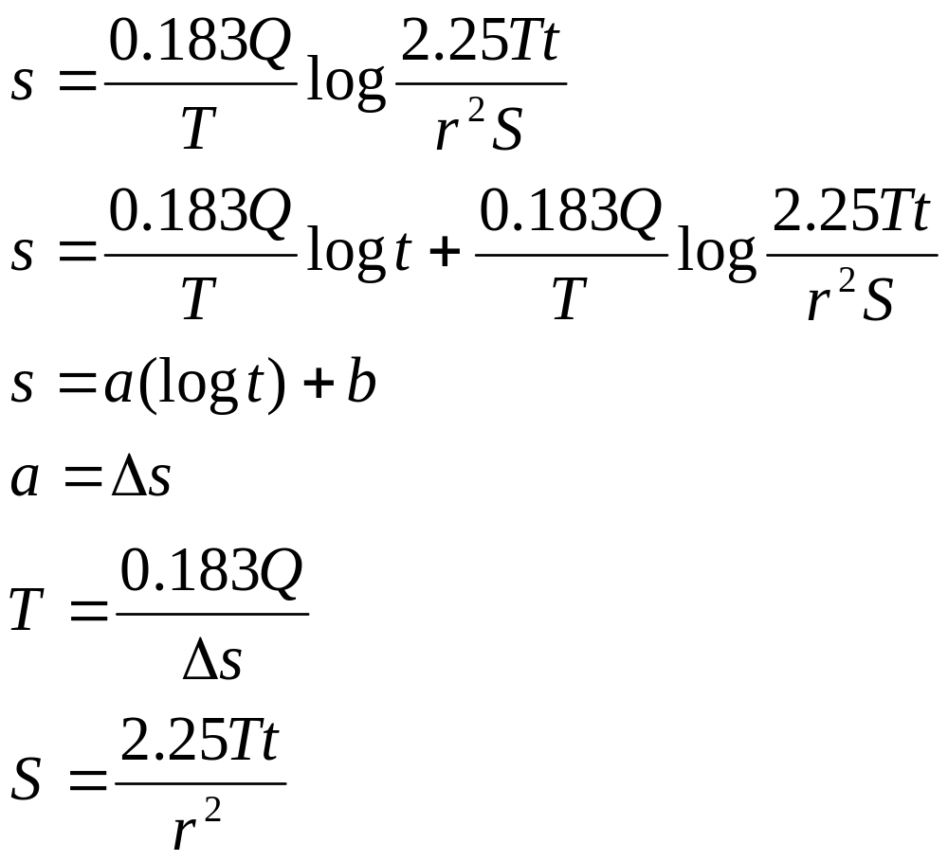

Slide 24
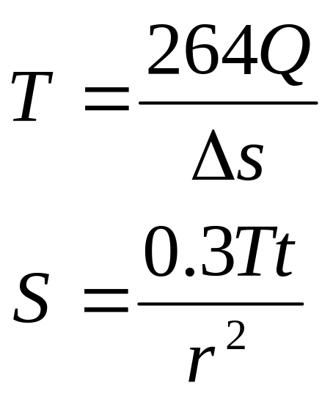
In U.S. conventional units
t, is day
T is gpd/ft
r is in ft

Slide 25
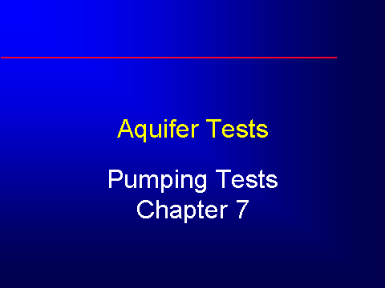

Slide 26
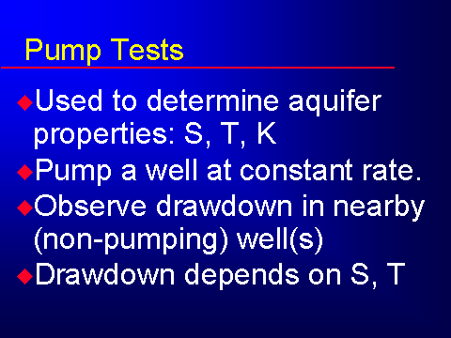

Slide 27
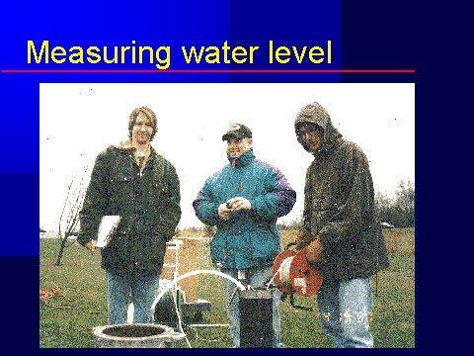

Slide 28
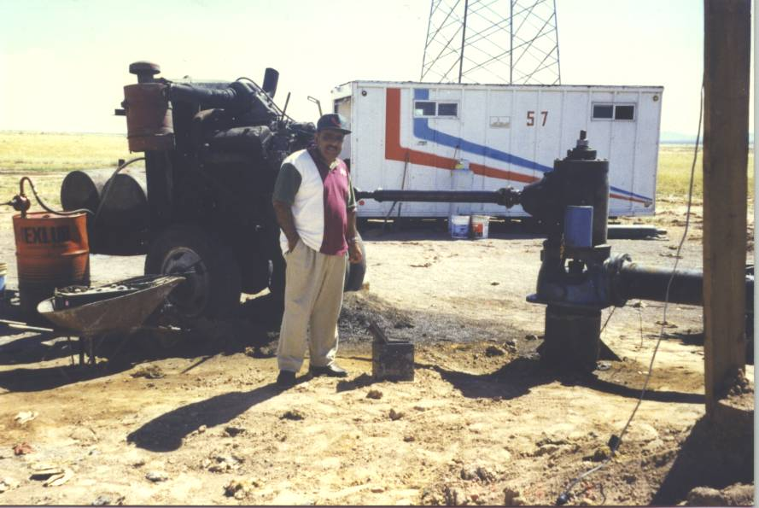

Slide 29
