Slide 1


CE 382, Hydraulic Systems Design
(pipes, pumps and open channels)

Slide 2
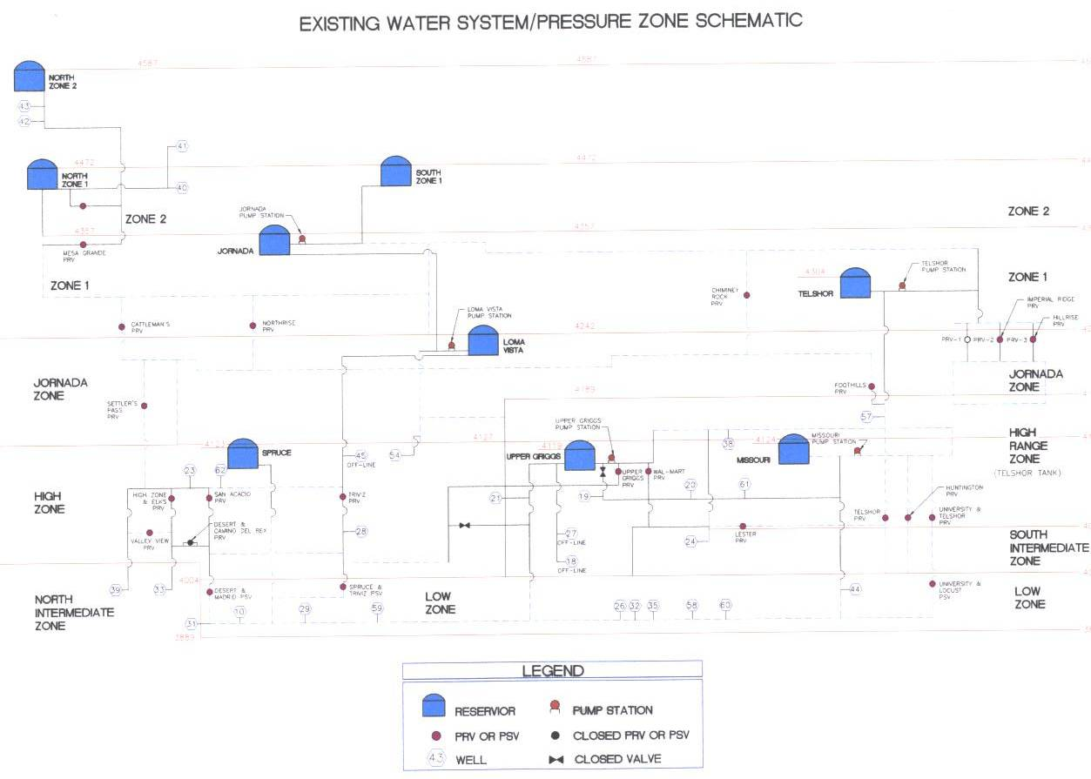

Slide 3
CE 382 is continuation of CE 231 and CE331
What did you learn in the previous hydraulic courses?

Slide 4
Principles of hydraulics
Conservation of energy
Conservation of mass (Continuity)
3. Conservation of forces (Momentum)

Slide 5
What is conservation of mass/ continuity?
A1. V1 = A2. V2

Slide 6
What is conservation of energy
Energy
E = P/γ + V²/2g +Z
E1 = E2+ hL (Bernullie equation)
hL = h_{f} + h_{m}

Slide 7
hL= hf+ hm
hL = head loss
hf = friction loss
hm = minor loss

Slide 8
What is h_{f} ?
h_{f} = conversion of kinetic energy to heat
What is h_{m}

Slide 9
Minor loss equation
h_{m} = k. V²/2g

Slide 10
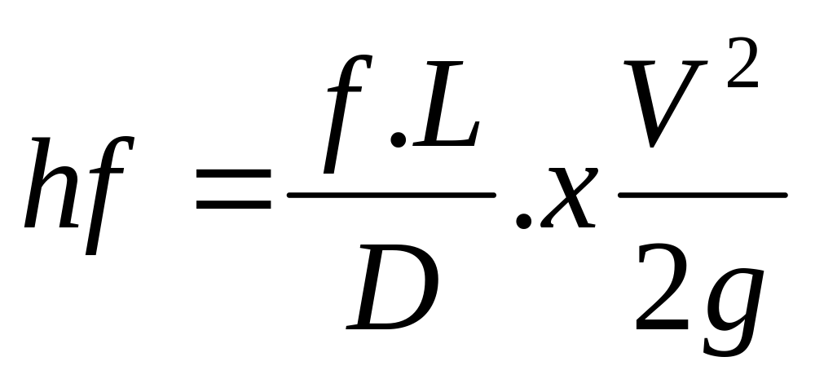
How to calculate hf?

Slide 11
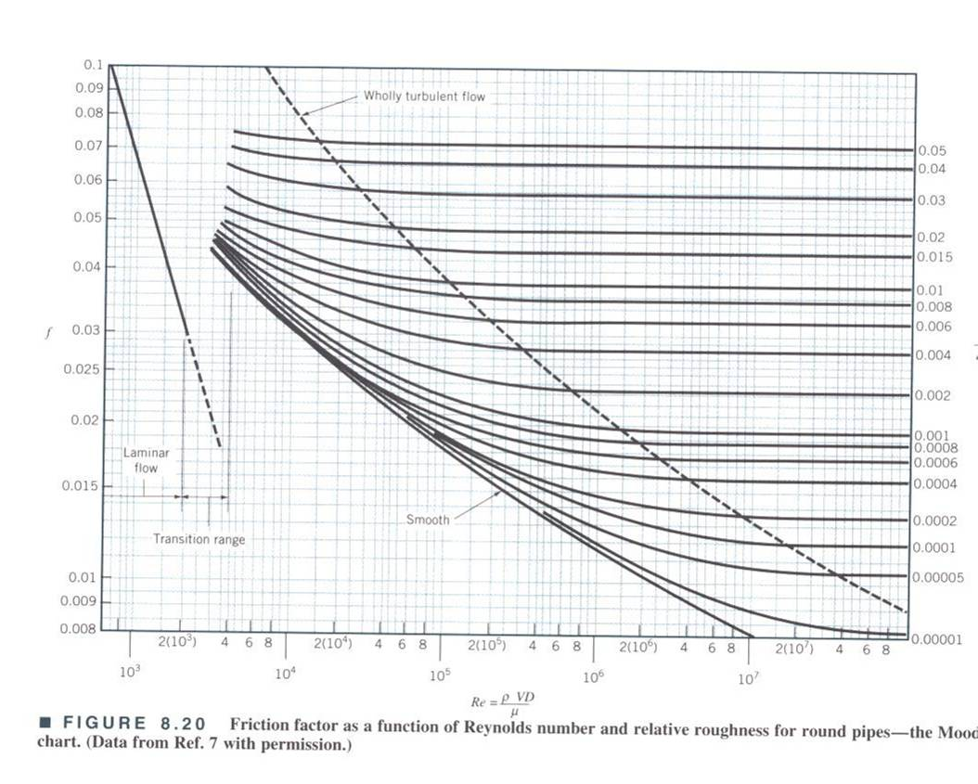

Slide 12
Other equations to calculate head loss
Darcy-Weisbach, D.W
2. Manning
3. Hazen-Williams, H-W

Slide 13
Where does minor loss occur?
Valves
Transition points
Changes in velocity, direction or shape
Change in flow line

Slide 14
What is Flow Line?

Slide 15

How much water will flow to point C?
If you want to reduce the flow, what would you do?
Draw the EGL
A
Water tank
B
The pipe is open at point C
C
Elev. A= 120 ft
Elev. B= 115 ft
Elev. C = 108 ft
Pipe B-C: 6 inch PVC

