Slide 1


CE 382, Hydraulic Systems Design
(pipes, pumps and open channels)
Principles of hydraulics
Conservation of energy
Continuity (conservation of mass)
Momentum (balance of forces)

Slide 2
What is conservation of energy
Energy
P/γ +v2/2g +Z
E1 = E2+ hL (Bernullie equation)
hL = hf + hm

Slide 3
The complete form of Bernullies equation
E1 = E2 + h_{L}- hp +ht
hL = head loss = sum of friction loss +minor losses
hp = head produced by a pump
ht =Head taken out by turbine

Slide 4
What is conservation of mass continuity?
A1. V1 = A2. V2
Q1 = Q2

Slide 5
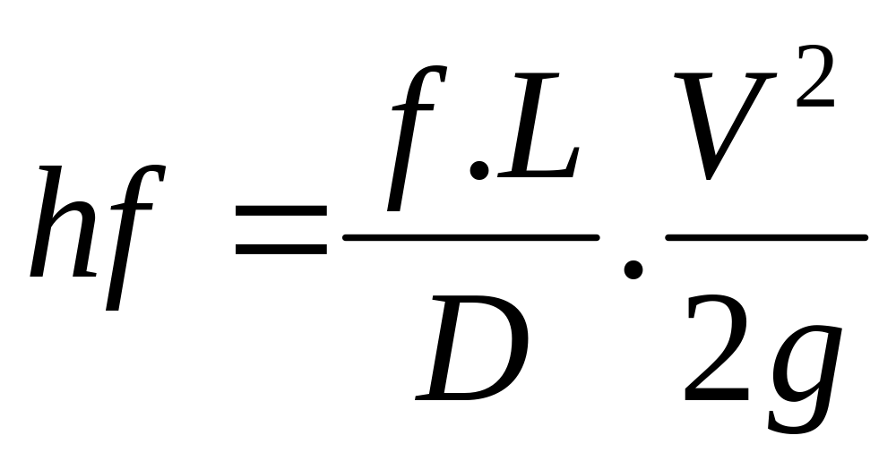
How to calculate hf?

Slide 6
hL= hf+ hm
hL = head loss
hf = friction loss
hm = minor loss

Slide 7
Other equations to calculate head loss
Darcy-Weisbach, D.W
Manning
Hazen-Williams, H-W

Slide 8
Minor loss equation
hm = k. v²/2g

Slide 9
Where does minor loss occur?
Valves
Transition points
Changes in velocity, direction or shape
Change in flow line

Slide 10

How much water will flow to point C?
If you want to reduce the flow, what would you do?
Draw the EGL
A
B
C
Elev. A= 120 ft
Elev. B= 115 ft
Elev. C = 108 ft
Pipe B-C: 6 inch PVC
L= 1000 ft

Slide 11

How much water will flow to point C?
If you want to reduce the flow, what would you do?
Draw the EGL
E1=120
A
EGL
B
E2= v²/2g
C
Elev. A= 120 ft
Elev. B= 115 ft
Elev. C = 108 ft
Pipe B-C: 6 inch PNC
L=1000 ft

Slide 12
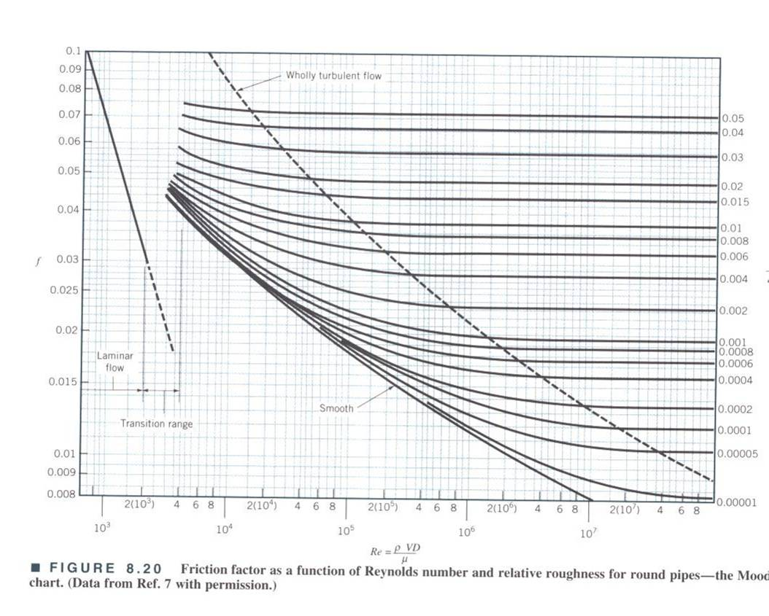

Slide 13
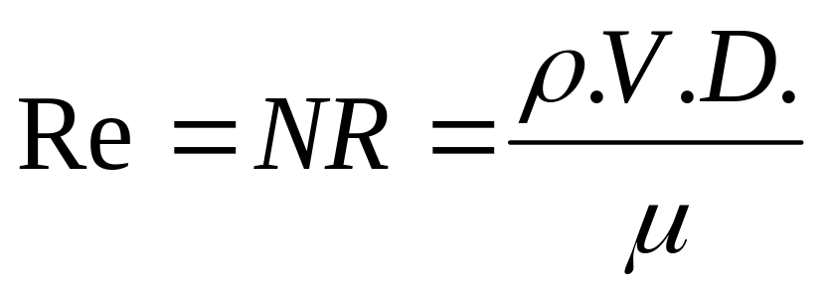
Calculating Reynolds number
= density of water Mass per unit volume
V= Velocity of flow
D = diameter
µ = Dynamic viscosity lb.s/ft² or N.M/m²

Slide 14
NR =V.D/ν
NR = Reynolds number
V = velocity, L/T
D= Inside Diameter, L
ν= kinematic viscosity, L2/T

Slide 15
Values of Viscosity for Water
At 70 F, µ = 2.037 x 10⁻⁵ lb.s/ft2 or 1.002 x10⁻³ N.S/m2
At 70 F, ν = 1.05 x 10⁻⁵ ft²/sec or 1.006 x 10⁻⁶ m2/sec.

Slide 16
How to Calculate f?
Example:
Pipe: Commercial steel, new
ID= 6 inch =0.5 ft
V= 8.6 ft/s
ν =1.2x10^-6 ft2/s
e = 0.00015 ft
e/D = 3x10^-4= 0.0003
NR= (V.D)/ν = 3.67x10^6

Slide 17
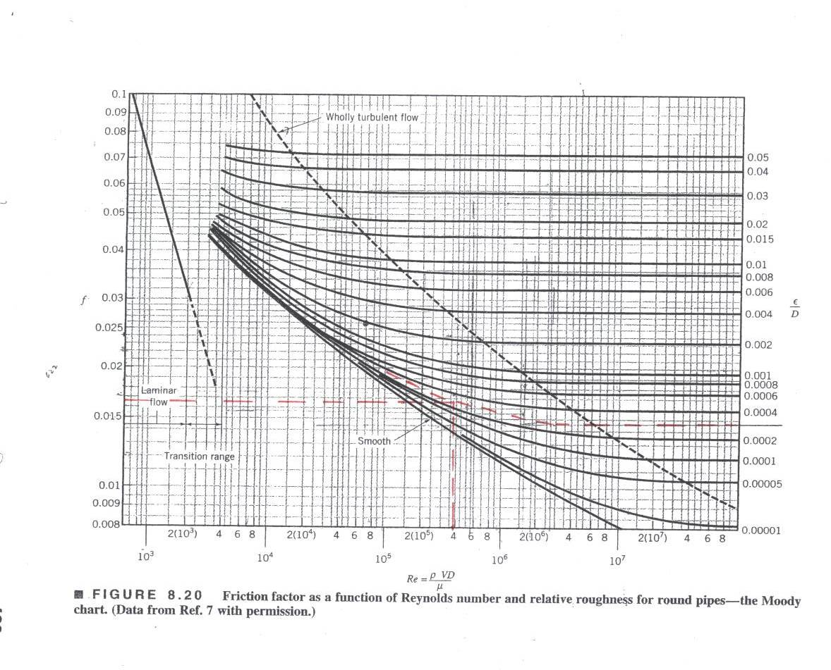

Slide 18
How much water will flow to point C?
If you want to reduce the flow, what would you do?
Draw the EGL
A
B
C
Elev. A= 120 ft
Elev. B= 115 ft
Elev. C = 108 ft
Pipe B-C: 6 inch steel
f = 0.02

Slide 19
E1 = E2 +(f.L/D).V²/2g
0+0+120=0+V²/2g +108 +(f.L/D).V²/2g
12 = V²/2g [1+f.L/D)
Function = 12-V²/2g[1+f.L/D)
Solve for V

Slide 20
What is a good number for V?
Assume v = 7 ft/s
NR = 3.5 x10^5
f = 0.014
Function, F = -10
Assume a lower number, V = 5 ft/s
NR = 2.5x10^5
f = 0.015
Function, F = -0.03, good enough

