Slide 1

CE 382, Hydraulic Systems Design
(pipes, pumps and open channels)
Principles of hydraulics
Conservation of energy (Bernullie)
P1/γ + V1^2/2g + Z1 = P2/γ + V2^2/2g +Z2+ hf +hm -hp
2. Continuity (conservation of mass)
ρ1.A1.V1 = ρ2.A2.V2
V1. A1 = V2. A2
3. Momentum (conservation of forces)
ΣF = Q2.ρ2.V2- Q1.ρ1.V1

Slide 2
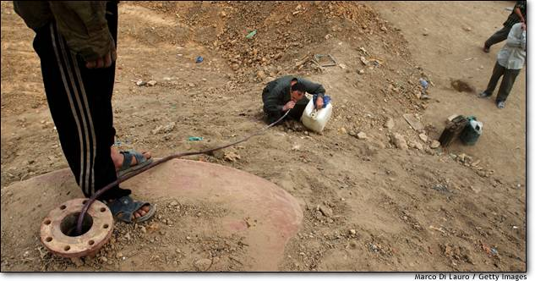
What is he doing?

Slide 3
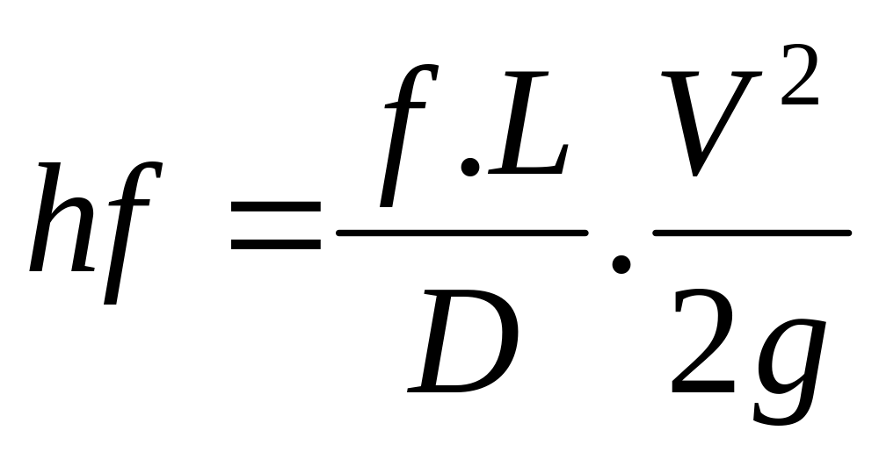
Methods How to calculate hf?
Darcy-Weisbach eq.

Slide 4
NR or Re =V.D/ν
NR = Reynolds number
V = velocity, L/T
D= Inside Diameter, L
ν= kinematic viscosity, L2/T
ν = 1x10^-6 m2/s or 1.05x10^-5 ft2/s at 20 C

Slide 5
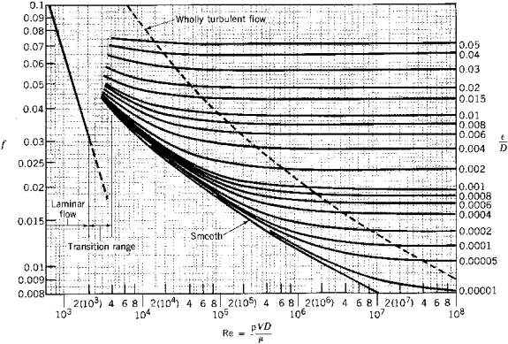

Slide 6
NR or Re = ρ.V.D/µ
= fluid density, M/L3
V = velocity, L/T
D = diameter, L
µ = dynamic viscosity, F-T/L2

Slide 7
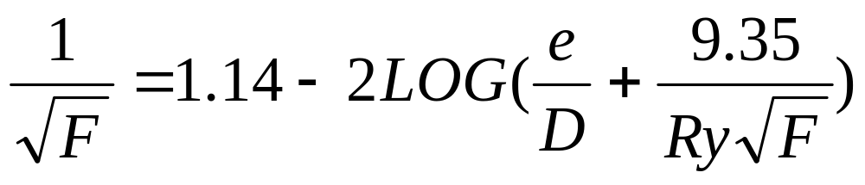
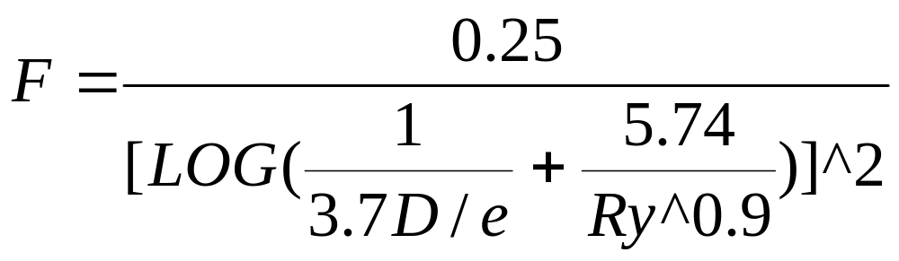
Colebrook’s eq.
Swamee and Jain eq.

Slide 8
Hazen – William eq.
V = k1.C.R^0.63.S^0.54
V = velocity, L/T
C = roughness coefficient (table 3-2, p12)
R = hydraulic radius, L
S = Slope of energy grade line, L/L
K1 = 0.849 for SI units
K1 = 1.318 for USCS units

Slide 9
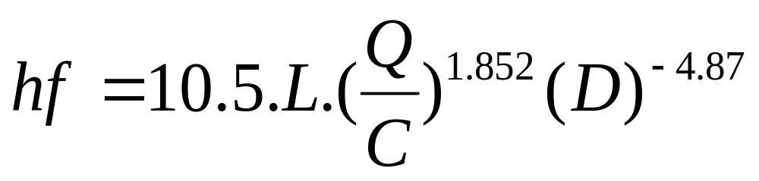
Hazen William, Conventional Units
hf = friction loss, ft
L = length, ft
Q= flow, gpm
D= diameter, inch

Slide 10
Hazen-William Conventional units
Q =0.28 C.(D^2.62)(S^0.54)
Q is in gpm
D is in inches

Slide 11
Manning
Q = k/n .A. R^2/3. S^1/2
Q discharge rate, L3/T
K = 1.486 for USCS and 1.0 for metric unit
n = Manning roughness coefficient (table 3.3, p13)
R = Hydraulic radius, L
S = Slope of energy grade line, L/L

Slide 12
Limitation of H-W eq,
Valid only for water
D> 5 cm
V<3 m/sec

Slide 13

Quiz #1
How much water will flow to point C?
If you want to reduce the flow, what would you do?
Draw the EGL
A
B
C
Elev. A= 120 ft
Elev. B= 115 ft
Elev. C = 108 ft
Pipe B-C: 6 inch steel, 1000 ft long
f = 0.02

Slide 14
Solution with H-W:
Ea = Ec +hf
0+0+120 = 0+V^2/2g + 115 + hf
Assume v^2/2g = 0
C =150
V= 1.318(150)(0.5/4)^0.63(5/1000)^0.54
V =3.05 ft/s
Q = V.A = 3.05 (3.14)(0.5)^2/4 = 0.6 ft3/s

Slide 15
Minor Losses
1. Sudden contraction
hc = Kc (V2^2)/2g
Kc from Table 3.4, p 15
If D2/D1 =0, Kc = 0.5

Slide 16
2. Gradual Contraction
h’c = K’c (V2^2/2g)
K’c = from figure 3.13, p 16
3. Entrance loss
Water entering from reservoir into pipe
he = Ke (V^2)/2g
Ke from figure 3.14, p 16

Slide 17
4. Sudden enlargement
he = (V1-V2)^2/2g
5. Gradual enlargement
h_{E} = K_{E} (V1^2-V2^2)/2g
K_{E} from figure 3.16 , page 17

Slide 18

5. Loss due to bend
h_{b} = K_{b} .(v^2)/2g
Kb for various R/D ration: from the table on Page 18.
6. Loss of head in Valves
hv = K_{v} (V^2)/2g

Slide 19
How can we measure K_{v} in a valve?

