Slide 1
What are the criteria for a design?
Should meet the objectives
Should have the lowest cost
Should be ethical/legal
Should be safe

Slide 2
What is the Hydrostatic Pressure?
P = 90 PSI = 208 ft
We need to account for the water hammer

Slide 3
How much pressure can a pipe tolerate?
Total P = Hydrostatic pressure + dP
Where dP = pressure caused by water hammer
Newton law of motion:
F = Mγ = M dv/dt
If dt approaches zero, F will approach infinity

Slide 4
What is water hammer?
What hammer is sudden change of pressure due to
Sudden change in flow or velocity
What causes water hammer?
Closing or opening of valve
Change in flow rate, velocity
Turning on/off pump
Air entrapment

Slide 5
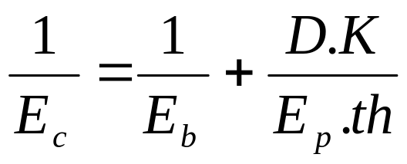
Modulus of elasticity of water, Eb = 2.2X10^9 N/M²
Modulus of elasticity of pipes are given in Table 4.1, p 25
Modulus of elasticity of PVC = 2.8X10^9 N/M²

Slide 6
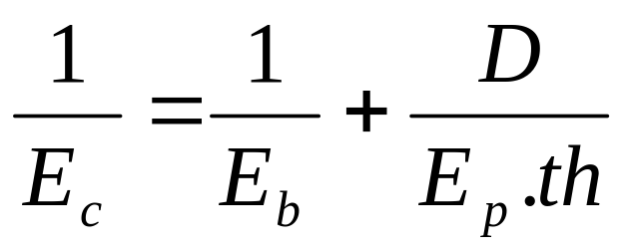
K = 5/4 –ε for pipes free to move longitudinally;
K = 1-ε^2, for pipes anchored at both ends
K = 1-0.5ε, for pipes with expansion joints
ε = Poisson’s ratio , depends on pipe material = 0.25
For most practical purposes, a conservative value
For K = 1

Slide 7
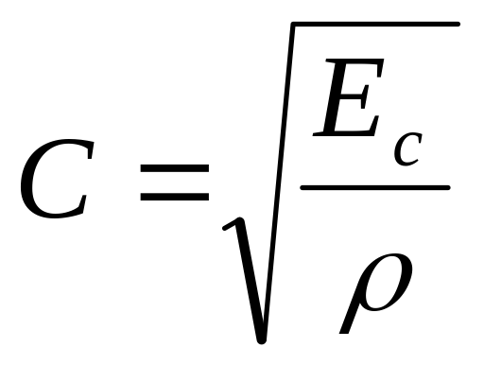
dP = ρ.V.C
V = initial velocity

Slide 8
Example 4.9, p 27
1/Ec = 1/(2.2.10^9) + 0.5/[(1.9.10^11).0.05]
Ec = 1.97.10^9 N/M²
C = [(1.97.10^9)/998]^0.5 = 1404 m/s
Tc = 2(L)/C = 2(1500)/1404 = 2.14 sec
Since the valve is closed in 1.4 sec<2.14
What if the valve closed in 2 sec?

Slide 9
Total Pressure = P0 + dP
dP = ρ.V.C = 998.(4.07)(1404) = 5.7.10^6 N/M².
dP = 998(4
Total pressure = P₀ + dP
Total P = 50(9.81)+dP = 5,700490.5
Total P = 582.25 m, =1909.8 ft=826 psi

Slide 10
How can we reduce the impact of water hammer?
Slow opening/slow closing valve
Air relieve valve
Air inlet valve
Stand pipe
Air chamber (surge tank)
Thicker pipe
Harder material
PRV
Low Velocity

Slide 11


Slide 12
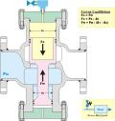

Slide 13
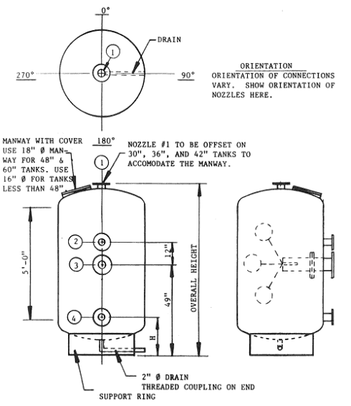

Slide 14


Slide 15
What if the pipe is PVC?
Total P = 256 psi

Slide 16
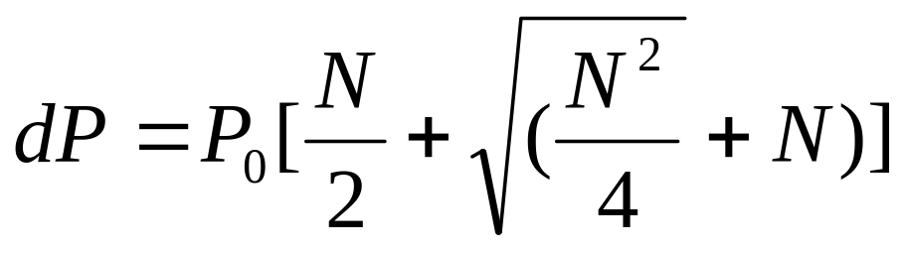
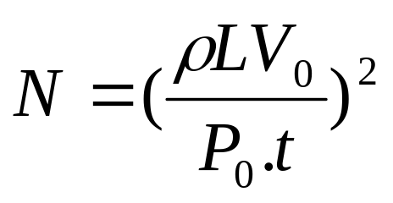
What if the valve is closed slowly
t (closure time) =10 sec
P₀= hydrostatic pressure, N/M2
L = pipe length
V₀ = Velocity before closure

Slide 17
N = [(998X1500X4.07)/(489519X10)]^2=1.55
dP = 489519[1.55/2+(1..5)^2/4+1.55)^0.5]=1,097,257 N/M2
dP = 158 PSI

Slide 18
How much pressure can a pipe tolerate?
HDB = Hydrostatic design base
F = safety factor = 2
S = HDB/F
S = Design stress
SDR = Standard dimension Ratio = OD/th
OD = outside pipe diameter
th= wall thickness
P = 2S/(SDR-1)
P = pressure tolerance of pipe

Slide 19
Example:
What is P for a 6 Inch Schedule 40 PVC pipe?
OD = 6.625 in
th = 0.28 in
SDR = 6.625/0.28 = 23.7
HDB= 4000 PSI
S =HDB/2 = 2000
P = 2X2000/23.7 = 176 PSI

Slide 20
Need to be aware of freezing
Freezing creates large amount of hydrostatic pressure
E = dp/dv/V
2.2X10^9 = dP/0.05
dP = 15,921 psi

