Slide 1
SPML : Secure Privacy-preserving Machine Learning framework using TEEs and differential privacy
Master Thesis
Presenter | Prateek Bhatnagar
Adviser | Dr.-Ing. Do Le Quoc
Professor | Prof. Dr. Christof Fetzer
Date | 26th August 2020

Slide 2
Outline
Introduction
Background
Design
Implementation
Evaluation
Conclusion

Slide 3

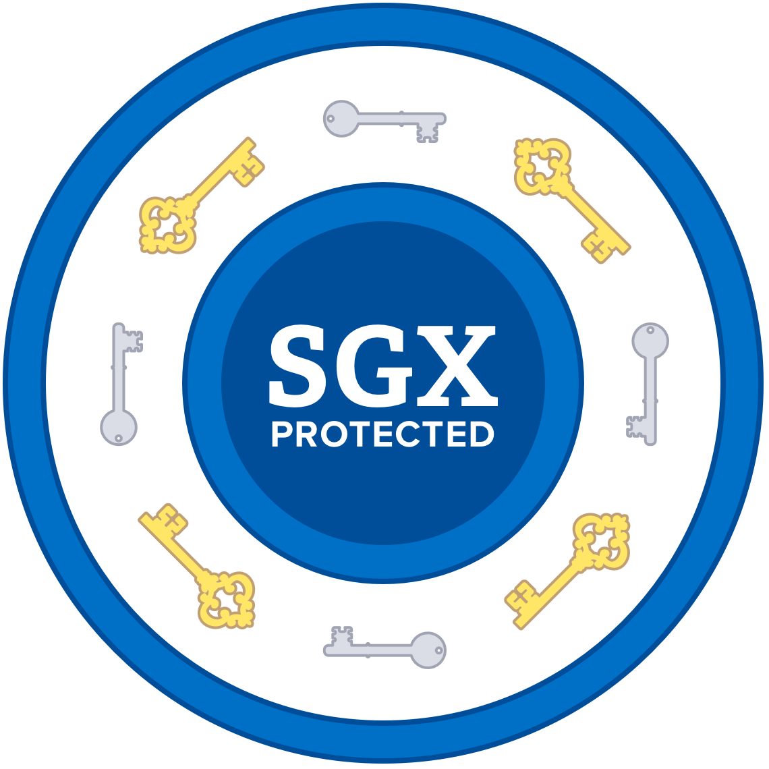





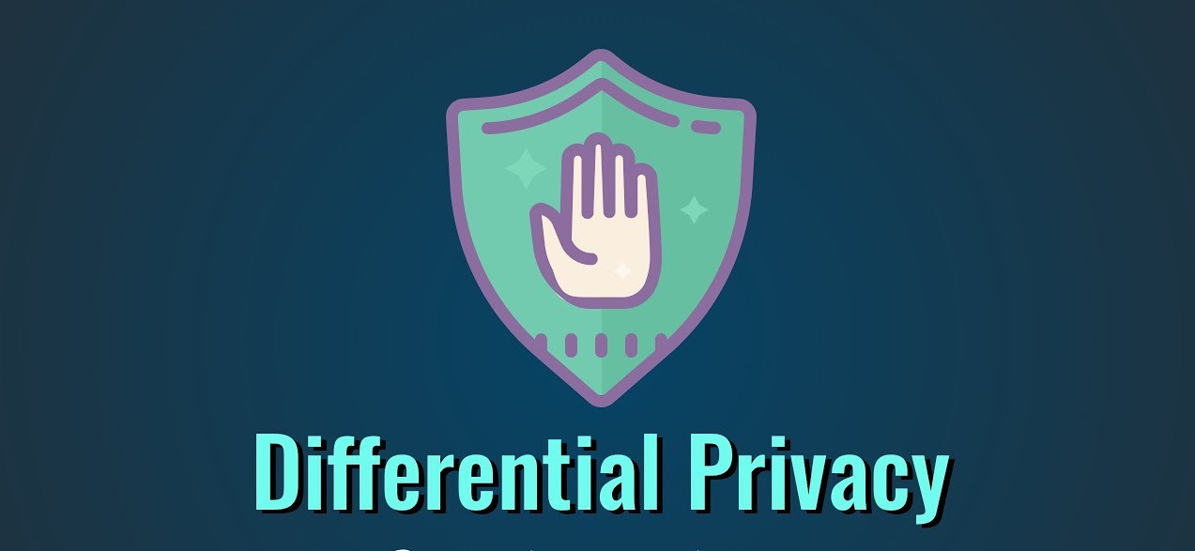
Introduction
Data, algorithms & model access not safe from adversary with root privilege
Inference APIs
User
Inference APIs
Trained model
Adversary
Adversary
User uploads data
Training
Algorithm
Sensitive Data
Data
Solution: Differential privacy mechanisms [ICALP’ 06]
Adversary -> Black-box access to model
DP alone can’t ensure the security
Model inversion attack [CCS’15]: Image extraction by knowing name
Membership inference attack [IEEE SP’17]: If input in training dataset?

Slide 4
Threat Model
Protect against adversary
with root access
that can fire black-box queries
Not considering
Side channel attacks
Denial of service
system setting is in a virtualized environment

Slide 5
Outline
Introduction
State-of-the-art/Background
Design
Implementation
Evaluation
Conclusion

Slide 6
State-of-the-art
Privacy
RAPPOR: Randomized Aggregatable Privacy-Preserving Ordinal Response [CCIS’14]
DP using enhanced randomized response mechanism
Not suitable for image/object classification
Doesn’t ensure confidentiality & integrity in an untrusted environment
Deep learning with differential privacy [CCIS’16]
DP using noise mechanism
Doesn’t ensure confidentiality & integrity in an untrusted environment
Security
Chiron [arXiv’ 18]
Doesn’t ensure privacy
TensorScone [arXiv’ 19]
Doesn’t ensure privacy

Slide 7
Intel SGX
Ensure confidentiality & integrity
Hardware based solution
Private memory region known as enclaves
Usage is not simple, need to know SDK
SGX SDK supports C/C++ only

Slide 8
SCONE [OSDI’16]
Contained based runtime environment
Transparent encryption/decryption
Minimal code changes required
Supports all modern languages

Slide 9
Problem statement
Security
+ Privacy
SPML: Secure privacy-preserving machine learning framework

Slide 10
Outline
Introduction
Background
Design
Implementation
Evaluation
Conclusion

Slide 11


Differential privacy
No DP
Query
How many people smoke?
Answer
Dataset
60
Adversary
DP
Query
Random
Algorithm
How many people smoke?
Answer
Dataset
59
Adversary
It hides the change
Doesn’t depend upon individual
Privacy preserved
Dataset

Slide 12

Differential privacy mechanisms
Randomized Response
Noise
Laplace noise
Gaussian noise
Head
Truth
First coin-flip
Tail
Second coin-flip
Head
Tail
Yes
No
Provides plausible deniability
Cynthia Dwork and Aaron Roth (2014), "The Algorithmic Foundations of Differential Privacy", Foundations and Trends® in Theoretical Computer Science: Vol. 9: No. 3–4, pp 211-407. http://dx.doi.org/10.1561/0400000042

Slide 13
Privacy budget
More noise
less accuracy
Privacy ⬄ Accuracy
Epsilon (ε)

Slide 14


Training phase
Intel SGX
[Enclave]
Training
computation
Privacy-preserving
trained model
Decrypted data
SCONE
User
Encrypted
privacy-preserving
trained model
Encrypted data

Slide 15


Inference phase
Intel SGX
[Enclave]
Inference
computation
Decrypted
inference result
Decrypted data
SCONE
Encrypted data
(Real-world)
User
Encrypted
privacy-preserving
trained model
Encrypted
inference result

Slide 16
Outline
Introduction
Background
Design
Implementation
Evaluation
Conclusion

Slide 17
Implementation
Noise: TF privacy APIs
TF & Keras APIs
Training
Computation
Inference
Computation
SCONE
(Intel SGX)
Integrating all things together
TensorFlow privacy not supporting Keras (2.3.1)
Patch work in Keras

Slide 18

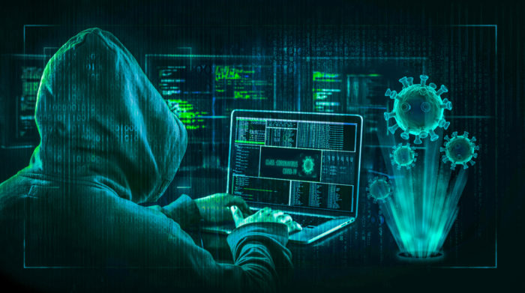
Implementation-Contribution
Integration
RR: Python APIs
Randomized response
Keras APIs
TensorFlow APIs
Advance features:
Checkpointing
Earlystopping
Federated learning
Advance features
IBM ART APIs
Proof/Test
Model inversion attack

Slide 19
Outline
Introduction
Background
Design
Implementation
Evaluation
Conclusion

Slide 20
Evaluation
Purpose
What is the effect of enabling security and privacy features on
Accuracy?
Latency?
Setup
Linux with 2.2 GHz Quad-Core
Intel(R) Xeon(R) CPU E3-1280 v6 @ 3.90GHz
8 cores
RAM as 64 GB
Dataset:
MNIST - Noise
CIFAR10 - Noise
Adult – Randomized response
Modes: Native vs SCONE simulation vs SCONE hardware

Slide 21
Terminology
Hardware+(Epsilon>0) - SPML+Security+Privacy
Hardware+(Epsilon=0) - SPML+Security
Training = 80% of size
Inference = 20% of size
Epsilon=0 - SPML+NativeTF
Epsilon>0 - SPML+Privacy

Slide 22
Noise – MNIST – Training+Inference - Accuracy results
Figure 1: Native mode
Figure 2 : Simulation mode
Figure 3 : Hardware mode
Privacy feature: Accuracy increases with epsilon value
Security feature: No effect on accuracy
Privacy+Security feature: Same as privacy

Slide 23
Noise – MNIST – Training – Latency results
Figure 1: All modes without privacy
Figure 2: All modes with privacy
Privacy feature:
10x (SPML+ Native TF)
Security feature:
Sim= 6x (Native TF)
Hardware=10x (Native TF)
Security+Privacy feature:
Sim= 6x (SPML+Privacy)
Hardware=25x (SPML+Privacy)

Slide 24
Noise – MNIST – Inference – Latency results
Figure 1: Inference phase
Privacy feature:
No Effect
Security feature:
Sim=3x (SPML+Native TF)
Hardware=6x (SPML+Native TF)
Security+Privacy feature:
Same as security

Slide 25
RR – Training - Accuracy results
Figure 1: Native mode
Figure 2: Hardware mode
Privacy feature:
Accuracy fluctuates
Security feature:
No effect on accuracy
Security+Privacy feature:
Same as privacy

Slide 26
RR – Training - Latency results
Figure 1: Latency
Privacy feature:
No effect
Security feature:
Sim= SPML+NativeTensorFlow
Hardware=4.2x (SPML+NativeTF)
Security+Privacy :
Same as security

Slide 27
Model inversion attack
Attack
(IBM’s ART library)
Trained model
Auxiliary information
(Test data mean)
Training images
No privacy bounds => high accuracy => high risk
Figure 1 (SPML+Security), accuracy=99.65%
Strong privacy bounds => lower accuracy => low utility
Figure 2 (SPML+ Security+Privacy), accuracy=10.19%, ε =0.2
Weak privacy bounds => high accuracy => high utility
Figure 3 (SPML+Security+Privacy), accuracy=85.93%, ε =8.0

Slide 28
Advance features
Advance features

Slide 29
Advance Features
#1: Inference only in hardware mode
#2 : Save & load model
Train 50:50: Accuracy same and time reduction (2x)
Earlystopping: Accuracy almost same and time reduction (1.3x)

Slide 30
#2. Save & load model - Earlystopping
Figure 1: Accuracy
Figure 2: Latency
Training time – 1.3x
Inference same as hardware
Accuracy remains almost same as hardware

Slide 31

#3: Federated learning
Aggregated/Global Model
TLS Connection
Local Trained Model
Client Device
Round1
TLS Connection
Global Trained Model
Local Trained Model
Client Device
TLS Connection
10th Round gives accuracy as 92% for all clients & server
Client local data never shared
Aggregated/Global Model

Slide 32
Outline
Introduction
Background
Design
Implementation
Evaluation
Conclusion

Slide 33
Conclusion
Unique
Security
Intel SGX
Confidentiality & integrity
+
Privacy
Differential privacy
Randomized response
Noise
+
Performance
Inference in practice (6x native) – 1.6 seconds
Training
Advance features
Advance Feature | Latency Improvement (training)
Inference only | Training not needed
Federated learning | Training not needed
Train 50:50 | 1.9x
Earlystopping | 1.3x
+
Testing
Model inversion attack
Table 1: Advance features

Slide 34
Future Work
SCONE CAS (Configuration and Attestation Service)
Generalized randomized response
Laplace noise
Implementation with other frameworks like pytorch

Slide 35
References
https://software.intel.com/en-us/sgx. Last accessed,April 2020. Sept. 2019.
Cynthia Dwork. “The Promise of Differential Privacy. A Tutorial on Algorithmic Techniques.” In: 52nd Annual IEEE Symposium on Foundations of Computer Science. Oct. 2011. url: https://www.microsoft.com/en-us/research/ publication / the - promise - of - differential - privacy - a - tutorial - on - algorithmic-techniques/.
Matthew Fredrikson et al. “Privacy in Pharmacogenetics: An End-to-End Case Study of Personalized Warfarin Dosing.” In: 23rd USENIX Security Symposium (USENIX Security 14). San Diego, CA: USENIX Association, Aug. 2014, pp. 17– 32. isbn: 978-1-931971-15-7. url: https://www.usenix.org/conference/ usenixsecurity14/technical-sessions/presentation/fredrikson_matthew.
Reza Shokri, Marco Stronati, and Vitaly Shmatikov. “Membership Inference Attacks against Machine Learning Models.” In: vol. abs/1610.05820. 2016. arXiv: 1610. 05820. url: http://arxiv.org/abs/1610.05820.
Sergei Arnautov et al. “SCONE: Secure Linux Containers with Intel SGX.” In: 12th USENIX Symposium on Operating Systems Design and Implementation (OSDI 16). Savannah, GA: USENIX Association, Nov. 2016, pp. 689–703. isbn: 978-1- 931971-33-1. url: https://www.usenix.org/conference/osdi16/technical-sessions/presentation/arnautov.
Úlfar Erlingsson, Vasyl Pihur, and Aleksandra Korolova. “RAPPOR: Randomized Aggregatable Privacy-Preserving Ordinal Response.” In: Proceedings of the 21st ACM Conference on Computer and Communications Security. Scottsdale, Arizona, 2014. url: https://arxiv.org/abs/1407.6981.

Slide 36
References
Martin Abadi et al. “Deep Learning with Differential Privacy.” In: Proceedings of the 2016 ACM SIGSAC Conference on Computer and Communications Security. CCS ’16. Vienna, Austria: Association for Computing Machinery, 2016, pp. 308–318. isbn: 9781450341394. doi: 10.1145/2976749.2978318. url: https://doi.org/ 10.1145/2976749.2978318.
Stanley L. Warner. “Randomized Response: A Survey Technique for Eliminating Evasive Answer Bias.” In: Journal of the American Statistical Association 60.309 (1965). PMID: 12261830, pp. 63–69. doi: 10.1080/01621459.1965.10480775. eprint: https://www.tandfonline.com/doi/pdf/10.1080/01621459.1965. 1048077. url: https://www.tandfonline.com/doi/abs/10.1080/01621459. 1965.10480775.
Martın Abadi et al. “TensorFlow: Large-Scale Machine Learning on Heterogeneous Distributed Systems.” In: CoRR abs/1603.04467 (2016). arXiv: 1603.04467. url: http://arxiv.org/abs/1603.04467.
François Chollet et al. Keras. https://keras.io. 2015.
http://yann.lecun.com/exdb/mnist/. Last accessed,April 2020. Apr. 2020.
https://www.cs.toronto.edu/ kriz/cifar.html. Last accessed,April 2020. Apr. 2020.
http://archive.ics.uci.edu/ml/datasets/Adult. Last accessed,May 2020. May 2020.
Maria-Irina Nicolae et al. “Adversarial Robustness Toolbox v1.2.0.” In: CoRR 1807.01069 (2018). url: https://arxiv.org/pdf/1807.01069.
François Chollet et al. Keras. https : / / keras . io / api / callbacks / model _ checkpoint/. 2015.

Slide 37
References
François Chollet et al. Keras. https : / / keras . io / api / callbacks / early _ stopping/. 2015.
Keith Bonawitz et al. “Towards Federated Learning at Scale: System Design.” In: CoRR abs/1902.01046 (2019). arXiv: 1902.01046. url: http://arxiv.org/abs/ 1902.01046.
SCONE FSPF. 2020. url: https://sconedocs.github.io/CASOverview/.
Pytorch. 2020.url:https://pytorch.org.
Icons
https://www.iconfinder.com/

Slide 38
Thank You
Prateek Bhatnagar

Slide 39
Backup

Slide 40
Malicious Query
Bob lives at Hamilton street
SELECT diseaseStatus from medicalDb where street=“Hamilton”
!Not Allowed
SELECT COUNT(diseaseStatus) from medicalDb where street=“Hamilton”
!Not Allowed
SELECT COUNT(diseaseStatus) from medicalDb where diseaseStatus=“True”
Answer:400
SELECT COUNT(diseaseStatus) from medicalDb where (diseaseStatus=“True” and
street!=“Hamilton”)
Answer:399

Slide 41
Advance Features
#1: Inference only in hardware mode
Training time reduced
Privacy preserving trained model
Upload to cloud
TLS
Inference APIs
Encrypted
privacy-preserving
trained model
Privacy-preserving
trained model
User

Slide 42
#1: Inference only in hardware mode
Figure 1: Accuracy
Figure 2: Latency
Accuracy remains same as native
Lot of time reduction for training
Inference same as hardware

Slide 43
Advance Features
#2. Save & load Model - Train 50:50
Training time reduced to train model with only new data
Privacy preserving trained model
Upload to cloud
TLS
Training
Algorithm
Inference APIs
Encrypted
privacy-preserving
trained model
Privacy-preserving
trained model
User
New Data
Training
Algorithm
Data

Slide 44
#2. Save & load Model - Train 50:50
Figure 2: Latency
Figure 1: Accuracy
Training time 1.9x
Inference same as hardware

Slide 45
Advance Features
#3. Federated learning
Training set 10000
Client1
2500
Client2
2500
Client3
2500
Client4
2500

Slide 46
Advance Features
#3. Federated learning
Rounds | Client1 | Client2 | Client3 | Client4 | Server
1 | 15.48 | 28.88 | 27.56 | 15.24 | 10.88
2 | 33.96 | 31.28 | 21.52 | 22.16 | 27.20
3 | 9.00 | 49.60 | 48.72 | 22.28 | 22.64
4 | 72.48 | 58.92 | 77.68 | 66.28 | 69.72
5 | 78.44 | 82.64 | 82.68 | 80.64 | 86.04
6 | 89.00 | 85.68 | 89.80 | 89.20 | 89.80
7 | 85.76 | 81.52 | 80.80 | 90.44 | 90.68
8 | 92.04 | 89.04 | 90.56 | 91.52 | 92.40
9 | 92.56 | 87.72 | 81.60 | 90.92 | 91.52
10 | 92.28 | 92.64 | 93.36 | 92.48 | 93.48
Table 1: Accuracy

Slide 47
Advance Features
#3. Federated learning
Figure 1: Latency

Slide 48
RR – Training - Accuracy results
Figure 1: Native mode
Figure 2: Simulation mode
Figure 3: Hardware mode

Slide 49
SCONE Encryption/Decryption
Start the container
docker run -it --rm -v $PWD/data:/data -v $PWD/odata:/odata --privileged --device /dev/isgx sconecuratedimages/www2019:scone-tensorflow-1.15 sh
Create the fspf file
cd /data
scone fspf create fspf.pb
Create region
Authenticated: Integrity
Encrypted: Confidentiality & Integrity
Non-protected: Nothing
Root region not protected and written to the disk
scone fspf addr fspf.pb / --kernel / --not-protected
Encrypted region encrypted and written to the disk
scone fspf addr fspf.pb /data --encrypted --kernel /data
Protection region for protection policy, read files from /odata and save them in /data
scone fspf addf fspf.pb /data /odata /data

Slide 50
SCONE Encryption/Decryption
Encrypt the file and store the key
scone fspf encrypt fspf.pb > /odata/keytag
To activate fpf set environment variable and save the key & tag
export SCONE_FSPF_KEY=$(cat /odata/keytag | awk '{print $11}')
export SCONE_FSPF_TAG=$(cat /odata/keytag | awk '{print $9}')
export SCONE_FSPF=/data/fspf.pb

Slide 51
SCONE CAS: Start
Pull the CAS image
Create a docker compose and expose the port
Generate MRENCLAVE
export IMAGE=${SCONE_CAS_IMAGE:-sconecuratedimages/services:cas.trust.group-out-of-date} export CAS_MRENCLAVE=$(docker pull $IMAGE > /dev/null ; docker run -i --rm -e "SCONE_HASH=1" $IMAGE cas)
Attest the CAS
docker run -e SCONE_MODE=SIM -it --rm $CLI_IMAGE scone cas attest -G --only_for_testing-debug host.docker.internal $CAS_MRENCLAVE
Store the certificate of SCONE CAS

Slide 52
SCONE CAS: Attest & Run
Export the CAS address and generate client SSL certificate to create session with CAS
Create program
Encrypt the directory
Create docker image & save
Determine MRENCLAVE of the image
Determine the keys and Tags
Create a session file (with MRENCLAVE, keys & tags)
Post the session to CAS (using CURL)
Insert the CAS address in deployment manifest

