Slide 1
Casing selection strategies for SCORE
Lucas Pereira de Gouveia
Universidade Federal de Alagoas

Slide 2
SCORE project
SCORE projects are imported by means of a json file
All well configuration data are converted in a SCORE project object
CasingDesign is an object type that needs:
one casing string from a SCORE project
one load scenario object
CasingDesign results provide:
load profiles
safety factor profiles
failure probabilities profiles

Slide 3
SCORE tubulars catalog
It is a json file without prices of tubulars (pipes and connections)
For casing selection we insert hypothetical prices in the json file for each tubular

Slide 4
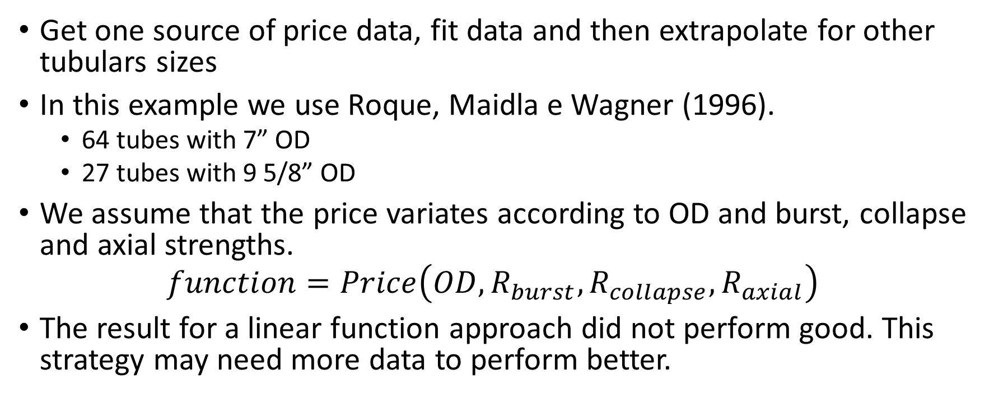
Hypothetical prices – Data fit
Get one source of price data, fit data and then extrapolate for other tubulars sizes
In this example we use Roque, Maidla e Wagner (1996).
64 tubes with 7” OD
27 tubes with 9 5/8” OD
We assume that the price variates according to OD and burst, collapse and axial strengths.
$$function=Price\left(OD, R_{burst}, R_{collapse},R_{axial}\right)$$
The result for a linear function approach did not perform good. This strategy may need more data to perform better.

Slide 5
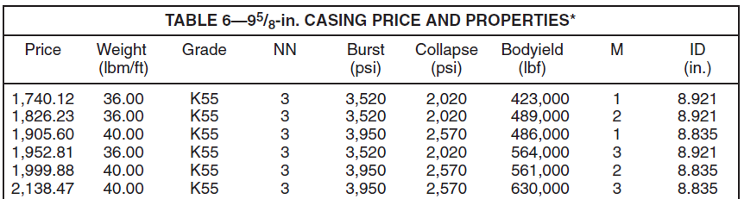
Hypothetical prices – Adapting data from Roque, Maidla e Wagner (1996)
64 tubes with 7” OD
27 tubes with 9 5/8” OD
Some tubes have the same OD, weight and grade, but different strength properties, we believe this
The connection performance reduces the strength of tubulars
In this case we are calculating with Score-lib the tube strengths properties and choosing the one that matches

Slide 6
B&B methodologies
Full discrete: binary tree
...
Analytical approach with scipy.optimize.minimize
Fit catalog
Fit constrainst is not available: inviável pois é preciso verificar as restrições de todos os tubos = força bruta
Fit 2 tubulars to constraints: linear approach with few points
É uma abordagem mista: etapa de minimize (com fit) e árvore.

