Slide 1
Go Language
Presenters:
Tejaswi Konduri
Nikhil Jonnalagadda
Abhishek Chandratre
Chaitanya Sri Krishna Lolla

Slide 2
Introduction
Go (often referred to as golang) is a free and open source
programming language created at Google in 2007 by
Robert Griesemer, Rob Pike, and Ken Thompson.
The primary motivation for designing Go was the authors dislike
for C++'s complexity.
Code File Extension: .go

Slide 3
Introduction (cont.)
Go has quick build time, elegant concurrency,
Readability.
What makes go successful?
Speed of compilation
Speed of execution
Deployment
Tools
Libraries

Slide 4
What is the language paradigm?
compiled
concurrent
imperative
structured

Slide 5
Go Language
The Good, The Bad and The Best

Slide 6
The Good
What motivates Programmers?
Native concurrency features like goroutines
and channels.
Speed
Communication with C libraries

Slide 7
The Bad
The not so good part:
Desktop or GUI - based applications
System level programming

Slide 8
The Best
Go is best suited for:
Network based applications, APIs, Web Servers
and Web applications.
Command line applications.

Slide 9
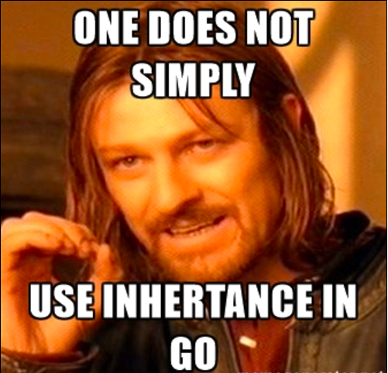
Object Oriented Golang, Really?

Slide 10
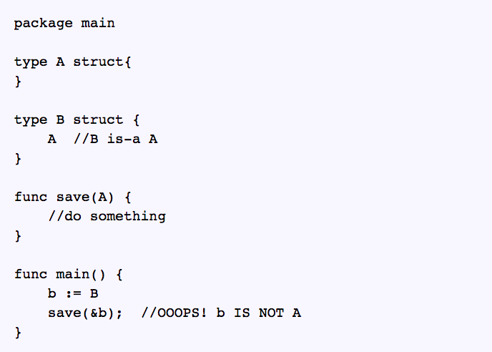
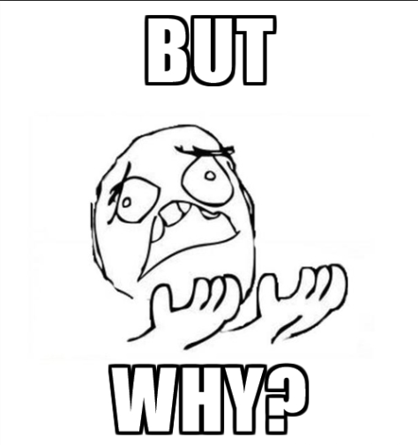
Object Oriented Golang, Really?

Slide 11
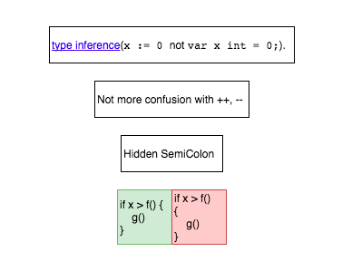
Still, Golang is fun.

Slide 12
Concurrency In Golang
Go routines
Channels
Notes:
Go routine is a function capable of running concurrently with other functions.
Channels provide a way for communication with one another and Synchronize their execution.

Slide 13
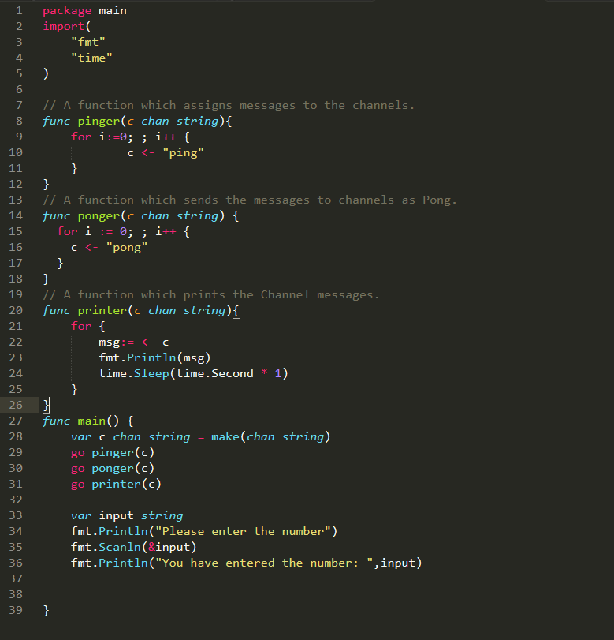
Ping – Pong Program
Notes:
Here Four Go routines : Pinger, Ponger, Printer and Main.
Pinger and Ponger are senders of the Messages.
Printer is the receiver of the message.
Written in such a way that, It prints Ping and pong until the user enters a number.

Slide 14
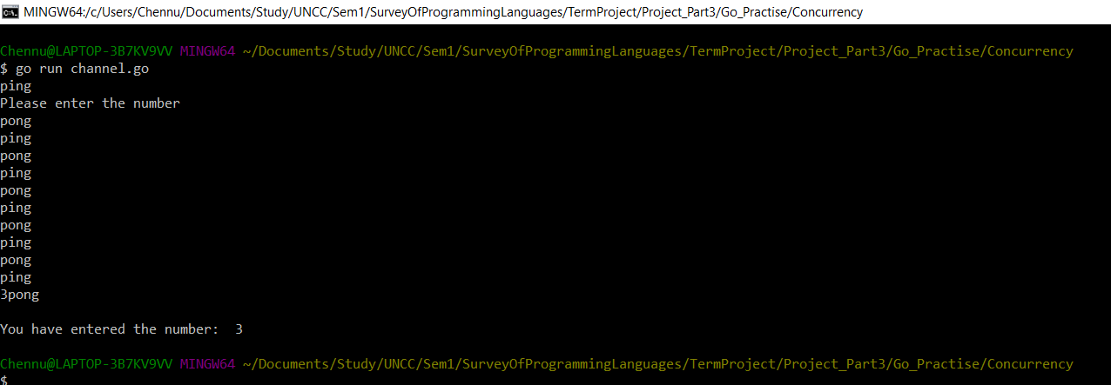
Outputs of the above program
Notes:
These are the outputs of the above program.

Slide 15
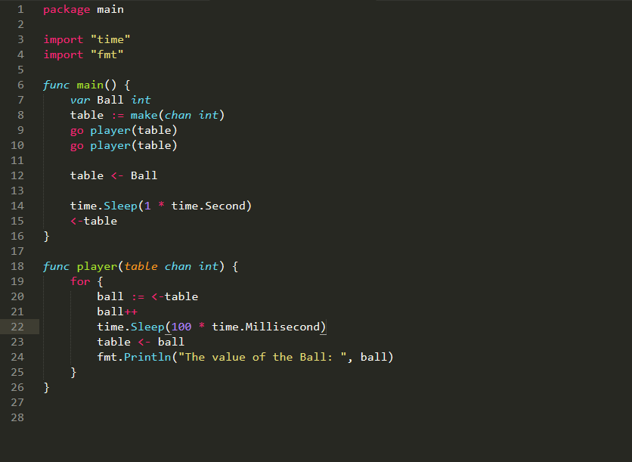
Ping Pong Table Ball Game
Notes:
Simple Ping pong Table Ball Game.
Here Table is Chanel
Two players try to play with a variable called “Ball” where they increment each time.

Slide 16
Visualization of Output using Open source software (GoTrace) - Developed By MIT.
Notes:
Here is some of the visualization of the above output using an opensource software Go trace developed in MIT.

Slide 17
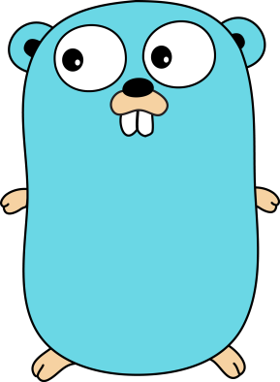
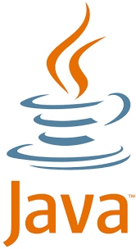
Java Concurrency vs Go concurrency
Java Uses OS Threads.
Java uses Shared Memory
(Objects).
Follows Synchronization
Methods likes Locks etc for
Synchronization.
Golang uses Go routines.
Golang uses Channels for
communication between them.
Golang follows FIFO method
Which is handled by Channel

Slide 18
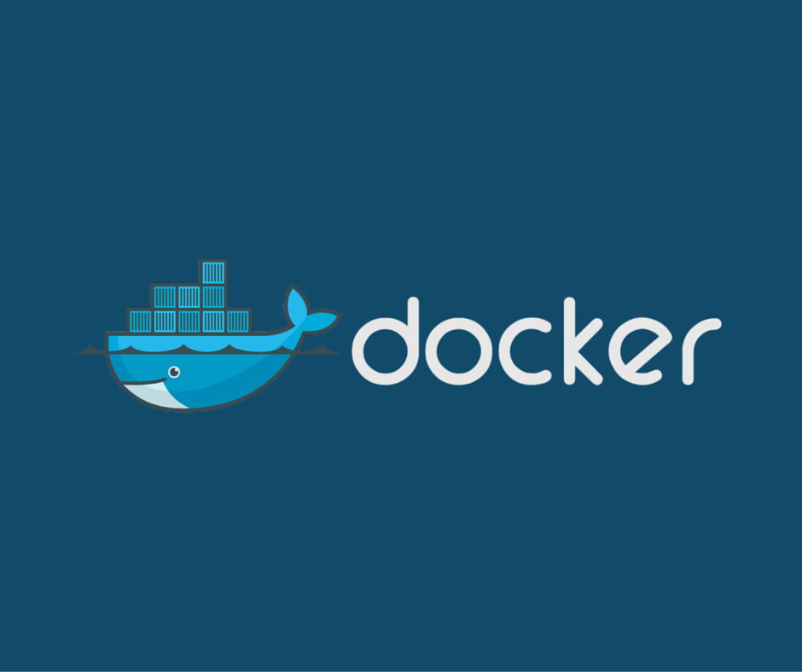
One Popular Application written in Golang
An Open source software that automates the deployment of Linux applications inside software containers.

Slide 19
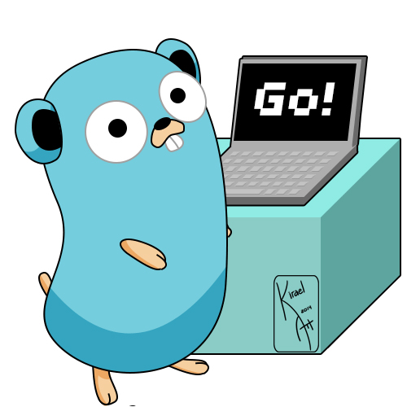
Thank You

