Slide 1
The EigenTrust Algorithm for Reputation Management in P2P Networks
Sepandar D. Kamvar
Mario T. Schlosser
Hector Garcia-Molina
Stanford University

Slide 2
P2P Networks
Open and anonymous
  Benefits
    Robust, Scalable, Diverse
  Problems
    Malicious peers
    Inauthentic files
      Viruses/Malware
      Tampered files
  Identifying malicious peers is more pressing than identifying inauthentic files
Notes:
Benefits and examples of P2P networks: recently for Bitcoins mining

Slide 3
Reputation Systems
Reputation Systems
  Global: Centralized system (eBay)
  Local: Distributed System
Key Idea of EigenTrust: Each peer i is assigned a global trust value that reflects the local experiences of all the peers in the network
j
i

Slide 4


Problem
Problem:
  Reduce inauthentic files distributed by malicious peers on a P2P network.
Motivation:
“Major record labels have launched an aggressive new guerrilla assault on the underground music networks, flooding online swapping services with bogus copies of popular songs.”
-Silicon Valley Weekly

Slide 5
Problem
Goal: To identify sources of inauthentic files and bias peers against downloading from them.
Method: Give each peer a trust value based on its previous behavior.
0.9
0.1

Slide 6
Some approaches
Past History
Friends of Friends
EigenTrust
Notes:
File-based: don’t include this, but if people ask, mention that, this is generalizable to services, while file-based approaches are not.

Slide 7
Terminology
Peer 3
Local trust value: c_{ij}. The opinion that peer i has of peer j, based on past experience.
Global trust value: t_{i}. The trust that the entire system places in peer i.
t₃=.5
Peer 1
t₁=.3
C₁₂=0.3
C₂₃=0.7
C₂₁=0.6
t₂=.2
C₁₄=0.01
Peer 2
t₄=0
Peer 4
Notes:
Here, also talk about trust vectors as well.

Slide 8
Local Trust Values
C_{ij}=
Each time peer i downloads an authentic file from peer j, c_{ij} increases.
Each time peer i downloads an inauthentic file from peer j, c_{ij} decreases.
Peer i
Peer j
Notes:
Here, talk about how opinion vectors are constructed.
Say that we choose this because of a probabilistic interpretation which we discuss later.

Slide 9

Normalizing Local Trust Values
All c_{ij} non-negative
c_{i1} + c_{i2} + . . . + c_{in} = 1
Peer 1
Peer 1
C₁₂=0.9
Peer 2
Peer 4
C₁₄=0.1
Peer 2
Peer 4

Slide 10
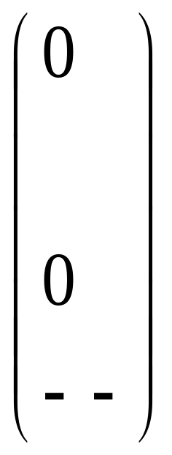
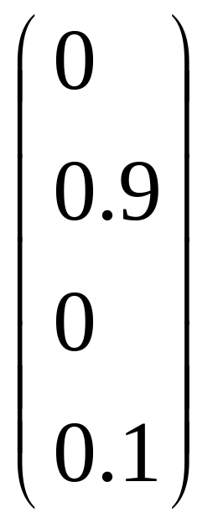
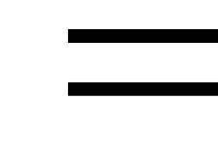
Local Trust Vector
Local trust vector c_{i}: contains all local trust values c_{ij} that peer i has of other peers j.
Peer 2
Peer 1
C₁₂=0.9
Peer 4
C₁₄=0.1
c₁
Peer 2
Peer 4
Peer 1
Notes:
Note that this should be viewed as a row vector conventionally.

Slide 11
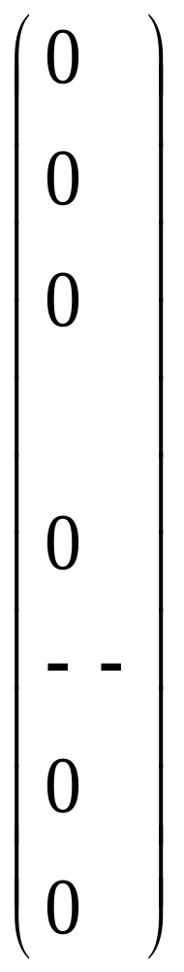
Approach 1: Past history
?
?
Each peer biases its choice of downloads using its own opinion vector c_{i}.
If it has had good past experience with peer j, it will be more likely to download from that peer.
Problem: Each peer has limited past experience. Knows few other peers.
?
Peer 4
?
Peer 1
Peer 6
?
?

Slide 12

Approach 2:
Friends of Friends
Ask for the opinions of the people who you trust.
(Cf. Referral trust)
Peer 2
Peer 4
Peer 1
Peer 6
Peer 8
Notes:
Here, it’s important to note that each peer has it’s own trust vector.

Slide 13

Friends of Friends
Weight their opinions by your trust in them.
(Cf. Referral trust = Functional trust)
(Cf. Transitivity)
Peer 4
Peer 1
Peer 2
Peer 4
Peer 8
Notes:
Peer i trusts the opinions of peer j (referral trust) if peer j has shared good files (functional trust).
Also trust is being chained => transitivity.

Slide 14
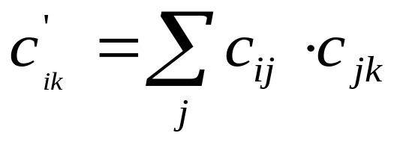

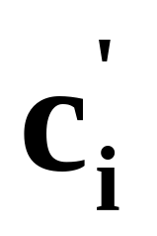

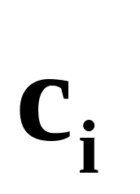
The Math : Transitive Trust
What they think of peer k.
And weight each friend’s opinion by how much you trust him.
Ask your friends j
.1
.3
.2
.3
.1
.1
.1
.5
0
0
0
.2
.2
0 .2 0 .3 0 .5 .1 0 0 0
Notes:
C global??? = k^th column functional trust in k
= i^th row referral trust of I
Special treatment of cii??? Or use only when no personal experience cii = 1 cik = 0??
-------------
C Updated thro product???
Each peer biases their downloads based on their c’(I,k).
Note that c(i)^T = (c(I,1),c(I,2),…c(I,k).
------------
Marked ones: c’_i(k) = [c(1,k),c(2,k),…,c(n,k)] o [c(I,1),c(I,2),…,c(I,n)]^T
functional trust in k i’s referral trust
k^th column/row of C/C^T
-----------
Better ROW approach: d’_i = d_i C
[di1’, di2’,…,din’] = [di1,di2,…,din] C
C= [c1
c2
…
cn]
--------------
Looks like C, C^2, C^3, …
======================================
ANALYSIS: (1) referral vs functional trust (combination meaningful because referral is grounded in experience??)
(2) Also no trust paths are not maintained – reasons can be correlated???
(two people may believe a source is bad because of the same samaritan/rumor monger;
counting the two opinions as independent will then be a mistake => locality vs paths)
(0) How do we combine personal opinion with neighbors suggestions
(functional vs referral <= local) (former override latter??) (scope implicit as unique)
(4) Avoids asking about itself –use information only about others for others
PEDAGOGY: were able to ask these questions because we have studied Trust Framework earlier …
=============

Slide 15
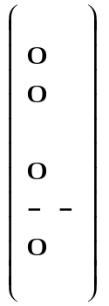
Problem with Friends
Either you know a lot of friends, in which case, you have to communicate, compute and store many values.
Or, you have few friends, in which case you won’t know many peers, even after asking your friends.
Notes:
Getting trust value of an unknown peer is like broadcast search over a peer-to-peer network, which we do too much of anyway.

Slide 16
Eigen Trust: Dual Goal
We want each peer to:
  Know all peers.
  Perform minimal computation (and storage).

Slide 17




Knowing All Peers
Ask your friends: t=C^{T}c_{i}.
Ask their friends: t=(C^{T})²c_{i}.
Keep asking until the cows come home: t=(C^{T})^{n}c_{i}.
Notes:
C^T is functional trust ; C_i is referral trust??
The sparse C will get converted into dense C^n as inputs are pooled together from different sources.
If C is aperiodic and irreducible, the outcome is irrespective of the starting vector and
converges to principal left eigenvector of C.
d = d C
============================
Are the diagonal entries zero?

Slide 18
Minimal Computation
Luckily, the trust vector t, if computed in this manner, converges to the same thing for every peer!
Therefore, each peer doesn’t have to store and compute its own trust vector. The whole network can cooperate to store and compute t.
Notes:
(converges to eigenvector of the opinion matrix)

Slide 19
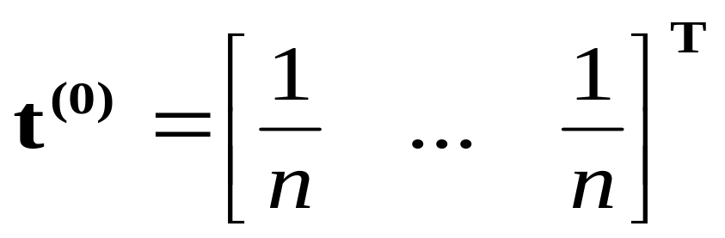
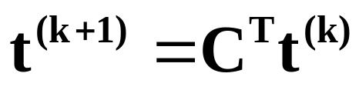
Non-distributed Algorithm
Initialize:
Repeat until convergence:

Slide 20

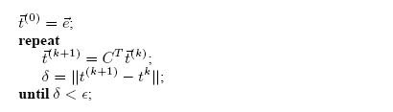

Basic EigenTrust Algorithm
Assumption: include central server at this stage
  A server stores all the values and performs the computation

Slide 21
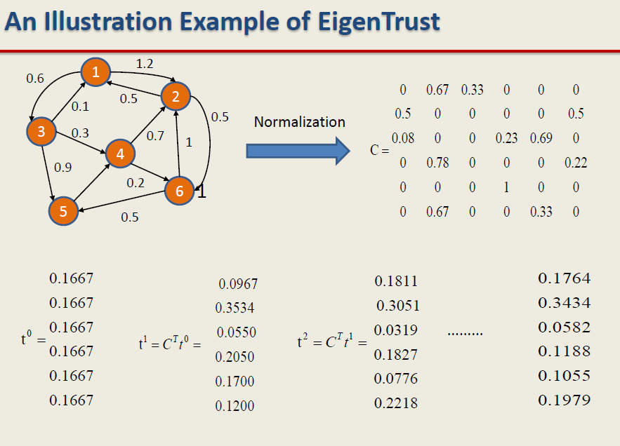
Notes:
Row 1 of C: Sqrt(0.6^2 + 1.2^2) = 1.34 length normalization: [- 0.89 0.448 - - -]
sum normalization: [ - 1.2 / 1.8 0.6/1.8 - - -]
(Normalization by adding up all the outarc weights) (t0 initialized to 1/6)

Slide 22
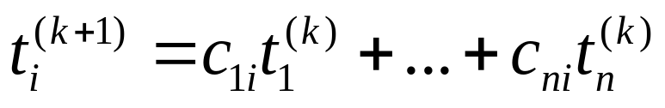
Distributed Algorithm
.1
.3
.2
.3
.1
.1
.1
.5
0
0
0
.2
No central authority to store and compute t.
Each peer i holds its own opinions c_{i}.
For now, let’s ignore questions of lying, and let each peer store and compute its own trust value.
.2
0 .2 0 .3 0 .5 .1 0 0 0
Notes:
Global trust values are independent of the peer i.
k = iteration index, not peer
c(*,i) = [c(1,i),…,c(n,i)] * [c(*,1),…,c(*,n)]
Global Trust in peer i is
global trust in peer 1 * peer 1’s local trust in peer i
+ global trust in peer 2 * peer 2’s local trust in peer i
+ …
[[ t_j’s are treated as referral trust; cji as functional trust]]
-----------------------
Each peer I computes its own reputation based on the opinions of the others about it and their reputations.

Slide 23
Distributed Algorithm
For each peer i {
-First, ask peers who know you for their opinions of you.
-Repeat until convergence {
-Compute current trust value: t_{i}^{(k+1)} = c_{1i} t₁^{(k)} +…+ c_{ni} t_{n}^{(k)}
-Send your opinion c_{ij} and trust value t_{i}^{(k)} to your
acquaintances.
-Wait for the peers who know you to send you their trust
values and opinions.
}
}
Notes:
Typo

Slide 24
Probabilistic Interpretation : Random Surfer Model
Notes:
An agent looking for reputable peers will use the following rule:
At each peer i, it will crawl to peer j with probablility cij.
Global trust: Stationary distribution of Markov chain (long-term visit rate)

Slide 25
Malicious Collectives :
Random Jumps to avoid dead ends
Notes:
Malicious collective: A group of peers that give each other high trust scores and others low trust scores to subvert the system.
Allow non-zero probability (0.15) to jump to pre-trusted peer. (Necessary for eigenvector to exist and be meaningful.)

Slide 26
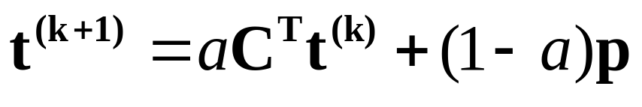
Revised Non-distributed Algorithm
Initialize:
Repeat until convergence:
Notes:
Jump to nodes with prior experience with probability a [[ ideal random surfer ]]
and to any pre-trusted node independent of past experience with probability (1-a) [[ random jumps to avoid dead ends ]]
What is the value of p? p is a vector with 1/|P| as trust value for pre-trusted nodes.
Enables overcoming several obstacles (apriori nodes (cf. new comers), inactive nodes, malicious collectives) as discussed later.

Slide 27
Pre-trusted Peers
Battling Malicious Collectives
Inactive Peers
Incorporating heuristic notions of trust
Improving Convergence Rate

Slide 28
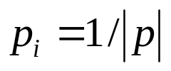




Practical Issues
Apriori notions of trust
  Can we assign any profit to newcomers?
  Only the first few peers to join the network are known to be trustworthy
  if , and otherwise
  Use instead of

Slide 29

Practical Issues(2)
Inactive Peers
  What happens if peer i doesn't download from anybody else?
  Choose to trust the pre-trusted peers

Slide 30

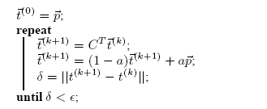
Practical Issues(3)
Malicious Collectives
  a group of malicious peers who know each other
  How to prevent them from subverting the system?
  The modified algorithm:

Slide 31
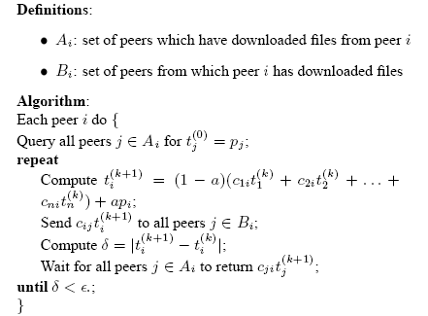
Distributed EigenTrust
Assumption: Everyone is honest
Each peer computes its own global trust value:

Slide 32
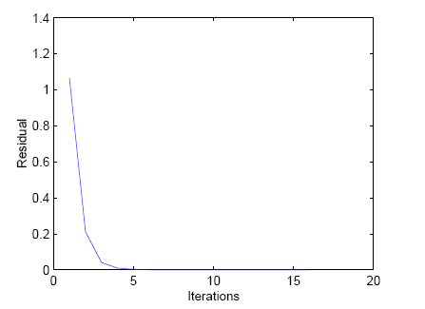
Algorithm Complexity
The algorithm converges fast
  A network of 100 peers after 100 query cycles
Notes:
Haveliwala and Kamvar, “The Second Eigenvalue of the Google Matrix” (http://dbpubs.stanford.edu/pub/2003-20)

Slide 33
Secure Score Management
Two basic ideas:
  Instead of having a peer compute and store its own score, have another peer compute and store its score.
  Have multiple score managers who vote on a peer’s score.
?
M
Score Manager
Distributed Hash Table
M
?
?
M
?
M
Score Managers
Notes:
Use m-hash functions to map a peer to its m-score managers.
Pick peer based on Majority Vote

Slide 34
How to use the trust values t_{i}
When you get responses from multiple peers:
  Deterministic: Choose the peer with highest trust value.
    To avoid discriminating against new peer (at the risk of inviting malicious peer), occasionally use other peer.
  Probabilistic: Choose a peer with probability proportional to its trust value.
    This approach improves load balancing.

Slide 35
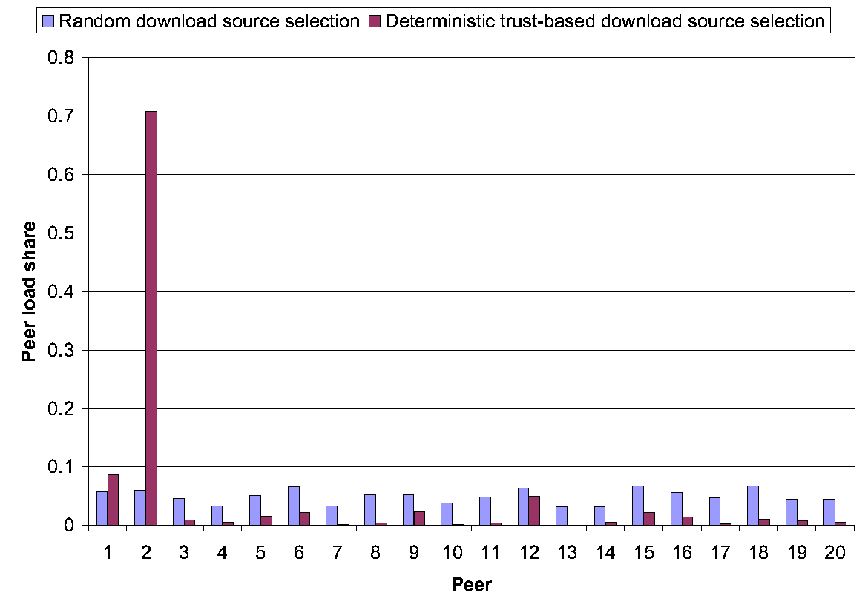
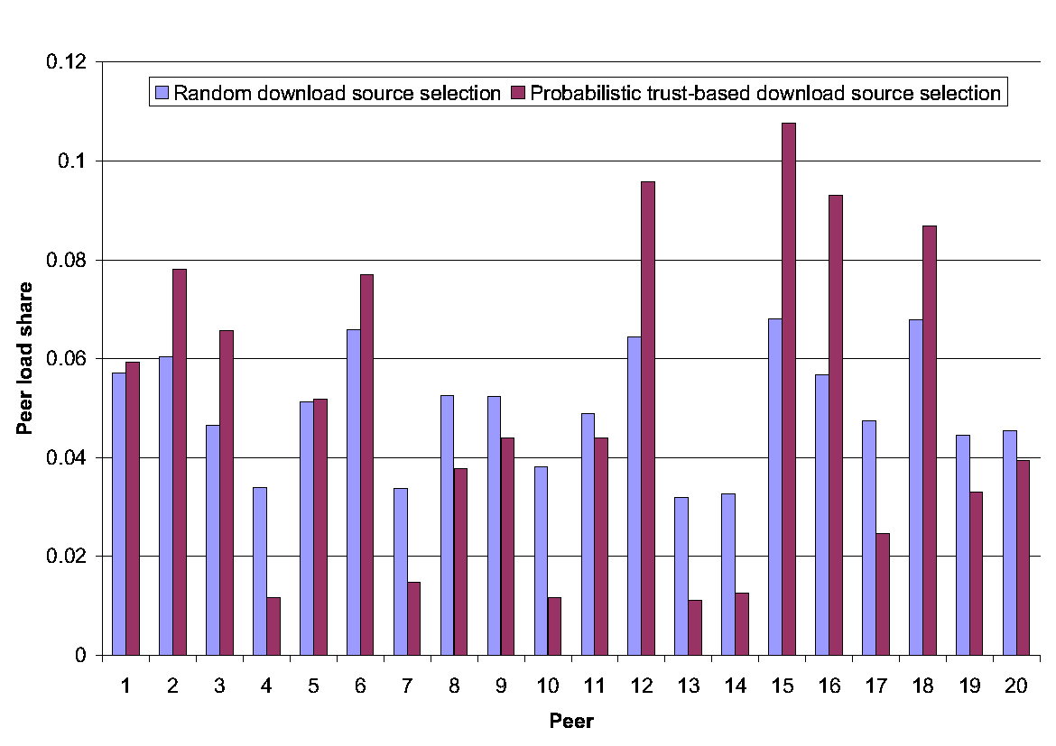
Load Distribution
Deterministic Download Choice
Probabilistic Download Choice
Notes:
Equitable load distribution. Note that the light blue bars have the same values –
Heights of the corresponding bars are different in the two graphs because the scales are different.

Slide 36
Threat Scenarios
Malicious Individuals
  Always provide inauthentic files.
Malicious Collective
  Always provide inauthentic files.
  Know each other. Give each other good opinions, and give other peers bad opinions.
Notes:
Simulate various threat scenarios and evaluate the quality of throughput to see how trust can make the system more robust

Slide 37
More Threat Scenarios
Camouflaged Collective
  Provide authentic files some of the time to trick good peers into giving them good opinions.
Malicious Spies
  Some members of the collective give good files all the time, but give good opinions to malicious peers.

Slide 38
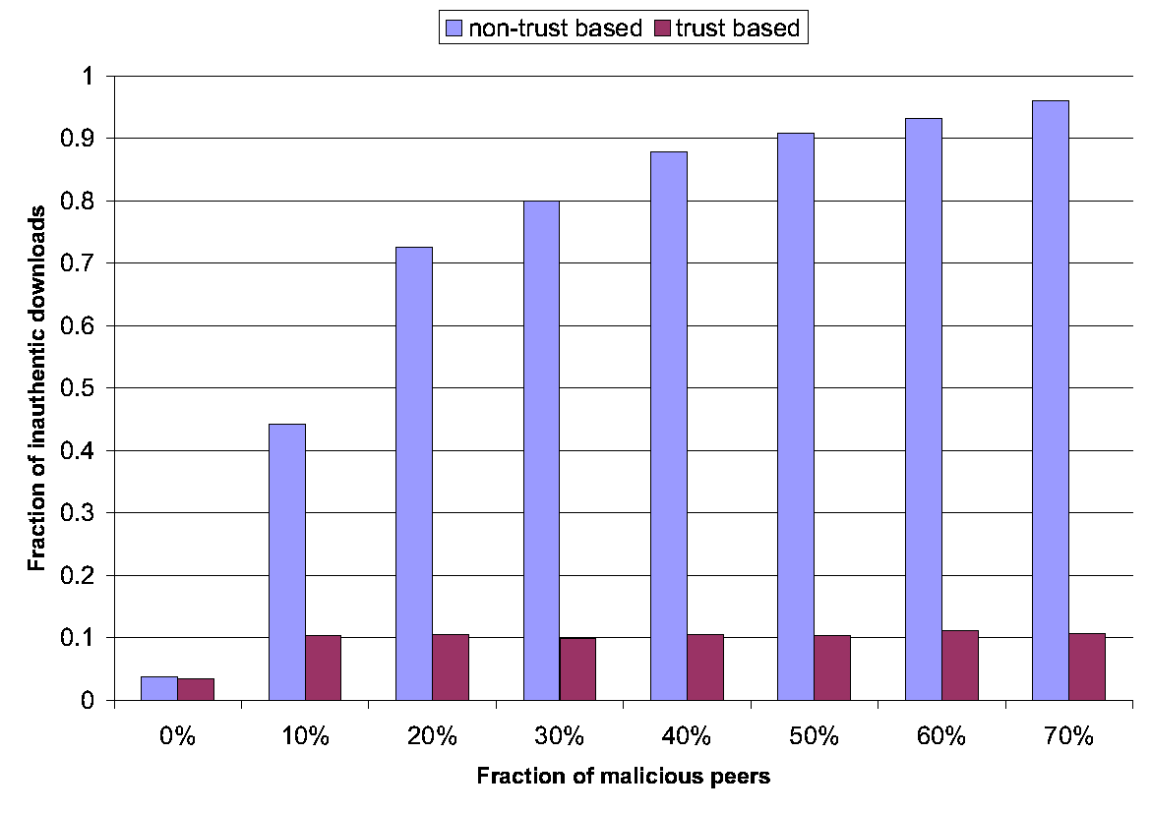
Malicious Individuals
Notes:
As the number of malicious nodes go up, support for trust computation helps warding off inauthentic downloads

Slide 39
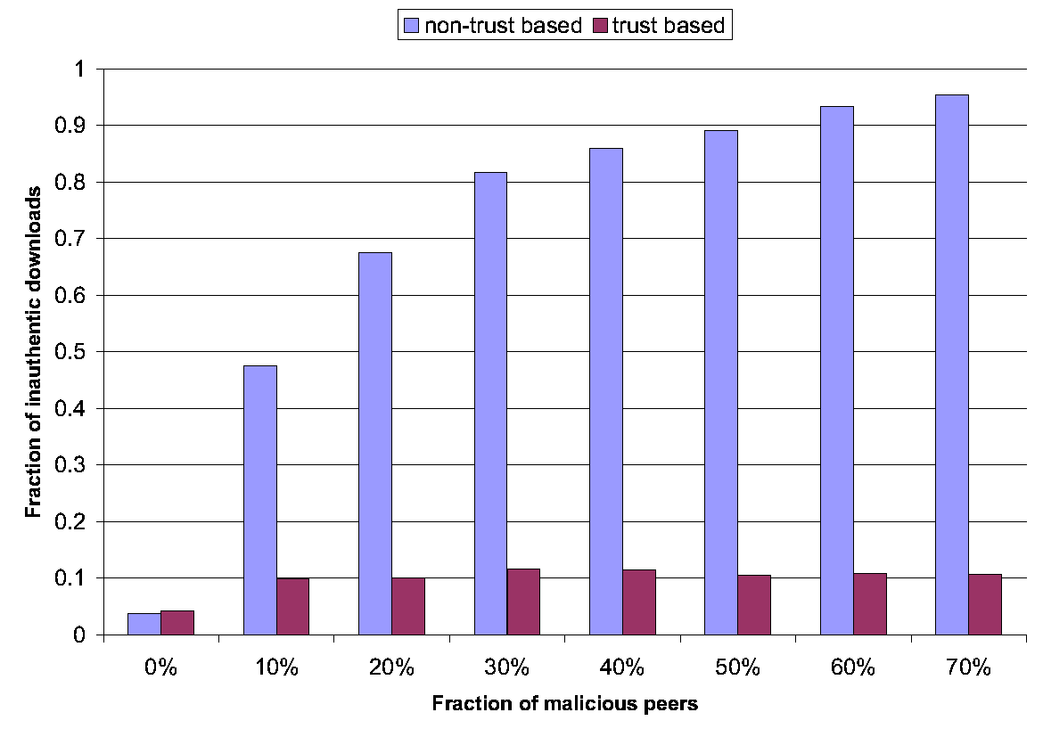
Malicious Collective
Notes:
As the number of malicious nodes go up, support for trust computation helps warding off inauthentic downloads.
The key is the existence of pre-trusted (high calibre) nodes that cannot be conned.

Slide 40
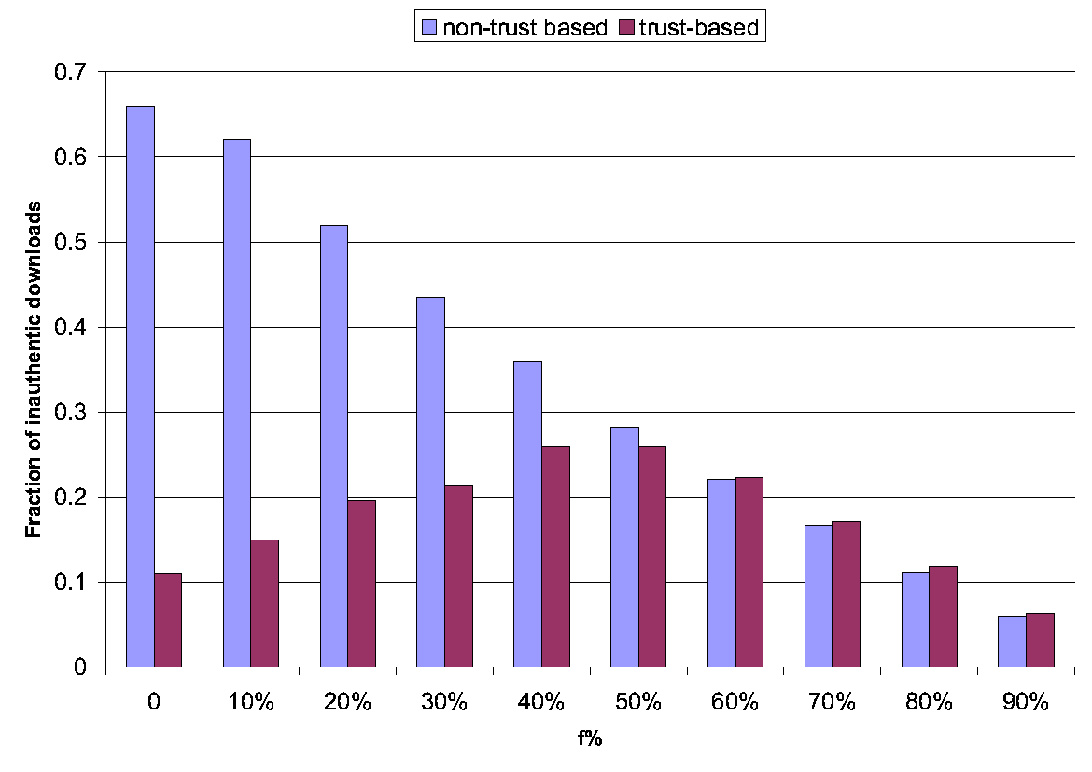
Camouflaged Collective
Notes:
As the number of malicious nodes go up, support for trust computation does not help because the peers do upload authentic files off and on.
However, notice that this comes at a cost to malicious peers that are now obligated to upload authentic files to increase their local trust.

Slide 41
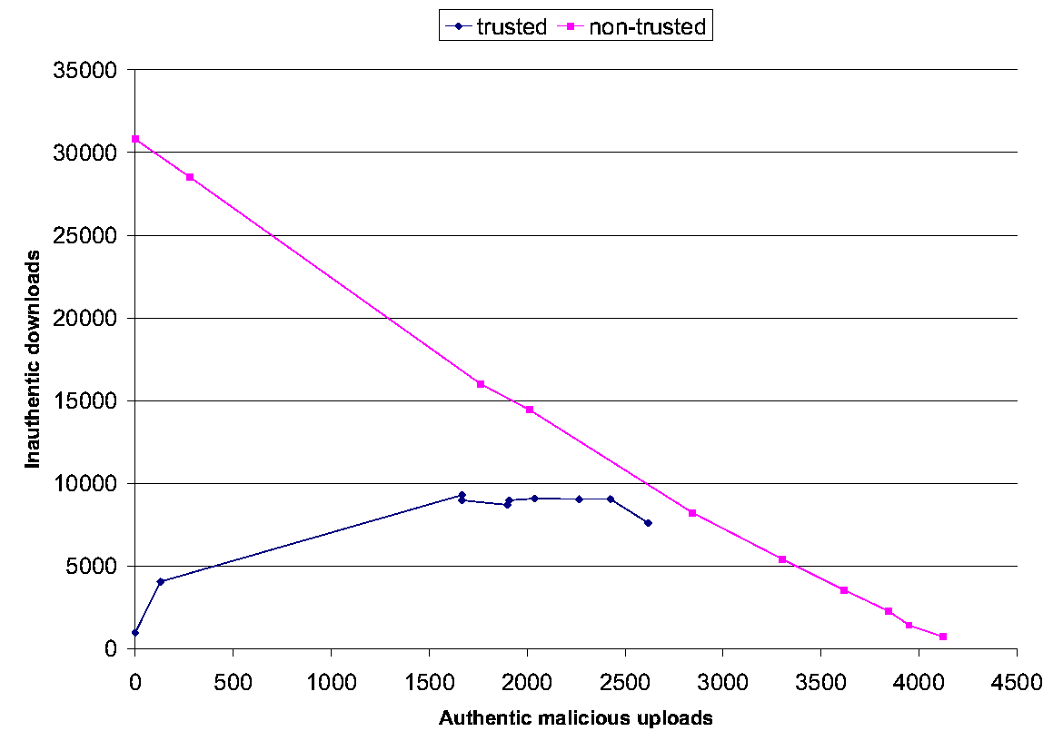
Malicious Spies
Notes:
Notice that malicious spies upload authentic files to increase their local trust, in order to give higher reputation to other malicious peers.

Slide 42
Conclusion
Eigentrust
  Dramatically reduces number of inauthentic files on the network.
  Robust to malicious peers.
  Low overhead.
Paper available at http://www.stanford.edu/~sdkamvar/research.html
Notes:
For Google Matrix : Stochastic (column add to 1) and irreducible (no islands). Max eigenvalue 1. Second largest eigen value = ALPHA
(smaller ALPHA faster convergence)

