Slide 1
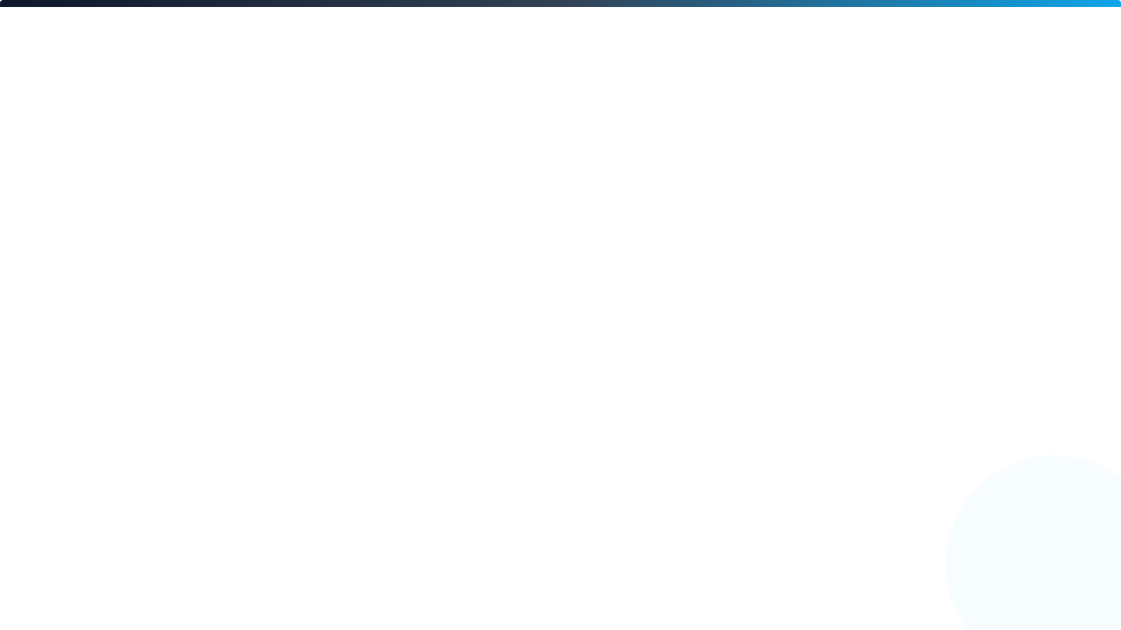
Proactive Bug Discovery via Agentic Exploration
Research Proposal | Group 4
Lê Trần Gia Huy | Lê Chí Tâm | Nguyễn Tiến Phú | Trương Văn An
June 20, 2026

Slide 2
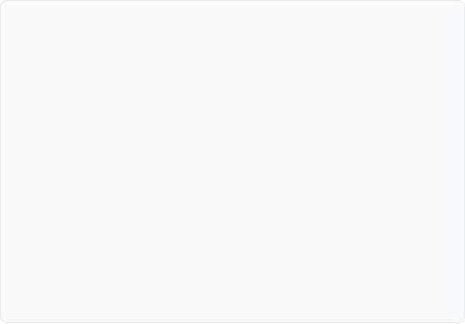
Problem & GAP
Context
—
Repository-level testing requires understanding entire codebases and documentation.
Shared Limitation (GAP-S)
—
"Proactive discovery" means finding bugs without existing human reports.
State-of-the-art LLMs (Claude-Sonnet-4.5) only achieve a 16.06% Fail-to-Pass rate in proactive scenarios.
—
Current LLMs (GPT-5, Claude) show severe limitations in this specific task.
Conclusion: Missing an autonomous agent architecture with real-time terminal interaction.

Slide 3
Evidence Summary
Paper / Tool | Dataset (N) | Primary Metric | Best Result
TestExplora (2026) | 2,389 tasks | F2P Rate (%) | 16.06% (Baseline)
SWT-Bench (2025) | GitHub Issues | Reproduction Rate | 27.3% (Reactive)
MASTEST (2025) | REST APIs | Bug Detection | 78.0% (Human-in-loop)
TESTWEAVER (2026) | 10 Services | Line Coverage | +16.4% improvement
*Evidence selected from 37 analyzed publications confirming the critical performance gap.

Slide 4





Research Questions (RQ)
Does Agentic Exploration exceed the 16.06% threshold of static context?
Does increasing budget to k=3 push F2P towards the 29.7% ceiling?
H0: Performance ≤ 16.06%
H0: k=5 improvement ≤ Static floor
H1: Performance > 16.06%
H1: k=5 approaches 29.7%
Threshold: 16.06% (TestExplora, 2026)
Threshold: 29.7% (SWEAgent + GPT-5-mini)
Test: Wilcoxon (α=0.05)
Test: Wilcoxon (α=0.05)

Slide 5
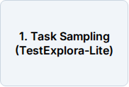
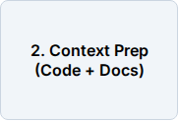
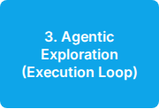
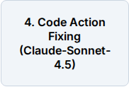
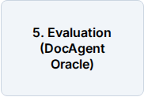
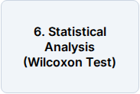
Experiment Pipeline
—
Input: Repository source code + Documentation (No issue reports).
—
Feedback: GPT-5-mini interacts with terminal, reads logs, and fixes suites.
—
Constraints: Maximum 80 turns per exploration loop.

Slide 6

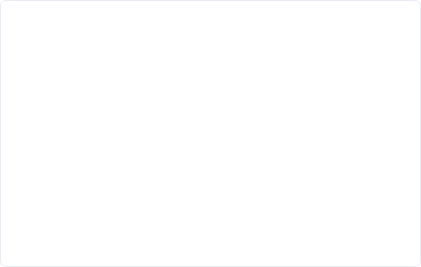
Dataset & Baseline
Dataset: TestExplora-Lite
Baseline: Plain Context
Source: Microsoft Open Source (GitHub)
Source: TestExplora (2026, Microsoft)
—
N: 517 samples from 482 repositories.
—
Claude-Sonnet-4.5 static generation.
—
Domain: Web, Data Science, Dev Tools.
—
Single-step prompt (No agent loop).
—
Anti-Leakage: Post-2023 stream data.
—
No terminal interaction tools.
—
Status: Accessible (Dockerized).
—
Direct comparison on the same dataset.

Slide 7
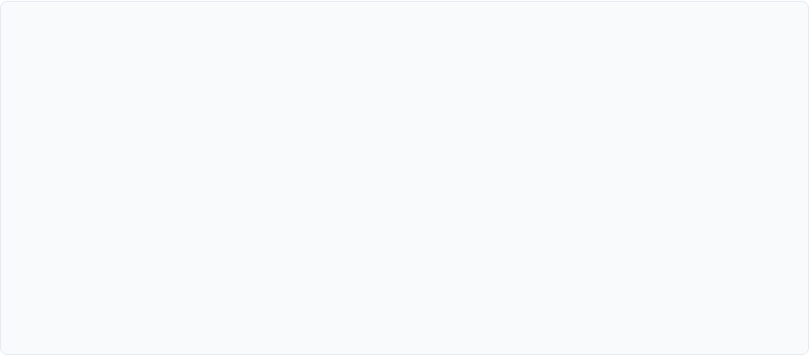
Statistical Plan
Primary Test | Wilcoxon signed-rank test (One-tailed)
Significance (α) | 0.05
Effect Size | Cliff's delta (Non-parametric)
Repetitions (K) | K=3 independent runs per configuration
Power | ≥ 0.80 target (G*Power analysis)
*Non-parametric tests chosen due to bounded [0-100%] and skewed distribution of F2P scores.

Slide 8
Threats to Validity
Internal Validity
External & Construct
—
Model Drift: Silent updates to cloud LLMs. Mitigation: Log model-version and system-fingerprints.
—
Generalizability: Mostly Python-based samples. Mitigation: Explicitly state scope; propose Java extension later.
—
Stochasticity: Randomness in high temperature (0.8). Mitigation: Report Median and SD over K=3 runs.
—
Metric Depth: F2P doesn't capture assertion depth. Mitigation: Use HP and EC as cross-validation metrics.

Slide 9
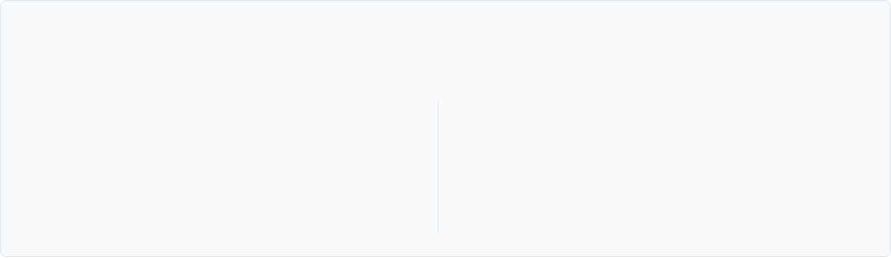
Expected Contribution
"Shifting from Reactive to Proactive Discovery"
Framework
Performance
An autonomous agent architecture capable of real-time terminal exploration and execution feedback loops.
Breaking the 16.06% SOTA ceiling for proactive repository-level testing in black-box/white-box scenarios.

Slide 10
Timeline & Roles
Week | Activity | Responsibility
5 | Proposal Drafting + Docker Environment Setup | PL, DG, LR
6 | Final Submission + Instructor Approval | PL, RW
7 | Pilot Run (20% sample) + Distribution Check | LR, MS
8 | Full Experiment Run + Statistical Testing | LR, MS, RW
Roles: PL (Lead), DG (Data), LR (LLM Runner), MS (Stats), RW (Writer)

Slide 11
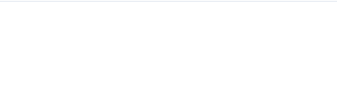
Q&A
Thank you for your attention
Backup slides available for evidence details and prompt templates.

