Slide 1

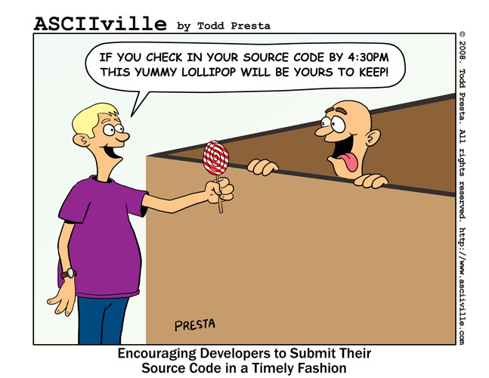
Agile Source Control
Versioning, Branching and Merging.
By Lawrence Cutlip-Mason

Slide 2

Topics:
Overview:
Branching
Merging
Tagging
Approaches:
Team Approach
Feature Approach
Release Approach

Slide 3

Branching
Branching is the most versatile way to version code.
Strategies:
Don't combine different release cycles on a single branch
Make Policies/Rules for the branches and NEVER change the existing branch rules/policies.
Define the owner of the code line (Branch/Trunk)
Don’t get branch crazy.
Clean up the branches by archiving or deletion.
Don’t branch from a branch.

Slide 4

Merging
Everyone merges every day even if you don’t realize it
Strategies:
Merge often.
Minimize branch changes.
The owner of the changes does the merge.
Use the correct tool.
Never blindly commit.
Do not do it at the last minute.
Only 1 person merges at a time
Test the merge destination after the merge takes place.
Tag the destination point before large merge operations, See Tagging.

Slide 5

Tagging
Tags are an immutable snapshot in time.
Strategies:
“Merge Tag” : Tag the target of a merge before you perform the merge.
“Release Tag” Tag the code line when you release.

Slide 6
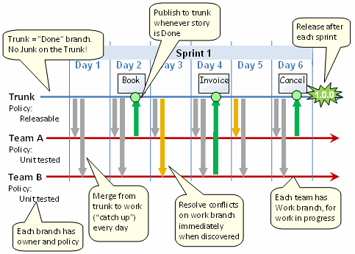
Team Approach (Single Sprint View)

Slide 7
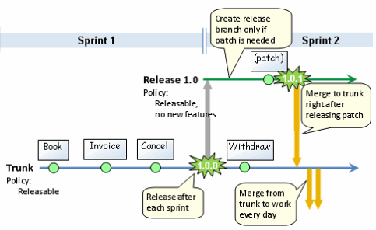
Team Approach (Multiple Sprint View)

Slide 8

Team Approach (Breakdown)
Trunk/Head is the “Done” branch.
Trunk Policy: Can release at any time
Rule: Whoever touches the trunk is responsible for ensuring that the whole trunk stays releasable - including all previous functionality.
Owner: SCRUM Master
Each branch represents a single team working on a collection of Stories
Team Operation:
Anyone working on the top priority story is King.
Everyone else on the team is a Servant.
Whenever a King needs help, Servants immediately offer their services.
A Servant may not disrupt a King.
As soon as the top priority story is Done, anyone working on the next story is now King.

Slide 9
Team Approach (Branching)
Create 1 branch per team
Trunk Policy: Code compiles, Code has been unit tested
Rule: Synchronize your local code with the work branch before check-in
Owner: Person in charge of the features the Team is working on.
Questions
Where do I check in code that I believe is done?
Answer: To the branch that the story belongs to
How do we know which branch does what?
Answer: Create a public board that ties a story to the branch.
What if we need to release early?
Answer: You don’t merge to trunk until all stories for the branch is done.

Slide 10
Team Approach (Merging from Trunk to Branch)
Performed everyday
Reason:
This lowers Code Divergence which is responsible for Merge Conflicts.
(Merging from Branch to Trunk)
Performed at the completion of a story
Reason:
Your code is releasable if you completed the story

Slide 11
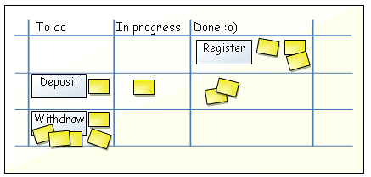
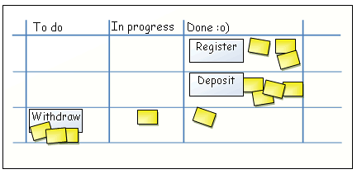
Team Approach (Pitfall)
What if our team implements multiple stories in parallel?
Example: What if we want to release Register which is done and Deposit is in progress?
If we synchronize to trunk at this point, we will be including the partially complete Deposit story, which isn't releasable and a violation of Trunk Policy.
You wait for Deposit to complete. Now somebody has started working on Withdraw!
If one of the Deposit tests fail it will be hard to know if that is due to the Deposit code or the partially complete Withdraw code.
Strategies:
Try to focus the team on one story at a time.
Coordinate: Wait to check in the Deposit code until Register is complete.
Start with the safe and invisible bits of the Deposit code
Keep your branches focused on only a few stories and be willing to wait for all to be completed

Slide 12
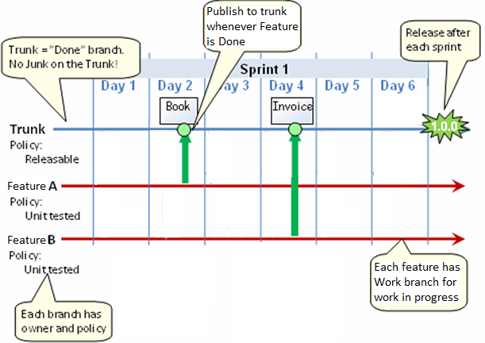
Feature Approach (Single Sprint View)

Slide 13
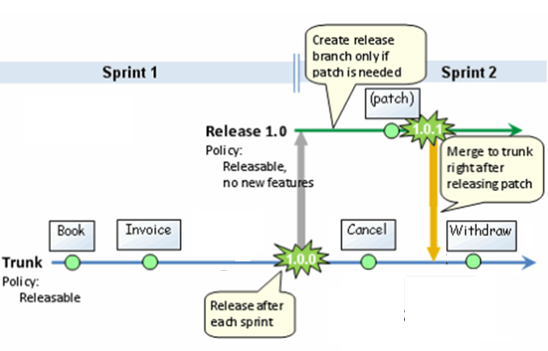
Feature Approach (Multiple Sprint View)

Slide 14
Feature Approach (Breakdown)
Trunk/Head is the “Done” branch.
Trunk Policy: Can release at any time
Rule: Whoever touches the trunk is responsible for ensuring that the whole trunk stays releasable - including all previous functionality.
Owner: SCRUM Master
Each branch represents a single Story, Epic or Bug Fix
Team Operation:
Most stories/epics will have 1 or 2 developers.
Creates a silo effect and can lead to lack of communication and code collisions

Slide 15
Feature Approach (Branching)
Create 1 branch per Story/Epic or Bug Fix
Trunk Policy: Code compiles, Code has been unit tested
Rule: Synchronize your local code with the work branch before check-in
Owner: Person in charge of the Story/Epic
Questions
Where do I check in code that I believe is done?
Answer: To the branch that the story belongs to
How do we know which branch does what?
Answer: Name the branch with the Story/Epic or BugFix ID or Name.
This creates a lot of branches how do you manage this?
Answer: You must organize the branch directory in some fashion (usually by sub folders).

Slide 16

Feature Approach (Merging from Trunk to Branch)
Almost never done
Reason:
The changes are minimal and limited to specific Stories/Epics overlap should be rare.
(Merging from Branch to Trunk)
Performed at the completion of the Story or Epic
Reason:
Your code is releasable if you completed the story or epic

Slide 17
Feature Approach (Pitfalls)
Pitfalls:
People are working on the same code for multiple stories so a lot of conflicts will occur.
We will have a ton of branches to pick through in SVN/CVS.
How do we remember all the branches
Strategies:
Your code is not small and well contained, refactor your code
You can create a separate folder for old branches and move branches to this “retired folder” or you can delete branches once the story is released.
Name them appropriately, usual recommendation is by the Ticket tracking number if available as some VCS systems have a branch/tag name size limit.

Slide 18
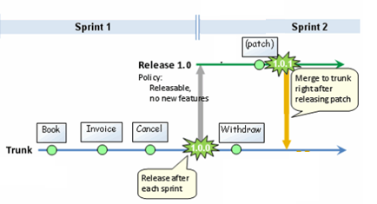
Release Approach

Slide 19
Release Approach (Breakdown)
Trunk/Head is the “Done” branch.
Trunk Policy: Buildable, Unit Tested, Released at X Times
Rule: Whoever touches the trunk is responsible for ensuring that the whole trunk stays in working condition - including all previous functionality.
Owner: SCRUM Master
There is only 1 branch created at the completion of the sprint/code complete. Once this is done ANY fixes for issues reported by QA need to be committed to the branch.
All Releases are from the Release Branch, never the trunk.
I like to call it AgilFall, It is a marriage of Waterfall (Test at the end) and Agile (smaller releases). It is only usable by small teams with very few releases/changes.
Team Operation:
First committer wins.

Slide 20
Release Approach (Branching)
Create 1 branch upon sprint completion or code complete
Branch Policy: Code compiles, Code has been unit tested, Only bug fixes reported by QA
Rule: Synchronize your local code with the work branch before check-in
Owner: Person in charge of the Release
Questions
I still have changes after code complete
Answer: Then your not code complete and your sprint cycle was not correctly scoped.
When does QA Test
Answer: After code complete.
QA Found bugs what do I do?
Answer: make the change on the branch and rebuild/deploy to QA servers from the branch

Slide 21
Release Approach (Merging from Trunk to Branch)
Never done
Reason:
Your Release branch is immutable except for bug fixes which are made directly to the branch. Once you branch your done.
(Merging from Branch to Trunk) Performed when a bug fix occurs on the branch
Reason:
To synchronize the Trunk to the Branch.

Slide 22
Release Approach (Pitfalls)
Pitfalls:
People are working on the same code for multiple stories so a lot of conflicts will occur.
I can’t check in my unfinished code because I will break everyone’s environment
I need to develop a feature that is not part of the Sprint (example: Epic).
Strategies:
Your code is not small and well contained, refactor your code
Develop your code to be independent of others
You can mix Release and Team Approaches to mitigate, mostly no parallel development will occur until Code Complete.

Slide 23
Tools (SVN)
Subclipse (Eclipse Plugin) *Recommended
http://subclipse.tigris.org/
Collabnet Merge Client (Plugin for Subclipse only)
https://desktop-eclipse.open.collab.net/servlets/ProjectProcess?pageID=MEuUjb&freeformpage=Merge%20Client
Subversive (Eclipse Plugin)
http://www.eclipse.org/subversive/
AnkhSVN (Visual Studio Plugin) *Recommended
https://ankhsvn.open.collab.net/
RapidSVN (Freestanding Product Linux & Windows)
http://rapidsvn.tigris.org/
RabbitVCS (Freestanding Product Linux, GIT+SVN)
http://rabbitvcs.org/
TortoiseSVN (Freestanding Product Windows) *Recommended
http://tortoisesvn.net/docs/release/TortoiseSVN_en/tsvn-dug-merge.html
CommitMonitor (Freestanding Product Windows, Monitors Repository)
http://stefanstools.sourceforge.net/CommitMonitor.html
SVNNotifier (Freestanding Product Windows, Monitors Repository)
http://svnnotifier.tigris.org/

Slide 24
Resources (SVN)
Merging Subclipse + Collabnet
https://desktop-eclipse.open.collab.net/servlets/ProjectProcess?pageID=MEuUjb&freeformpage=Merge%20Client
Merging TortoiseSVN
http://tortoisesvn.net/docs/release/TortoiseSVN_en/tsvn-dug-merge.html
Merging Subclipse
Use the Eclipse Help “Subclipse - Subversion Eclipse Plugin > Reference > Team Menu”

Slide 25
Common Misconceptions
Merging is hard!
Merging is only as hard as you make it, time is your own enemy.
Branching is bad!
Only if you don’t have a policy and stick to the policy
You can only Branch the entire project
Incorrect CVS/GIT/SVN all can branch ANY item under VC!
We don’t need to branch, we only have 1 release at a time going on.
Everyone can and should use branches, even if it’s only a “Release Branch”
If we branch we don’t need to Tag.
Tags are a way to save a snapshot so you can easily get back to it later to perform some other operation.

