Slide 1
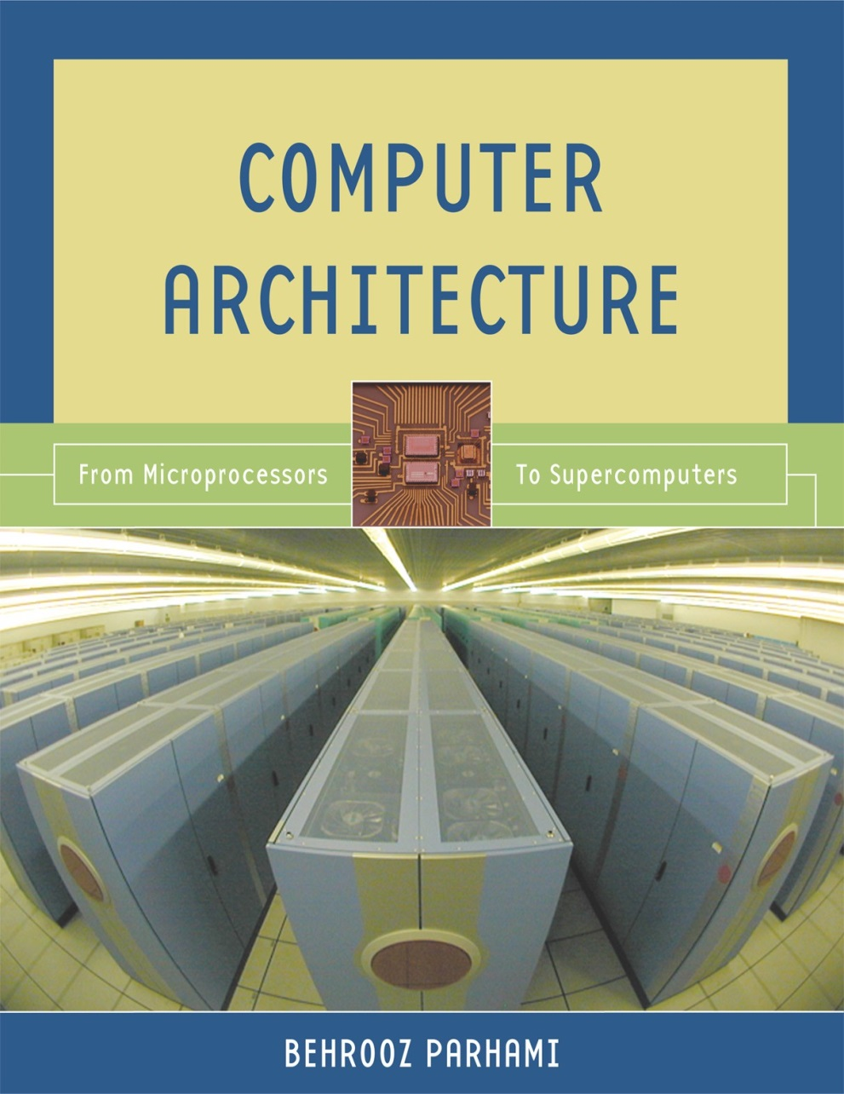
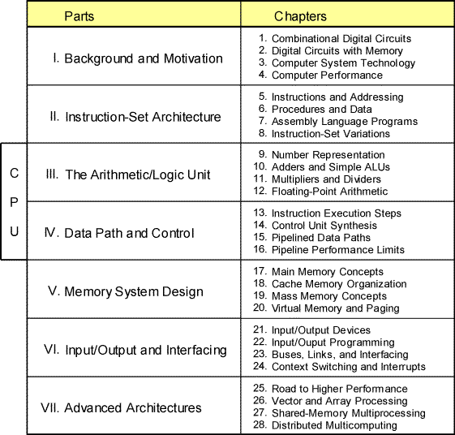
Part II
Instruction-Set Architecture
Oct. 2014
Computer Architecture, Instruction-Set Architecture
Slide <number>

Slide 2
About This Presentation
This presentation is intended to support the use of the textbook Computer Architecture: From Microprocessors to Supercomputers, Oxford University Press, 2005, ISBN 0-19-515455-X. It is updated regularly by the author as part of his teaching of the upper-division course ECE 154, Introduction to Computer Architecture, at the University of California, Santa Barbara. Instructors can use these slides freely in classroom teaching and for other educational purposes. Any other use is strictly prohibited. © Behrooz Parhami
Edition | Released | Revised | Revised | Revised | Revised
First | June 2003 | July 2004 | June 2005 | Mar. 2006 | Jan. 2007
 |  | Jan. 2008 | Jan. 2009 | Jan. 2011 | Oct. 2014
Oct. 2014
Computer Architecture, Instruction-Set Architecture
Slide <number>

Slide 3
A Few Words About Where We Are Headed
Performance = 1 / Execution time simplified to 1 / CPU execution time
CPU execution time = Instructions × CPI / (Clock rate)
Performance = Clock rate / ( Instructions × CPI )
Try to achieve CPI = 1 with clock that is as high as that for CPI > 1 designs; is CPI < 1 feasible? (Chap 15-16)
Design hardware
for CPI = 1; seek improvements with CPI > 1 (Chap 13-14)
Define an instruction set;
make it simple enough
to require a small number
of cycles and allow high clock rate, but not so simple that we need many instructions, even for very simple tasks (Chap 5-8)
Design memory & I/O structures to support ultrahigh-speed CPUs
Design ALU for arithmetic & logic ops (Chap 9-12)
Oct. 2014
Computer Architecture, Instruction-Set Architecture
Slide <number>

Slide 4


Strategies for Speeding Up Instruction Execution
Performance = 1 / Execution time simplified to 1 / CPU execution time
CPU execution time = Instructions × CPI / (Clock rate)
Performance = Clock rate / ( Instructions × CPI )
Assembly line analogy
Single-cycle
(CPI = 1)
Faster
Parallel processing or pipelining
Items that take longest to inspect dictate the speed of the assembly line
Faster
Multicycle
(CPI > 1)
Oct. 2014
Computer Architecture, Instruction-Set Architecture
Slide <number>

Slide 5
II Instruction Set Architecture
Introduce machine “words” and its “vocabulary,” learning:
  A simple, yet realistic and useful instruction set
  Machine language programs; how they are executed
  RISC vs CISC instruction-set design philosophy
Topics in This Part
Chapter 5 Instructions and Addressing
Chapter 6 Procedures and Data
Chapter 7 Assembly Language Programs
Chapter 8 Instruction Set Variations
Oct. 2014
Computer Architecture, Instruction-Set Architecture
Slide <number>

Slide 6
5 Instructions and Addressing
First of two chapters on the instruction set of MiniMIPS:
  Required for hardware concepts in later chapters
  Not aiming for proficiency in assembler programming
Topics in This Chapter
5.1 Abstract View of Hardware
5.2 Instruction Formats
5.3 Simple Arithmetic / Logic Instructions
5.4 Load and Store Instructions
5.5 Jump and Branch Instructions
5.6 Addressing Modes
Oct. 2014
Computer Architecture, Instruction-Set Architecture
Slide <number>

Slide 7
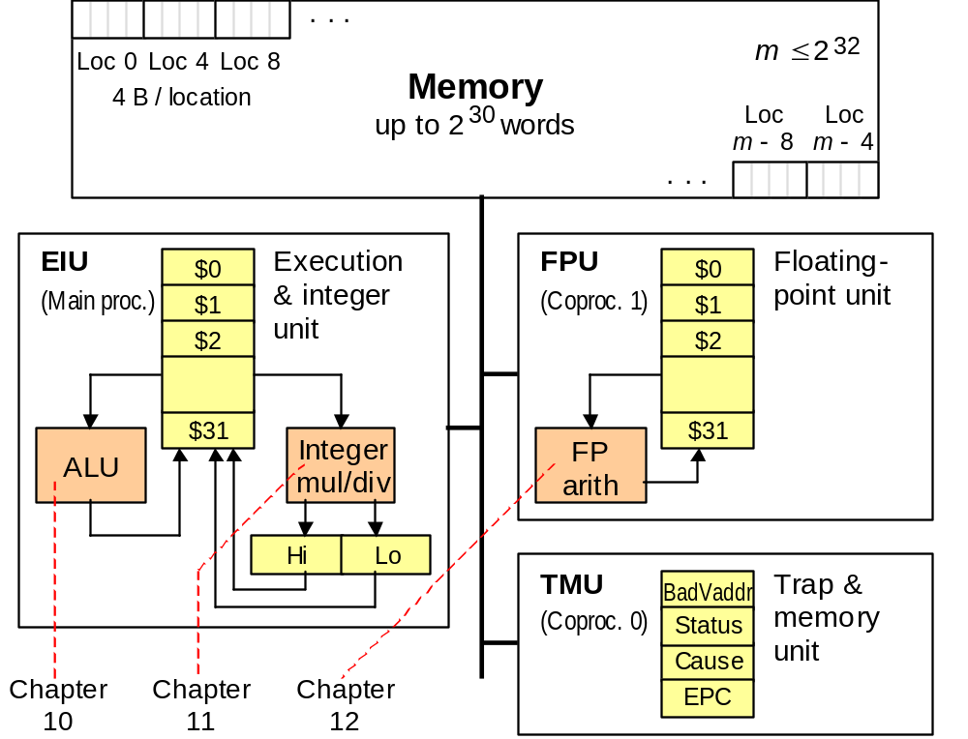
5.1 Abstract View of Hardware
Figure 5.1 Memory and processing subsystems for MiniMIPS.
Oct. 2014
Computer Architecture, Instruction-Set Architecture
Slide <number>

Slide 8
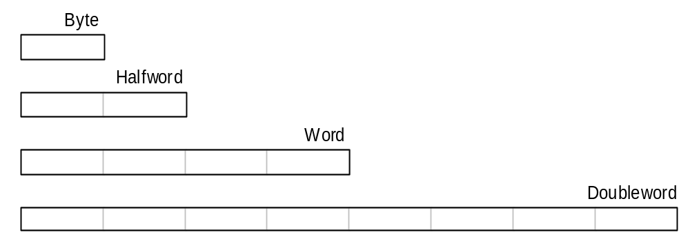
Data Types
Byte = 8 bits
Used only for floating-point data, so safe to ignore in this course
Halfword = 2 bytes
Word = 4 bytes
Doubleword = 8 bytes
Quadword (16 bytes) also used occasionally
MiniMIPS registers hold 32-bit (4-byte) words. Other common data sizes include byte, halfword, and doubleword.
Oct. 2014
Computer Architecture, Instruction-Set Architecture
Slide <number>

Slide 9
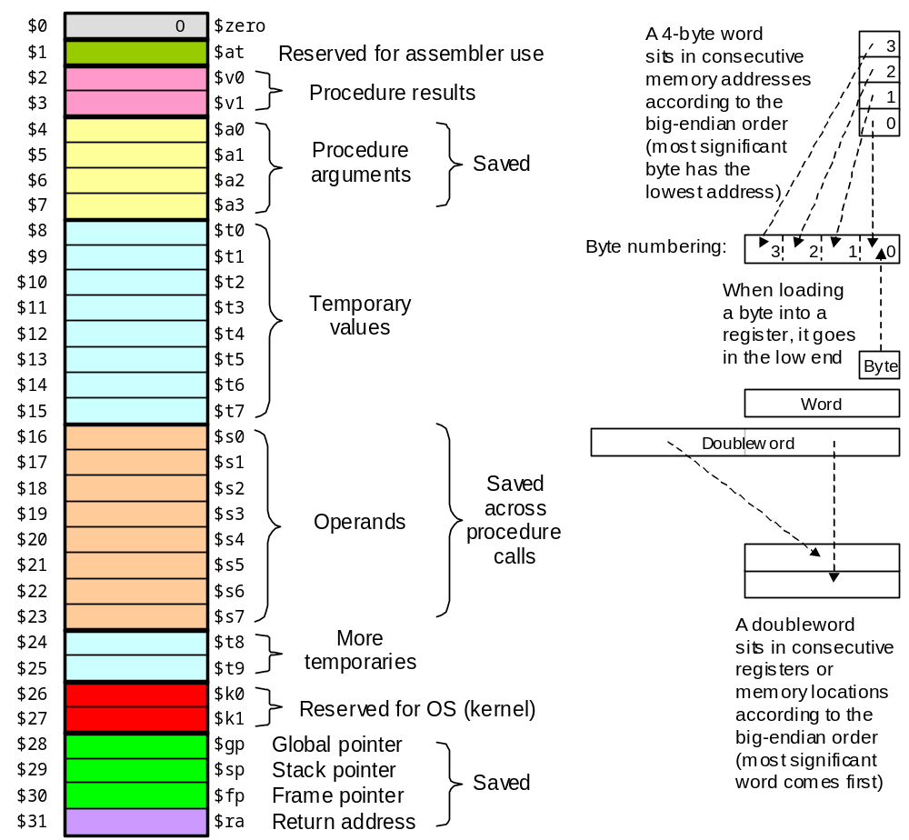
Register Conventions
Figure 5.2 Registers and data sizes in MiniMIPS.
Oct. 2014
Computer Architecture, Instruction-Set Architecture
Slide <number>

Slide 10
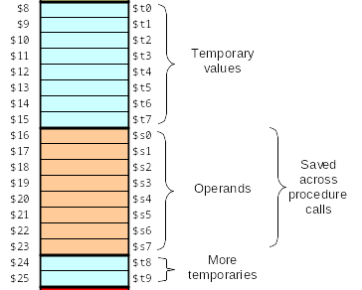

Registers Used in This Chapter
10 temporary registers
8 operand registers
Change
Wallet
Keys
Analogy for register usage conventions
Figure 5.2 (partial)
Oct. 2014
Computer Architecture, Instruction-Set Architecture
Slide <number>

Slide 11
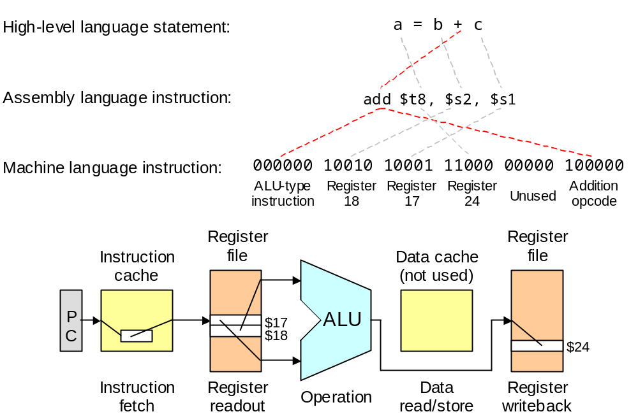
5.2 Instruction Formats
Figure 5.3 A typical instruction for MiniMIPS and steps in its execution.
Oct. 2014
Computer Architecture, Instruction-Set Architecture
Slide <number>

Slide 12
Add, Subtract, and Specification of Constants
MiniMIPS add & subtract instructions; e.g., compute:
g = (b + c) − (e + f)
add $t8,$s2,$s3 # put the sum b + c in $t8
add $t9,$s5,$s6 # put the sum e + f in $t9
sub $s7,$t8,$t9 # set g to ($t8) − ($t9)
Decimal and hex constants
Decimal 25, 123456, −2873
Hexadecimal 0x59, 0x12b4c6, 0xffff0000
Machine instruction typically contains
an opcode
one or more source operands
possibly a destination operand
Oct. 2014
Computer Architecture, Instruction-Set Architecture
Slide <number>

Slide 13
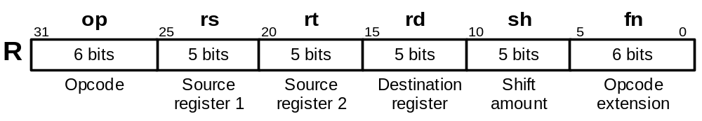
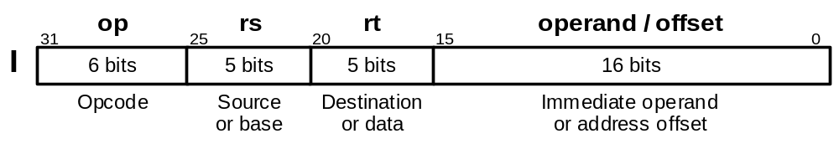
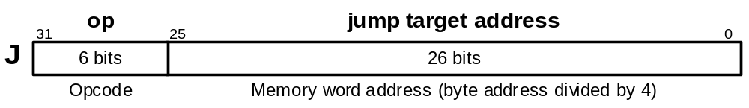
MiniMIPS Instruction Formats
Figure 5.4 MiniMIPS instructions come in only three formats: register (R), immediate (I), and jump (J).
Oct. 2014
Computer Architecture, Instruction-Set Architecture
Slide <number>

Slide 14
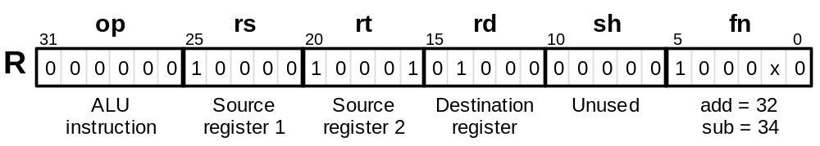
5.3 Simple Arithmetic/Logic Instructions
Add and subtract already discussed; logical instructions are similar
add $t0,$s0,$s1 # set $t0 to ($s0)+($s1)
sub $t0,$s0,$s1 # set $t0 to ($s0)-($s1)
and $t0,$s0,$s1 # set $t0 to ($s0)∧($s1)
or $t0,$s0,$s1 # set $t0 to ($s0)∨($s1)
xor $t0,$s0,$s1 # set $t0 to ($s0)⊕($s1)
nor $t0,$s0,$s1 # set $t0 to (($s0)∨($s1))′
Figure 5.5 The arithmetic instructions add and sub have a format that is common to all two-operand ALU instructions. For these, the fn field specifies the arithmetic/logic operation to be performed.
Oct. 2014
Computer Architecture, Instruction-Set Architecture
Slide <number>

Slide 15
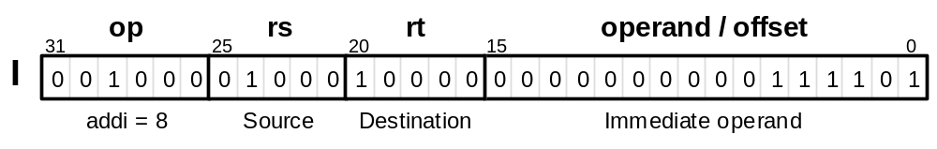
Arithmetic/Logic with One Immediate Operand
An operand in the range [−32 768, 32 767], or [0x0000, 0xffff], can be specified in the immediate field.
addi $t0,$s0,61 # set $t0 to ($s0)+61
andi $t0,$s0,61 # set $t0 to ($s0)∧61
ori $t0,$s0,61 # set $t0 to ($s0)∨61
xori $t0,$s0,0x00ff # set $t0 to ($s0)⊕ 0x00ff
For arithmetic instructions, the immediate operand is sign-extended
1 0
Errors
0 1
Figure 5.6 Instructions such as addi allow us to perform an arithmetic or logic operation for which one operand is a small constant.
Oct. 2014
Computer Architecture, Instruction-Set Architecture
Slide <number>

Slide 16
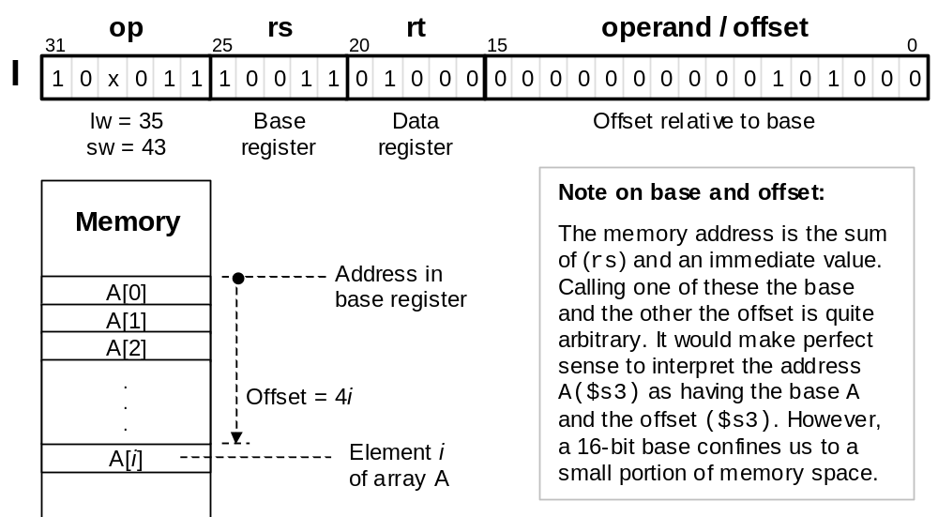
5.4 Load and Store Instructions
lw $t0,40($s3)
lw $t0,A($s3)
Figure 5.7 MiniMIPS lw and sw instructions and their memory addressing convention that allows for simple access to array elements via a base address and an offset (offset = 4i leads us to the i th word).
Oct. 2014
Computer Architecture, Instruction-Set Architecture
Slide <number>

Slide 17
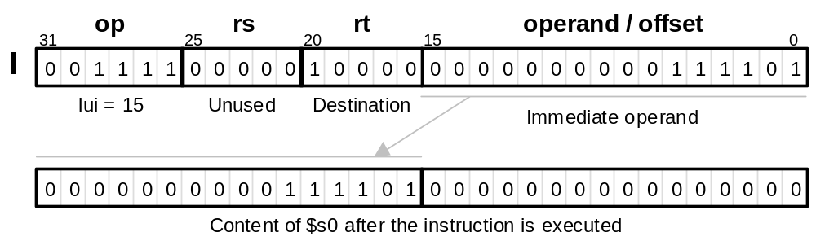
lw, sw, and lui Instructions
lw $t0,40($s3) # load mem[40+($s3)] in $t0
sw $t0,A($s3) # store ($t0) in mem[A+($s3)]
# “($s3)” means “content of $s3”
lui $s0,61 # The immediate value 61 is
# loaded in upper half of $s0
# with lower 16b set to 0s
Figure 5.8 The lui instruction allows us to load an arbitrary 16-bit value into the upper half of a register while setting its lower half to 0s.
Oct. 2014
Computer Architecture, Instruction-Set Architecture
Slide <number>

Slide 18
Initializing a Register
Example 5.2
Show how each of these bit patterns can be loaded into $s0:
0010 0001 0001 0000 0000 0000 0011 1101
1111 1111 1111 1111 1111 1111 1111 1111
Solution
The first bit pattern has the hex representation: 0x2110003d
lui $s0,0x2110 # put the upper half in $s0
ori $s0,0x003d # put the lower half in $s0
Same can be done, with immediate values changed to 0xffff
for the second bit pattern. But, the following is simpler and faster:
nor $s0,$zero,$zero # because (0 ∨ 0)′ = 1
Oct. 2014
Computer Architecture, Instruction-Set Architecture
Slide <number>

Slide 19
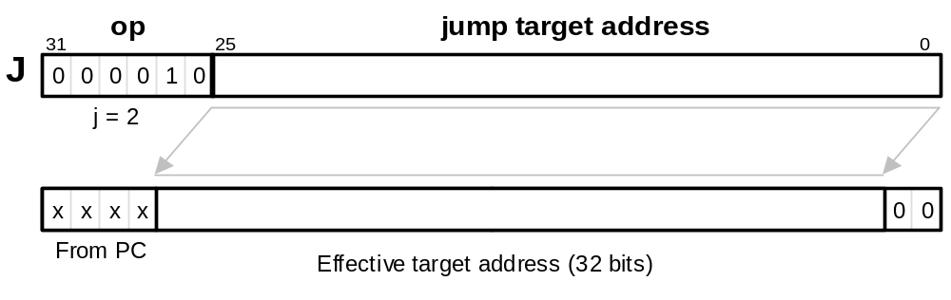
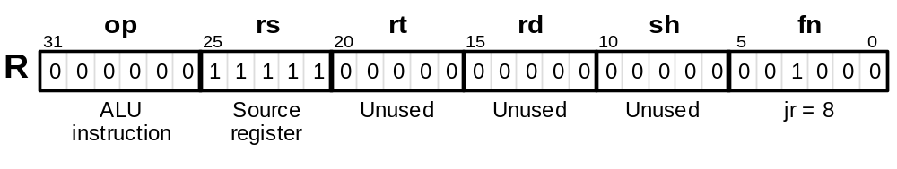
5.5 Jump and Branch Instructions
Unconditional jump and jump through register instructions
j verify # go to mem loc named “verify”
jr $ra # go to address that is in $ra;
# $ra may hold a return address
$ra is the symbolic name for reg. $31 (return address)
(incremented)
Figure 5.9 The jump instruction j of MiniMIPS is a J-type instruction which is shown along with how its effective target address is obtained. The jump register (jr) instruction is R-type, with its specified register often being $ra.
Oct. 2014
Computer Architecture, Instruction-Set Architecture
Slide <number>

Slide 20
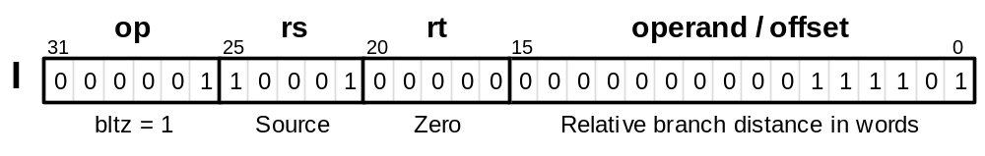
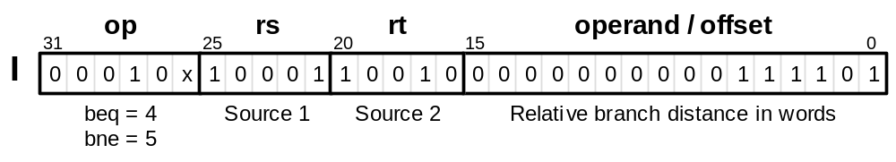
Conditional Branch Instructions
Conditional branches use PC-relative addressing
bltz $s1,L # branch on ($s1)< 0
beq $s1,$s2,L # branch on ($s1)=($s2)
bne $s1,$s2,L # branch on ($s1)≠($s2)
Figure 5.10 (part 1) Conditional branch instructions of MiniMIPS.
Oct. 2014
Computer Architecture, Instruction-Set Architecture
Slide <number>

Slide 21
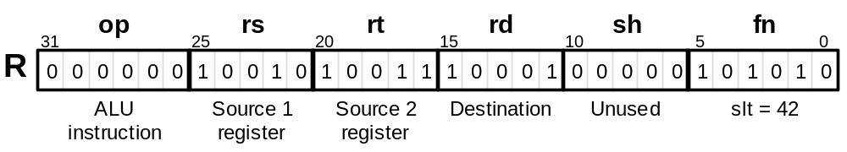
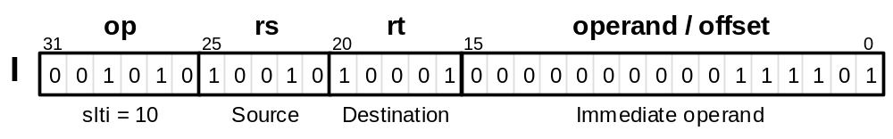
Comparison Instructions for Conditional Branching
slt $s1,$s2,$s3 # if ($s2)<($s3), set $s1 to 1
# else set $s1 to 0;
# often followed by beq/bne
slti $s1,$s2,61 # if ($s2)<61, set $s1 to 1
# else set $s1 to 0
Figure 5.10 (part 2) Comparison instructions of MiniMIPS.
Oct. 2014
Computer Architecture, Instruction-Set Architecture
Slide <number>

Slide 22
Examples for Conditional Branching
If the branch target is too far to be reachable with a 16-bit offset
(rare occurrence), the assembler automatically replaces the branch
instruction beq $s0,$s1,L1 with:
bne $s1,$s2,L2 # skip jump if (s1)≠(s2)
j L1 # goto L1 if (s1)=(s2)
L2: ...
Forming if-then constructs; e.g., if (i == j) x = x + y
bne $s1,$s2,endif # branch on i≠j
add $t1,$t1,$t2 # execute the “then” part
endif: ...
If the condition were (i < j), we would change the first line to:
slt $t0,$s1,$s2 # set $t0 to 1 if i<j
beq $t0,$0,endif # branch if ($t0)=0;
# i.e., i not< j or i≥j
Oct. 2014
Computer Architecture, Instruction-Set Architecture
Slide <number>

Slide 23
Compiling if-then-else Statements
Example 5.3
Show a sequence of MiniMIPS instructions corresponding to:
if (i<=j) x = x+1; z = 1; else y = y–1; z = 2*z
Solution
Similar to the “if-then” statement, but we need instructions for the
“else” part and a way of skipping the “else” part after the “then” part.
slt $t0,$s2,$s1 # j<i? (inverse condition)
bne $t0,$zero,else # if j<i goto else part
addi $t1,$t1,1 # begin then part: x = x+1
addi $t3,$zero,1 # z = 1
j endif # skip the else part
else: addi $t2,$t2,-1 # begin else part: y = y–1
add $t3,$t3,$t3 # z = z+z
endif:...
Oct. 2014
Computer Architecture, Instruction-Set Architecture
Slide <number>

Slide 24
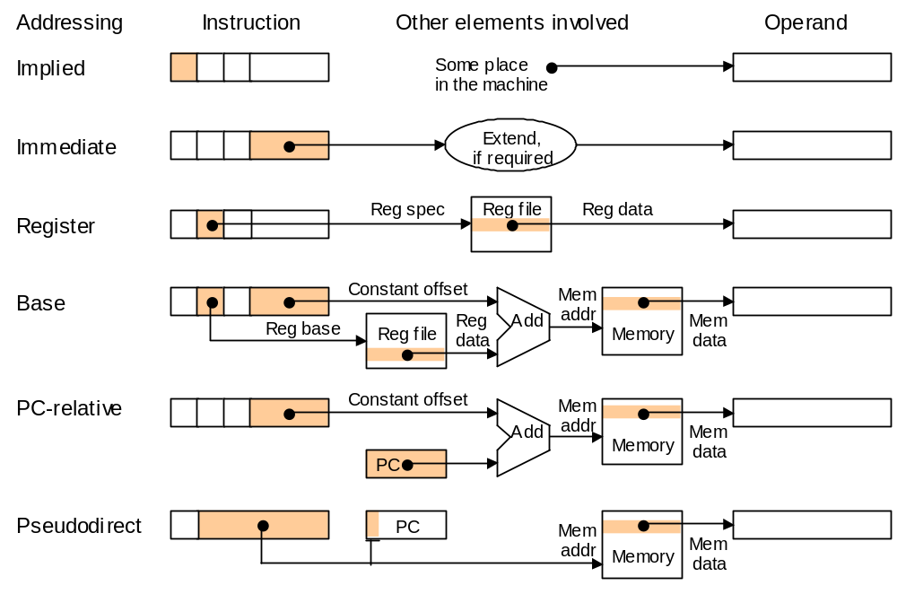
5.6 Addressing Modes
Incremented
Figure 5.11 Schematic representation of addressing modes in MiniMIPS.
Oct. 2014
Computer Architecture, Instruction-Set Architecture
Slide <number>

Slide 25
Finding the Maximum Value in a List of Integers
Example 5.5
List A is stored in memory beginning at the address given in $s1.
List length is given in $s2.
Find the largest integer in the list and copy it into $t0.
Solution
Scan the list, holding the largest element identified thus far in $t0.
lw $t0,0($s1) # initialize maximum to A[0]
addi $t1,$zero,0 # initialize index i to 0
loop: add $t1,$t1,1 # increment index i by 1
beq $t1,$s2,done # if all elements examined, quit
add $t2,$t1,$t1 # compute 2i in $t2
add $t2,$t2,$t2 # compute 4i in $t2
add $t2,$t2,$s1 # form address of A[i] in $t2
lw $t3,0($t2) # load value of A[i] into $t3
slt $t4,$t0,$t3 # maximum < A[i]?
beq $t4,$zero,loop # if not, repeat with no change
addi $t0,$t3,0 # if so, A[i] is the new maximum
j loop # change completed; now repeat
done: ... # continuation of the program
Oct. 2014
Computer Architecture, Instruction-Set Architecture
Slide <number>

Slide 26
The 20 MiniMIPS Instructions Covered So Far
Instruction | Usage
Load upper immediate | lui rt,imm
Add | add rd,rs,rt
Subtract | sub rd,rs,rt
Set less than | slt rd,rs,rt
Add immediate | addi rt,rs,imm
Set less than immediate | slti rd,rs,imm
AND | and rd,rs,rt
OR | or rd,rs,rt
XOR | xor rd,rs,rt
NOR | nor rd,rs,rt
AND immediate | andi rt,rs,imm
OR immediate | ori rt,rs,imm
XOR immediate | xori rt,rs,imm
Load word | lw rt,imm(rs)
Store word | sw rt,imm(rs)
Jump | j L
Jump register | jr rs
Branch less than 0 | bltz rs,L
Branch equal | beq rs,rt,L
Branch not equal | bne rs,rt,L
op
15
0
0
0
8
10
0
0
0
0
12
13
14
35
43
2
0
1
4
5
fn
32
34
42
36
37
38
39
8
Copy
Arithmetic
Logic
Memory access
Control transfer
Table 5.1
Oct. 2014
Computer Architecture, Instruction-Set Architecture
Slide <number>

Slide 27
6 Procedures and Data
Finish our study of MiniMIPS instructions and its data types:
  Instructions for procedure call/return, misc. instructions
  Procedure parameters and results, utility of stack
Topics in This Chapter
6.1 Simple Procedure Calls
6.2 Using the Stack for Data Storage
6.3 Parameters and Results
6.4 Data Types
6.5 Arrays and Pointers
6.6 Additional Instructions
Oct. 2014
Computer Architecture, Instruction-Set Architecture
Slide <number>

Slide 28
6.1 Simple Procedure Calls
Using a procedure involves the following sequence of actions:
1. Put arguments in places known to procedure (reg’s $a0-$a3)
2. Transfer control to procedure, saving the return address (jal)
3. Acquire storage space, if required, for use by the procedure
4. Perform the desired task
5. Put results in places known to calling program (reg’s $v0-$v1)
6. Return control to calling point (jr)
MiniMIPS instructions for procedure call and return from procedure:
jal proc # jump to loc “proc” and link;
# “link” means “save the return
# address” (PC)+4 in $ra ($31)
jr rs # go to loc addressed by rs
Oct. 2014
Computer Architecture, Instruction-Set Architecture
Slide <number>

Slide 29
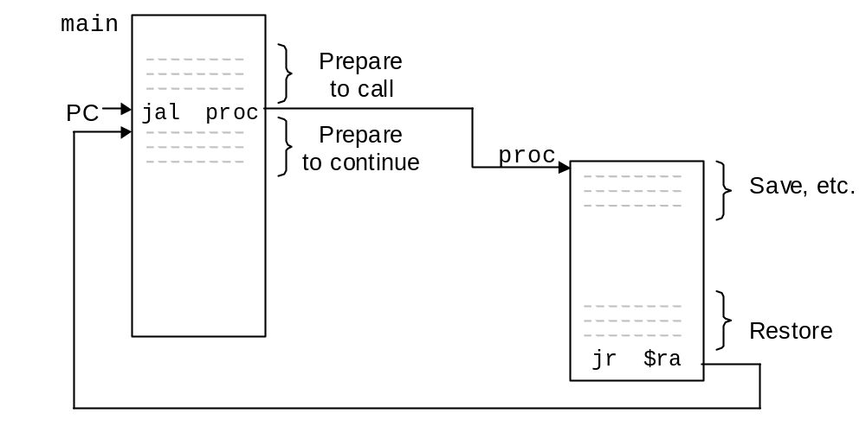
Illustrating a Procedure Call
Figure 6.1 Relationship between the main program and a procedure.
Oct. 2014
Computer Architecture, Instruction-Set Architecture
Slide <number>

Slide 30
Recalling Register Conventions
Figure 5.2 Registers and data sizes in MiniMIPS.
Oct. 2014
Computer Architecture, Instruction-Set Architecture
Slide <number>

Slide 31
A Simple MiniMIPS Procedure
Example 6.1
Procedure to find the absolute value of an integer.
$v0 ← |($a0)|
Solution
The absolute value of x is –x if x < 0 and x otherwise.
abs: sub $v0,$zero,$a0 # put -($a0) in $v0;
# in case ($a0) < 0
bltz $a0,done # if ($a0)<0 then done
add $v0,$a0,$zero # else put ($a0) in $v0
done: jr $ra # return to calling program
In practice, we seldom use such short procedures because of the overhead that they entail. In this example, we have 3-4 instructions of overhead for 3 instructions of useful computation.
Oct. 2014
Computer Architecture, Instruction-Set Architecture
Slide <number>

Slide 32
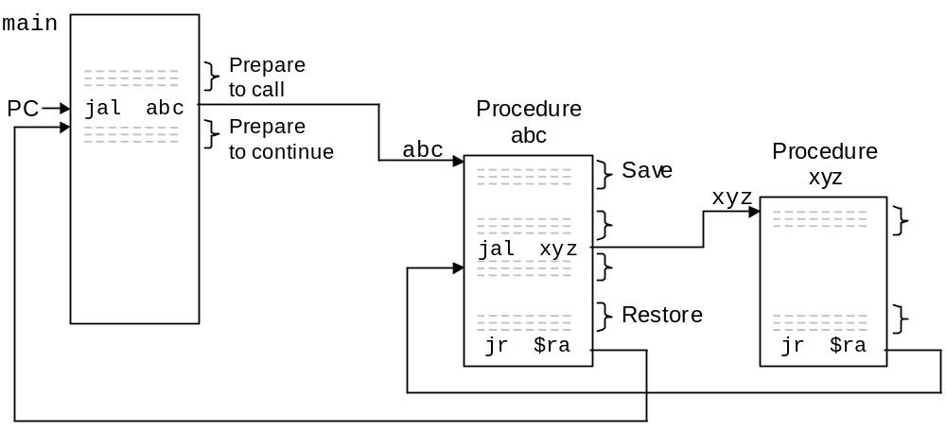
Nested Procedure Calls
Text version is incorrect
Figure 6.2 Example of nested procedure calls.
Oct. 2014
Computer Architecture, Instruction-Set Architecture
Slide <number>

Slide 33

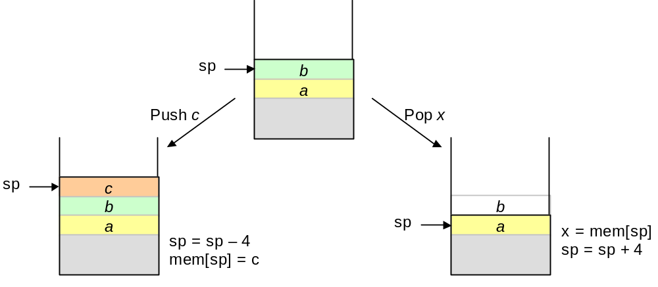
6.2 Using the Stack for Data Storage
Analogy:
Cafeteria stack of plates/trays
Figure 6.4 Effects of push and pop operations on a stack.
push: addi $sp,$sp,-4
sw $t4,0($sp)
pop: lw $t5,0($sp)
addi $sp,$sp,4
Oct. 2014
Computer Architecture, Instruction-Set Architecture
Slide <number>

Slide 34
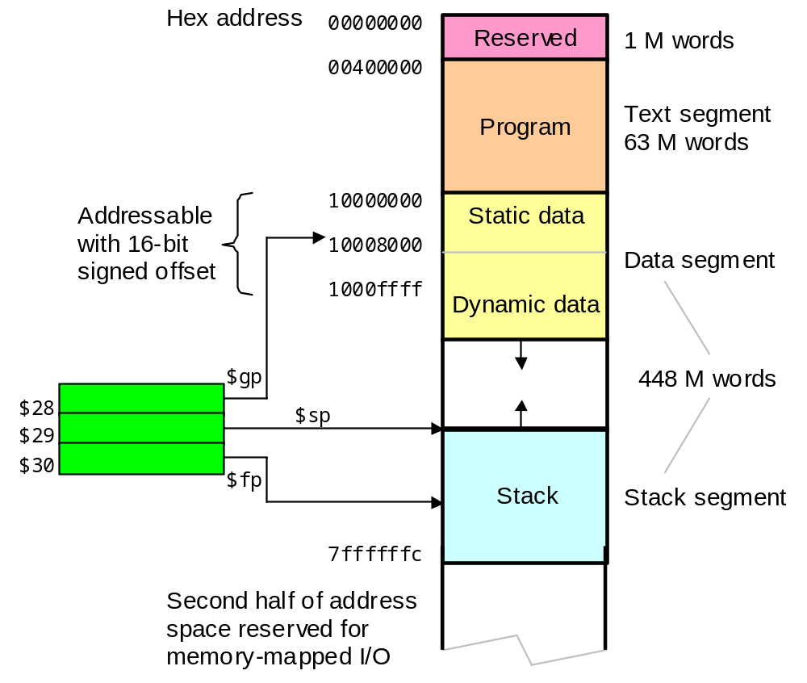
Memory Map in MiniMIPS
80000000
Figure 6.3 Overview of the memory address space in MiniMIPS.
Oct. 2014
Computer Architecture, Instruction-Set Architecture
Slide <number>

Slide 35
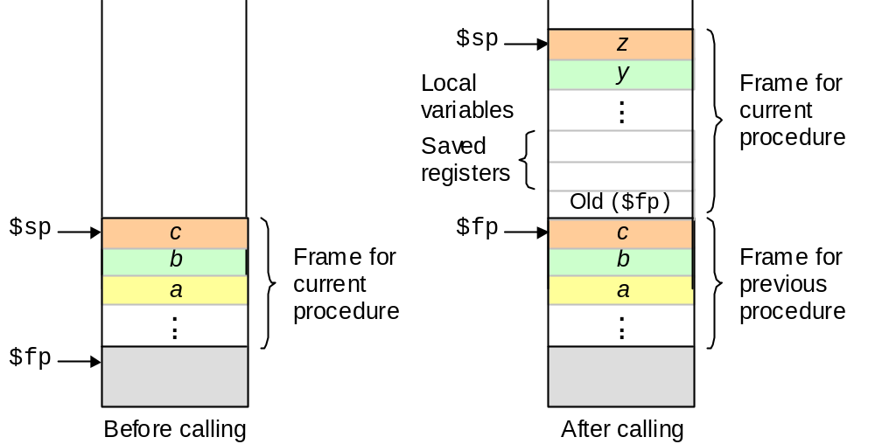
6.3 Parameters and Results
Stack allows us to pass/return an arbitrary number of values
Figure 6.5 Use of the stack by a procedure.
Oct. 2014
Computer Architecture, Instruction-Set Architecture
Slide <number>

Slide 36
Example of Using the Stack
Saving $fp, $ra, and $s0 onto the stack and restoring them at the end of the procedure
proc: sw $fp,-4($sp) # save the old frame pointer
addi $fp,$sp,0 # save ($sp) into $fp
addi $sp,$sp,–12 # create 3 spaces on top of stack
sw $ra,-8($fp) # save ($ra) in 2nd stack element
sw $s0,-12($fp) # save ($s0) in top stack element
.
.
.
lw $s0,-12($fp) # put top stack element in $s0
lw $ra,-8($fp) # put 2nd stack element in $ra
addi $sp,$fp, 0 # restore $sp to original state
lw $fp,-4($sp) # restore $fp to original state
jr $ra # return from procedure
$sp
($s0)
($ra)
($fp)
$sp
$fp
$fp
Oct. 2014
Computer Architecture, Instruction-Set Architecture
Slide <number>

Slide 37
6.4 Data Types
Data size (number of bits), data type (meaning assigned to bits)
Signed integer: byte word
Unsigned integer: byte word
Floating-point number: word doubleword
Bit string: byte word doubleword
Converting from one size to another
Type 8-bit number Value 32-bit version of the number
Unsigned 0010 1011 43 0000 0000 0000 0000 0000 0000 0010 1011
Unsigned 1010 1011 171 0000 0000 0000 0000 0000 0000 1010 1011
Signed 0010 1011 +43 0000 0000 0000 0000 0000 0000 0010 1011
Signed 1010 1011 –85 1111 1111 1111 1111 1111 1111 1010 1011
Oct. 2014
Computer Architecture, Instruction-Set Architecture
Slide <number>

Slide 38
ASCII Characters
Table 6.1 ASCII (American standard code for information interchange)
0 1 2 3 4 5 6 7 8-9 a-f
0
1
2
3
4
5
6
7
8
9
a
b
c
d
e
f
NUL | DLE | SP | 0 | @ | P | ` | p
SOH | DC1 | ! | 1 | A | Q | a | q
STX | DC2 | “ | 2 | B | R | b | r
ETX | DC3 | # | 3 | C | S | c | s
EOT | DC4 | $ | 4 | D | T | d | t
ENQ | NAK | % | 5 | E | U | e | u
ACK | SYN | & | 6 | F | V | f | v
BEL | ETB | ‘ | 7 | G | W | g | w
BS | CAN | ( | 8 | H | X | h | x
HT | EM | ) | 9 | I | Y | i | y
LF | SUB | * | : | J | Z | j | z
VT | ESC | + | ; | K | [ | k | {
FF | FS | , | < | L | \ | l | |
CR | GS | - | = | M | ] | m | }
SO | RS | . | > | N | ^ | n | ~
SI | US | / | ? | O | _ | o | DEL
More
controls
More
symbols
8-bit ASCII code
(col #, row #)_{hex}
e.g., code for +
is (2b) _{hex} or
(0010 1011)_{two}
Oct. 2014
Computer Architecture, Instruction-Set Architecture
Slide <number>

Slide 39
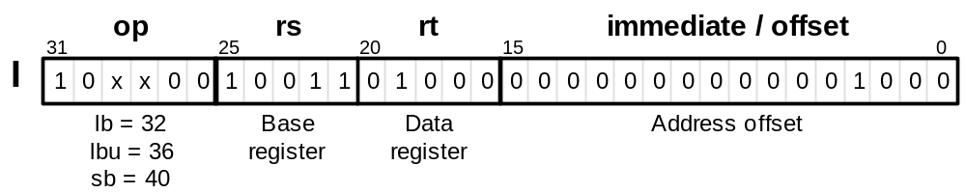
Loading and Storing Bytes
Bytes can be used to store ASCII characters or small integers.
MiniMIPS addresses refer to bytes, but registers hold words.
lb $t0,8($s3) # load rt with mem[8+($s3)]
# sign-extend to fill reg
lbu $t0,8($s3) # load rt with mem[8+($s3)]
# zero-extend to fill reg
sb $t0,A($s3) # LSB of rt to mem[A+($s3)]
Figure 6.6 Load and store instructions for byte-size data elements.
Oct. 2014
Computer Architecture, Instruction-Set Architecture
Slide <number>

Slide 40
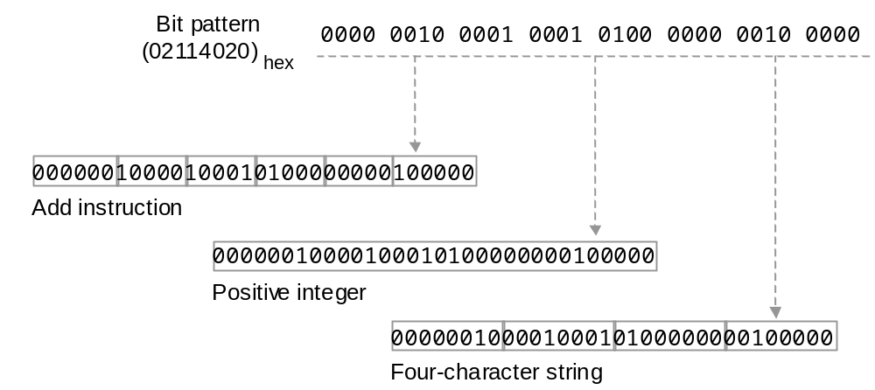
Meaning of a Word in Memory
Figure 6.7 A 32-bit word has no inherent meaning and can be interpreted in a number of equally valid ways in the absence of other cues (e.g., context) for the intended meaning.
Oct. 2014
Computer Architecture, Instruction-Set Architecture
Slide <number>

Slide 41
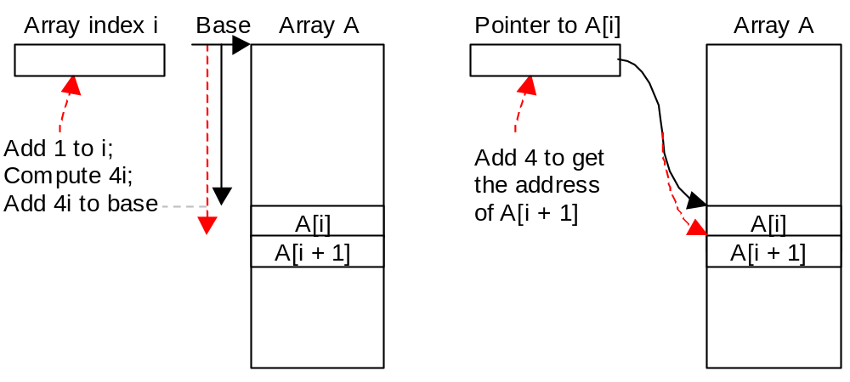
6.5 Arrays and Pointers
Index: Use a register that holds the index i and increment the register in each step to effect moving from element i of the list to element i + 1
Pointer: Use a register that points to (holds the address of) the list element being examined and update it in each step to point to the next element
Figure 6.8 Stepping through the elements of an array using the indexing method and the pointer updating method.
Oct. 2014
Computer Architecture, Instruction-Set Architecture
Slide <number>

Slide 42
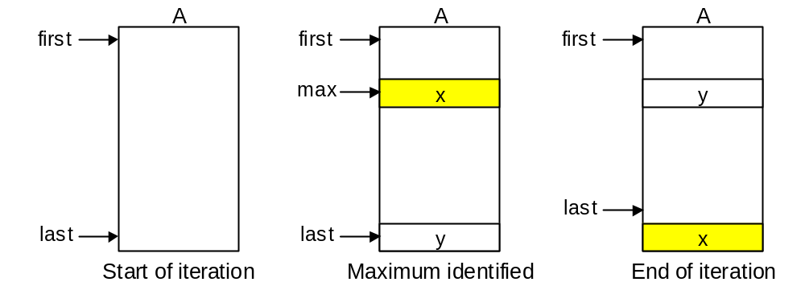
Selection Sort
Example 6.4
To sort a list of numbers, repeatedly perform the following:
Find the max element, swap it with the last item, move up the “last” pointer
Figure 6.9 One iteration of selection sort.
Oct. 2014
Computer Architecture, Instruction-Set Architecture
Slide <number>

Slide 43
Selection Sort Using the Procedure max
Example 6.4 (continued)
In $a0
Outputs from
proc max
Inputs to
proc max
In $v0
In $v1
In $a1
sort: beq $a0,$a1,done # single-element list is sorted
jal max # call the max procedure
lw $t0,0($a1) # load last element into $t0
sw $t0,0($v0) # copy the last element to max loc
sw $v1,0($a1) # copy max value to last element
addi $a1,$a1,-4 # decrement pointer to last element
j sort # repeat sort for smaller list
done: ... # continue with rest of program
Oct. 2014
Computer Architecture, Instruction-Set Architecture
Slide <number>

Slide 44
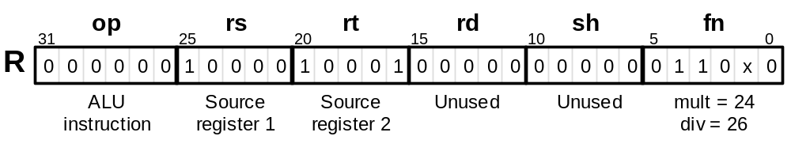
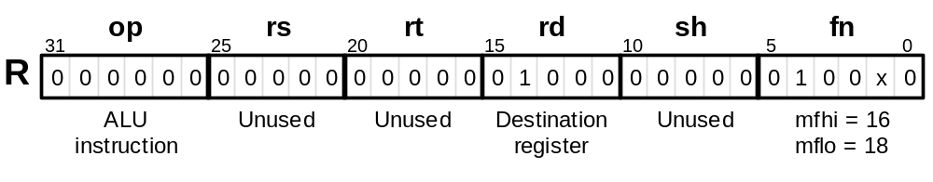
6.6 Additional Instructions
MiniMIPS instructions for multiplication and division:
mult $s0, $s1 # set Hi,Lo to ($s0)×($s1)
div $s0, $s1 # set Hi to ($s0)mod($s1)
# and Lo to ($s0)/($s1)
mfhi $t0 # set $t0 to (Hi)
mflo $t0 # set $t0 to (Lo)
Reg
file
Mul/Div
unit
Hi
Lo
Figure 6.10 The multiply (mult) and divide (div) instructions of MiniMIPS.
Figure 6.11 MiniMIPS instructions for copying the contents of Hi and Lo registers into general registers .
Oct. 2014
Computer Architecture, Instruction-Set Architecture
Slide <number>

Slide 45
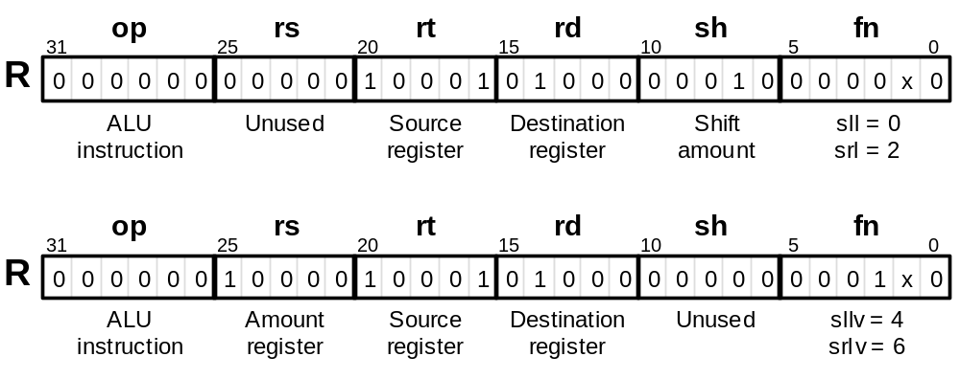
Logical Shifts
MiniMIPS instructions for left and right shifting:
sll $t0,$s1,2 # $t0=($s1) left-shifted by 2
srl $t0,$s1,2 # $t0=($s1) right-shifted by 2
sllv $t0,$s1,$s0 # $t0=($s1) left-shifted by ($s0)
srlv $t0,$s1,$s0 # $t0=($s1) right-shifted by ($s0)
Figure 6.12 The four logical shift instructions of MiniMIPS.
Oct. 2014
Computer Architecture, Instruction-Set Architecture
Slide <number>

Slide 46
Unsigned Arithmetic and Miscellaneous Instructions
MiniMIPS instructions for unsigned arithmetic (no overflow exception):
addu $t0,$s0,$s1 # set $t0 to ($s0)+($s1)
subu $t0,$s0,$s1 # set $t0 to ($s0)–($s1)
multu $s0,$s1 # set Hi,Lo to ($s0)×($s1)
divu $s0,$s1 # set Hi to ($s0)mod($s1)
# and Lo to ($s0)/($s1)
addiu $t0,$s0,61 # set $t0 to ($s0)+61;
# the immediate operand is
# sign extended
To make MiniMIPS more powerful and complete, we introduce later:
sra $t0,$s1,2 # sh. right arith (Sec. 10.5)
srav $t0,$s1,$s0 # shift right arith variable
syscall # system call (Sec. 7.6)
Oct. 2014
Computer Architecture, Instruction-Set Architecture
Slide <number>

Slide 47
The 20 MiniMIPS Instructions from Chapter 6
(40 in all so far)
op
0
0
0
0
0
0
0
0
9
0
0
0
0
0
0
32
36
40
3
0
fn
16
18
33
35
24
25
26
27
0
2
3
4
6
7
12
Instruction | Usage
Move from Hi | mfhi rd
Move from Lo | mflo rd
Add unsigned | addu rd,rs,rt
Subtract unsigned | subu rd,rs,rt
Multiply | mult rs,rt
Multiply unsigned | multu rs,rt
Divide | div rs,rt
Divide unsigned | divu rs,rt
Add immediate unsigned | addiu rs,rt,imm
Shift left logical | sll rd,rt,sh
Shift right logical | srl rd,rt,sh
Shift right arithmetic | sra rd,rt,sh
Shift left logical variable | sllv rd,rt,rs
Shift right logical variable | srlv rt,rd,rs
Shift right arith variable | srav rd,rt,rd
Load byte | lb rt,imm(rs)
Load byte unsigned | lbu rt,imm(rs)
Store byte | sb rt,imm(rs)
Jump and link | jal L
System call | syscall
Copy
Arithmetic
Table 6.2 (partial)
Shift
Memory access
Control transfer
Oct. 2014
Computer Architecture, Instruction-Set Architecture
Slide <number>

Slide 48
Table 6.2 The 37 + 3 MiniMIPS Instructions Covered So Far
Instruction | Usage
Load upper immediate | lui rt,imm
Add | add rd,rs,rt
Subtract | sub rd,rs,rt
Set less than | slt rd,rs,rt
Add immediate | addi rt,rs,imm
Set less than immediate | slti rd,rs,imm
AND | and rd,rs,rt
OR | or rd,rs,rt
XOR | xor rd,rs,rt
NOR | nor rd,rs,rt
AND immediate | andi rt,rs,imm
OR immediate | ori rt,rs,imm
XOR immediate | xori rt,rs,imm
Load word | lw rt,imm(rs)
Store word | sw rt,imm(rs)
Jump | j L
Jump register | jr rs
Branch less than 0 | bltz rs,L
Branch equal | beq rs,rt,L
Branch not equal | bne rs,rt,L
Instruction | Usage
Move from Hi | mfhi rd
Move from Lo | mflo rd
Add unsigned | addu rd,rs,rt
Subtract unsigned | subu rd,rs,rt
Multiply | mult rs,rt
Multiply unsigned | multu rs,rt
Divide | div rs,rt
Divide unsigned | divu rs,rt
Add immediate unsigned | addiu rs,rt,imm
Shift left logical | sll rd,rt,sh
Shift right logical | srl rd,rt,sh
Shift right arithmetic | sra rd,rt,sh
Shift left logical variable | sllv rd,rt,rs
Shift right logical variable | srlv rd,rt,rs
Shift right arith variable | srav rd,rt,rs
Load byte | lb rt,imm(rs)
Load byte unsigned | lbu rt,imm(rs)
Store byte | sb rt,imm(rs)
Jump and link | jal L
System call | syscall
Oct. 2014
Computer Architecture, Instruction-Set Architecture
Slide <number>

Slide 49
7 Assembly Language Programs
Everything else needed to build and run assembly programs:
  Supply info to assembler about program and its data
  Non-hardware-supported instructions for convenience
Topics in This Chapter
7.1 Machine and Assembly Languages
7.2 Assembler Directives
7.3 Pseudoinstructions
7.4 Macroinstructions
7.5 Linking and Loading
7.6 Running Assembler Programs
Oct. 2014
Computer Architecture, Instruction-Set Architecture
Slide <number>

Slide 50
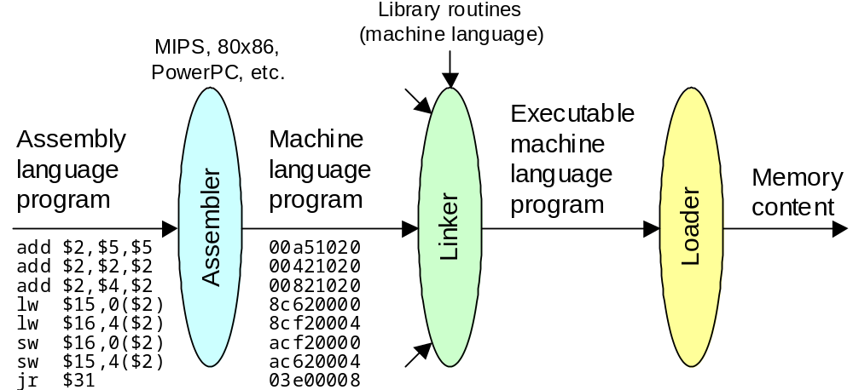
7.1 Machine and Assembly Languages
Figure 7.1 Steps in transforming an assembly language program to an executable program residing in memory.
Oct. 2014
Computer Architecture, Instruction-Set Architecture
Slide <number>

Slide 51
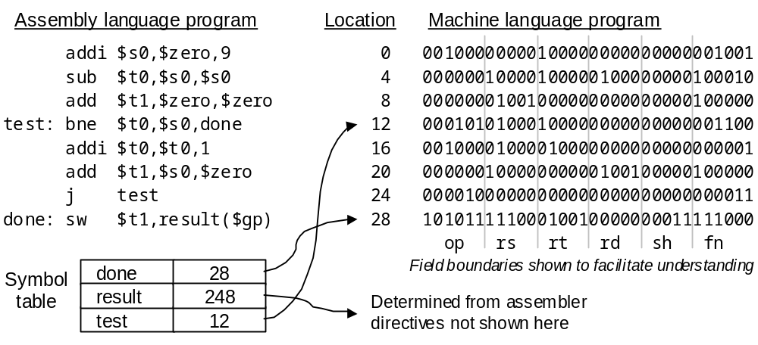
Symbol Table
Figure 7.2 An assembly-language program, its machine-language version, and the symbol table created during the assembly process.
Oct. 2014
Computer Architecture, Instruction-Set Architecture
Slide <number>

Slide 52
7.2 Assembler Directives
Assembler directives provide the assembler with info on how to translate
the program but do not lead to the generation of machine instructions
.macro # start macro (see Section 7.4)
.end_macro # end macro (see Section 7.4)
.text # start program’s text segment
... # program text goes here
.data # start program’s data segment
tiny: .byte 156,0x7a # name & initialize data byte(s)
max: .word 35000 # name & initialize data word(s)
small: .float 2E-3 # name short float (see Chapter 12)
big: .double 2E-3 # name long float (see Chapter 12)
.align 2 # align next item on word boundary
array: .space 600 # reserve 600 bytes = 150 words
str1: .ascii “a*b” # name & initialize ASCII string
str2: .asciiz “xyz” # null-terminated ASCII string
.global main # consider “main” a global name
Oct. 2014
Computer Architecture, Instruction-Set Architecture
Slide <number>

Slide 53
Composing Simple Assembler Directives
Example 7.1
Write assembler directive to achieve each of the following objectives:
a. Put the error message “Warning: The printer is out of paper!” in memory.
b. Set up a constant called “size” with the value 4.
c. Set up an integer variable called “width” and initialize it to 4.
d. Set up a constant called “mill” with the value 1,000,000 (one million).
e. Reserve space for an integer vector “vect” of length 250.
Solution:
a. noppr: .asciiz “Warning: The printer is out of paper!”
b. size: .byte 4 # small constant fits in one byte
c. width: .word 4 # byte could be enough, but ...
d. mill: .word 1000000 # constant too large for byte
e. vect: .space 1000 # 250 words = 1000 bytes
Oct. 2014
Computer Architecture, Instruction-Set Architecture
Slide <number>

Slide 54
7.3 Pseudoinstructions
Example of one-to-one pseudoinstruction: The following
not $s0 # complement ($s0)
is converted to the real instruction:
nor $s0,$s0,$zero # complement ($s0)
Example of one-to-several pseudoinstruction: The following
abs $t0,$s0 # put |($s0)| into $t0
is converted to the sequence of real instructions:
add $t0,$s0,$zero # copy x into $t0
slt $at,$t0,$zero # is x negative?
beq $at,$zero,+4 # if not, skip next instr
sub $t0,$zero,$s0 # the result is 0 – x
Oct. 2014
Computer Architecture, Instruction-Set Architecture
Slide <number>

Slide 55
MiniMIPS Pseudo-instructions
Pseudoinstruction | Usage
Move | move regd,regs
Load address | la regd,address
Load immediate | li regd,anyimm
Absolute value | abs regd,regs
Negate | neg regd,regs
Multiply (into register) | mul regd,reg1,reg2
Divide (into register) | div regd,reg1,reg2
Remainder | rem regd,reg1,reg2
Set greater than | sgt regd,reg1,reg2
Set less or equal | sle regd,reg1,reg2
Set greater or equal | sge regd,reg1,reg2
Rotate left | rol regd,reg1,reg2
Rotate right | ror regd,reg1,reg2
NOT | not reg
Load doubleword | ld regd,address
Store doubleword | sd regd,address
Branch less than | blt reg1,reg2,L
Branch greater than | bgt reg1,reg2,L
Branch less or equal | ble reg1,reg2,L
Branch greater or equal | bge reg1,reg2,L
Copy
Arithmetic
Table 7.1
Shift
Logic
Memory access
Control transfer
Oct. 2014
Computer Architecture, Instruction-Set Architecture
Slide <number>

Slide 56
7.4 Macroinstructions
A macro is a mechanism to give a name to an often-used
sequence of instructions (shorthand notation)
.macro name(args) # macro and arguments named
... # instr’s defining the macro
.end_macro # macro terminator
How is a macro different from a pseudoinstruction?
Pseudos are predefined, fixed, and look like machine instructions
Macros are user-defined and resemble procedures (have arguments)
How is a macro different from a procedure?
Control is transferred to and returns from a procedure
After a macro has been replaced, no trace of it remains
Oct. 2014
Computer Architecture, Instruction-Set Architecture
Slide <number>

Slide 57
Macro to Find the Largest of Three Values
Example 7.4
Write a macro to determine the largest of three values in registers and to put the result in a fourth register.
Solution:
.macro mx3r(m,a1,a2,a3) # macro and arguments named
move m,a1 # assume (a1) is largest; m = (a1)
bge m,a2,+4 # if (a2) is not larger, ignore it
move m,a2 # else set m = (a2)
bge m,a3,+4 # if (a3) is not larger, ignore it
move m,a3 # else set m = (a3)
.endmacro # macro terminator
If the macro is used as mx3r($t0,$s0,$s4,$s3), the assembler replaces the arguments m, a1, a2, a3 with $t0, $s0, $s4, $s3, respectively.
Oct. 2014
Computer Architecture, Instruction-Set Architecture
Slide <number>

Slide 58
7.5 Linking and Loading
The linker has the following responsibilities:
Ensuring correct interpretation (resolution) of labels in all modules
Determining the placement of text and data segments in memory
Evaluating all data addresses and instruction labels
Forming an executable program with no unresolved references
The loader is in charge of the following:
Determining the memory needs of the program from its header
Copying text and data from the executable program file into memory
Modifying (shifting) addresses, where needed, during copying
Placing program parameters onto the stack (as in a procedure call)
Initializing all machine registers, including the stack pointer
Jumping to a start-up routine that calls the program’s main routine
Oct. 2014
Computer Architecture, Instruction-Set Architecture
Slide <number>

Slide 59
7.6 Running Assembler Programs
Spim is a simulator that can run MiniMIPS programs
The name Spim comes from reversing MIPS
Three versions of Spim are available for free downloading:
PCSpim for Windows machines QtSPIM for many OSs
xspim for X-windows
spim for Unix systems
You can download SPIM from:
SPIM
A MIPS32 Simulator
James Larus
spim@larusstone.org
Microsoft Research
Formerly: Professor, CS Dept., Univ. Wisconsin-Madison
spim is a self-contained simulator that will run MIPS32 assembly language programs. It reads and executes assembly . . .
http://www.cs.wisc.edu/~larus/spim.html
http://spimsimulator.sourceforge.net
Oct. 2014
Computer Architecture, Instruction-Set Architecture
Slide <number>

Slide 60
Input/Output Conventions for MiniMIPS
Table 7.2 Input/output and control functions of syscall in PCSpim.
($v0) | Function | Arguments | Result
1 | Print integer | Integer in $a0 | Integer displayed
2 | Print floating-point | Float in $f12 | Float displayed
3 | Print double-float | Double-float in $f12,$f13 | Double-float displayed
4 | Print string | Pointer in $a0 | Null-terminated string displayed
5 | Read integer |  | Integer returned in $v0
6 | Read floating-point |  | Float returned in $f0
7 | Read double-float |  | Double-float returned in $f0,$f1
8 | Read string | Pointer in $a0, length in $a1 | String returned in buffer at pointer
9 | Allocate memory | Number of bytes in $a0 | Pointer to memory block in $v0
10 | Exit from program |  | Program execution terminated
Output
Input
Cntl
Oct. 2014
Computer Architecture, Instruction-Set Architecture
Slide <number>

Slide 61
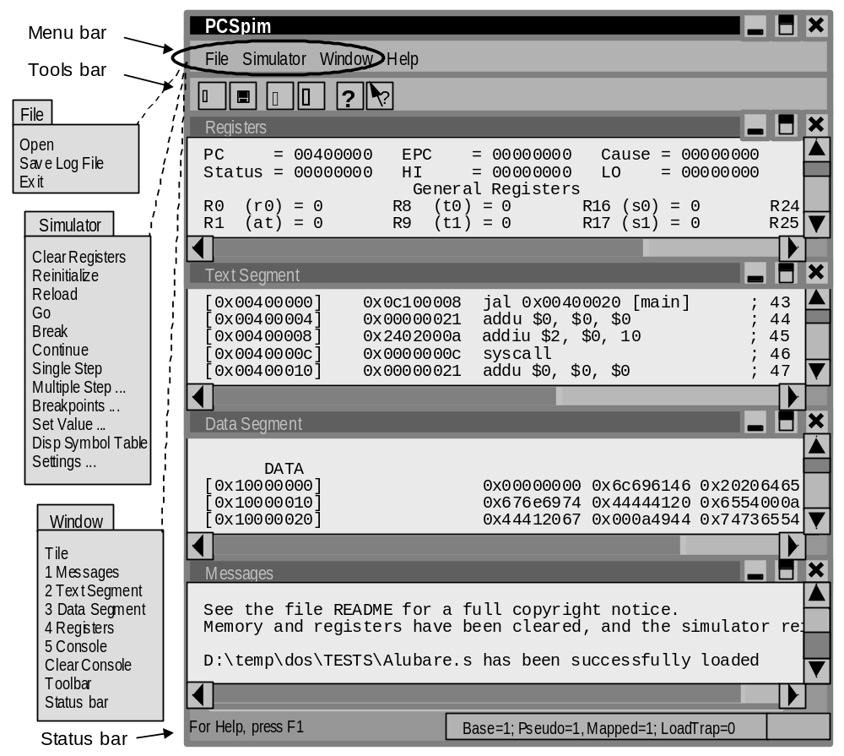
PCSpim User Interface
Figure 7.3
Oct. 2014
Computer Architecture, Instruction-Set Architecture
Slide <number>

Slide 62
8 Instruction Set Variations
The MiniMIPS instruction set is only one example
  How instruction sets may differ from that of MiniMIPS
  RISC and CISC instruction set design philosophies
Topics in This Chapter
8.1 Complex Instructions
8.2 Alternative Addressing Modes
8.3 Variations in Instruction Formats
8.4 Instruction Set Design and Evolution
8.5 The RISC/CISC Dichotomy
8.6 Where to Draw the Line
Oct. 2014
Computer Architecture, Instruction-Set Architecture
Slide <number>

Slide 63
Review of Some Key Concepts
Macroinstruction
Instruction
Microinstruction
Instruction
Microinstruction
Different from procedure,
in that the macro is replaced with equivalent instructions
Instruction
Microinstruction
Instruction
Microinstruction
Microinstruction
Instruction format for a simple RISC design
All of the same length
Fields used consistently (simple decoding)
Can initiate reading of registers even before decoding the instruction
Short, uniform execution
Oct. 2014
Computer Architecture, Instruction-Set Architecture
Slide <number>

Slide 64
8.1 Complex Instructions
Table 8.1 (partial) Examples of complex instructions in two popular modern microprocessors and two computer families of historical significance
Machine | Instruction | Effect
Pentium | MOVS | Move one element in a string of bytes, words, or doublewords using addresses specified in two pointer registers; after the operation, increment or decrement the registers to point to the next element of the string
PowerPC | cntlzd | Count the number of consecutive 0s in a specified source register beginning with bit position 0 and place the count in a destination register
IBM 360-370 | CS | Compare and swap: Compare the content of a register to that of a memory location; if unequal, load the memory word into the register, else store the content of a different register into the same memory location
Digital VAX | POLYD | Polynomial evaluation with double flp arithmetic: Evaluate a polynomial in x, with very high precision in intermediate results, using a coefficient table whose location in memory is given within the instruction
Oct. 2014
Computer Architecture, Instruction-Set Architecture
Slide <number>

Slide 65
Some Details of Sample Complex Instructions
0000 0010 1100 0111
Source
string
cntlzd
(Count leading 0s)
6 leading 0s
0000 0000 0000 0110
Destination
string
POLYD
(Polynomial evaluation in double floating-point)
c_{n–1}x^{n–1} + . . . + c₂x² + c₁x + c₀
Coefficients
MOVS
(Move string)
x
Oct. 2014
Computer Architecture, Instruction-Set Architecture
Slide <number>

Slide 66
Benefits and Drawbacks of Complex Instructions
Fewer instructions in program
(less memory)
More complex format
(slower decoding)
Fewer memory accesses for instructions
Less flexible
(one algorithm for polynomial evaluation or sorting may not be the best in all cases)
Programs may become easier to write/read/understand
Potentially faster execution (complex steps are still done sequentially in multiple cycles, but hardware control can be faster than software loops)
If interrupts are processed at the end of instruction cycle, machine may become less responsive to time-critical events (interrupt handling)
Oct. 2014
Computer Architecture, Instruction-Set Architecture
Slide <number>

Slide 67
8.2 Alternative Addressing Modes
Let’s refresh our memory (from Chap. 5)
Figure 5.11 Schematic representation of addressing modes in MiniMIPS.
Oct. 2014
Computer Architecture, Instruction-Set Architecture
Slide <number>

Slide 68
Table 6.2
Addressing Mode Examples in the MiniMIPS ISA
Instruction | Usage
Load upper immediate | lui rt,imm
Add | add rd,rs,rt
Subtract | sub rd,rs,rt
Set less than | slt rd,rs,rt
Add immediate | addi rt,rs,imm
Set less than immediate | slti rd,rs,imm
AND | and rd,rs,rt
OR | or rd,rs,rt
XOR | xor rd,rs,rt
NOR | nor rd,rs,rt
AND immediate | andi rt,rs,imm
OR immediate | ori rt,rs,imm
XOR immediate | xori rt,rs,imm
Load word | lw rt,imm(rs)
Store word | sw rt,imm(rs)
Jump | j L
Jump register | jr rs
Branch less than 0 | bltz rs,L
Branch equal | beq rs,rt,L
Branch not equal | bne rs,rt,L
Instruction | Usage
Move from Hi | mfhi rd
Move from Lo | mflo rd
Add unsigned | addu rd,rs,rt
Subtract unsigned | subu rd,rs,rt
Multiply | mult rs,rt
Multiply unsigned | multu rs,rt
Divide | div rs,rt
Divide unsigned | divu rs,rt
Add immediate unsigned | addiu rs,rt,imm
Shift left logical | sll rd,rt,sh
Shift right logical | srl rd,rt,sh
Shift right arithmetic | sra rd,rt,sh
Shift left logical variable | sllv rd,rt,rs
Shift right logical variable | srlv rd,rt,rs
Shift right arith variable | srav rd,rt,rs
Load byte | lb rt,imm(rs)
Load byte unsigned | lbu rt,imm(rs)
Store byte | sb rt,imm(rs)
Jump and link | jal L
System call | syscall
Oct. 2014
Computer Architecture, Instruction-Set Architecture
Slide <number>

Slide 69
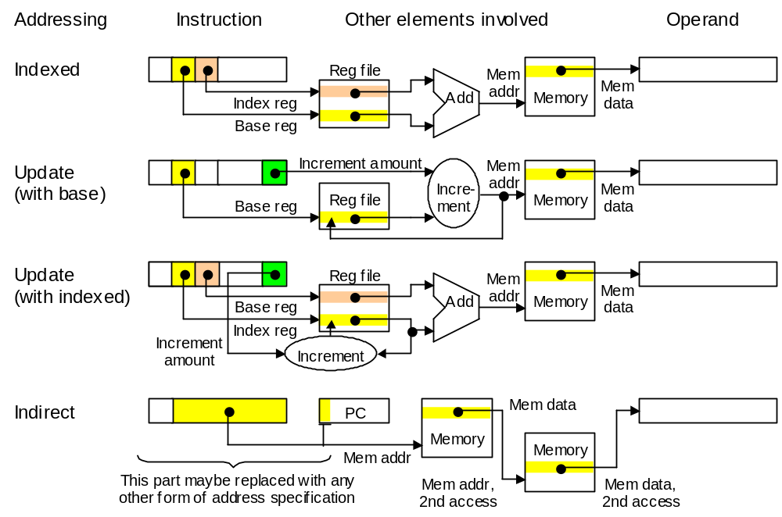
More Elaborate Addressing Modes
x := B[i]
x := Mem[p]
p := p + 1
x := B[i]
i := i + 1
t := Mem[p]
x := Mem[t]
x := Mem[Mem[p]]
Figure 8.1 Schematic representation of more elaborate addressing modes not supported in MiniMIPS.
Oct. 2014
Computer Architecture, Instruction-Set Architecture
Slide <number>

Slide 70
Usefulness of Some Elaborate Addressing Modes
Update mode: XORing a string of bytes
loop: lb $t0,A($s0)
xor $s1,$s1,$t0
addi $s0,$s0,-1
bne $s0,$zero,loop
One instruction with update addressing
Indirect mode: Case statement
Branch to location Li if s = i (switch var.)
case: lw $t0,0($s0) # get s
add $t0,$t0,$t0 # form 2s
add $t0,$t0,$t0 # form 4s
la $t1,T # base T
add $t1,$t0,$t1
lw $t2,0($t1) # entry
jr $t2
T
L0
T + 4
L1
T + 8
L2
T + 12
L3
T + 16
L4
T + 20
L5
Oct. 2014
Computer Architecture, Instruction-Set Architecture
Slide <number>

Slide 71
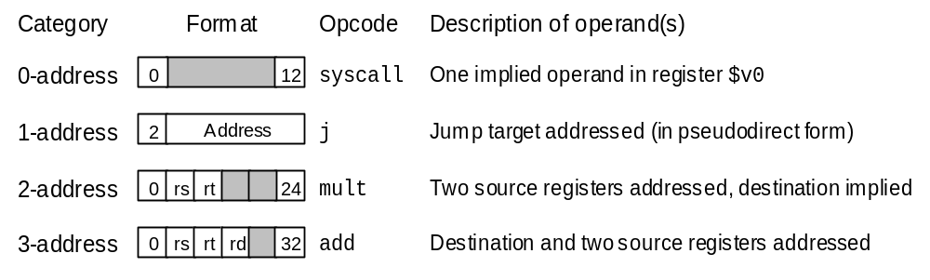
8.3 Variations in Instruction Formats
0-, 1-, 2-, and 3-address instructions in MiniMIPS
Figure 8.2 Examples of MiniMIPS instructions with 0 to 3 addresses; shaded fields are unused.
Oct. 2014
Computer Architecture, Instruction-Set Architecture
Slide <number>

Slide 72
Zero-Address Architecture: Stack Machine
Stack holds all the operands (replaces our register file)
Load/Store operations become push/pop
Arithmetic/logic operations need only an opcode: they pop operand(s) from the top of the stack and push the result onto the stack
Example: Evaluating the expression (a + b) × (c – d)
Push a
Push b
Add
Push d
Push c
Subtract
Multiply
a
b
a + b
d
c
c – d
Result
a
a + b
d
a + b
Polish string: a b + d c – ×
a + b
If a variable is used again, you may have to push it multiple times
Special instructions such as “Duplicate” and “Swap” are helpful
Oct. 2014
Computer Architecture, Instruction-Set Architecture
Slide <number>

Slide 73
One-Address Architecture: Accumulator Machine
The accumulator, a special register attached to the ALU, always holds operand 1 and the operation result
Only one operand needs to be specified by the instruction
Example: Evaluating the expression (a + b) × (c – d)
Load a
add b
Store t
load c
subtract d
multiply t
Within branch instructions, the condition or target address must be implied
Branch to L if acc negative
If register x is negative skip the next instruction
May have to store accumulator contents in memory (example above)
No store needed for a + b + c + d + . . . (“accumulator”)
Oct. 2014
Computer Architecture, Instruction-Set Architecture
Slide <number>

Slide 74
Two-Address Architectures
Two addresses may be used in different ways:
Operand1/result and operand 2
Condition to be checked and branch target address
Example: Evaluating the expression (a + b) × (c – d)
load $1,a
add $1,b
load $2,c
subtract $2,d
multiply $1,$2
Instructions of a hypothetical two-address machine
A variation is to use one of the addresses as in a one-address machine and the second one to specify a branch in every instruction
Oct. 2014
Computer Architecture, Instruction-Set Architecture
Slide <number>

Slide 75
Example of a Complex Instruction Format
Instruction prefixes (zero to four, 1 B each)
Operand/address
size overwrites and
other modifiers
Mod Reg/Op R/M
Scale Index Base
Most memory
operands need
these 2 bytes
Opcode (1-2 B)
ModR/M
SIB
Instructions can contain
up to 15 bytes
Offset or displacement (0, 1, 2, or 4 B)
Immediate (0, 1, 2, or 4 B)
Components that form a variable-length IA-32 (80x86) instruction.
Oct. 2014
Computer Architecture, Instruction-Set Architecture
Slide <number>

Slide 76
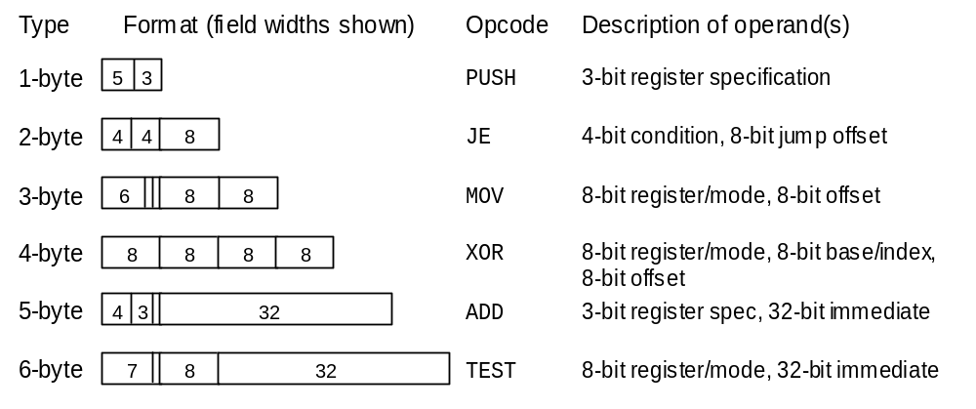
Some of IA-32’s Variable-Width Instructions
Figure 8.3 Example 80x86 instructions ranging in width from 1 to 6 bytes; much wider instructions (up to 15 bytes) also exist
Oct. 2014
Computer Architecture, Instruction-Set Architecture
Slide <number>

Slide 77
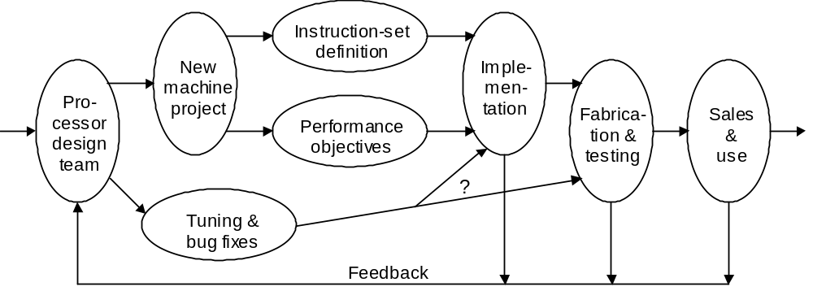
8.4 Instruction Set Design and Evolution
Desirable attributes of an instruction set:
Consistent, with uniform and generally applicable rules
Orthogonal, with independent features noninterfering
Transparent, with no visible side effect due to implementation details
Easy to learn/use (often a byproduct of the three attributes above)
Extensible, so as to allow the addition of future capabilities
Efficient, in terms of both memory needs and hardware realization
Figure 8.4 Processor design and implementation process.
Oct. 2014
Computer Architecture, Instruction-Set Architecture
Slide <number>

Slide 78
8.5 The RISC/CISC Dichotomy
The RISC (reduced instruction set computer) philosophy:
Complex instruction sets are undesirable because inclusion of mechanisms to interpret all the possible combinations of opcodes and operands might slow down even very simple operations.
Ad hoc extension of instruction sets, while maintaining backward
compatibility, leads to CISC; imagine modern English containing
every English word that has been used through the ages
Features of RISC architecture
Small set of inst’s, each executable in roughly the same time
Load/store architecture (leading to more registers)
Limited addressing mode to simplify address calculations
Simple, uniform instruction formats (ease of decoding)
Oct. 2014
Computer Architecture, Instruction-Set Architecture
Slide <number>

Slide 79
RISC/CISC Comparison via Generalized Amdahl’s Law
Example 8.1
An ISA has two classes of simple (S) and complex (C) instructions. On a reference implementation of the ISA, class-S instructions account for 95% of the running time for programs of interest. A RISC version of the machine is being considered that executes only class-S instructions directly in hardware, with class-C instructions treated as pseudoinstructions. It is estimated that in the RISC version, class-S instructions will run 20% faster while class-C instructions will be slowed down by a factor of 3. Does the RISC approach offer better or worse performance compared to the reference implementation?
Solution
Per assumptions, 0.95 of the work is speeded up by a factor of 1.0 / 0.8 = 1.25, while the remaining 5% is slowed down by a factor of 3. The RISC speedup is 1 / [0.95 / 1.25 + 0.05 × 3] = 1.1. Thus, a 10% improvement in performance can be expected in the RISC version.
Oct. 2014
Computer Architecture, Instruction-Set Architecture
Slide <number>

Slide 80
Some Hidden Benefits of RISC
In Example 8.1, we established that a speedup factor of 1.1 can be expected from the RISC version of a hypothetical machine
This is not the entire story, however!
If the speedup of 1.1 came with some additional cost, then one might legitimately wonder whether it is worth the expense and design effort
The RISC version of the architecture also:
Reduces the effort and team size for design
Shortens the testing and debugging phase
Simplifies documentation and maintenance
Cheaper product and shorter time-to-market
Oct. 2014
Computer Architecture, Instruction-Set Architecture
Slide <number>

Slide 81
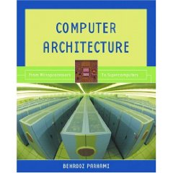

MIPS Performance Rating Revisited
An m-MIPS processor can execute m million instructions per second
Comparing an m-MIPS processor with a 10m-MIPS processor
Like comparing two people who read m pages and 10m pages per hour
10 pages / hr
100 pages / hr
Reading 100 pages per hour, as opposed to 10 pages per hour, may not allow you to finish the same reading assignment in 1/10 the time
Oct. 2014
Computer Architecture, Instruction-Set Architecture
Slide <number>

Slide 82
RISC / CISC Convergence
The earliest RISC designs:
CDC 6600, highly innovative supercomputer of the mid 1960s
IBM 801, influential single-chip processor project of the late 1970s
In the early 1980s, two projects brought RISC to the forefront:
UC Berkeley’s RISC 1 and 2, forerunners of the Sun SPARC
Stanford’s MIPS, later marketed by a company of the same name
Throughout the 1980s, there were heated debates about the relative merits of RISC and CISC architectures
Since the 1990s, the debate has cooled down!
We can now enjoy both sets of benefits by having complex instructions automatically translated to sequences of very simple instructions that are then executed on RISC-based underlying hardware
Oct. 2014
Computer Architecture, Instruction-Set Architecture
Slide <number>

Slide 83
8.6 Where to Draw the Line
The ultimate reduced instruction set computer (URISC):
How many instructions are absolutely needed for useful computation?
Only one!
subtract source1 from source2, replace source2 with the
result, and jump to target address if result is negative
Assembly language form:
label: urisc dest,src1,target
Pseudoinstructions can be synthesized using the single instruction:
stop: .word 0
start: urisc dest,dest,+1 # dest = 0
urisc temp,temp,+1 # temp = 0
urisc temp,src,+1 # temp = -(src)
urisc dest,temp,+1 # dest = -(temp); i.e. (src)
... # rest of program
This is the move pseudoinstruction
Corrected
version
Oct. 2014
Computer Architecture, Instruction-Set Architecture
Slide <number>

Slide 84
Some Useful Pseudo Instructions for URISC
Example 8.2 (2 parts of 5)
Write the sequence of instructions that are produced by the URISC assembler for each of the following pseudoinstructions.
parta: uadd dest,src1,src2 # dest=(src1)+(src2)
partc: uj label # goto label
Solution
at1 and at2 are temporary memory locations for assembler’s use
parta: urisc at1,at1,+1 # at1 = 0
urisc at1,src1,+1 # at1 = -(src1)
urisc at1,src2,+1 # at1 = -(src1)–(src2)
urisc dest,dest,+1 # dest = 0
urisc dest,at1,+1 # dest = -(at1)
partc: urisc at1,at1,+1 # at1 = 0
urisc at1,one,label # at1 = -1 to force jump
Oct. 2014
Computer Architecture, Instruction-Set Architecture
Slide <number>

Slide 85
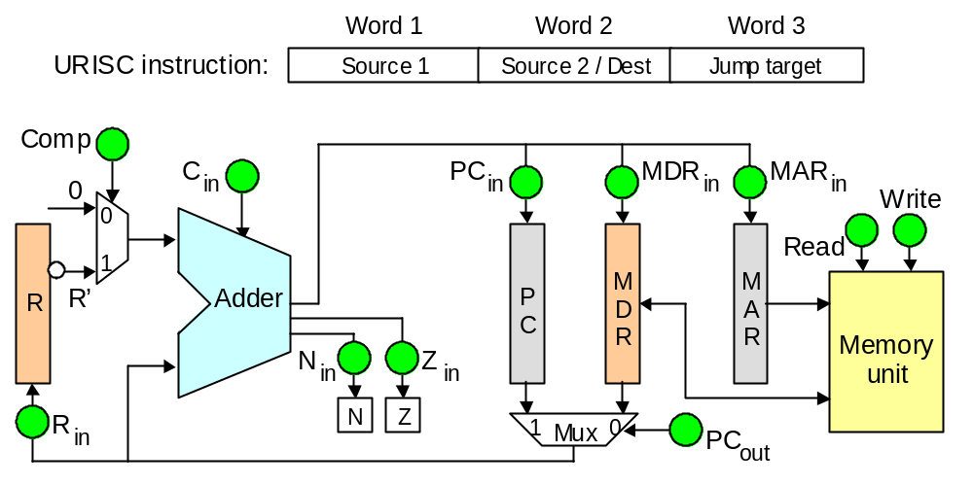
URISC Hardware
Figure 8.5 Instruction format and hardware structure for URISC.
Oct. 2014
Computer Architecture, Instruction-Set Architecture
Slide <number>

