Slide 1
Estimation

Slide 2
Chapter Goals
After completing this chapter, you should be able to:
Distinguish between a point estimate and a confidence interval estimate
Construct and interpret a confidence interval estimate for a single population mean using both the Z and t distributions
Form and interpret a confidence interval estimate for a single population proportion

Slide 3

Confidence Intervals
Content of this chapter
Confidence Intervals for the Population Mean, μ
  when Population Variance σ² is Known
  when Population Variance σ² is Unknown
Confidence Intervals for the Population Proportion, (large samples)

Slide 4
Definitions
An estimator of a population parameter is
  a random variable that depends on sample information . . .
  whose value provides an approximation to this unknown parameter
A specific value of that random variable is called an estimate

Slide 5
Point and Interval Estimates
A point estimate is a single number,
a confidence interval provides additional information about variability
Lower
Confidence
Limit
Upper
Confidence
Limit
Point Estimate
Width of
confidence interval

Slide 6

Point Estimates
We can estimate a
Population Parameter …
with a Sample
Statistic
(a Point Estimate)
Mean
μ
x
Proportion
P
Benedictine-CoE / MBA541

Slide 7
Confidence Intervals
How much uncertainty is associated with a point estimate of a population parameter?
An interval estimate provides more information about a population characteristic than does a point estimate
Such interval estimates are called confidence intervals

Slide 8
Confidence Interval Estimate
An interval gives a range of values:
  Takes into consideration variation in sample statistics from sample to sample
  Based on observation from 1 sample
  Gives information about closeness to unknown population parameters
  Stated in terms of level of confidence
    Can never be 100% confident

Slide 9
Confidence Interval and Confidence Level
If P(a < θ < b) = 1 - α then the interval from a to b is called a 100(1 - α)% confidence interval of θ.
The quantity (1 - α) is called the confidence level of the interval (α between 0 and 1)
  In repeated samples of the population, the true value of the parameter θ would be contained in 100(1 - α)% of intervals calculated this way.
  The confidence interval calculated in this manner is written as a < θ < b with 100(1 - α)% confidence

Slide 10
Estimation Process
Random Sample
I am 95% confident that μ is between 40 & 60.
Population
Mean
X = 50
(mean, μ, is unknown)
Sample

Slide 11
Confidence Level, (1-α)
(continued)
Suppose confidence level = 95%
Also written (1 - α) = 0.95
A relative frequency interpretation:
  From repeated samples, 95% of all the confidence intervals that can be constructed will contain the unknown true parameter
A specific interval either will contain or will not contain the true parameter
  No probability involved in a specific interval

Slide 12
General Formula
The general formula for all confidence intervals is:
The value of the reliability factor depends on the desired level of confidence
Point Estimate ± (Reliability Factor)(Standard Error)

Slide 13
Confidence Intervals
Confidence
Intervals
Population
Mean
Population
Proportion
σ² Known
σ² Unknown

Slide 14
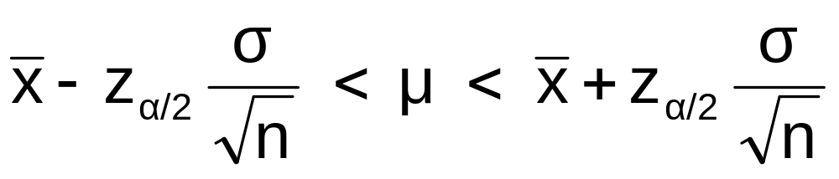
Confidence Interval for μ
(σ² Known)
Assumptions
  Population variance σ² is known
  Population is normally distributed
  If population is not normal, use large sample
Confidence interval estimate:
(where z_{α/2} is the normal distribution value for a probability of α/2 in each tail)

Slide 15

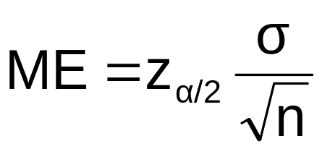
Margin of Error
The confidence interval,
Can also be written as
where ME is called the margin of error
The interval width, w, is equal to twice the margin of error
Benedictine-CoE / MBA541

Slide 16
Reducing the Margin of Error
The margin of error can be reduced if
the population standard deviation can be reduced (σ↓)
The sample size is increased (n↑)
The confidence level is decreased, (1 – α) ↓

Slide 17

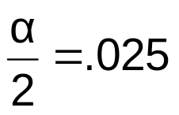
Finding the Reliability Factor, z_{α/2}
Consider a 95% confidence interval:
Z units:
z = -1.96
0
z = 1.96
X units:
Lower
Confidence
Limit
Upper
Confidence
Limit
Point Estimate
Point Estimate
Find z_{.025} = 1.96 from the standard normal distribution table

Slide 18

Common Levels of Confidence
Commonly used confidence levels are 90%, 95%, and 99%
Confidence Coefficient,
Confidence Level
Z_{/2} value
80%
90%
95%
98%
99%
99.8%
99.9%
.80
.90
.95
.98
.99
.998
.999
1.28
1.645
1.96
2.33
2.575
3.08
3.27

Slide 19



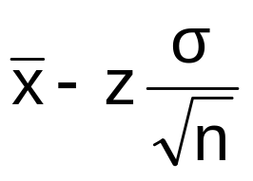
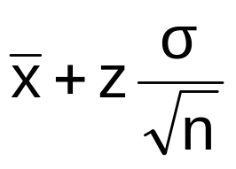
Intervals and Level of Confidence
Sampling Distribution of the Mean
x
Intervals extend from
to
x₁
x₂
100(1-)%
of intervals constructed contain μ;
100()% do not.
Confidence Intervals

Slide 20

Example
A sample of 11 circuits from a large normal population has a mean resistance of 2.20 ohms. We know from past testing that the population standard deviation is 0.35 ohms.
Determine a 95% confidence interval for the true mean resistance of the population.
Benedictine-CoE / MBA541

Slide 21
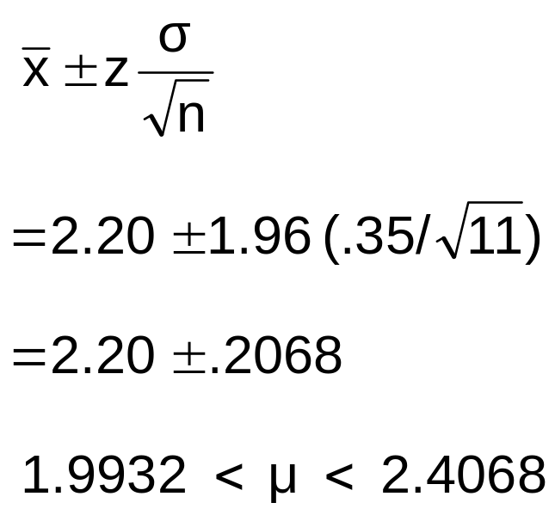

Example
(continued)
A sample of 11 circuits from a large normal population has a mean resistance of 2.20 ohms. We know from past testing that the population standard deviation is .35 ohms.
Solution:

Slide 22
Interpretation
We are 95% confident that the true mean resistance is between 1.9932 and 2.4068 ohms
Although the true mean may or may not be in this interval, 95% of intervals formed in this manner will contain the true mean

Slide 23
Confidence Intervals
Confidence
Intervals
Population
Mean
Population
Proportion
σ² Known
σ² Unknown
Benedictine-CoE / MBA541

Slide 24
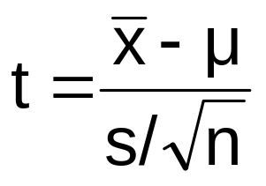
Student’s t Distribution
Consider a random sample of n observations
  with mean x and standard deviation s
  from a normally distributed population with mean μ
Then the variable
follows the Student’s t distribution with (n - 1) degrees of freedom
Benedictine-CoE / MBA541

Slide 25
Confidence Interval for μ
(σ² Unknown)
If the population standard deviation σ is unknown, we can substitute the sample standard deviation, s
This introduces extra uncertainty, since s is variable from sample to sample
So we use the t distribution instead of the normal distribution

Slide 26
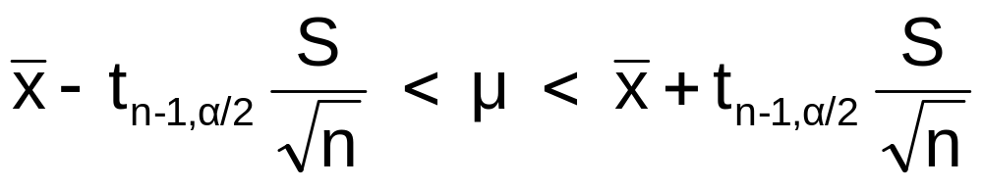

Confidence Interval for μ
(σ Unknown)
(continued)
Assumptions
  Population standard deviation is unknown
  Population is normally distributed
  If population is not normal, use large sample
Use Student’s t Distribution
Confidence Interval Estimate:
where t_{n-1,α/2} is the critical value of the t distribution with n-1 d.f. and an area of α/2 in each tail:

Slide 27
Student’s t Distribution
The t is a family of distributions
The t value depends on degrees of freedom (d.f.)
  Number of observations that are free to vary after sample mean has been calculated
d.f. = n - 1

Slide 28
Student’s t Distribution
Note: t Z as n increases
Standard Normal
(t with df = ∞)
t (df = 13)
t-distributions are bell-shaped and symmetric, but have ‘fatter’ tails than the normal
t (df = 5)
t
0

Slide 29
Student’s t Table
Upper Tail Area
Let: n = 3
df = n - 1 = 2
 = .10
/2 =.05
df
.10
.05
.025
1
3.078
6.314
12.706
2
1.886
2.920
4.303
3
1.638
2.353
3.182
/2 = .05
The body of the table contains t values, not probabilities
0
2.920
t

Slide 30
t distribution values
With comparison to the Z value
Confidence t t t Z
Level (10 d.f.) (20 d.f.) (30 d.f.) ____
.80 1.372 1.325 1.310 1.282
.90 1.812 1.725 1.697 1.645
.95 2.228 2.086 2.042 1.960
.99 3.169 2.845 2.750 2.576
Note: t Z as n increases

Slide 31
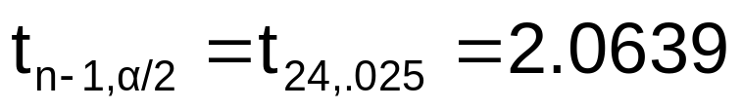
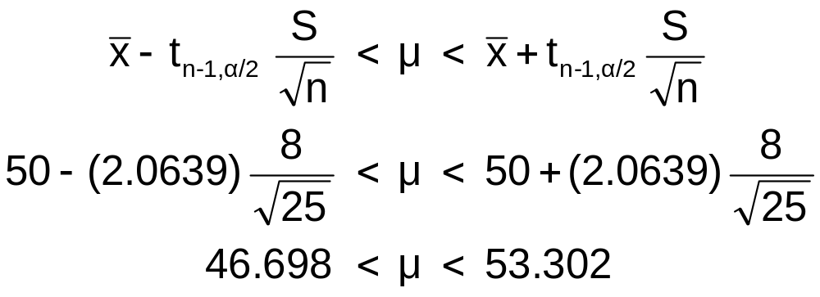
Example
A random sample of n = 25 has x = 50 and
s = 8. Form a 95% confidence interval for μ
  d.f. = n – 1 = 24, so
  The confidence interval is

Slide 32
Confidence Intervals
Confidence
Intervals
Population
Mean
Population
Proportion
σ Known
σ Unknown

Slide 33

Confidence Intervals for the
Population Proportion, p
An interval estimate for the population proportion ( P ) can be calculated by adding an allowance for uncertainty to the sample proportion ( )
Benedictine-CoE / MBA541

Slide 34
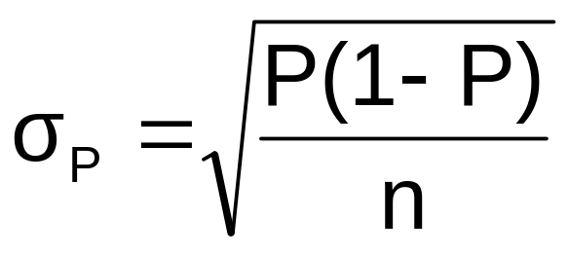
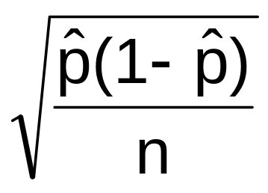
Confidence Intervals for the
Population Proportion, p
(continued)
Recall that the distribution of the sample proportion is approximately normal if the sample size is large, with standard deviation
We will estimate this with sample data:

Slide 35
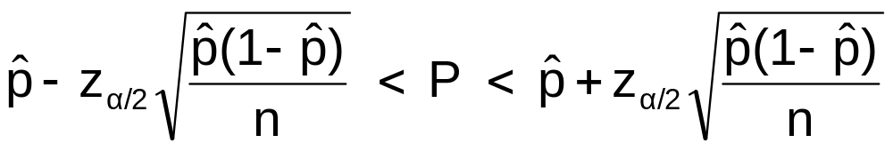

Confidence Interval Endpoints
Upper and lower confidence limits for the population proportion are calculated with the formula
where
  z_{α/2} is the standard normal value for the level of confidence desired
  is the sample proportion
  n is the sample size

Slide 36

Example
A random sample of 100 people shows that 25 are left-handed.
Form a 95% confidence interval for the true proportion of left-handers

Slide 37
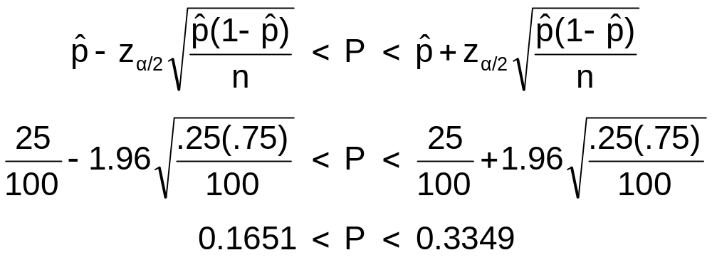
Example
(continued)
A random sample of 100 people shows that 25 are left-handed. Form a 95% confidence interval for the true proportion of left-handers.

Slide 38
Interpretation
We are 95% confident that the true percentage of left-handers in the population is between
16.51% and 33.49%.
Although the interval from 0.1651 to 0.3349 may or may not contain the true proportion, 95% of intervals formed from samples of size 100 in this manner will contain the true proportion.

Slide 39
Chapter Summary
Introduced the concept of confidence intervals
Discussed point estimates
Developed confidence interval estimates
Created confidence interval estimates for the mean (σ² known)
Introduced the Student’s t distribution
Determined confidence interval estimates for the mean (σ² unknown)
Created confidence interval estimates for the proportion

