Slide 1
Sampling Distributions

Slide 2


Chapter Goals
After completing this chapter, you should be able to:
Define the concept of a sampling distribution
Determine the mean and standard deviation for the sampling distribution of the sample mean,
Describe the Central Limit Theorem and its importance
Determine the mean and standard deviation for the sampling distribution of the sample proportion

Slide 3
Sampling Distributions
A sampling distribution is a distribution of all of the possible values of a statistic for a given size sample selected from a population

Slide 4
Chapter Outline
Sampling Distributions
Sampling Distribution of Sample
Mean
Sampling Distribution of Sample Proportion
Sampling Distribution of Sample Variance

Slide 5
Sampling Distributions of
Sample Means
Sampling Distributions
Sampling Distribution of Sample
Mean
Sampling Distribution of Sample Proportion
Sampling Distribution of Sample Variance

Slide 6



Developing a
Sampling Distribution
Assume there is a population …
Population size N=4
Random variable, X,
is age of individuals
Values of X:
18, 20, 22, 24 (years)
D
A
B
C

Slide 7
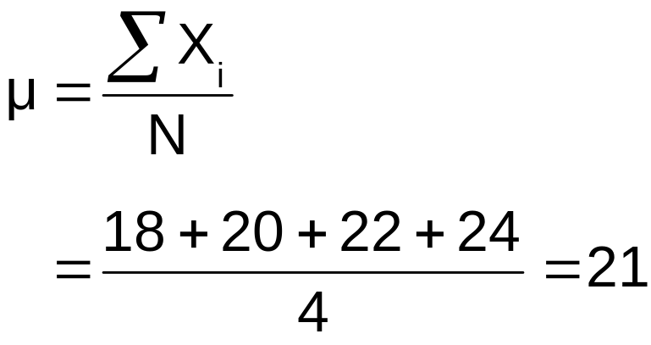
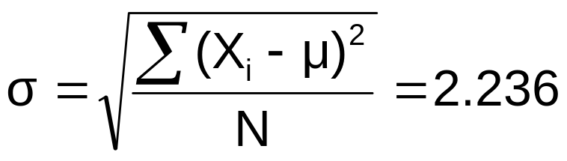
Developing a
Sampling Distribution
(continued)
Summary Measures for the Population Distribution:
P(x)
.25
0
18 20 22 24
A B C D
x
Uniform Distribution

Slide 8
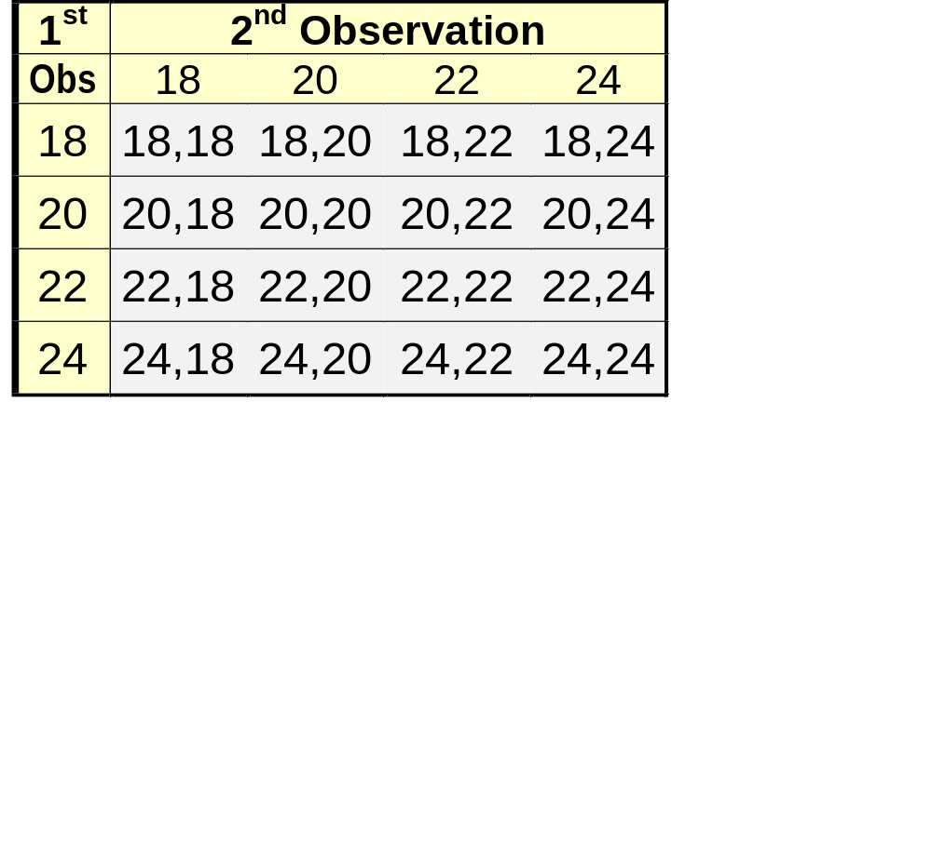
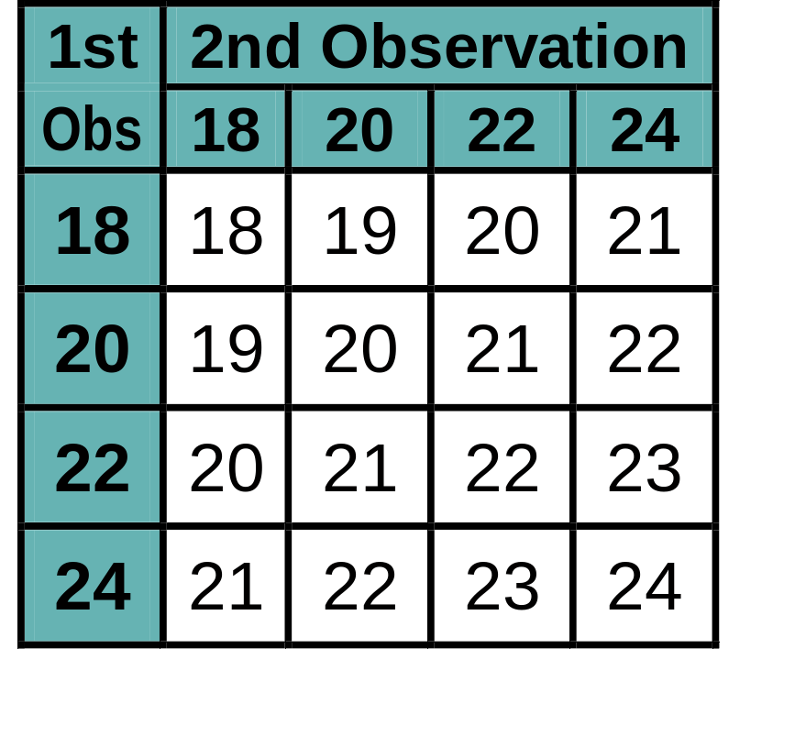
Now consider all possible samples of size n = 2
Developing a
Sampling Distribution
(continued)
16 Sample Means
16 possible samples (sampling with replacement)
Benedictine-CoE / MBA541

Slide 9
Sampling Distribution of All Sample Means
Developing a
Sampling Distribution
(continued)
16 Sample Means
Sample Means Distribution
_
P(X)
.3
.2
.1
0
_
18 19 20 21 22 23 24
X
(no longer uniform)
Benedictine-CoE / MBA541

Slide 10
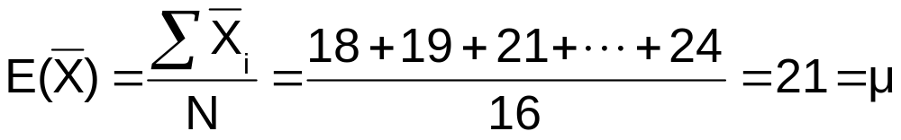
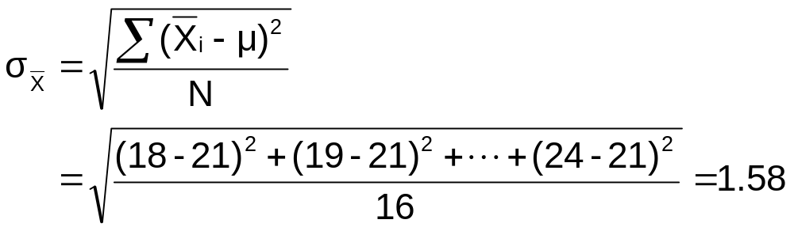
Summary Measures of this Sampling Distribution:
Developing a
Sampling Distribution
(continued)

Slide 11
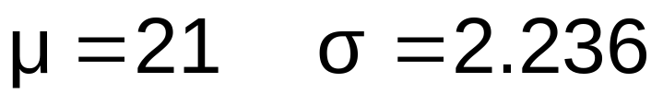
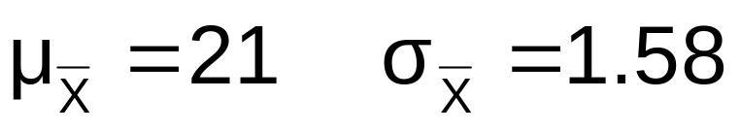
Comparing the Population with its Sampling Distribution
Population
N = 4
Sample Means Distribution
n = 2
_
P(X)
P(X)
.3
.3
.2
.2
.1
.1
0
0
_
18 20 22 24
A B C D
X
18 19 20 21 22 23 24
X

Slide 12
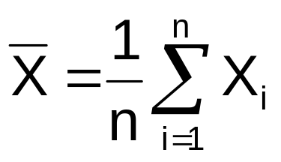
Expected Value of Sample Mean
Let X₁, X₂, . . . X_{n} represent a random sample from a population
The sample mean value of these observations is defined as

Slide 13
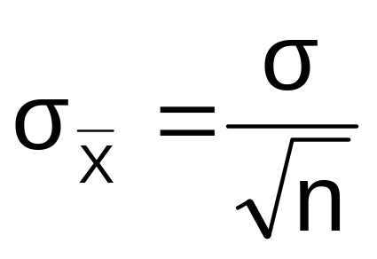
Standard Error of the Mean
Different samples of the same size from the same population will yield different sample means
A measure of the variability in the mean from sample to sample is given by the Standard Error of the Mean:
Note that the standard error of the mean decreases as the sample size increases

Slide 14

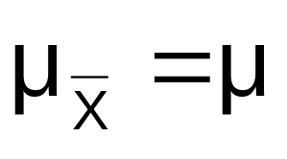
If the Population is Normal
If a population is normal with mean μ and standard deviation σ, the sampling distribution of is also normally distributed with
and

Slide 15

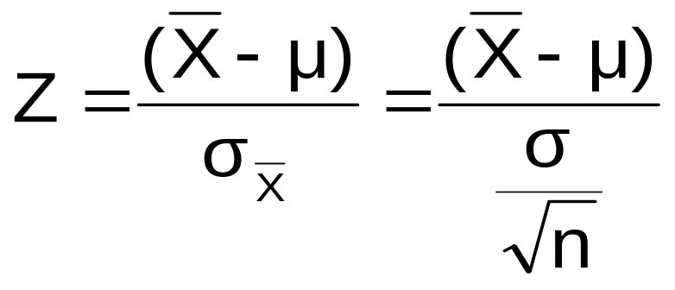



Z-value for Sampling Distribution of the Mean
Z-value for the sampling distribution of :
where: = sample mean
= population mean
= population standard deviation
n = sample size

Slide 16
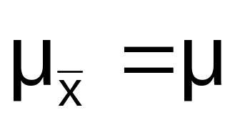


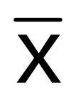

Sampling Distribution Properties
Normal Population Distribution
(i.e. is unbiased )
Normal Sampling Distribution
(has the same mean)

Slide 17


Sampling Distribution Properties
(continued)
For sampling with replacement:
  As n increases,
  decreases
Larger sample size
Smaller sample size

Slide 18
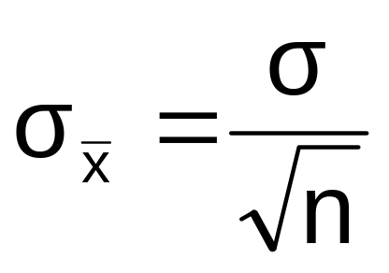
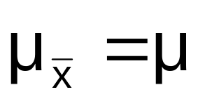
If the Population is not Normal
We can apply the Central Limit Theorem:
  Even if the population is not normal,
  …sample means from the population will be approximately normal as long as the sample size is large enough.
  Properties of the sampling distribution:
  and

Slide 19
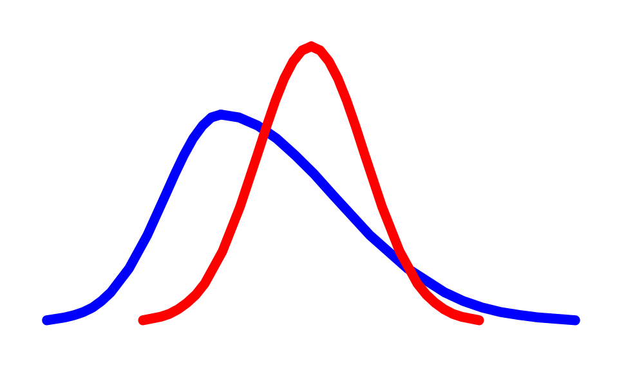
Central Limit Theorem
the sampling distribution becomes almost normal regardless of shape of population
As the sample size gets large enough…
n↑

Slide 20


If the Population is not Normal
(continued)
Population Distribution
Sampling distribution properties:
Central Tendency
Variation
Sampling Distribution
(becomes normal as n increases)
Larger sample size
Smaller sample size

Slide 21
How Large is Large Enough?
For most distributions, n ≥ 30 will give a sampling distribution that is nearly normal
For normal population distributions, the sampling distribution of the mean is always normally distributed

Slide 22
Example
Suppose a population has mean μ = 8 and standard deviation σ = 3. Suppose a random sample of size n = 36 is selected.
What is the probability that the sample mean is between 7.8 and 8.2?

Slide 23


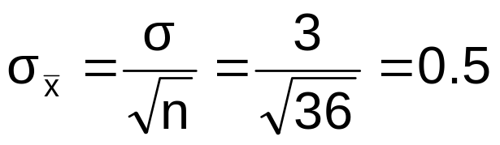
Example
(continued)
Solution:
Even if the population is not normally distributed, the central limit theorem can be used (n > 25)
… so the sampling distribution of is approximately normal
… with mean = 8
…and standard deviation

Slide 24
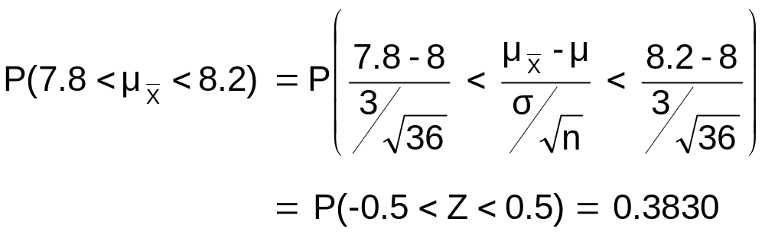




Example
(continued)
Solution (continued):
Population Distribution
Sampling Distribution
Standard Normal Distribution
.1915 +.1915
?
?
?
?
?
?
?
?
?
?
Sample
Standardize
?
?
7.8 8.2
-0.5 0.5
Z
X

Slide 25

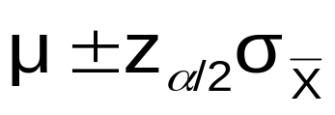
Acceptance Intervals
Goal: determine a range within which sample means are likely to occur, given a population mean and variance
  By the Central Limit Theorem, we know that the distribution of X is approximately normal if n is large enough, with mean μ and standard deviation
  Let z_{α/2} be the z-value that leaves area α/2 in the upper tail of the normal distribution (i.e., the interval - z_{α/2} to z_{α/2} encloses probability 1 – α)
  Then
  is the interval that includes X with probability 1 – α

Slide 26
Sampling Distributions of
Sample Proportions
Sampling Distributions
Sampling Distribution of Sample
Mean
Sampling Distribution of Sample Proportion
Sampling Distribution of Sample Variance
Benedictine-CoE / MBA541

Slide 27

Population Proportions, P
P = the proportion of the population having
some characteristic
Sample proportion ( ) provides an estimate
of P:
0 ≤ ≤ 1
has a binomial distribution, but can be approximated by a normal distribution when nP(1 – P) ≥ 10

Slide 28


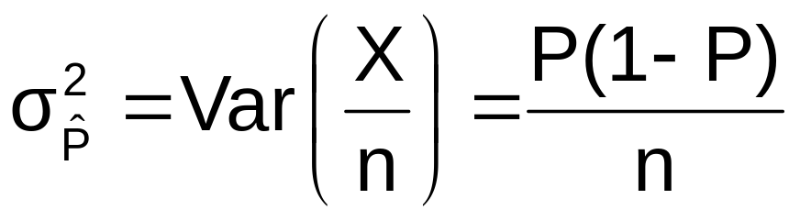
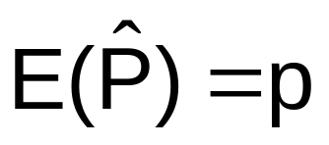
Sampling Distribution of P
^
Normal approximation:
  Properties:
  and
Sampling Distribution
.3
.2
.1
0
0 . 2 .4 .6 8 1
(where P = population proportion)

Slide 29

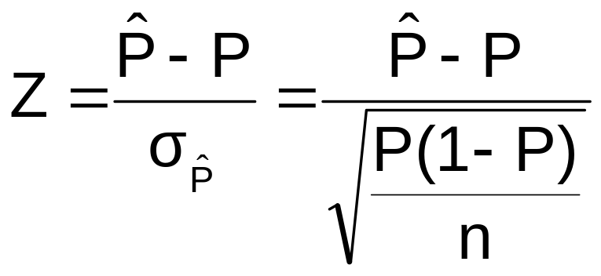
Z-Value for Proportions
Standardize to a Z value with the formula:

Slide 30

Example
If the true proportion of voters who support Proposition A is P = .4, what is the probability that a sample of size 200 yields a sample proportion between .40 and .45?
i.e.: if P = .4 and n = 200, what is
P(.40 ≤ ≤ .45) ?

Slide 31
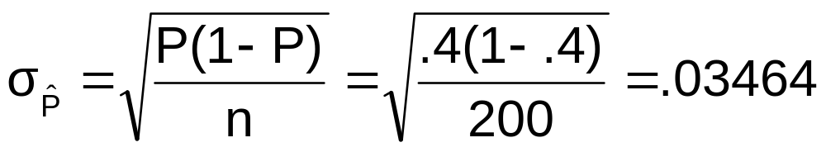

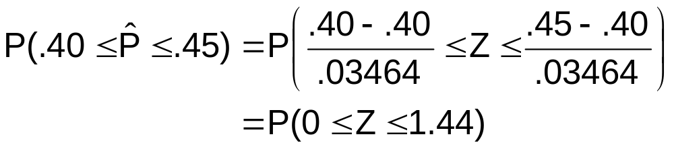
Example
(continued)
if P = .4 and n = 200, what is
P(.40 ≤ ≤ .45) ?
Find :
Convert to standard normal:

Slide 32

Example
(continued)
if p = .4 and n = 200, what is
P(.40 ≤ ≤ .45) ?
Use standard normal table: P(0 ≤ Z ≤ 1.44) = .4251
Standardized
Normal Distribution
Sampling Distribution
.4251
Standardize
.40
.45
0
1.44
Z

Slide 33
Chapter Summary
Introduced sampling distributions
Described the sampling distribution of sample means
  For normal populations
  Using the Central Limit Theorem
Described the sampling distribution of sample proportions
Calculated probabilities using sampling distributions

