Slide 1
Continuous Random Variables and Probability Distributions

Slide 2
Chapter Goals
After completing this chapter, you should be able to:
Explain the difference between a discrete and a continuous random variable
Describe the characteristics of the uniform and normal distributions
Translate normal distribution problems into standardized normal distribution problems
Find probabilities using a normal distribution table

Slide 3
Chapter Goals
(continued)
After completing this chapter, you should be able to:
Evaluate the normality assumption
Use the normal approximation to the binomial distribution
Recognize when to apply the exponential distribution

Slide 4
Probability Distributions
Probability Distributions
Ch. 5
Discrete
Probability Distributions
Continuous
Probability Distributions
Ch. 6
Binomial
Uniform
Hypergeometric
Normal
Poisson
Exponential

Slide 5
Continuous Probability Distributions
A continuous random variable is a variable that can assume any value in an interval
  thickness of an item
  time required to complete a task
  temperature of a solution
  height, in inches
These can potentially take on any value, depending only on the ability to measure accurately.

Slide 6
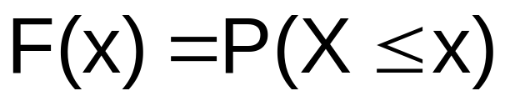
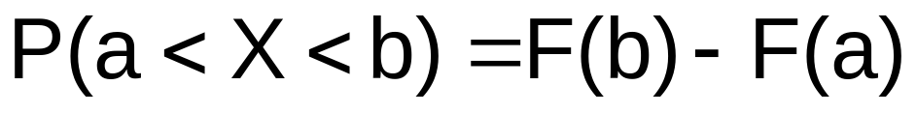
Cumulative Distribution Function
The cumulative distribution function, F(x), for a continuous random variable X expresses the probability that X does not exceed the value of x
Let a and b be two possible values of X, with a < b. The probability that X lies between a and b is

Slide 7
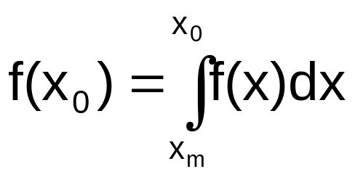
Probability Density Function
The probability density function, f(x), of random variable X has the following properties:
f(x) > 0 for all values of x
The area under the probability density function f(x) over all values of the random variable X is equal to 1.0
The probability that X lies between two values is the area under the density function graph between the two values
The cumulative density function F(x₀) is the area under the probability density function f(x) from the minimum x value up to x₀
where x_{m} is the minimum value of the random variable x

Slide 8
Probability as an Area
Shaded area under the curve is the probability that X is between a and b
f(x)
P
(
≤
≤
)
a
x
b
=
P
(
<
<
)
a
x
b
(Note that the probability of any individual value is zero)
a
b
x

Slide 9
The Uniform Distribution
Probability Distributions
Continuous
Probability Distributions
Uniform
Normal
Exponential

Slide 10
The Uniform Distribution
The uniform distribution is a probability distribution that has equal probabilities for all possible outcomes of the random variable
f(x)
Total area under the uniform probability density function is 1.0
x_{min}
x_{max}
x

Slide 11
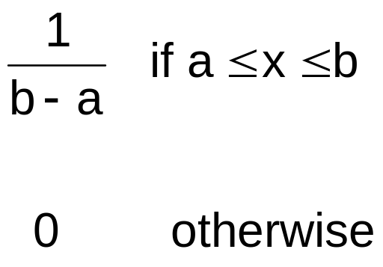
The Uniform Distribution
(continued)
The Continuous Uniform Distribution:
f(x) =
where
f(x) = value of the density function at any x value
a = minimum value of x
b = maximum value of x

Slide 12
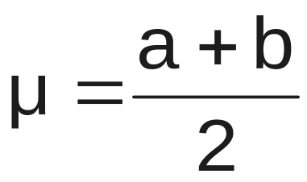
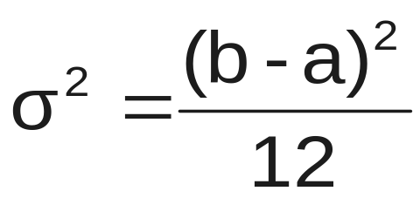
Properties of the
Uniform Distribution
The mean of a uniform distribution is
The variance is

Slide 13
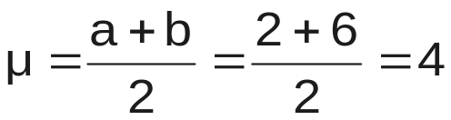
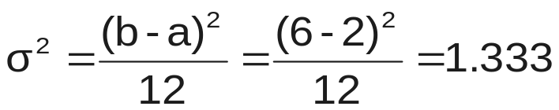
Uniform Distribution Example
Example: Uniform probability distribution
over the range 2 ≤ x ≤ 6:
1
f(x) = = .25 for 2 ≤ x ≤ 6
6 - 2
f(x)
.25
2
6
x

Slide 14
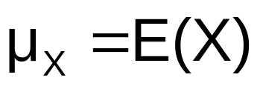
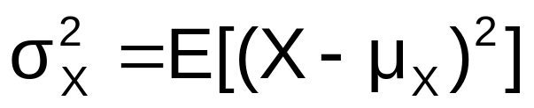
Expectations for Continuous Random Variables
The mean of X, denoted μ_{X} , is defined as the expected value of X
The variance of X, denoted σ_{X}² , is defined as the expectation of the squared deviation, (X - μ_{X})², of a random variable from its mean

Slide 15
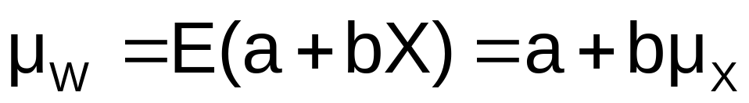
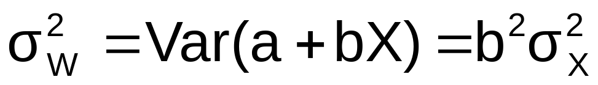
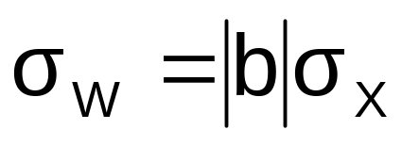
Linear Functions of Variables
Let W = a + bX , where X has mean μ_{X} and variance σ_{X}² , and a and b are constants
Then the mean of W is
the variance is
the standard deviation of W is

Slide 16
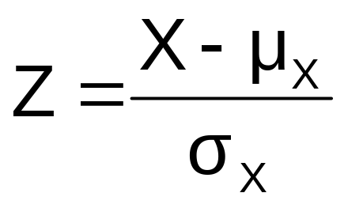
Linear Functions of Variables
(continued)
An important special case of the previous results is the standardized random variable
which has a mean 0 and variance 1

Slide 17
The Normal Distribution
Probability Distributions
Continuous
Probability Distributions
Uniform
Normal
Exponential

Slide 18
The Normal Distribution
(continued)
‘Bell Shaped’
Symmetrical
Mean, Median and Mode
are Equal
Location is determined by the mean, μ
Spread is determined by the standard deviation, σ
The random variable has an infinite theoretical range:
+ ∞ to − ∞
f(x)
σ
x
μ
Mean
= Median
= Mode

Slide 19
The Normal Distribution
(continued)
The normal distribution closely approximates the probability distributions of a wide range of random variables
Distributions of sample means approach a normal distribution given a “large” sample size
Computations of probabilities are direct and elegant
The normal probability distribution has led to good business decisions for a number of applications

Slide 20
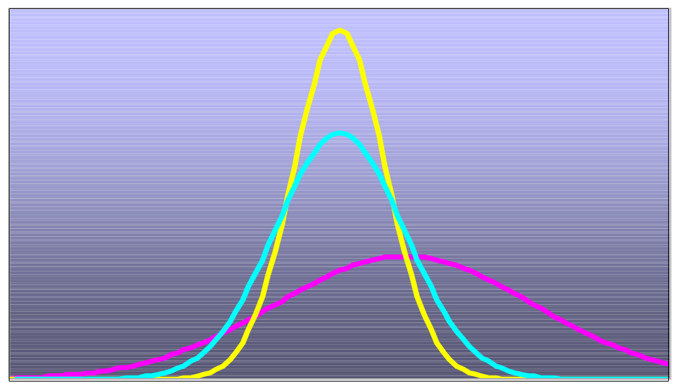
Many Normal Distributions
By varying the parameters μ and σ, we obtain different normal distributions

Slide 21

The Normal Distribution Shape
f(x)
Changing μ shifts the distribution left or right.
Changing σ increases or decreases the spread.
σ
μ
x
Given the mean μ and variance σ we define the normal distribution using the notation

Slide 22
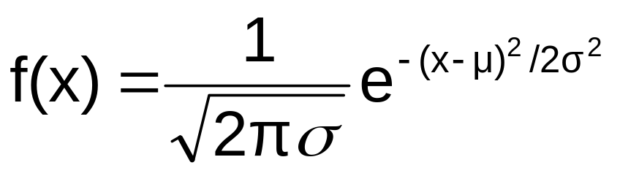
The Normal Probability
Density Function
The formula for the normal probability density function is
Where e = the mathematical constant approximated by 2.71828
π = the mathematical constant approximated by 3.14159
μ = the population mean
σ = the population standard deviation
x = any value of the continuous variable,  < x < 

Slide 23
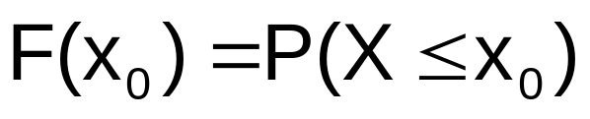

Cumulative Normal Distribution
For a normal random variable X with mean μ and variance σ² , i.e., X~N(μ, σ²), the cumulative distribution function is
f(x)
0
x₀
x

Slide 24

Finding Normal Probabilities
The probability for a range of values is measured by the area under the curve
a
μ
b
x

Slide 25
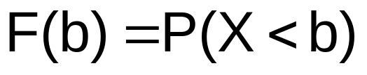
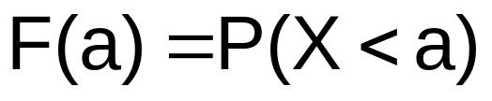
Finding Normal Probabilities
(continued)
a
μ
b
x
a
μ
b
x
a
μ
b
x

Slide 26
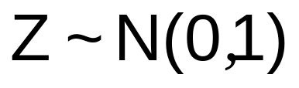
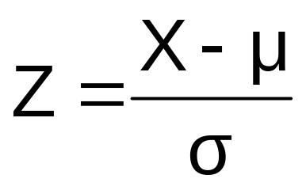
The Standardized Normal
Any normal distribution (with any mean and variance combination) can be transformed into the standardized normal distribution (Z), with mean 0 and variance 1
Need to transform X units into Z units by subtracting the mean of X and dividing by its standard deviation
f(Z)
1
Z
0

Slide 27
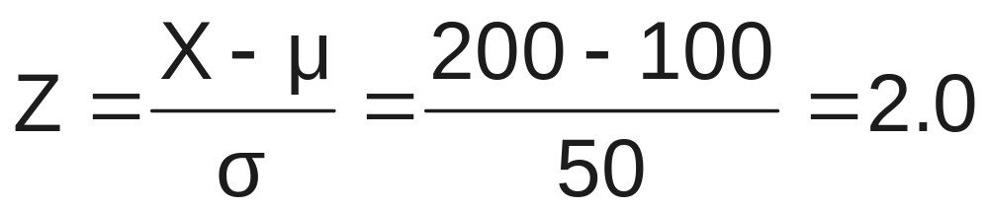
Example
If X is distributed normally with mean of 100 and standard deviation of 50, the Z value for X = 200 is
This says that X = 200 is two standard deviations (2 increments of 50 units) above the mean of 100.

Slide 28
Comparing X and Z units
100
200
X
(μ = 100, σ = 50)
0
2.0
Z
(μ = 0, σ = 1)
Note that the distribution is the same, only the scale has changed. We can express the problem in original units (X) or in standardized units (Z)

Slide 29
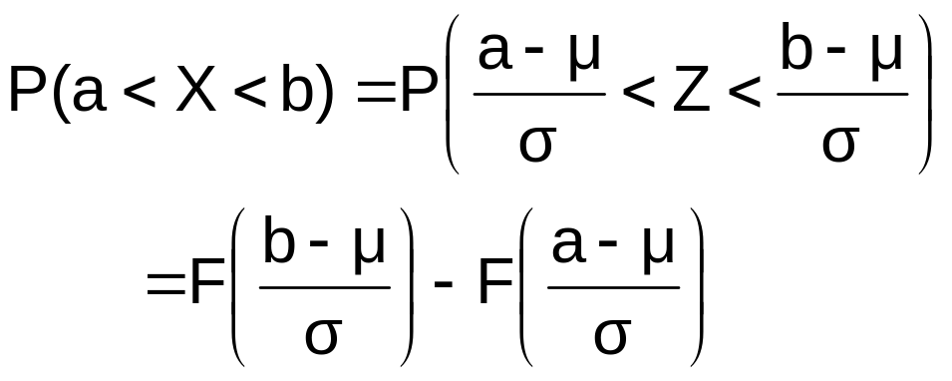
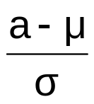
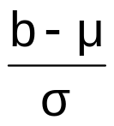
Finding Normal Probabilities
f(x)
a
µ
b
x
0
Z

Slide 30


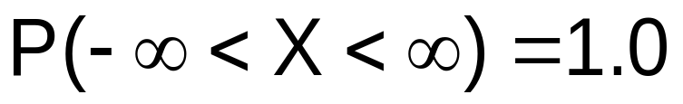
Probability as
Area Under the Curve
The total area under the curve is 1.0, and the curve is symmetric, so half is above the mean, half is below
f(X)
0.5
0.5
μ
X

Slide 31

Appendix Table 1
The Standardized Normal table in the textbook (Appendix Table 1) shows values of the cumulative normal distribution function
For a given Z-value a , the table shows F(a)
  (the area under the curve from negative infinity to a )
0
a
Z

Slide 32
The Standardized Normal Table
Appendix Table 1 gives the probability F(a) for any value a
.9772
Example:
P(Z < 2.00) = .9772
0
2.00
Z

Slide 33
The Standardized Normal Table
(continued)
For negative Z-values, use the fact that the distribution is symmetric to find the needed probability:
.9772
.0228
Example:
P(Z < -2.00) = 1 – 0.9772
= 0.0228
0
2.00
Z
.9772
.0228
-2.00
0
Z

Slide 34
General Procedure for Finding Probabilities
To find P(a < X < b) when X is distributed normally:
Draw the normal curve for the problem in
terms of X
Translate X-values to Z-values
Use the Cumulative Normal Table

Slide 35
Finding Normal Probabilities
Suppose X is normal with mean 8.0 and standard deviation 5.0
Find P(X < 8.6)
X
8.0
8.6

Slide 36
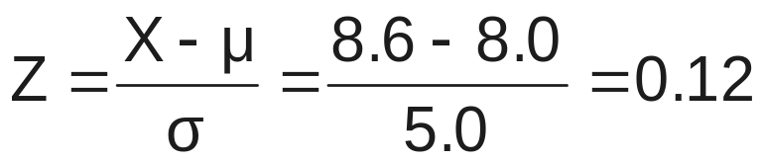
Finding Normal Probabilities
(continued)
Suppose X is normal with mean 8.0 and standard deviation 5.0. Find P(X < 8.6)
μ = 8
σ = 10
μ = 0
σ = 1
8
8.6
X
0
0.12
Z
P(X < 8.6)
P(Z < 0.12)

Slide 37
Solution: Finding P(Z < 0.12)
Standardized Normal Probability
Table (Portion)
P(X < 8.6)
= P(Z < 0.12)
z
F(z)
F(0.12) = 0.5478
.10
.5398
.11
.5438
.12
.5478
Z
.13
.5517
0.00
0.12

Slide 38
Upper Tail Probabilities
Suppose X is normal with mean 8.0 and standard deviation 5.0.
Now Find P(X > 8.6)
X
8.0
8.6

Slide 39
Upper Tail Probabilities
(continued)
Now Find P(X > 8.6)…
P(X > 8.6) = P(Z > 0.12) = 1.0 - P(Z ≤ 0.12)
= 1.0 - 0.5478 = 0.4522
0.5478
1.000
1.0 - 0.5478 = 0.4522
Z
Z
0
0
0.12
0.12

Slide 40
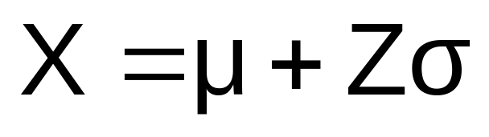
Finding the X value for a Known Probability
Steps to find the X value for a known probability:
1. Find the Z value for the known probability
2. Convert to X units using the formula:

Slide 41
Finding the X value for a Known Probability
(continued)
Example:
Suppose X is normal with mean 8.0 and standard deviation 5.0.
Now find the X value so that only 20% of all values are below this X
.2000
?
8.0
X
?
0
Z

Slide 42
Find the Z value for
20% in the Lower Tail
1. Find the Z value for the known probability
Standardized Normal Probability
Table (Portion)
20% area in the lower tail is consistent with a Z value of -0.84
z
F(z)
.82
.7939
.80
.20
.83
.7967
.84
.7995
?
8.0
X
.85
.8023
Z
-0.84
0

Slide 43
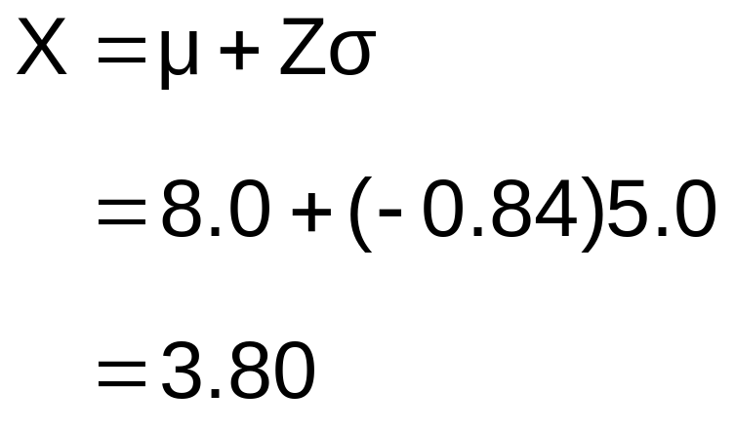
Finding the X value
2. Convert to X units using the formula:
So 20% of the values from a distribution with mean 8.0 and standard deviation 5.0 are less than 3.80

Slide 44
Assessing Normality
Not all continuous random variables are normally distributed
It is important to evaluate how well the data is approximated by a normal distribution

Slide 45
The Normal Probability Plot
Normal probability plot
  Arrange data from low to high values
  Find cumulative normal probabilities for all values
  Examine a plot of the observed values vs. cumulative probabilities (with the cumulative normal probability on the vertical axis and the observed data values on the horizontal axis)
  Evaluate the plot for evidence of linearity

Slide 46
The Normal Probability Plot
(continued)
A normal probability plot for data from a normal distribution will be approximately linear:
100
Percent
0
Data

Slide 47
The Normal Probability Plot
(continued)
Left-Skewed
Right-Skewed
100
100
Percent
Percent
0
0
Data
Data
Uniform
Nonlinear plots indicate a deviation from normality
100
Percent
0
Data

Slide 48
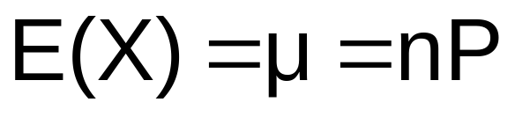
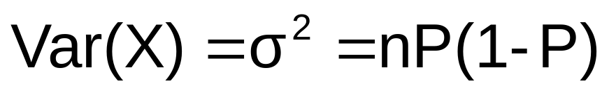
Normal Distribution Approximation for Binomial Distribution
Recall the binomial distribution:
  n independent trials
  probability of success on any given trial = P
Random variable X:
  X_{i} =1 if the i^{th} trial is “success”
  X_{i} =0 if the i^{th} trial is “failure”

Slide 49
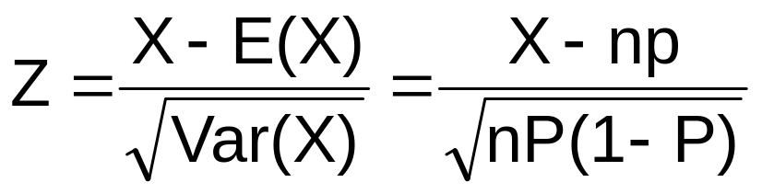
Normal Distribution Approximation for Binomial Distribution
(continued)
The shape of the binomial distribution is approximately normal if n is large
The normal is a good approximation to the binomial when nP(1 – P) > 9
Standardize to Z from a binomial distribution:

Slide 50
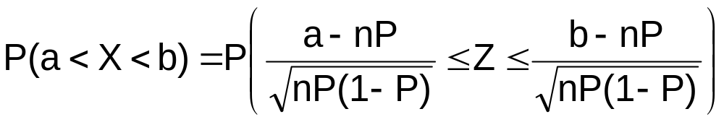
Normal Distribution Approximation for Binomial Distribution
(continued)
Let X be the number of successes from n independent trials, each with probability of success P.
If nP(1 - P) > 9,

Slide 51
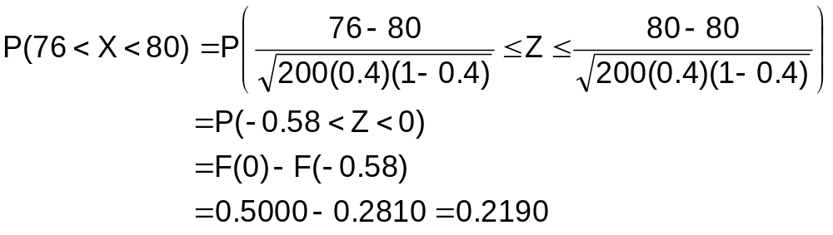
Binomial Approximation Example
40% of all voters support ballot proposition A. What is the probability that between 76 and 80 voters indicate support in a sample of n = 200 ?
  E(X) = µ = nP = 200(0.40) = 80
  Var(X) = σ² = nP(1 – P) = 200(0.40)(1 – 0.40) = 48
  ( note: nP(1 – P) = 48 > 9 )

Slide 52
The Exponential Distribution
Probability Distributions
Continuous
Probability Distributions
Normal
Uniform
Exponential

Slide 53
The Exponential Distribution
Used to model the length of time between two occurrences of an event (the time between arrivals)
  Examples:
    Time between trucks arriving at an unloading dock
    Time between transactions at an ATM Machine
    Time between phone calls to the main operator

Slide 54
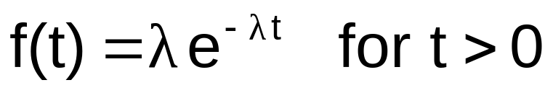
The Exponential Distribution
(continued)
The exponential random variable T (t>0) has a probability density function
Where
  λ is the mean number of occurrences per unit time
  t is the number of time units until the next occurrence
  e = 2.71828
T is said to follow an exponential probability distribution

Slide 55
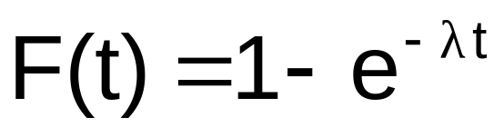
The Exponential Distribution
Defined by a single parameter, its mean λ (lambda)
The cumulative distribution function (the probability that an arrival time is less than some specified time t) is
where e = mathematical constant approximated by 2.71828
● = the population mean number of arrivals per unit
t = any value of the continuous variable where t > 0

Slide 56
Exponential Distribution
Example
Example: Customers arrive at the service counter at the rate of 15 per hour. What is the probability that the arrival time between consecutive customers is less than three minutes?
The mean number of arrivals per hour is 15, so  = 15
Three minutes is .05 hours
P(arrival time < .05) = 1 – e^{- X} = 1 – e^{-(15)(.05)} = 0.5276
So there is a 52.76% probability that the arrival time between successive customers is less than three minutes

Slide 57
Summary
Defined continuous random variables
Presented key continuous probability distributions and their properties
  uniform, normal, exponential
Found probabilities using formulas and tables
Interpreted normal probability plots
Examined when to apply different distributions
Applied the normal approximation to the binomial distribution

