Slide 1
图神经网络调研
刘朝玮

Slide 2

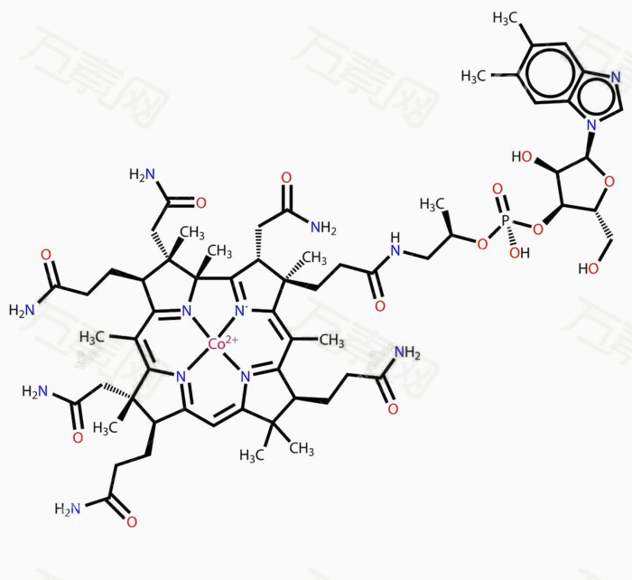
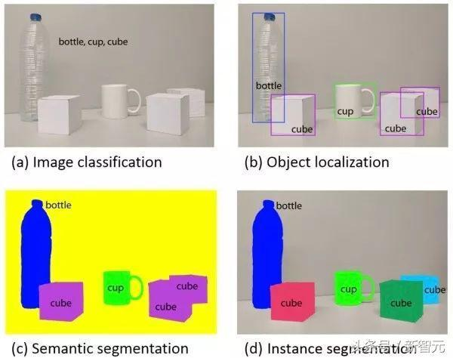
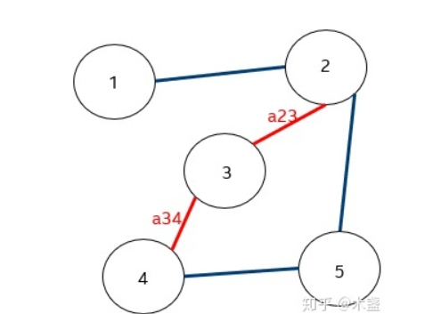
图神经网络介绍
图神经网络的介绍
DECEMBER 2
Notes:
近年来卷积神经网络(CNN)非常得火，在解决图像分类[1]、语义分割[2]、机器翻译[3]等问题表现出了很强的能力。
但是传统的卷积神经网络只能应用在欧几里得数据中，
无法正确的解决图等非欧几里得数据的问题，例如社交网络、分子结构等。
图神经网络(RNN)因此诞生，它能够捕获图的结构、节点、边的特征，处理图这种非欧几里得数据，并且已经变为一个热门的研究课题。

Slide 3
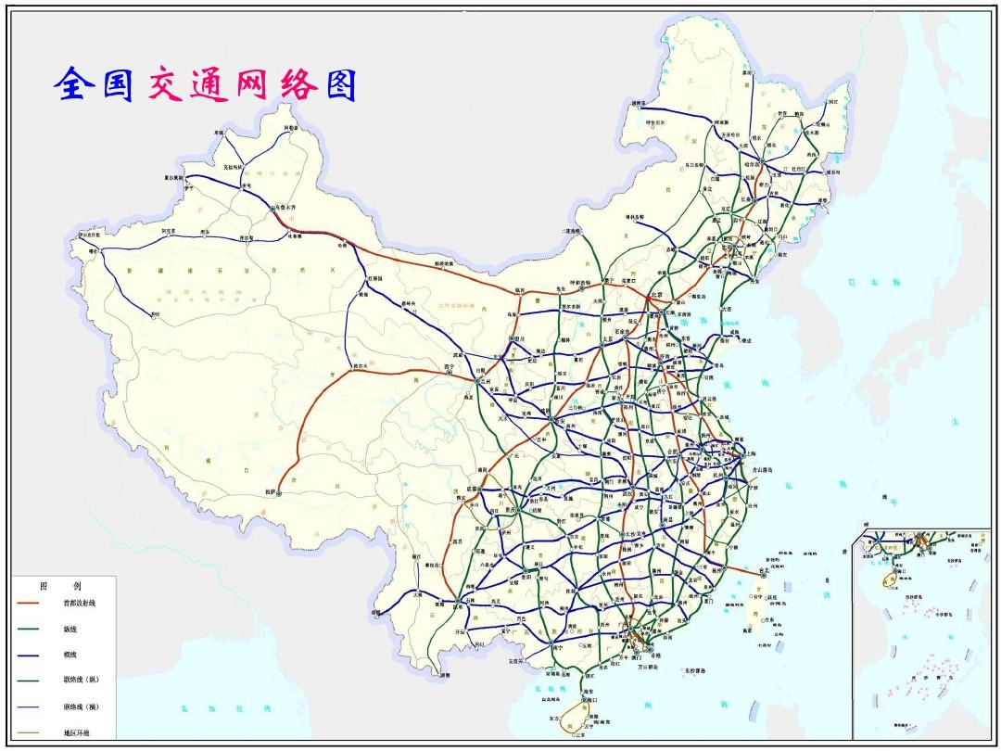
背景与意义
研究意义
交通网络
社交网络
分子图
Notes:
好的数据增广技术能够提升图神经网络的表现。
正确预测交通车流量，合理分配交通资源
预测社交网络，进行智能推荐好友等
预测新药物，新材料

Slide 4
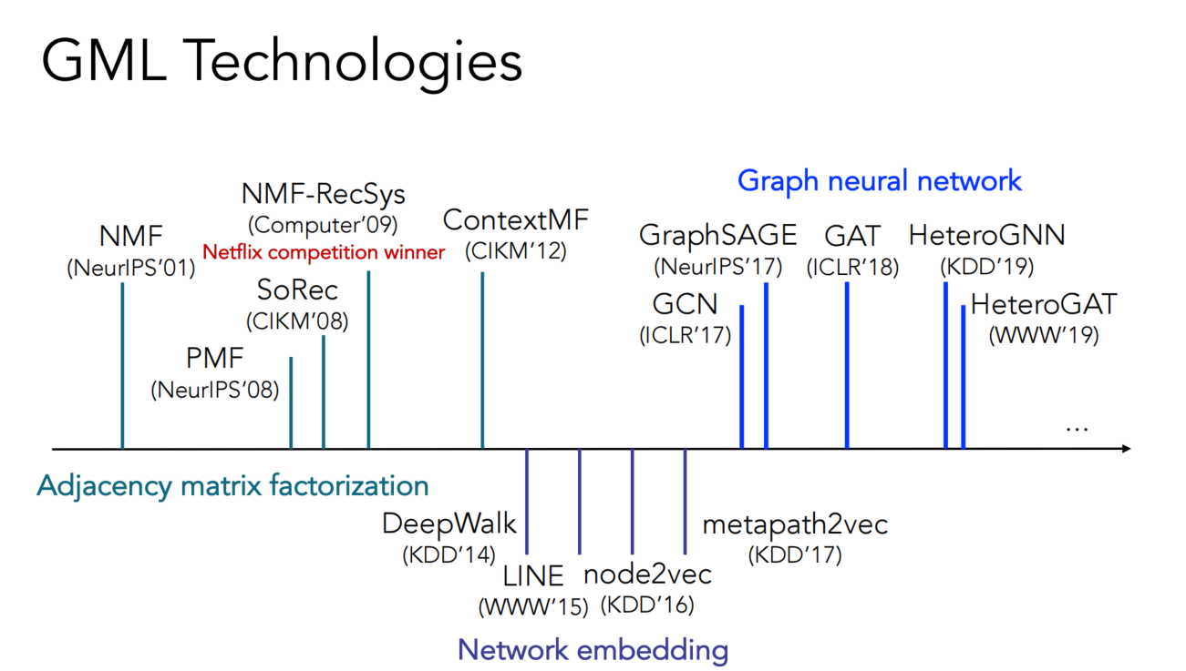
Notes:
有哪些图 有向图等等，然后统计一下

Slide 5

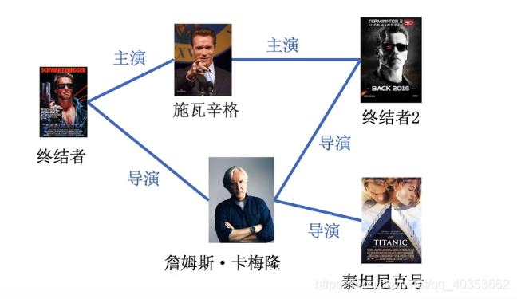
普通图
异构图
HeteroGraph

Slide 6
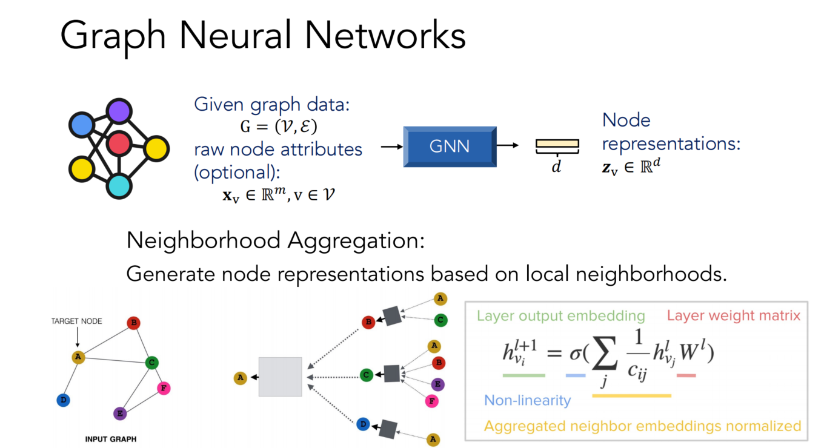

Slide 7
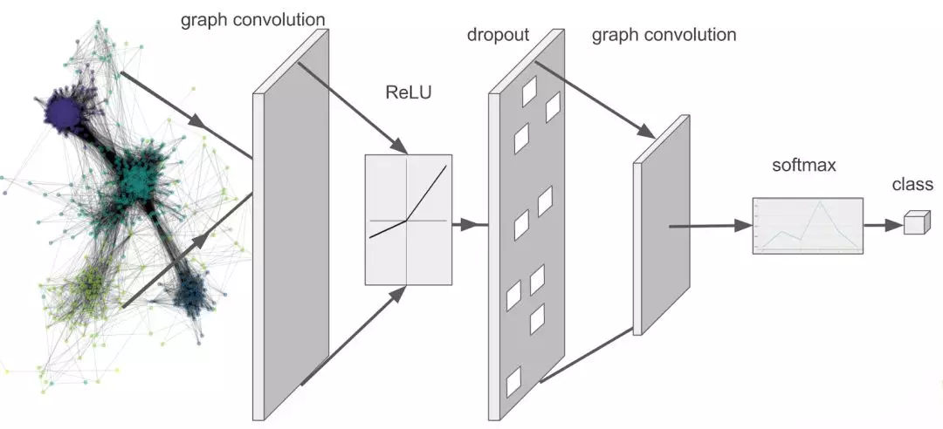
Experiment
$$Z=f(X,A)=softmax(\hat{A} ReLU(\hat{A} XW^{(0)})W^{(1)}) .$$

Slide 8
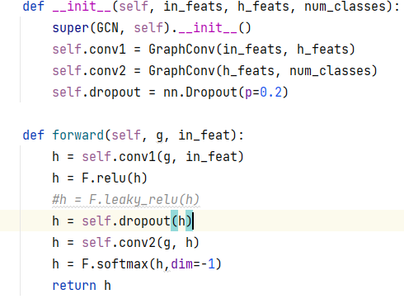
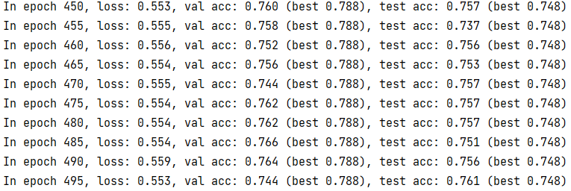
Experiment
Dataset:Cora

Slide 9
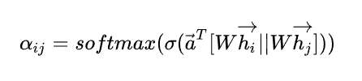
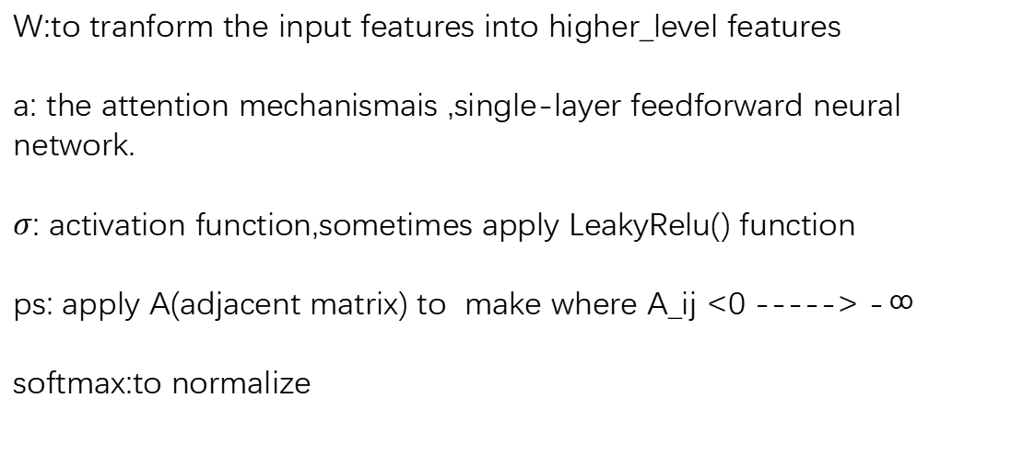
GRAPH ATTENTIONAL LAYER
compute attention cofficents
W:to tranform the input features into higher_level features
a: the attention mechanismais ,single-layer feedforward neural network.
$σ$: activation function,sometimes apply LeakyRelu() function
ps: apply A(adjacent matrix) to make where A_ij <0 -----> -∞
softmax:to normalize

Slide 10
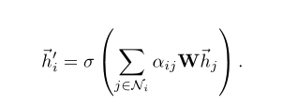
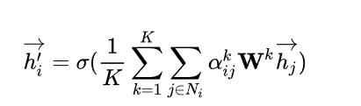
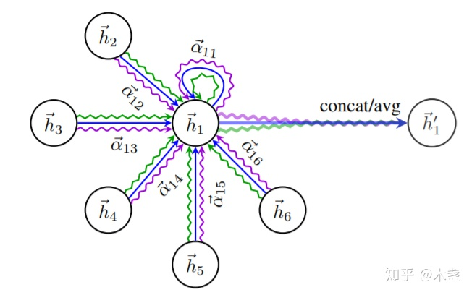

aggregation process
for K=1:
for K= others,such as K=3
$σ$ :softmax to normarlize

Slide 11
loss function
#code:
loss_train = F.nll_loss(output[idx_train], labels[idx_train])
#use predicted results and orginal labels to calculate the loss
loss_train.backward()
optimizer.step()

Slide 12
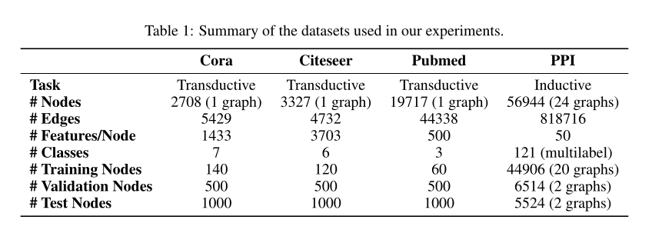
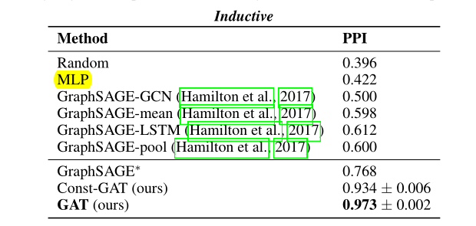
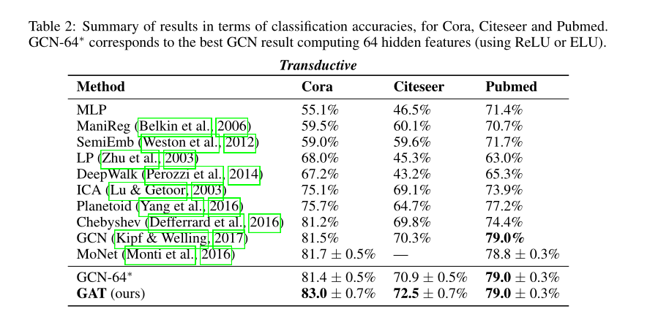

Result
After training GAT by pytorch,results(data:”cora”) showed that:

Slide 13
业务结合应用场景：
1.图嵌入，在模型中用到地图的特征
2.推荐领域：利用图进行社交关系的推荐。
3.如果有图结构等数据：可以利用图嵌入作为一种训练的特征

Slide 14
之后内容为两篇论文的解析：
1.SEMI-SUPERVISED CLASSIFICATION WITH GRAPH CONVOLUTIONAL NETWORKS
2.Graph Attention Networks

Slide 15
Paper 1
SEMI-SUPERVISED CLASSIFICATION WITH GRAPH CONVOLUTIONAL NETWORKS
Author: Thomas N. Kipf Max Welling
University of Amsterdam University of Amsterdam

Slide 16
Two-fold contributions
Introducing a simple and well-behaved layer-wise propagation rule for neural network models
Demonstrating how this form of a graph-based neural network model can be used for fast and scalable semi-supervised classification of nodes in a graph

Slide 17


Graph Fourier transform
$$\hat{f}=U^{T}f$$
Inverse Graph Fourier transform
$f=U\hat{f}$
The graph signal can be represented as two domains, namely spatial domain and spectral domain
The eigenvector is the Fourier basis of the graph, The coefficient $\hat{f}$ represents the contribution of the corresponding Fourier base to the input signal

Slide 18
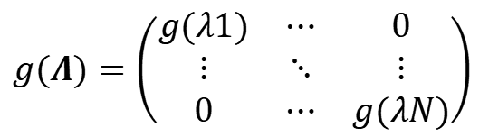



The coefficients $\hat{f}$ are obtained from the graph Fourier transform
$$\hat{f}=U^{T}f$$
Filtering operation, $g(Λ)$ is a function of eigenvalues of $L$
$$g(Λ)=\left(\begin{matrix}g(λ1) & ⋯ & 0 \\ ⋮ & ⋱ & ⋮ \\ 0 & ⋯ & g(λN)\end{matrix}\right)$$
$$\hat{f’}=g(Λ)∙\hat{f}=g(Λ)∙U^{T}f$$
Use IGFT to reconstruct the signal D in graph domain
$$f’=U\hat{f’}=U∙g(Λ)∙U^{T}f$$

Slide 19

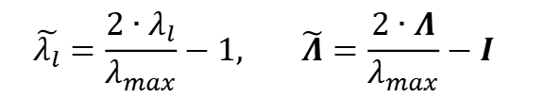
Chebyshev polynomials:
$$T_{k}(y)=2yT_{k−1}(y)−T_{k−2}(y) with T_{0}(y)=1 and T_{1}(y)=y$$
Because the domain of Chebyshev polynomial is $[−1,1]$, it is necessary to rescale the eigenvalues of Laplace matrix to approximate convolution operators:
$$\tilde{λ_{l}}=\frac{2∙λ_{l}}{λ_{max}}−1, \tilde{Λ}=\frac{2∙Λ}{λ_{max}}−I$$
$$\tilde{L}=\frac{2∙L}{λ_{max}}−I$$

Slide 20
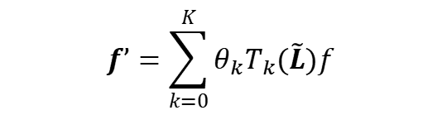

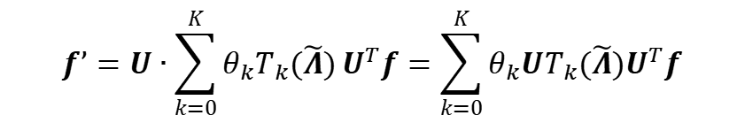
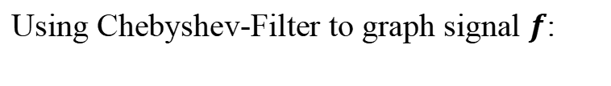

Chebyshev-Filter:
$$g(Λ)=\sum_{k=0}^{K}{θ_{k}T_{k}(\tilde{Λ})}$$
Using Chebyshev-Filter to graph signal $f$:
$$f’=U∙\sum_{k=0}^{K}{θ_{k}T_{k}(\tilde{Λ})}U^{T}f=\sum_{k=0}^{K}{θ_{k}{UT}_{k}(\tilde{Λ})U^{T}f}$$
Theorem: $\tilde{L}=\frac{2∙L}{λ_{max}}−I$, ${UT}_{k}(\tilde{Λ})U^{T}=$ $T_{k}(\tilde{L})$
Therefore, it is further simplified to obtain:
$$f’=\sum_{k=0}^{K}{θ_{k}T_{k}(\tilde{L})f}$$

Slide 21
GCN-Filter
● Limit the layer-wise convolution operation to K = 1
● Approximate $λ_{x}≈2,$ as we can expect that neural network parameters will adapt to this change in scale during training.
$$g(Λ)=θ_{0}T_{0}(\tilde{Λ})+θ_{1}T_{1}(\tilde{Λ})$$
$$=θ_{0}I+θ_{1}\tilde{Λ}$$
$$=θ_{0}I+θ_{1}(Λ−I)$$

Slide 22



GCN-Filter
● Use GCN-Filter to graph signal $f,$ the output signal $f’ is :$
$$f’=U∙g(Λ)∙U^{T}f$$
$$=θ_{0}UIU^{T}f+θ_{1}U(Λ−I)U^{T}f$$
$$=θ_{0}f+θ_{1}(L−I)f$$
$$=θ_{0}f−θ_{1}(D^{−\frac{1}{2}}AD^{−\frac{1}{2}})f$$
$$L=D^{−\frac{1}{2}}(D−A)D^{−\frac{1}{2}}=I−D^{−\frac{1}{2}}AD^{−\frac{1}{2}}$$
Normalized Laplace matrix$:$
● With a single parameter $θ=θ_{0}={−θ}_{1} ,$
$$f’=θ(I+D^{−\frac{1}{2}}AD^{−\frac{1}{2}})f$$

Slide 23

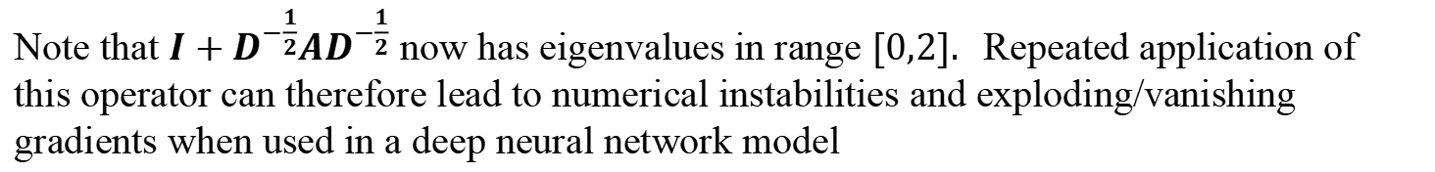
GCN-Filter
Note that $I+D^{−\frac{1}{2}}AD^{−\frac{1}{2}}$ now has eigenvalues in range $[0,2].$ Repeated application of this operator can therefore lead to numerical instabilities and exploding/vanishing gradients when used in a deep neural network model
To alleviate this problem, we introduce the following renormalization trick:
$$I+D^{−\frac{1}{2}}AD^{−\frac{1}{2}}→{\tilde{D}}^{−\frac{1}{2}}\tilde{A}{\tilde{D}}^{−\frac{1}{2}}$$
With $\tilde{A}=A+I and \tilde{D_{II}}=\sum_{j}{\tilde{A_{i,j}}}$

Slide 24
GCN-Filter
We can generalize this definition to a signal $X∈R^{N×C}$with $C$ input channels and F filters or feature maps as follows:
To alleviate this problem, we introduce the following renormalization trick:
$$Z={\tilde{D}}^{−\frac{1}{2}}\tilde{A}{\tilde{D}}^{−\frac{1}{2}}XΘ$$
Where $Θ∈R^{C×F}$ is now a matrix of filter parameters and $Z∈R^{N×F}$ is the convolved signal matrix.

Slide 25
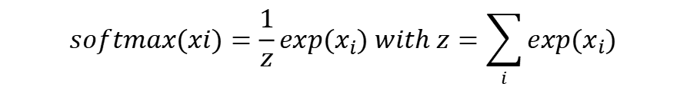
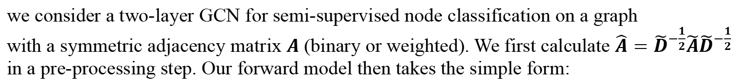
SEMI-SUPERVISED NODE CLASSIFICATION
we consider a two-layer GCN for semi-supervised node classification on a graph
with a symmetric adjacency matrix $A$ (binary or weighted). We first calculate ${\hat{A}=\tilde{D}}^{−\frac{1}{2}}\tilde{A}{\tilde{D}}^{−\frac{1}{2}}$ in a pre-processing step. Our forward model then takes the simple form:
$$Z=f(X,A)=softmax(\hat{A} ReLU(\hat{A} XW^{(0)})W^{(1)}) .$$
Here $W^{(0)}∈R^{C×H}$ is an input-to-hidden weight matrix for a hidden layer with H feature maps.
$W^{(1)}∈R^{H×F}$is a hidden-to-output weight matrix.
The softmax activation function, defined as:
$$softmax(xi)=\frac{1}{z}exp(x_{i}) with z=\sum_{i}{exp(x_{i})}$$

Slide 26
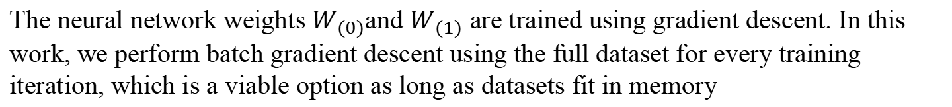

SEMI-SUPERVISED NODE CLASSIFICATION
For semi-supervised multi-class classification, we then evaluate the cross-entropy error over all labeled examples:
$$ℒ=−\sum_{lεy_{l}}{\sum_{f=1}^{F}{Y_{lf}\ln{Z_{lf}}}}$$
$y_{l}$ is the set of node indices that have labels
The neural network weights $W_{(0)}$and $W_{(1)}$ are trained using gradient descent. In this work, we perform batch gradient descent using the full dataset for every training iteration, which is a viable option as long as datasets fit in memory

Slide 27
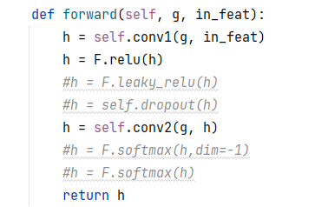
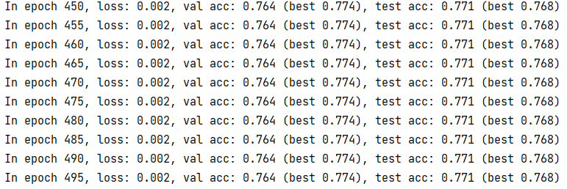
Experiment
Dataset:Cora
Graph Convolution
ReLU
Graph Convolution

Slide 28
Experiment
$$Z=f(X,A)=softmax(\hat{A} ReLU(\hat{A} XW^{(0)})W^{(1)}) .$$

Slide 29
Experiment
Dataset:Cora

Slide 30

GRAPH ATTENTION NETWORKS
Aim:
to deal with variable sized inputs,focusing on the most relevant parts of the part to make decisions
ps:compared with GCN,need more parameters

Slide 31
GRAPH ATTENTIONAL LAYER
compute attention cofficents
W:to tranform the input features into higher_level features
a: the attention mechanismais ,single-layer feedforward neural network.
$σ$: activation function,sometimes apply LeakyRelu() function
ps: apply A(adjacent matrix) to make where A_ij <0 -----> -∞
softmax:to normalize

Slide 32
aggregation process
for K=1:
for K= others,such as K=3
$σ$ :softmax to normarlize

Slide 33
loss function
#code:
loss_train = F.nll_loss(output[idx_train], labels[idx_train])
#use predicted results and orginal labels to calculate the loss
loss_train.backward()
optimizer.step()

Slide 34
Result
After training GAT by pytorch,results(data:”cora”) showed that:

