Slide 1

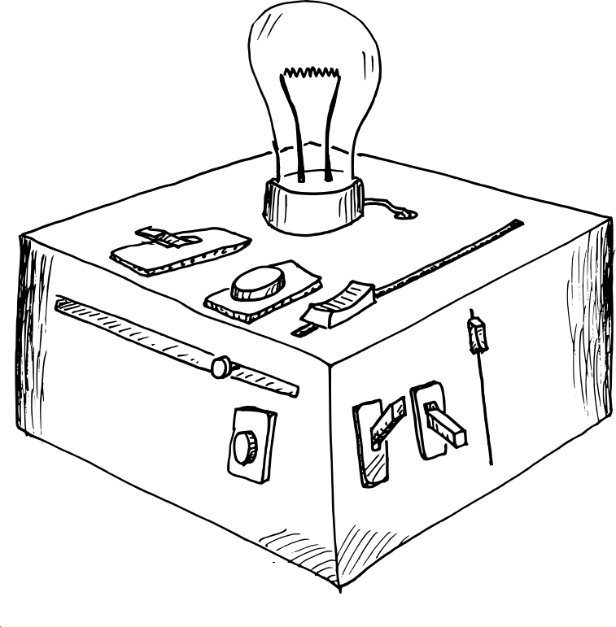

Model to meaning
How to interpret generalized multilevel models in
Luke Watson
CONNECT
LAB

Slide 2
Outline
Making a model
Categorical contrasts
Marginal effects
Implementation
Extras

Slide 3
Events and encounters
As researchers, we create models to make sense of how events and encounters are related to each other
Sometimes it is simple, we record information about how individuals respond to encountering the presence or absence of a single event or gradient of that event
  Like gradient of drug doses, presence of CS+ or absence of CS+, etc.

Slide 4
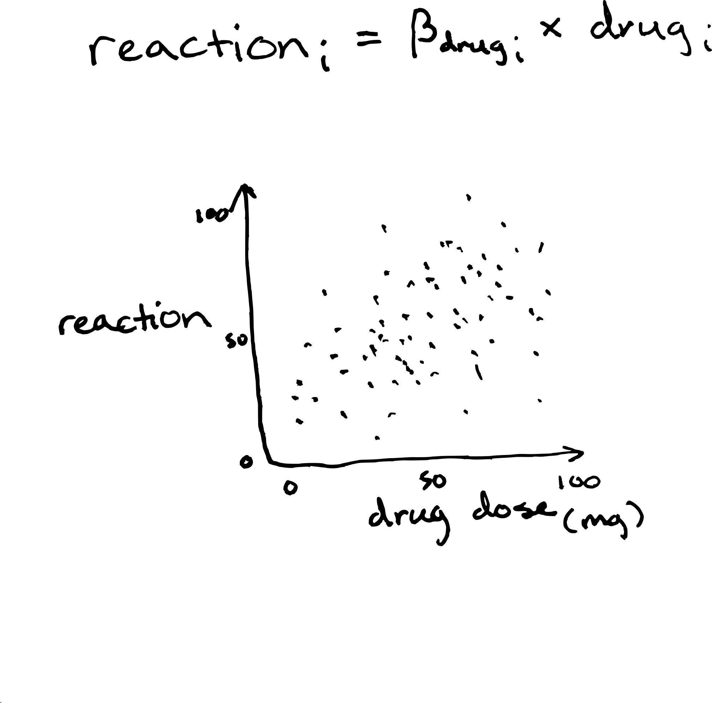
Simple model
Effect of drug dose on reaction remains constant across doses, equal to β (slope)

Slide 5
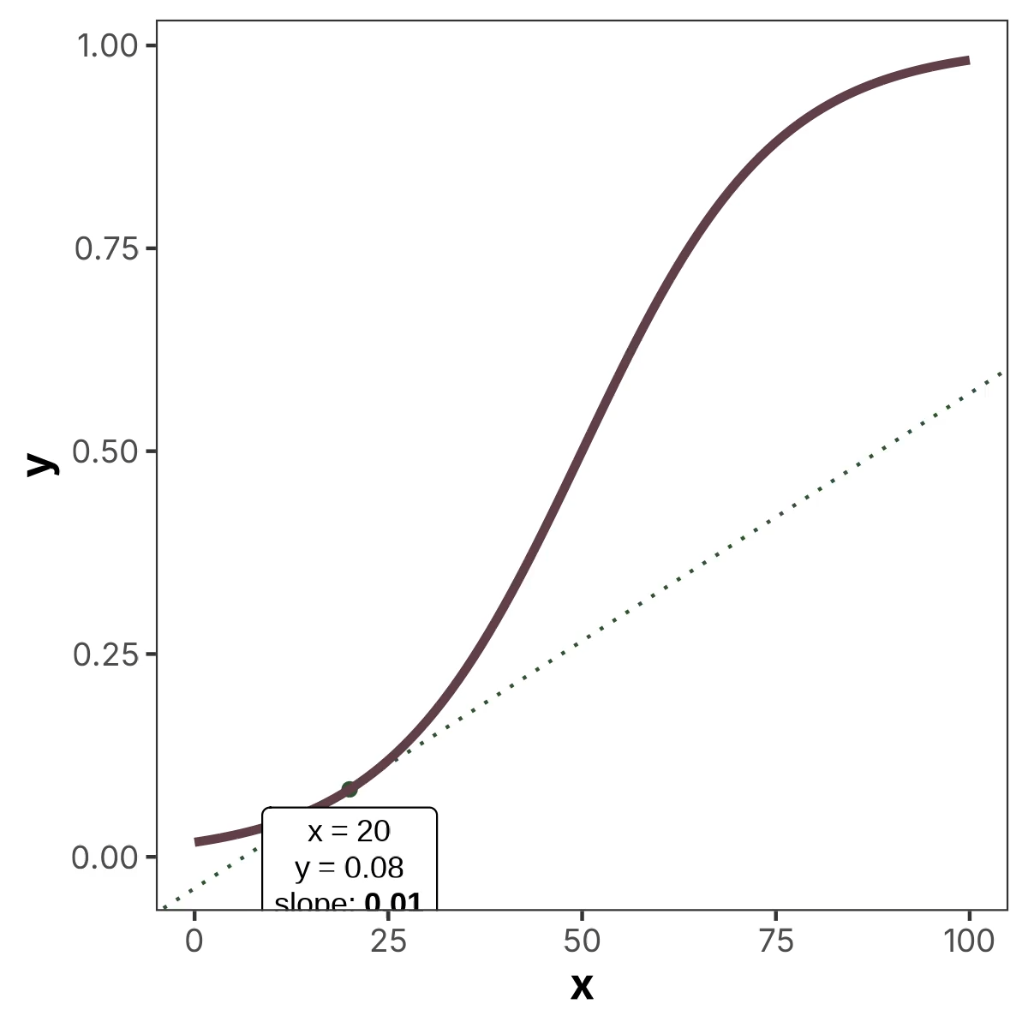
More complexity
A harder scenario is a non-linear model, where the effect of x on y changes across values of x
A single β slope no longer tells us exactly what is happening

Slide 6
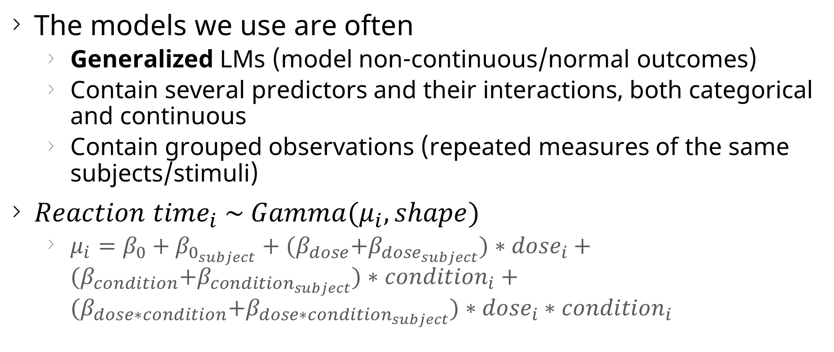
Research models
The models we use are often
  Generalized LMs (model non-continuous/normal outcomes)
  Contain several predictors and their interactions, both categorical and continuous
  Contain grouped observations (repeated measures of the same subjects/stimuli)
${Reaction time}_{i} \sim Gamma(μ_{i}, shape)$
  $μ_{i}=β_{0}+β_{0_{subject}}+{(β}_{dose}+β_{{dose}_{subject}})∗{dose}_{i}+{(β}_{condition}+β_{{condition}_{subject}})∗{condition}_{i}+{(β}_{dose∗condition}+β_{{dose∗condition}_{subject}})∗{dose}_{i}∗{condition}_{i}$

Slide 7
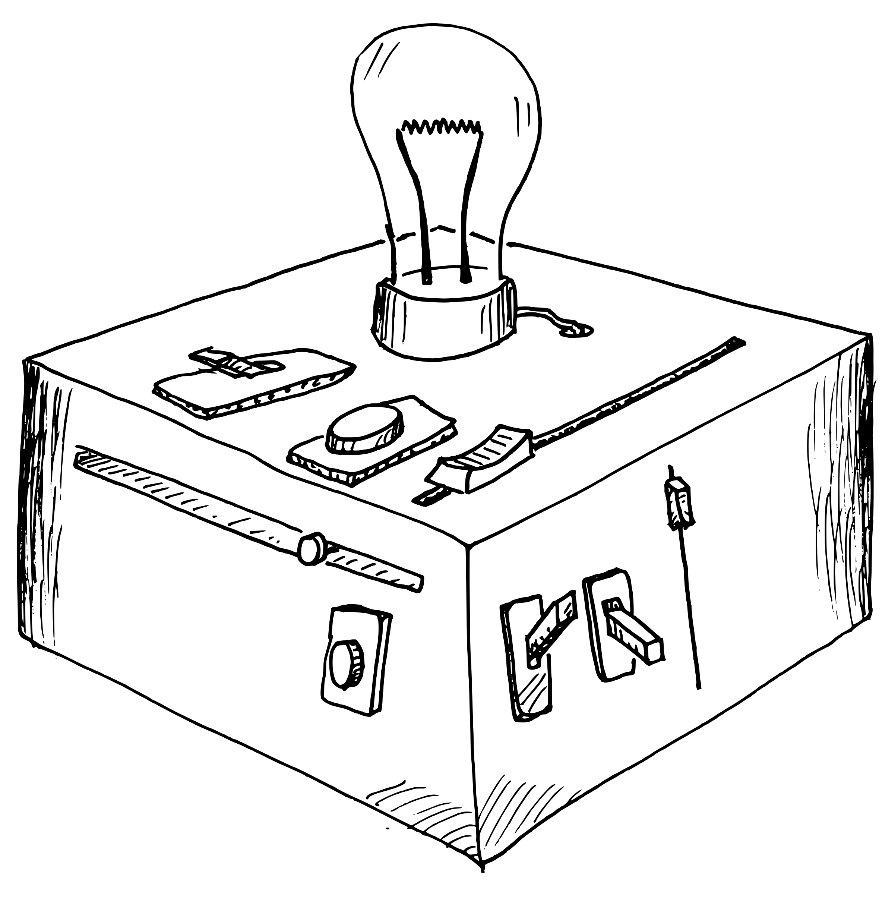
The typical model
Models like ours can be thought of like little machines we create
We assemble sliders and switches (predictors) connected to an output device (outcome)
Now, how do these components affect our output?

Slide 8
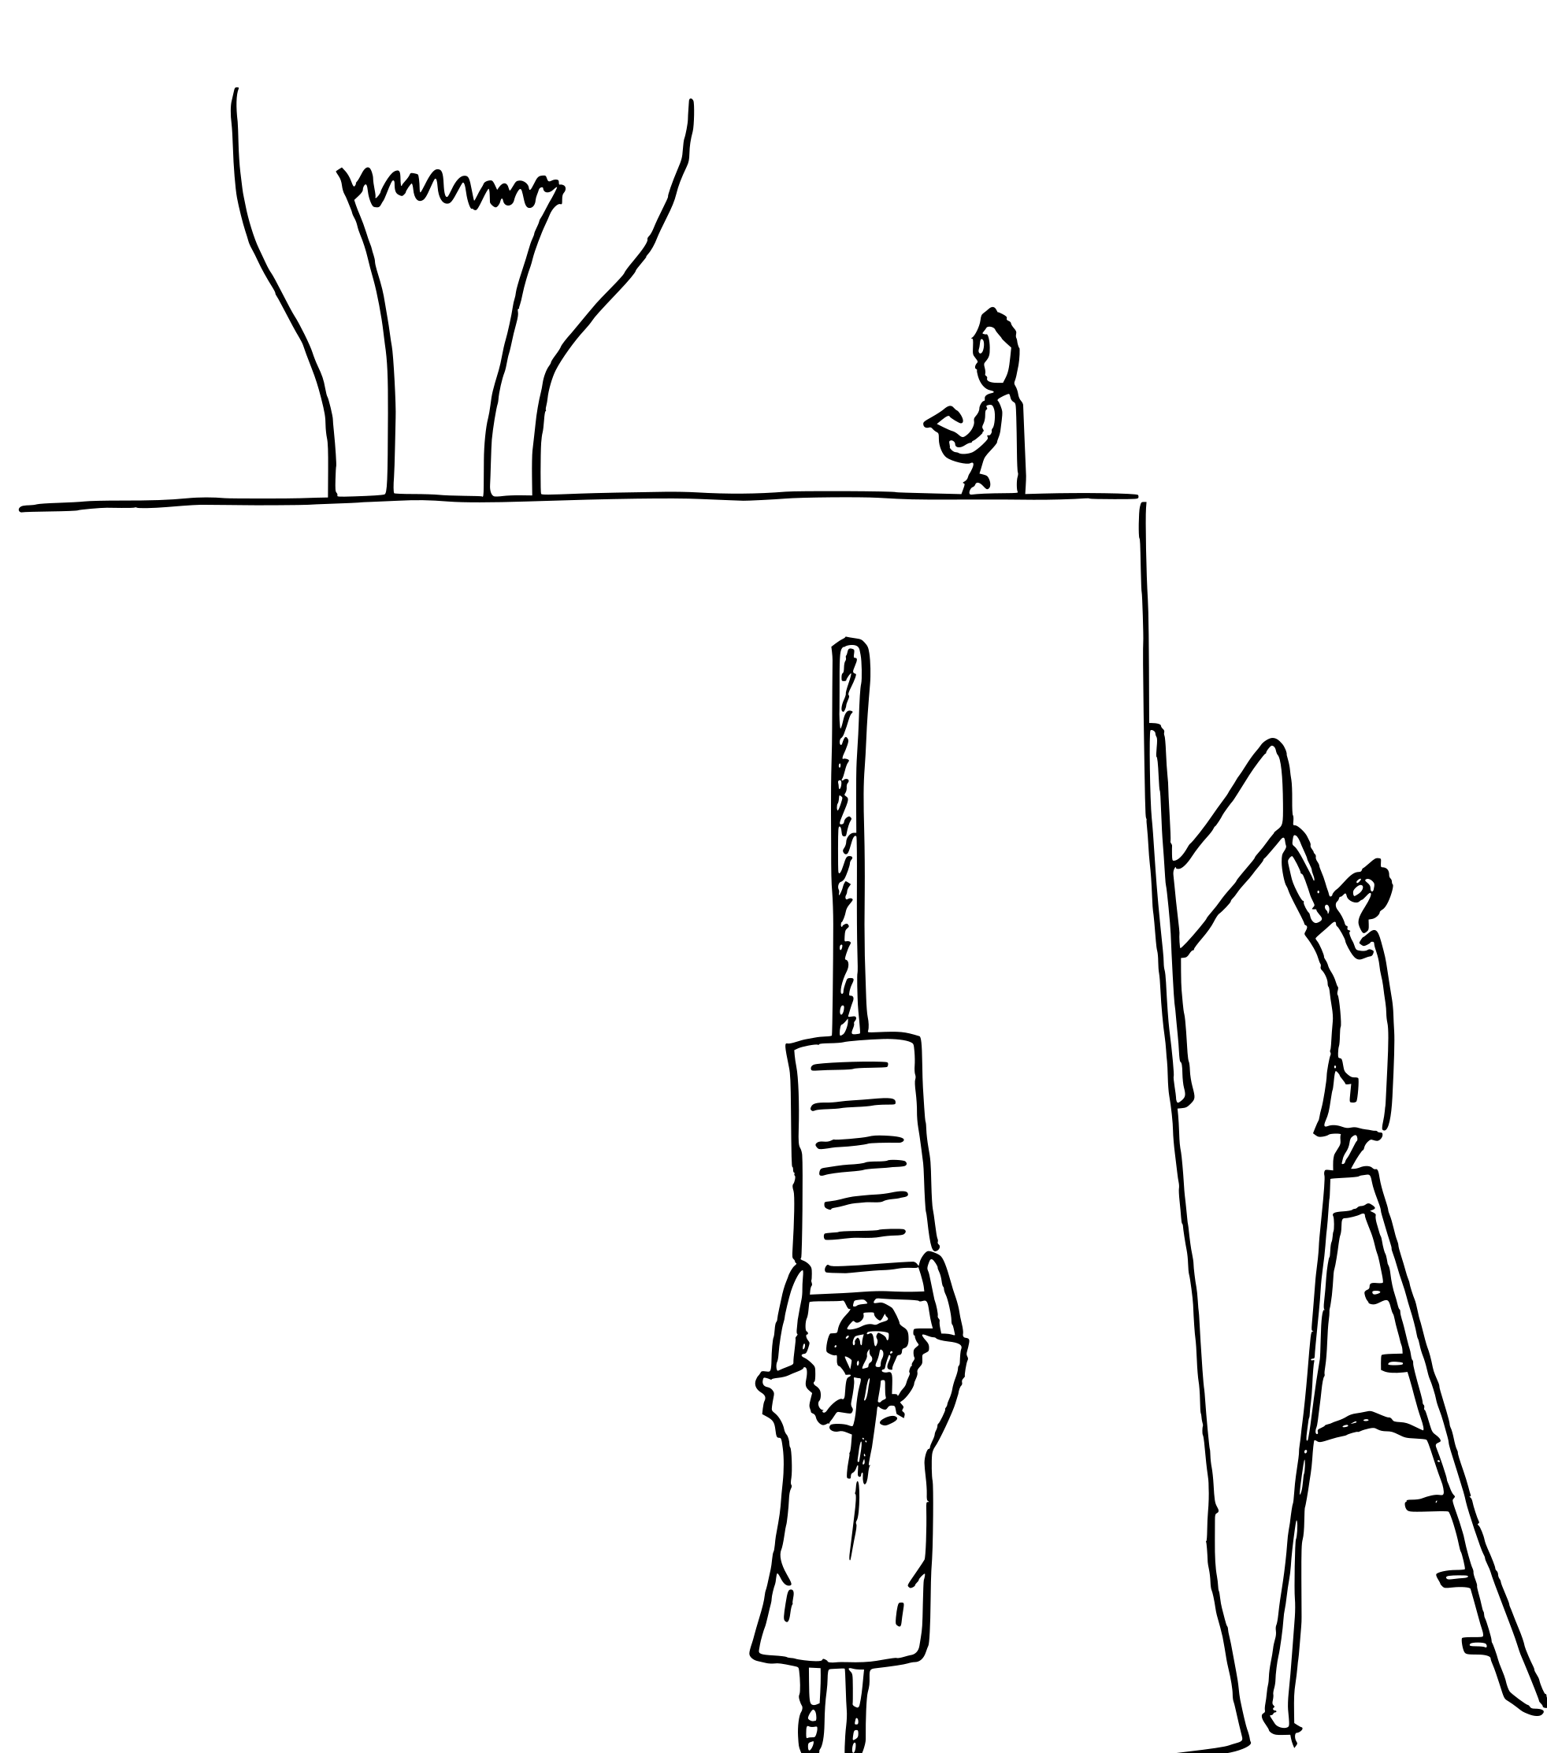
Investigating the model
We can be structured about our investigation
  Observe the effect of moving one slider while holding all other switches and sliders constant
This is easier to intuit than a table of numbers vaguely related to how our machine functions

Slide 9
Marginal effects
In the stats world, this is known as a marginal effect
The individual effect of a predictor on the outcome while holding all other variables constant
There are lots of different ways to accomplish this and plenty of names they go by (just like modeling itself)!

Slide 10
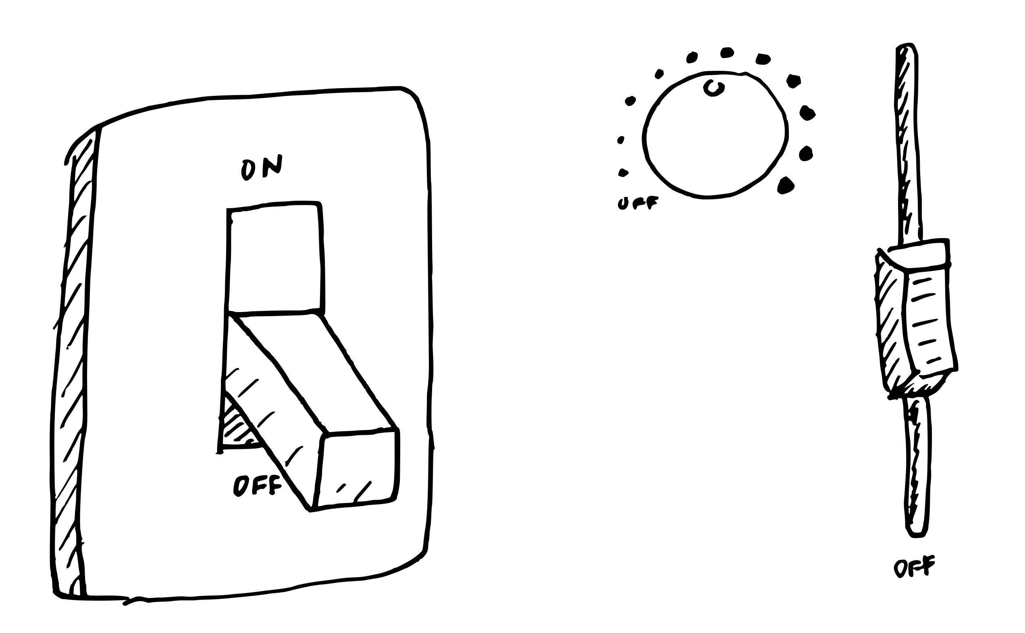
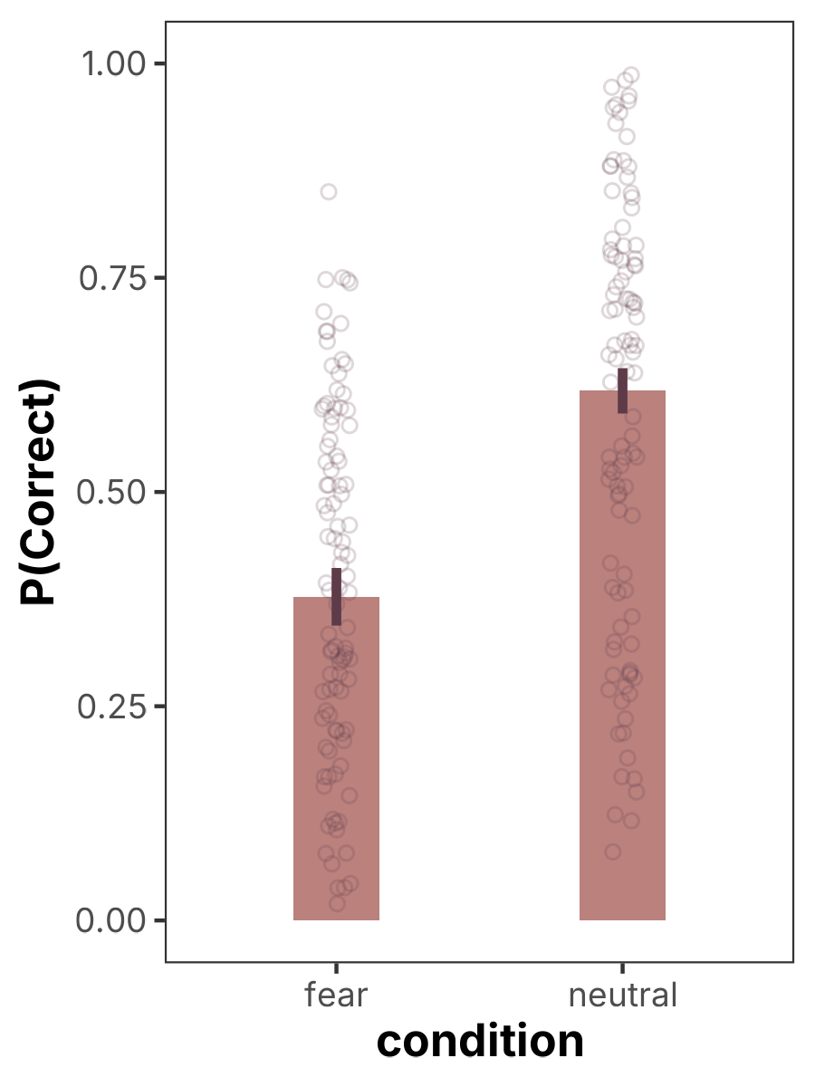
Categorical contrasts
The effect of turning a predictor from off to on
  These are our switches
Change in reaction time with and without a drug
Usually visualized as a bar plot

Slide 11
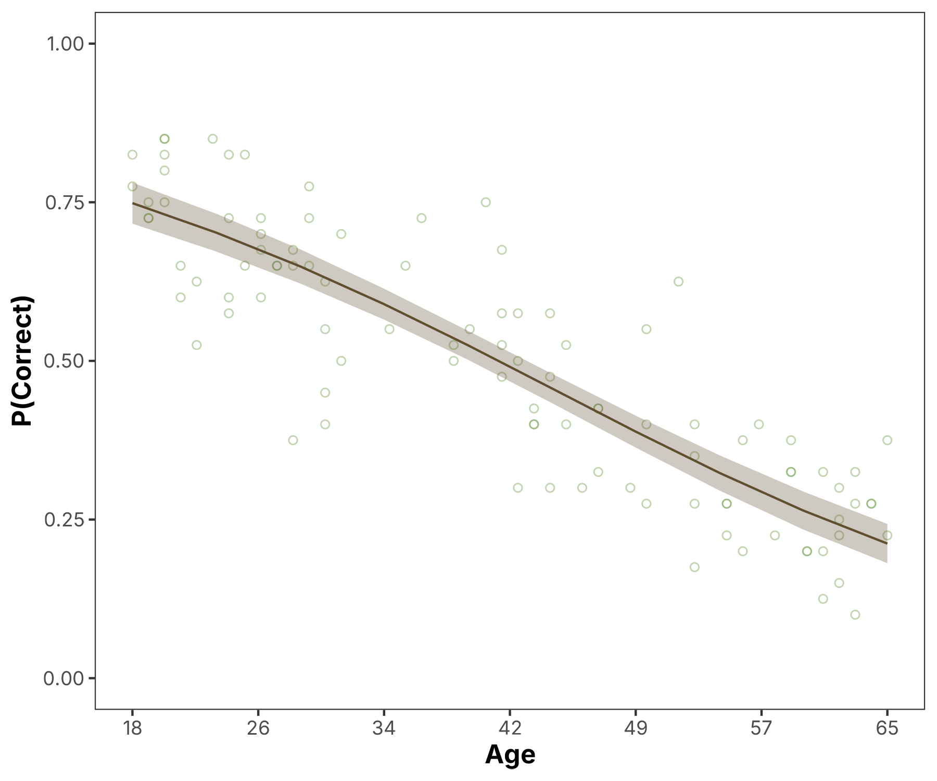
True marginal effects
A true marginal effects concern how small changes in our predictor affects our outcome
  Aka our sliders
Change in reaction time as dose increases gradually
Usually visualized with a line plot

Slide 12
Implementation
We can compute categorical contrasts and marginal effects with our models in R in a couple of ways
Base R: fitted() and predict() with manual post-processing
  emmeans: library designed for performing statistical contrasts and marginal effects
  marginaleffects: library works like emmeans but also optimized for visualization

Slide 13
Example model
Predictor
Age
Subjects
Trial
Fear
Neutral
Outcome
Predictor
correct
incorrect
Trial
Stimuli
Predictor
Fear
Neutral
glmer
  formula = Correct ~ Age * Trial * Condition + (1 | Stimulus) + (Trial * Condition | Subject)
  family = ‘binomial’

Slide 14
Example model results
glmer
  formula = Correct ~ Age * Trial * Condition + (1 | Stimulus) + (Trial * Condition | Subject)
  family = ‘binomial’
term | b | SE | t | p
(Intercept) | -0.01 | 0.05 | -0.18 | 0.859
age | -0.85 | 0.05 | -16.10 | <.001
trial | 0.10 | 0.05 | 2.30 | 0.021
condition | -0.49 | 0.04 | -11.90 | <.001
age x trial | 0.02 | 0.05 | 0.44 | 0.658
age x condition | 0.19 | 0.04 | 4.47 | <.001
trial x condition | 0.00 | 0.04 | 0.02 | 0.984
age x trial x condition | -0.11 | 0.04 | -2.71 | 0.007

Slide 15
Contrasts
Base R predict/fitted
> code
data_with_predictions <- my_data |>
add_column(predicted = fitted(glmer_model))
data_with_predictions |>
group_by(condition) |>
summarize(mean_p_correct = mean(predicted))
> output
> condition mean_p_correct
1 fear 0.393
2 neutral 0.595

Slide 16
Contrasts
emmeans emmeans()
> code
model_predictions <- emmeans(
glmer_model,
~ condition * age * trial,
regrid = 'response'
)
> output
condition x_age x_trial prob SE df asymp.LCL asymp.UCL
fear -2.02e-16 0 0.378 0.0172 Inf 0.344 0.411
neutral -2.02e-16 0 0.618 0.0135 Inf 0.592 0.644

Slide 17
Contrasts
marginaleffects avg_predictions()
> code
model_predictions <- avg_predictions(
glmer_model,
by = 'condition'
)
> output
condition Estimate Std. Error z Pr(>|z|) S 2.5 % 97.5 %
fear 0.393 0.0151 26.1 <0.001 496.2 0.364 0.423
neutral 0.595 0.0108 55.0 <0.001 Inf 0.574 0.616

Slide 18
Contrasts
Computing contrasts, supply additional arguments
> emmeans
> marginaleffects
emmeans(
glmer_model,
pairwise ~ age * trial * condition,
regrid = 'response'
)
avg_predictions(
glmer_model,
by = 'condition',
hypothesis = ~ pairwise
)
> output
> output
Hypothesis Estimate Std. Error z Pr(>|z|) S 2.5 % 97.5 %
(neutral) - (fear) 0.202 0.0165 12.2 <0.001 111.7 0.17 0.234
estimate SE df z.ratio p.value
-0.24 0.0194 Inf -12.380 <.0001

Slide 19
Why is this important?
These functions take a different approach to generating constrasts and predictions from a model
emmeans
marginaleffects

Slide 20
Contrasts
visualization
> output
> code
model_predictions |>
# as_tibble() |> # if using emmeans
ggplot(aes(x = condition, y = estimate)) +
geom_col() +
theme_stuff()

Slide 21
Marginal effects
emmeans emtrends()
> code
emtrends(
glmer_model, ~ x_age, var = 'x_age',
at = list(x_age = c(-1, 0, 1)),
regrid = 'response'
)
> output
NOTE: Results may be misleading due to involvement in interactions
x_age x_age.trend SE df asymp.LCL asymp.UCL
-1 -0.158 0.00962 Inf -0.177 -0.139
0 -0.199 0.01230 Inf -0.223 -0.175
1 -0.180 0.00817 Inf -0.196 -0.164
Notes:
Key difference with working with continuous variables is that you must supply a list of values to estimate slopes over. In this example, x_age is a standardized variable, meaning that supplying values of -1, 0, 1 represent +/- 1 SD of the mean (0). By regrid-ing to response, we leave the land of log odds and go back to the land of probabilities. This means that our linear log-odds model will now become curved. You can observe this by trying this code with and without the regrid argument and notice how the slopes will go from distinct to all the same across values of x_age.

Slide 22
Marginal effects
marginaleffects avg_slopes()
> code
avg_slopes(
glmer_model,
variables = 'x_age',
newdata = datagrid(x_age = c(-1, 0, 1), condition = unique)
)
> output
x_age Estimate Std. Error z Pr(>|z|) S 2.5 % 97.5 %
-1 -0.149 0.0143 -10.39 <0.001 81.6 -0.177 -0.121
0 -0.163 0.0186 -8.79 <0.001 59.2 -0.199 -0.127
1 -0.145 0.0131 -11.04 <0.001 91.8 -0.171 -0.119

Slide 23
Marginal effects
Visualization, use predictions
> output
> code
preds |>
ggplot(
aes(x = x_age, y = estimate)
) +
geom_line() +
geom_ribbon(
aes(
ymin = conf.low,
ymax = conf.high
)
) +
theme_stuff()
preds <- predictions( glmer_model,
by = 'x_age',
newdata = datagrid(
x_age = seq( min(my_data$x_age), max(my_data$x_age),
length.out = 10
)
)
)
Notes:
Predictions is the general form of avg_predictions. Specifying the ‘by’ argument tells it to average down predictions. We input a range of age values and spit out 10 of them to estimate a smooth curve that we can then see in our plot. Using geom_ribbon and geom_line, we can show the fitted line with a proper confidence ribbon around it.

Slide 24
Interactions
Log odds slopes by condition across age
> output
> emmeans
> marginaleffects
> output
condition = fear:
x_age x_trial x_age.trend SE df asymp.LCL asymp.UCL
-2.02e-16 0 -0.653 0.0743 Inf -0.798 -0.507
condition = neutral:
x_age x_trial x_age.trend SE df asymp.LCL asymp.UCL
-2.02e-16 0 -1.039 0.0612 Inf -1.159 -0.919
condition Estimate Std. Error z Pr(>|z|) S 2.5 % 97.5 %
fear -0.653 0.0743 -8.78 <0.001 59.1 -0.798 -0.507
neutral -1.039 0.0612 -16.99 <0.001 212.6 -1.159 -0.919
emtrends(
glmer_model,
~ x_age * condition * x_trial, var = 'x_age',
by = 'condition’
)
avg_slopes(
glmer_model,
by = 'condition',
variables = 'x_age',
type = 'link'
)
Notes:
We can add arguments to spilt up age trend estimates by condition. Use var = ‘age’ with emtrends, can regrid to response and investigate change in slopes across age or simply investigate log-odds slope differences between conditions.

Slide 25
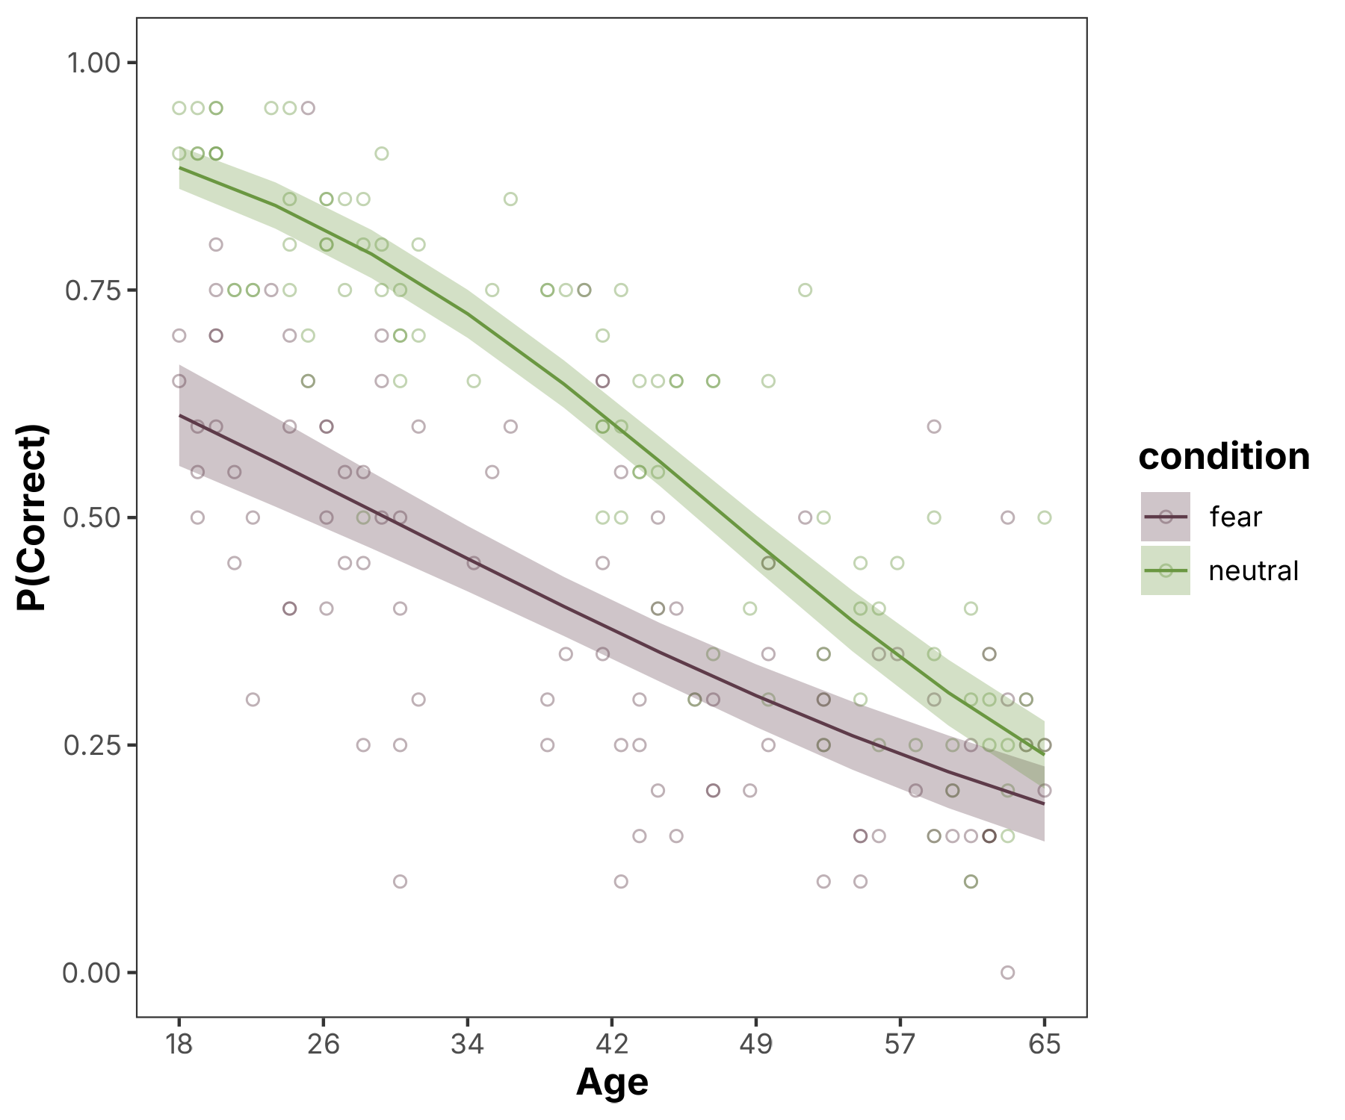
Interactions
Visualization, use predictions
> output
> code
preds |>
ggplot(
aes(x = x_age, y = estimate)
) +
geom_line(aes(color = condition)) +
geom_ribbon(
aes(
fill = condition,
ymin = conf.low,
ymax = conf.high
)
) +
theme_stuff()
preds <- predictions( glmer_model,
by = c('condition', 'x_age'), newdata = datagrid( condition = unique, x_age = seq(
min(my_data$x_age),
max(my_data$x_age), length.out = 10
)
)
)
Notes:
Predictions is the general form of avg_predictions. Specifying the ‘by’ argument tells it to average down predictions. We input a range of age values and spit out 10 of them to estimate a smooth curve that we can then see in our plot. Using geom_ribbon and geom_line, we can show the fitted line with a proper confidence ribbon around it.

Slide 26
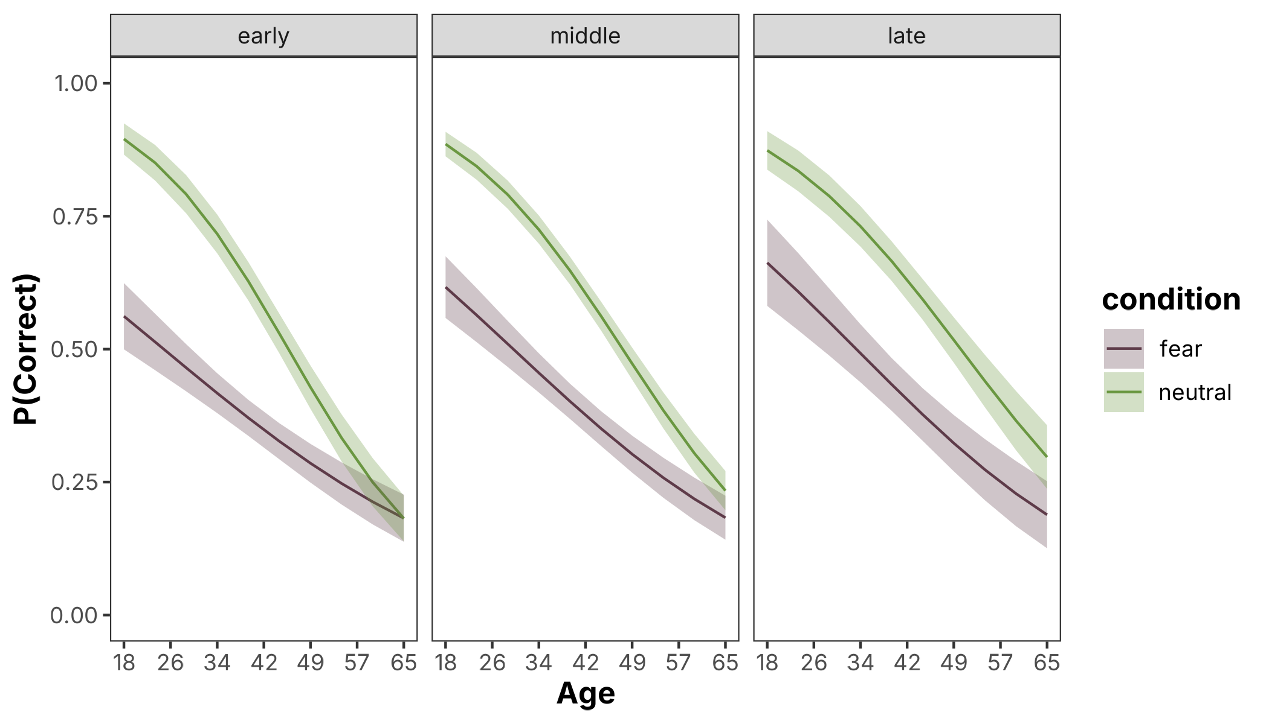
Interactions
preds |>
ggplot(aes(x = x_age, y = estimate)) +
geom_line(aes(color = condition)) +
facet_wrap(~ x_trial) +
theme_stuff()
3-way interaction has a few options
> output
> code
preds <- predictions(
glmer_model,
by = c('condition', 'x_trial', 'x_age'),
newdata = datagrid(
condition = unique,
x_age = seq(min(my_data$x_age), max(my_data$x_age), length.out = 10), x_trial = c(-1, 0, 1)
)
)
> code
Notes:
We can go even further probing the significant 3-way interaction, which is where visualization becomes key to interpreting what is happening with these non-trivial parameters. Our positive parameter value for the 3-way interaction indicates that a subject’s chance of being correct diminishes the older they are and if they are in the fear condition versus the neutral condition, but these age-condition curves flatten out and become more parallel as they become more practiced with more trials.

Slide 27
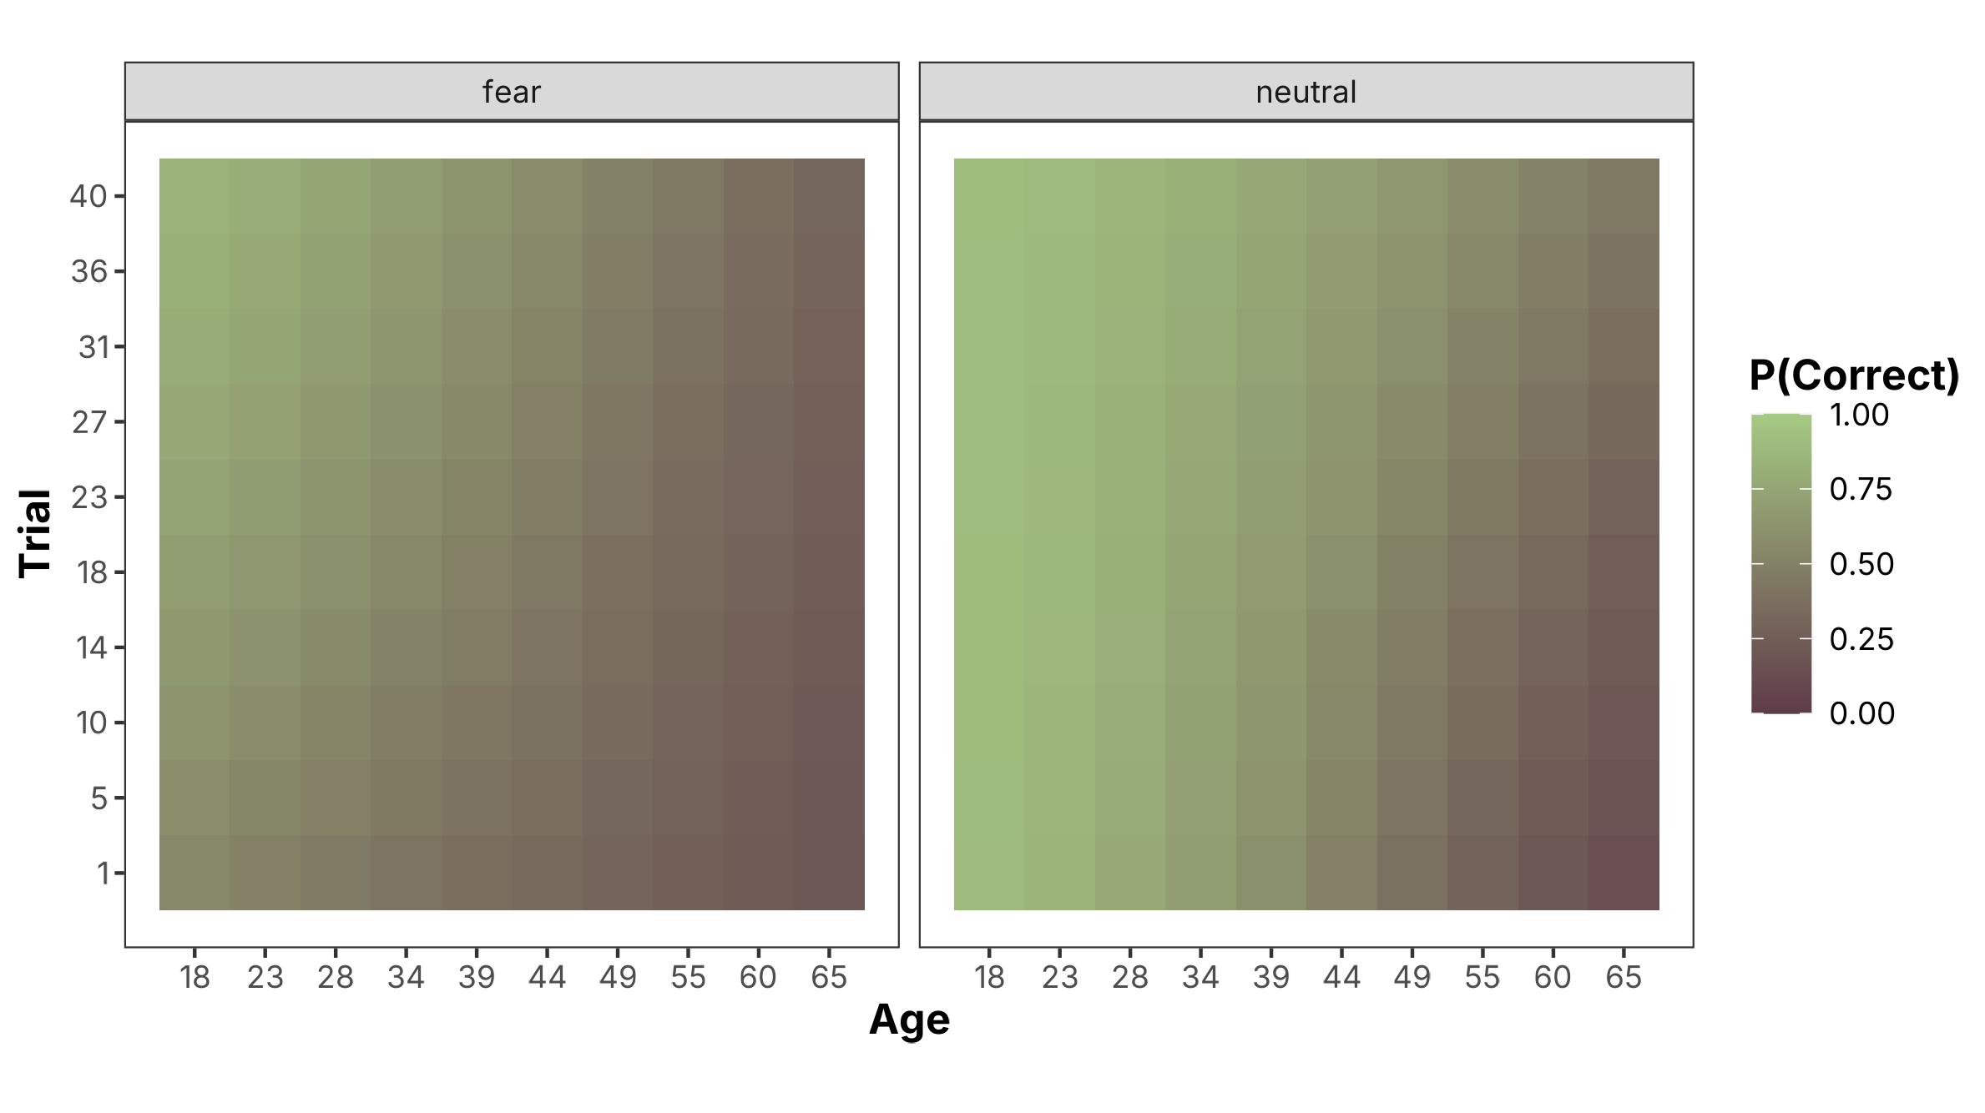
Interactions
preds |>
ggplot(aes(x = x_age, y = x_trial)) +
geom_tile(aes(fill = estimate)) +
facet_wrap(~ condition) +
theme_stuff()
More resolution and a heatmap
> output
> code
preds <- predictions(
glmer_model,
by = c('condition', 'x_trial', 'x_age'),
newdata = datagrid(
condition = unique,
x_age = seq(min(my_data$x_age), max(my_data$x_age), length.out = 10), x_trial = seq(
min(my_data$x_trial), max(my_data$x_trial), length.out = 10
)
)
)
> code
Notes:
We can specify a higher resolution for trial to extract more information about model predictions across age, trial, and condition. This can be visualized with something like a heatmap that can show interesting intricies of something like our 3-way interaction. Here, the tiles gradate from bottom left to top right from low chances of correct recall to high chances of correct recall, with the lowest chances being old folks on their first trial in the fear condition and the highest being young folks in their last trial in the neutral condition.

Slide 28
Extras
These functions can also produce marginal effects and constrasts for Bayesian models, carrying forward posterior uncertainty
Also do extra random effects handling either setting to zero or (EMM) integrating them out (ME)

Slide 29
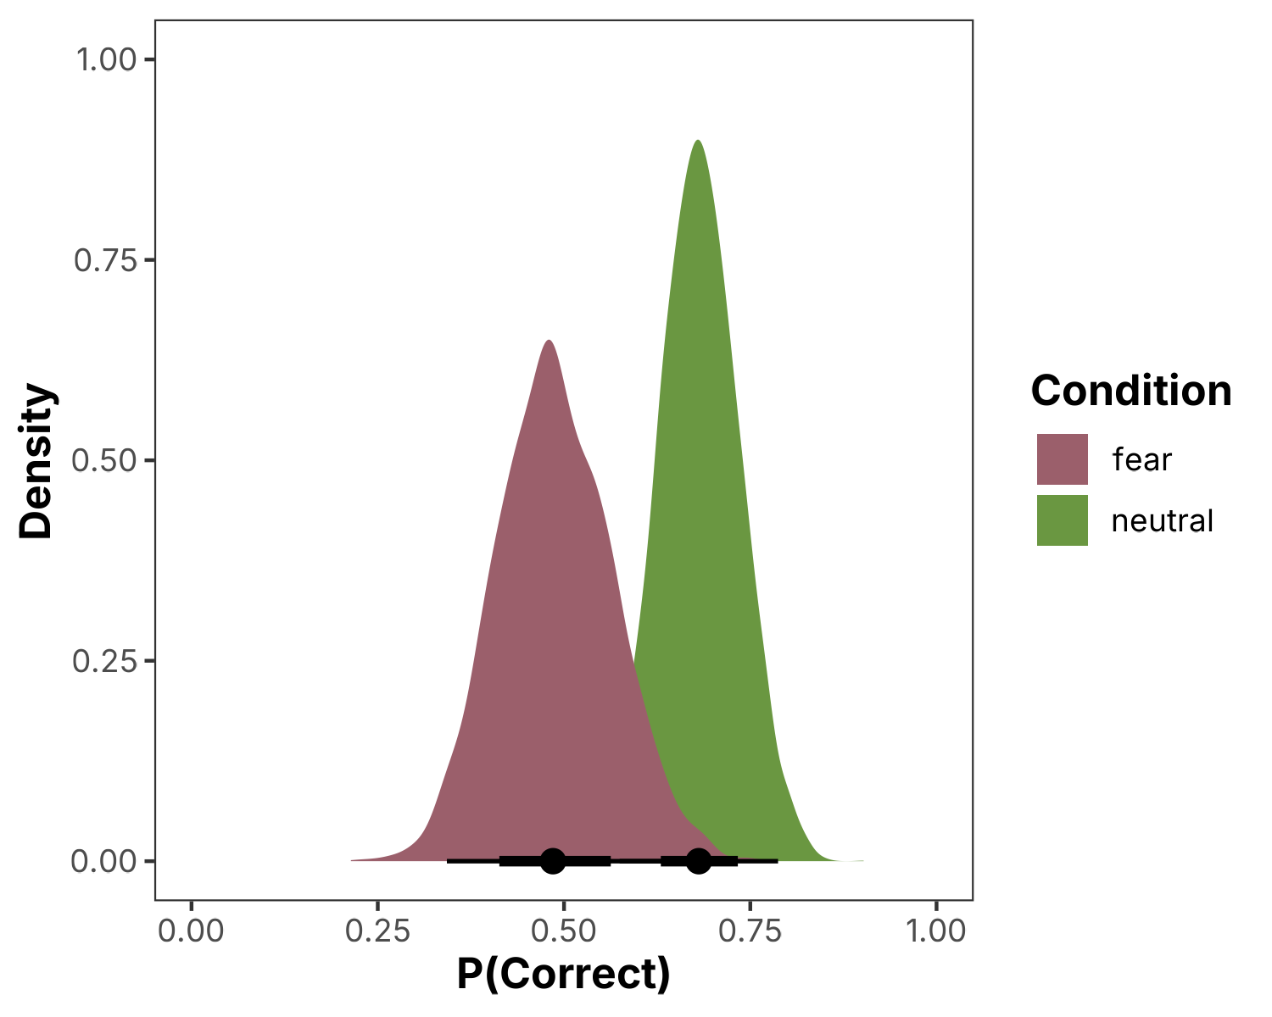
Bayesian
Contrast treatment conditions but as Bayesian posteriors
> output
> code
preds <- predictions( brm_model,
newdata = datagrid(
condition = unique
),
by = 'condition',
re_formula = NULL
) |>
posterior_draws()
preds |>
ggplot(
aes(x = draw, fill = condition)
) +
stat_halfeye() +
theme_stuff()

Slide 30
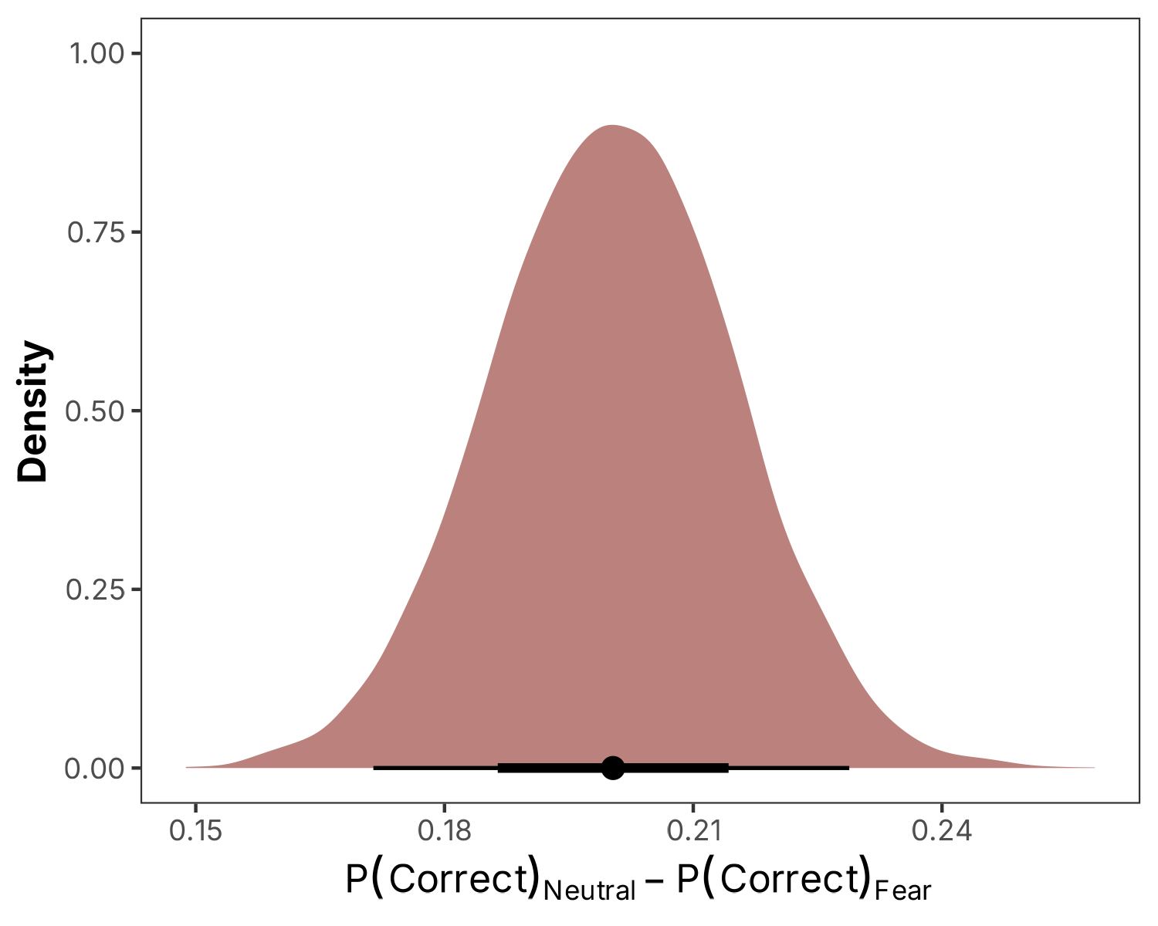
Bayesian
Get the treatment effect as its own distribution
> output
> code
preds <- avg_comparisons( brm_model,
variables = 'condition',
re_formula = NULL
) |>
posterior_draws()
preds |>
ggplot(
aes(x = draw, fill = condition)
) +
stat_halfeye() +
theme_stuff()

Slide 31
Takeaways
Work with your model like you’re curious about what it does
  Flip its switches and move its sliders one at a time and visualize what it comes up with
We can accomplish this with models we fit in R with marginaleffects and emmeans
Additional info and source code can be found in the github link Morgan sent along in the announcement email!

Slide 32
Thank you!

