Slide 1
NutriTrack
Food Nutrition Tracking & Analysis API
Chenxi Li
XJCO3011 Web Services and Web Data — Coursework 1
April 2026
Live: https://lichenxi.pythonanywhere.com

Slide 2
People lack programmable tools to track nutrition — NutriTrack bridges this gap
Problem
Solution: NutriTrack
Tracking daily nutritional intake is complex and tedious
Existing tools are either too complex or not programmable
AI assistants cannot directly interact with nutrition databases
REST API built on USDA SR Legacy dataset
7,793 foods across 25 categories
Food search with relevance ranking
Meal logging with full CRUD
Nutritional analytics (daily/weekly/balance)
MCP integration → AI can call the API

Slide 3
FastAPI + SQLite + MCP enables a lightweight yet fully-featured nutrition API
Component | Choice | Rationale
Framework | FastAPI | Auto Swagger docs, Pydantic validation, lightweight
Database | SQLite | Zero-config, portable, sufficient for ~7,800 records
ORM | SQLAlchemy 2.0 | Alembic migrations, complex query support
Auth | JWT (python-jose) | Stateless, RESTful-aligned
MCP | FastMCP SDK | Official Python SDK, stdio transport
HTTP Clients / MCP Server → FastAPI (17 endpoints) → SQLite (7,793 foods + users + meals)
Auth (JWT) · Foods (search/categories) · Meals (CRUD) · Analytics (daily/weekly/balance) · User Profile

Slide 4
Smart search, two-tier validation, and personalised analysis are the key design decisions
4 Data Models
Smart Search
User → Meal → MealItem → Food
Relational chain with foreign keys
2-level relevance ranking:
starts-with > contains
Optional category filter (25 categories)
Two-Tier Input Validation
Personalised Nutrition
Hard reject: impossible values (negative weight, future dates)
Soft warning: "Weight 350 kg is unusually high. Please verify."
Mifflin-St Jeor equation for BMR
Adjusts for age, gender, height, weight, activity level
Balance analysis: low / ok / high per nutrient

Slide 5
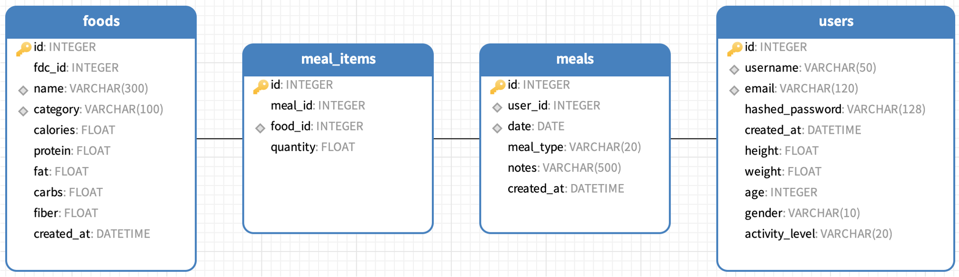
Database ER Diagram
Relationships: User 1 - N Meal (one user has many meals) · Meal 1 - N MealItem (one meal contains many items) · Food 1 - N MealItem (one food appears in many items) · Food N - N Meal (many-to-many via MealItem junction table)

Slide 6
MCP integration enables AI assistants to call all 16 API tools via natural language
What is MCP?
Our MCP Server
Model Context Protocol — open standard by Anthropic
Allows AI assistants to call external tools via structured interface
stdio transport, works with Claude Desktop
16 tools covering all API endpoints
Full CRUD: search, log, update, delete meals
Analytics: daily summary, weekly trends, balance
User management: register, login, profile
Example Flow
User: "Log a lunch with chicken breast and rice"
→ AI calls search_food("chicken breast") → log_meal({items: [...]}) → returns confirmation

Slide 7
Live demo shows AI-powered meal logging through MCP + 17 Swagger endpoints
MCP Demo (video clip)
Swagger UI — 17 Endpoints
1. AI searches for food → search_food tool
2. AI logs a meal → log_meal tool
3. AI shows summary → get_daily_summary tool
Claude Desktop discovers all 16 tools automatically
Auth: register, login
Foods: search, categories, by-category, by-id
Meals: create, list, detail, update, delete
Analytics: daily summary, weekly trend, balance
User: profile, update profile
MCP Video:
OneDrive (login required): Nutritrack MCP Test.mp4
Google Drive: Nutritrack MCP Test.mp4
Baidu Pan: Nutritrack MCP Test.mp4 (Password: q3md)
Online API Doc:
Swagger UI Live:https://lichenxi.pythonanywhere.com/docs
ReDoc:https://lichenxi.pythonanywhere.com/redoc

Slide 8
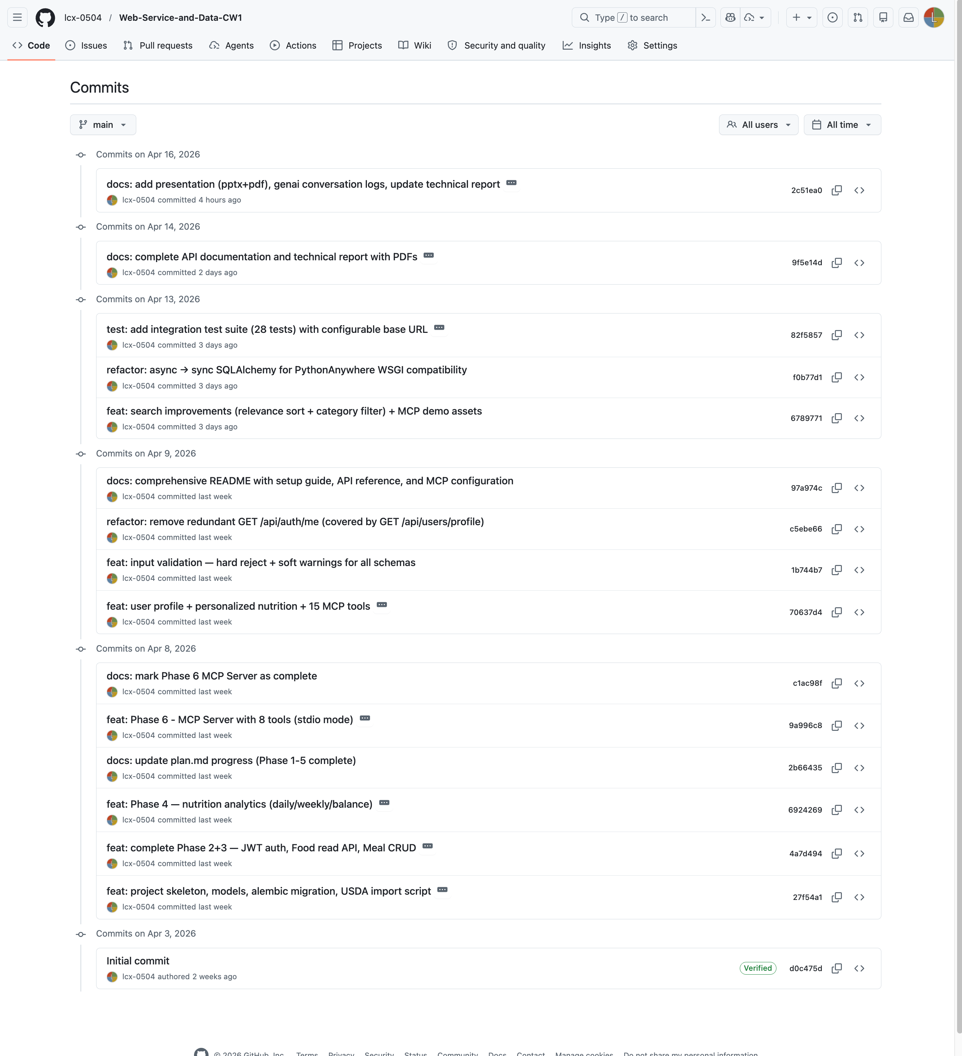
Version Control & Testing
Git History (16 commits)
d0c475d Initial commit
27f54a1 feat: project skeleton, models, alembic migration, USDA import
4a7d494 feat: JWT auth, Food read API, Meal CRUD
6924269 feat: nutrition analytics (daily/weekly/balance)
70637d4 feat: user profile + personalized nutrition + MCP tools
1b744b7 feat: input validation — hard reject + soft warnings
6789771 feat: search improvements + MCP demo assets
f0b77d1 refactor: async → sync for PythonAnywhere WSGI
82f5857 test: 28 integration tests with configurable base URL
9f5e14d + 2c51ea0 docs: API docs, tech report, presentation, genai logs
Testing (28 integration tests)
Auth, Foods, Meals CRUD, Analytics, User Profile
Configurable: local (127.0.0.1:8000) or remote (PythonAnywhere)
Edge cases: duplicate registration, unauthorized access, future dates

Slide 9
Links & Deliverables
Deliverable | Link / Location
Code Repository | https://github.com/lcx-0504/Web-Service-and-Data-CW1
Commit History (16 commits) | https://github.com/lcx-0504/Web-Service-and-Data-CW1/commits/main
Live API (Deployed on PythonAnywhere) | https://lichenxi.pythonanywhere.com/
Swagger UI | https://lichenxi.pythonanywhere.com/docs
ReDoc | https://lichenxi.pythonanywhere.com/redoc
API Documentation (PDF – 17 Endpoints) | https://github.com/lcx-0504/Web-Service-and-Data-CW1/blob/main/docs/api-documentation.pdf
Technical Report (PDF) | https://github.com/lcx-0504/Web-Service-and-Data-CW1/blob/main/docs/technical-report.pdf
Presentation (PPTX) | https://github.com/lcx-0504/Web-Service-and-Data-CW1/blob/main/docs/presentation.pdf
GenAI Logs (Claude Code & Github Copilot with Claude Opus 4.6) | https://github.com/lcx-0504/Web-Service-and-Data-CW1/tree/main/docs/genai-logs
MCP Server (16 tools) | https://github.com/lcx-0504/Web-Service-and-Data-CW1/blob/main/mcp_server/server.py
MCP Demo Video | Multiple Links Provided in README: https://github.com/lcx-0504/Web-Service-and-Data-CW1/tree/main?tab=readme-ov-file#mcp-demo-video
Integration Tests | Test Script: https://github.com/lcx-0504/Web-Service-and-Data-CW1/blob/main/backend/tests/test_api.py Test Log: https://github.com/lcx-0504/Web-Service-and-Data-CW1/blob/main/docs/test-results.txt

Slide 10
Technical Report Summary & Conclusions
1. Fully tested: 28 integration tests across 5 modules — all passed against PythonAnywhere.
2. Deployed: PythonAnywhere free tier with custom ASGI→WSGI bridge (3 iterations to solve).
3. MCP-enabled: 16 tools allow AI assistants to interact with the entire API via natural language.
4. GenAI-assisted: GitHub Copilot + Claude Code (Opus 4.6) for planning, coding, debugging, and docs.
Chenxi Li · GitHub: github.com/lcx-0504/Web-Service-and-Data-CW1
Thank you — Questions?

