Slide 1
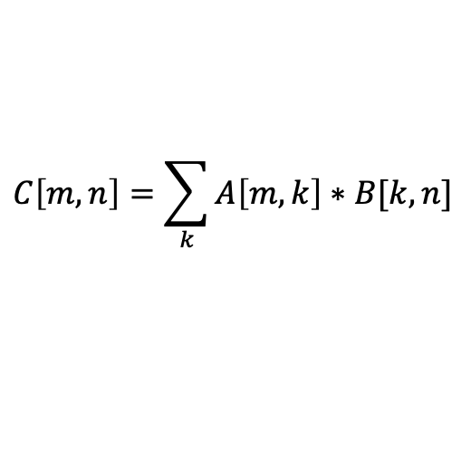
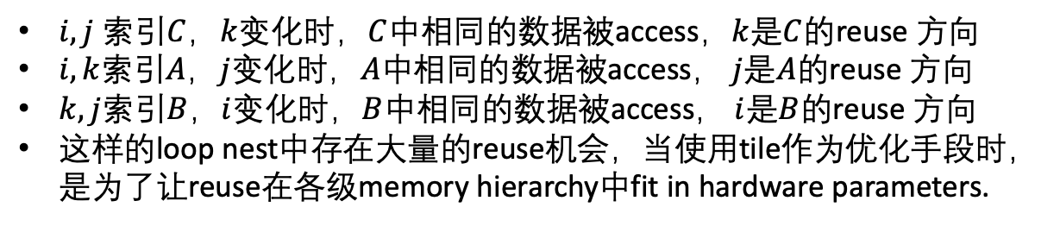
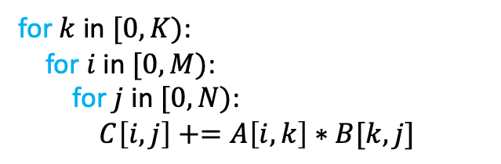
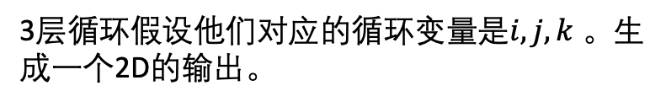
$$C\left[m,n\right]=\sum_{k}{A\left[m,k\right]∗B[k,n]}$$
High-strided memory
Insufficient data reuse
3层循环假设他们对应的循环变量是$i,j,k$ 。生成一个2D的输出。
for $k$ in $[0, K)$:
for$i$in $[0, M)$:
for $j$ in $[0, N)$:
$C\left[i,j\right]+=A\left[i,k\right]∗B[k,j]$
$i,j$ 索引$C$，$k$变化时，$C$中相同的数据被access，$k$是$C$的reuse 方向
$i,k$索引$A$，$j$变化时，$A$中相同的数据被access， $j$是$A$的reuse 方向
$k,j$索引$B$，$i$变化时，$B$中相同的数据被access， $i$是$B$的reuse 方向
这样的loop nest中存在大量的reuse机会，当使用tile作为优化手段时，是为了让reuse在各级memory hierarchy中fit in hardware parameters.

Slide 2































$${pos}_{b}$$
$$N$$
Global Memory
Shared Memory $Bs$
$$N_{s}$$
$$T_{n}$$
$$K_{S}$$
$$1$$
$$T_{k}$$
$$K$$
$$B matrix$$
$$K$$
$${pos}_{c}$$
$$B_{y}$$
$$2$$
$${pos}_{a}$$
$$T_{k}$$
$$K_{s}$$
$$⊗$$
$$T_{m}$$
$$1$$
$$M_{s}$$
$$2$$
$$M_{s}$$
$$M$$
$$M$$
Shared Memory $As$
Register
$$N_{s}$$
$$B_{x}$$
$$A matrix$$
Global Memory
$$C matrix$$
Global Memory
$$N$$

Slide 3
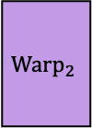
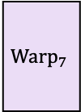

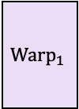
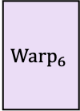
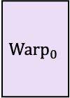
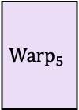

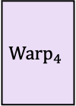

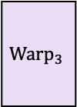
$$N_{s}$$
B Tile
$$K_{s}$$
$${Warp}_{0}$$
$${Warp}_{2}$$
$${Warp}_{4}$$
$${Warp}_{6}$$
$$M_{s}$$
$${Warp}_{1}$$
$${Warp}_{3}$$
$${Warp}_{5}$$
$${Warp}_{7}$$
A Tile
C Tile

Slide 4






















$$N_{w}={8∗N}_{r}$$
$$32 = 8 ∗ 4$$
B Tile
(Shared Memory)
$$K_{s}=8$$
$$N_{r}=4$$
Register File
$$B_{0}$$
$$B_{1}$$
$$B_{2}$$
$$B_{3}$$
$$M_{r}=4$$
$$M_{w}={4∗M}_{r}$$
$$16 =4 ∗ 4$$
$$K_{s}=8$$
$$A_{0}$$
$$warp0$$
$${warp}_{2}$$
$${warp}_{4}$$
$${warp}_{6}$$
$$M_{s}=32$$
$$A_{1}$$
$${warp}_{1}$$
$${warp}_{3}$$
$${warp}_{5}$$
$${warp}_{7}$$
A Tile
(Shared Memory)
$$N_{s}=128$$
C Tile
(Shared Memory)

Slide 5
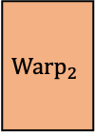
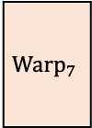

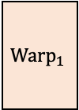
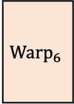
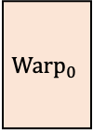
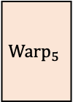

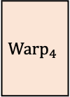

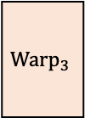
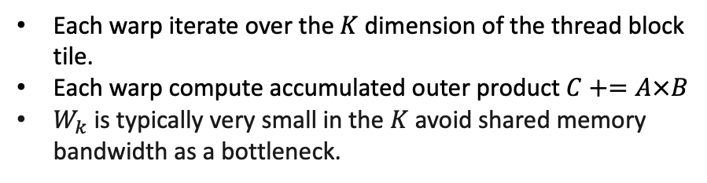
Warp Tile
在寄存器中累加快于在shared memory中累加；
TB中的threads将shared memory中的分块cache到register file 中；
由于shared memory有限，每次也只能cache一个对shared memory的分块；
$$T_{n}$$
B Tile
Each warp iterate over the$K$dimension of the thread block tile.
Each warp compute accumulated outer product $C+=A×B$
$W_{k}$ is typically very small in the $K$ avoid shared memory bandwidth as a bottleneck.
$$T_{k}$$
$${Warp}_{0}$$
$${Warp}_{2}$$
$${Warp}_{4}$$
$${Warp}_{6}$$
$$T_{m}$$
$${Warp}_{1}$$
$${Warp}_{3}$$
$${Warp}_{5}$$
$${Warp}_{7}$$
A Tile
C Tile

Slide 6
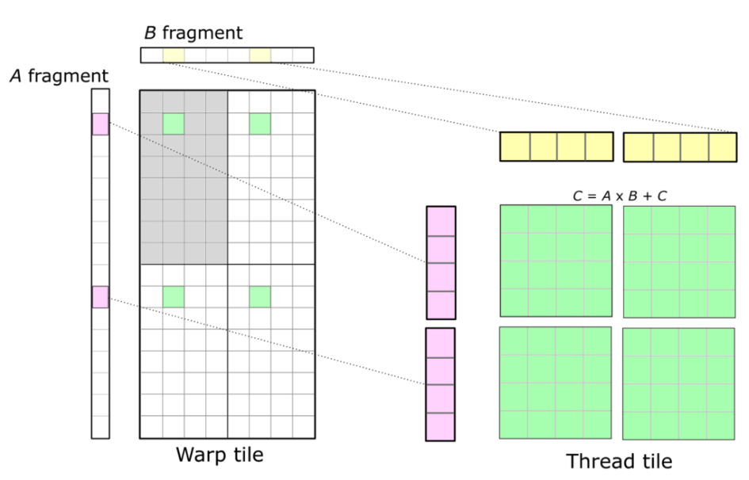
Thread Tile
一个warp内的thread issue多个instructions，有助于提高ILP
一个threads计算多个elements，有助于提高计算强度。
Threads cannot access each other’s registers, so we must choose an organization that enables values held in registers to be reused for multiple math instructions executed by the same thread.
每个thread 计算8x8的元素

Slide 7




$$T_{k}$$
0
1
2
3
4
5
6
7
1
3
$$T_{m}$$
8
9
10
11
9
11
$${REG}_{m}$$
12
13
14
15
$${REG}_{k}$$

Slide 8









$$C$$
$$A$$
$$B$$
$$k$$
$$b∗n$$
$$b∗m$$
$$k$$
$$A′$$
$$B′$$

Slide 9
z
blockDim.z
blockDim.x
x
blockDim.y
y

Slide 10


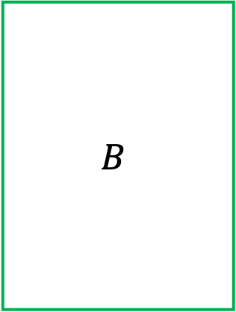




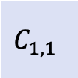







$$N$$
$$N$$
$$B$$
gridDim.x
$$K$$
$$C$$
$$A$$
gridDim.y
$$(x,y )$$
blockDim.x
$$M$$
blockDim.y
$$=$$
$$@$$
Loop in the kernel.
$$B_{:,1}$$
$$K$$
$$C_{1,1}$$
$$=$$
$$A_{1,:}$$
$$@$$
$$K$$
Data accessed by a CTA.

Slide 11
THREAD 0,0
THREAD 0,1
A warp
……
Loop in the kernel.
$$B_{:,1}$$
$$K$$
$$C_{1,1}$$
$$=$$
$$A_{1,:}$$
$$@$$
$$K$$
Data accessed by a CTA.

Slide 12

THREAD 0,0
THREAD 0,1
A warp
……
Loop in the kernel.
$$K$$
$$C_{1,1}$$
$$=$$
$$A_{1,:}$$
$$@$$
$$K$$
$$B_{:,1}$$
Data accessed by a CTA.

Slide 13

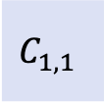





$$\frac{K}{B}$$
Loop in the kernel.
Loop in the kernel.
$$C_{1,1}$$
$$=$$
$$A_{1,:}$$
$$@$$
$$\frac{K}{B}$$
$$B_{:,1}$$
Data accessed by a CTA.

Slide 14
0
1
2
3
4
5
6
7
0
1
2
3
4
5
6
7
0
0
1
1
2
2
3
3
0
1
2
3
4
5
6
7
0
1
2
3
4
5
6
7
0
0
1
1
2
2
3
3

Slide 15
0
1
2
3
4
5
6
7
0
1
2
3
4
5
6
7
0
0
1
1
2
2
3
3
0
1
2
3
4
5
6
7
0
1
2
3
4
5
6
7
0
0
1
1
2
2
3
3

Slide 16
0
1
2
3
4
5
6
7
0
1
2
3

Slide 17
64
32
Global Memory
Row Major
PredicatedTileIterator
(load iterator)
PitchLinearWarpRakedThreadMap
RegularTileIterator
(store iterator)
32
Shared
Memory
RowMajorTensorOpMultiplicandCrosswise
64
(swizzled layout)

Slide 18
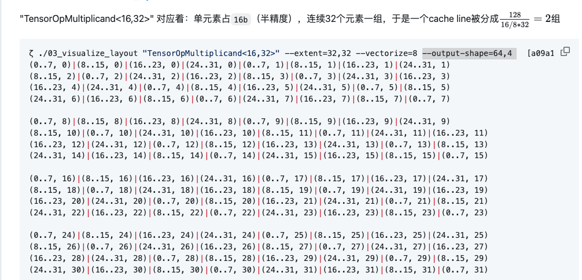
Contiguous dimension
Cache Line
(128B)

