Slide 1




















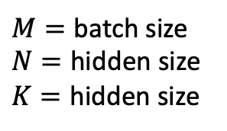


$$T_{N}$$
$$N$$
warps
$$T_{k}$$
warps
$$K$$
$$T_{N}$$
$$M$$
$$×$$
$$…$$
$$=$$
$$M$$
CTA
$$T_{k}$$
$M=$ batch size
$N=$ hidden size
$K=$ hidden size
$$T_{k}$$
$$T_{N}$$
$$M$$
$$×$$
$$T_{k}$$
$$M$$
$$M$$
$$M$$
$$×$$
$$T_{N}$$
$$…$$
warps
$$=$$
$$…$$
$$×$$
Transpose output in shared memory to make this dimension continuous in memory

Slide 2




max_seq_length
$$K,V$$
0
batch
batch_size
0
1
2
3
4
5
6
hidden_dim
1
7
8
9
……
10
11
12
13
14
$$O$$
14
$$Q$$
$$Attention Scores$$
padding free input batch
sequence length

Slide 3









sequence length $L$
sequence length $L$
$$K,V$$
$$K,V$$
$$D$$
$$D$$
$$Q$$
$$Attention$$
$$Scores$$
$$L$$
(1). Prefill stage
(2). Decode stage

Slide 4
re-order data in memory
remove padding
re-order data in memory
re-build padding
The time and space complexity of MHA is quadratic to sequence length.
re-order data in memory
remove padding

Slide 5







$$K,V$$
Load the entire sequence is loaded into shared memory
batch
$$K,V$$
Tile this dimension
$$Q$$
$$V$$
$$O$$
$$Q$$
$$Attention Scores$$
sequence length

Slide 6
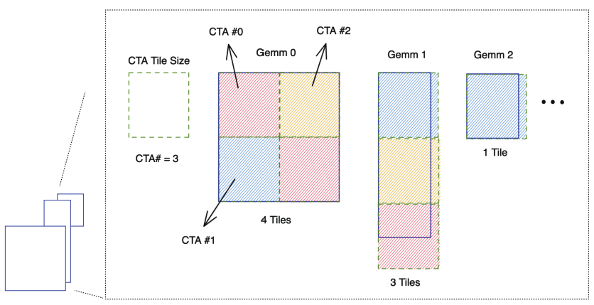
wave1
wave2
wave3

Slide 7
