Slide 1
Introduction to
Bash Scripting
Lucas Czech
Computational Molecular Evolution Course
Hinxton, 9th of May 2017

Slide 2
Overview
Variables
Command Line Arguments
Loops
Conditions
Exercises!

Slide 3
Scripts
Begin with: #!/bin/bash
Make executable via chmod 775 script.sh
Execute via ./script.sh
Task: Create a script that prints “Hello World”

Slide 4
Variables
Store some information
Assign via foo=”Hello CoME”
Read via $foo or ${foo}
Task: Change the script so that it uses a variable with the text

Slide 5
Command Line Arguments
Access to how the script was called, e.g.
./script.sh some arguments
Use $# for number of arguments
Use $@ for all argument contents
Use $1 (etc) for single argument content
Task: Print the number of arguments and the content of the first argument, and on the next line, the full content of the command line arguments

Slide 6
Loops
Use to repeat a certain thing
Syntax:
for variable in list
do
…
done
Task: Loop over all words in the argument content and print them

Slide 7
Loops
To repeat a certain number of times:
for variable in `seq 10`
do
…
done
Task: Print all numbers that are divisible by 10, counting from 100 to 0, i.e.,
100 90 .. 0

Slide 8
Loops
Alternative syntax:
for (( i=1; i<=5; i++ ))
do
…
done
Task: Loop over all words in the arguments and print them, using this loop form

Slide 9
Conditions
Only execute certain parts of the script
Use for control flow
Syntax:
if [ "foo" = "foo" ]; then
echo "it's foo!"
fi
Task: Print “it's foo!” if the first
command line argument is “foo”

Slide 10
Conditions
Use else for the other case
Syntax:
if [ "@1" = "foo" ]; then
echo "it's foo!"
else
echo “oohh no”
fi

Slide 11
Conditions
Use special if statements to check file stuff
File exists: [ -e file ]
Directory exists: [ -d file ]
File exists and not empty: [ -s file ]
file1 newer than file2:
[ file1 -nt file2 ]
Negate expression: [ ! -e file ]

Slide 12
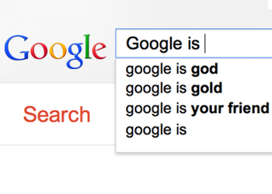

Slide 13
Task: Write a script
Download “day_2” from github.com/lczech/come2017_linux
Loop over all .fasta files: for file in ...
Get the base name: name=${file%%.fasta}
Move the file to a directory of that name
Call mafft to get file.aln
Call FastTree to get tree.newick

Slide 14
A little example

Slide 15
Task: Write a script
Take a number as input
Create that many directories, named like this:
dir_ + a random number
(optional: make sure the directory does not yet exists)
Create a script in each directory that outputs the random number
Call these scripts from within your main script

Slide 16

https://xkcd.com/619/

