Slide 1
15-300 Research Survey Sketching

Slide 2
Motivation & fundamental
One important problem in tons of machine learning & data analysis:
Dimensionality reduction

Slide 3
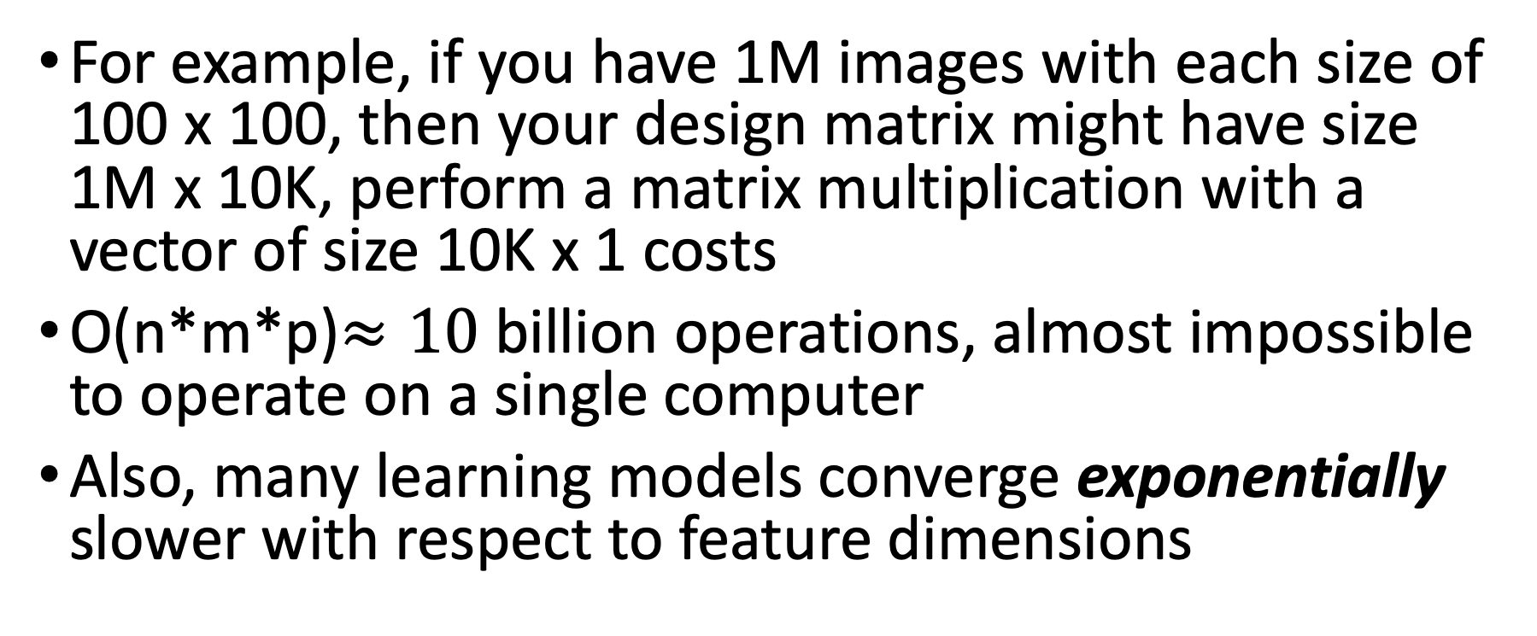
Motivation & fundamental
For example, if you have 1M images with each size of 100 x 100, then your design matrix might have size 1M x 10K, perform a matrix multiplication with a vector of size 10K x 1 costs
O(n*m*p)$≈10$ billion operations, almost impossible to operate on a single computer
Also, many learning models converge exponentially slower with respect to feature dimensions

Slide 4
Motivation & fundamental
So dimensionality reduction is especially important
Popular methods:
1. PCA
2. backward/forward feature selection
3. factor analysis
4. t-distributed stochastic neighbor embedding
5. Gaussian randomized projection
6. feature hashing
…..

Slide 5
Motivation & fundamental
We focus on a randomized, matrix based algorithm, called
Sketching

Slide 6
Motivation & fundamental
Recall from your statistics or machine learning course
One important building block & algorithm:
Least square regression

Slide 7
Motivation & fundamental
Setup:
n data points X1,…,Xn, each has d features and a corresponding output label Y1,…,Yn
Goal: find a best fitting line that fits the data, i.e., find a weight vector w
Measure of error: Mean-squared error

Slide 8
Motivation & fudamental
Notations: X is an n x (d+1) matrix, with each row i corresponds to Xi, the first column is all-one vector.
Y is an n x 1 vector, with entry i := Yi
w is the weight vector, of size (d+1) x 1

Slide 9
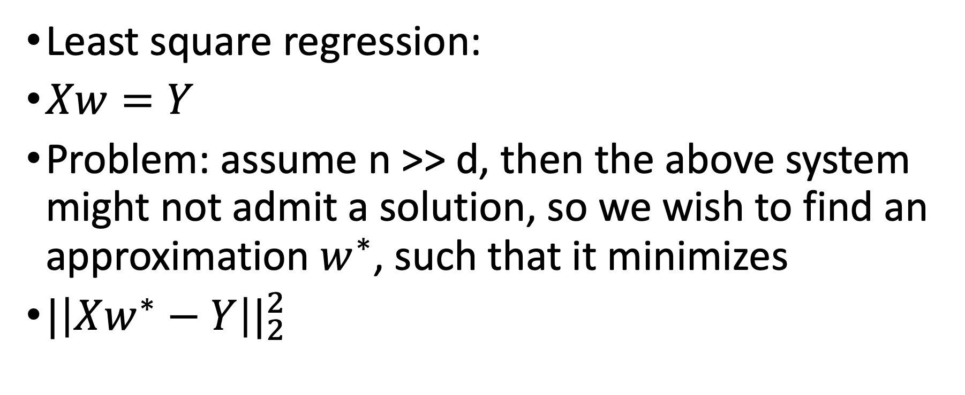
Motivation & fundamental
Least square regression:
$Xw=Y$
Problem: assume n >> d, then the above system might not admit a solution, so we wish to find an approximation $w^{∗}$, such that it minimizes
${|\left|Xw^{∗}−Y\right||}_{2}^{2}$

Slide 10
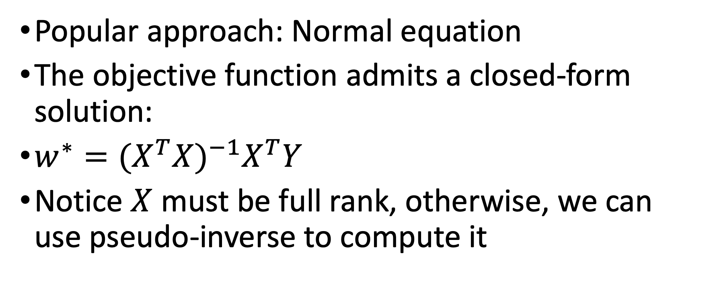

Approach to find such $w^{∗}$
Popular approach: Normal equation
The objective function admits a closed-form solution:
$w^{∗}={(X^{T}X)}^{−1}X^{T}Y$
Notice $X$ must be full rank, otherwise, we can use pseudo-inverse to compute it

Slide 11
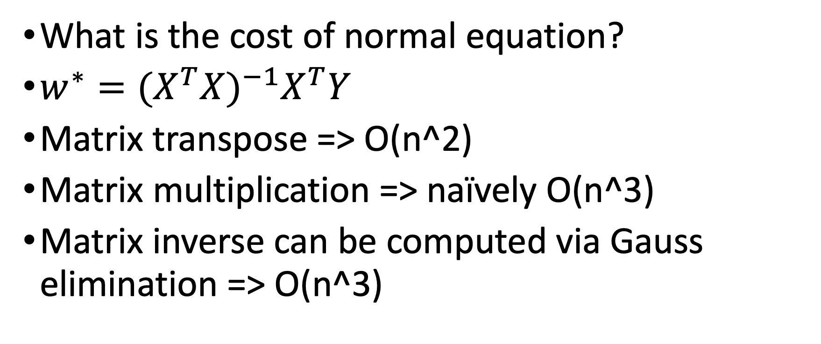
Normal equation cost analysis
What is the cost of normal equation?
$w^{∗}={(X^{T}X)}^{−1}X^{T}Y$
Matrix transpose => O(n^2)
Matrix multiplication => naïvely O(n^3)
Matrix inverse can be computed via Gauss elimination => O(n^3)

Slide 12
Normal equation cost analysis
Matrix multiplication of A: n x m, B: m x p => O(n*m*p)
So computing normal equation will cost at least O(n*d^2)
TOO EXPENSIVE!!!

Slide 13
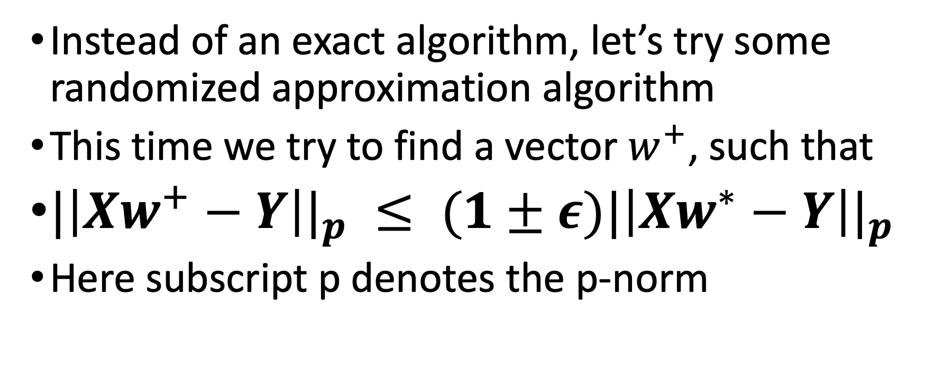
Alternatives
Instead of an exact algorithm, let’s try some randomized approximation algorithm
This time we try to find a vector $w^{+}$, such that
${|\left|Xw^{+}−Y\right||}_{p} ≤ {(1±ε)|\left|Xw^{∗}−Y\right||}_{p}$
Here subscript p denotes the p-norm

Slide 14
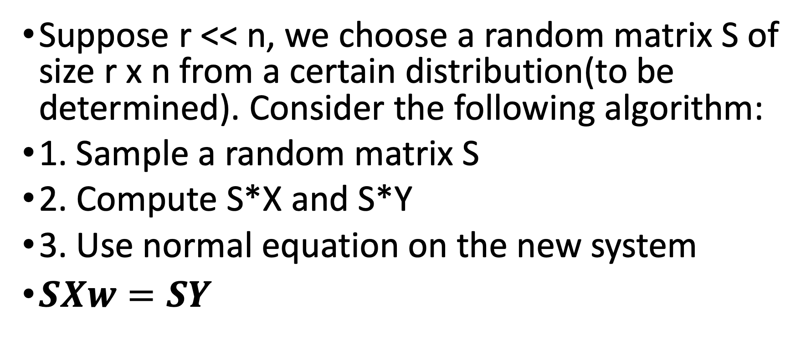
Alternatives - Sketching
Suppose r << n, we choose a random matrix S of size r x n from a certain distribution(to be determined). Consider the following algorithm:
1. Sample a random matrix S
2. Compute S*X and S*Y
3. Use normal equation on the new system
$SXw=SY$

Slide 15
Sketching for linear regression: analysis
Key advantage of this algorithm, suppose it works:
The matrix SX is now of size r x (d+1) and SY is of size r x 1, given r << n, we can afford the cost of computing the closed-form solution of normal equation, which is
O(r*d^2)

Slide 16
Sketching for linear regression: analysis
One obvious drawback: given no assumption of S, notice the cost of multiplying S and X is
O(r*n*d)
Which in fact does not provide us a much faster algorithm

Slide 17
Further development of sketching on linear regression problem
The idea is to instead choose S from a more structured random family, so that we can improve the run time of matrix multiplication
Fast Johnson-Lindenstrauss transform:
O(n*d*log d)+poly(d/epsilon)
Kenneth Clarkson and David Woodruff, on 2013:
O(nnz(X))+poly(d/epsilon)
Here nnz(X) := number of non-zero entries in X

Slide 18
Sketching: a powerful tool
As we have illustrated in the linear regression, or more specifically the least square estimation problem, sketching proved to be very useful in improving the run time

Slide 19
Sketching: a powerful tool
There are a lot of other areas that apply sketching:
Subspace embeddings
Least absolute deviation regression
Low rank approximation

Slide 20
Sketching potential directions
As a popular dimensionality reduction method, can we adapt sketching to some other machine learning models?
For example, deep neural network?

Slide 21
Some results
Besides several problems we have discussed before, there are other results that trying to apply sketching on machine learning models:
Sketching and Neural Network: use sketching and one layer of hidden unit to approximate sparse polynomial function => polynomial regression

Slide 22
Some results
Data Sketching for Faster Training of Machine Learning Models: use sketching to find a best subset to improve error convergence
Oblivious Sketching of High-Degree Polynomial Kernels: extend sketching to polynomial kernels with small sketching dimension

Slide 23
Thoughts & reflections
Dimensionality reduction is essential
Sketching is a successful realization of dimensionality reduction
Most researches & papers of sketching focus more on finding good random matrix family or applying sketching for more primitive numerical linear algebra problem

Slide 24
Thoughts & reflections
If we wish to apply sketching to specific learning algorithm, especially the popular deep neural network.
How to choose a good sketch?
How to efficiently choose such a sketch?
Theoretical analysis of applying sketching on such model.
Empirical results of applying sketching on this model.

Slide 25
CMU relevance
Professor David Woodruff in Computer Science Department has worked in this field for a very long time, and he had published tons of amazing papers, and an especially informative survey on sketching
For your own learning, you can consult
Sketching as a tool for numerical linear algebra
By David as a survey of this field

Slide 26
Related papers & surveys
Spectral Algorithms by Ravindran Kannan, Santosh Vempala
Randomized algorithms for matrices and data by Michael W. Mahoney

Slide 27
Related papers & surveys
Kenneth L. Clarkson, David P. Woodruff, Low Rank Approximation and Regression in Input Sparsity Time, April 8, 2013
Baharan Mirzasoleiman, Jeff Bilmes, Jure Leskovec, Data Sketching for Faster Training of Machine Learning Models, Jun 5, 2019

Slide 28
Related papers & surveys
Michael Kapralov, Rasmus Pagh, Ameya Velingker, David Woodruff, Amir Zandieh, Oblivious Sketching of High-Degree Polynomial Kernels, September 5, 2019
Amit Daniely, Nevena Lazic, Yoram Singer, Kunal Talwar, Sketching and Neural Networks, April 21, 2016

